Slide 1
Detecting Smoking Episodes
Using multiple sources of information collected at different time scales
Notes:
Paper will outline the scientific problem of detection. We will detect smoking episodes in a manner that allows for error propagation. We are unable to ascertain precisely when a smoking episode occurs. We assume for now that we observe all times of hand-to-month gestures. Puffs can only occur as hand-to-mouth gestures. The measurement error problem is that this gesture is a 1 or 0 (1=puff, 0=otherwise). So the missing data is the 1, 0’s at each hand-to-mouth gesture. The measurements are at multiple time-scales and of mixed type (i.e., EMA and sensor).
Then the question is to use all the other information to figure out which hand-to-mouth are LABELLED as a puff inside a smoking episode
Imputation 1 is more “likely” and so we will impute these labels more often; however, the uncertainty in the measurements allows imputation 2 to also be likely (albeit less likely than imputation 1).

Slide 2
Detecting smoking episodes using multiple information sources
Smoking Episodes
Beginning
Of day
End
Of day
Smoking Puffs
PuffMarker
1
0
>100
Yes
Missed
No
Various
Measures
Of
Smoking
Episodes
And
Puffs
Random EMA
5-15
Event-based EMA
End-of-day EMA
Multiple imputation to produce smoking episodes with error
Imputation 1
Imputation 2
Notes:
Paper will outline the scientific problem of detection. We will detect smoking episodes in a manner that allows for error propagation. We are unable to ascertain precisely when a smoking episode occurs. We assume for now that we observe all times of hand-to-month gestures. Puffs can only occur as hand-to-mouth gestures. The measurement error problem is that this gesture is a 1 or 0 (1=puff, 0=otherwise). So the missing data is the 1, 0’s at each hand-to-mouth gesture. The measurements are at multiple time-scales and of mixed type (i.e., EMA and sensor).
Then the question is to use all the other information to figure out which hand-to-mouth are LABELLED as a puff inside a smoking episode
Imputation 1 is more “likely” and so we will impute these labels more often; however, the uncertainty in the measurements allows imputation 2 to also be likely (albeit less likely than imputation 1).

Slide 3
Goals for the brainstorming
Briefly explain the data pre-processing protocol
Review model structure:
Y: latent smoking event process
W: various noisy measurements
HTMGs (observed point process: assume all HTMGs observed while wearing the sensors)
puffMarker events (cts-time measure with high sensitivity, low specificity)
Event-contingent self-report (cts-time measure with high sensitivity, low specificity)
Random self-report (every few hours: medium sensitivity, high specificity)
End-of-day self-report (end of study day: medium sensitivity, medium specificity)

Slide 4
Goals for the brainstorming
Overarching goal: construct posterior distribution of Y given noisy measures W
Key brainstorm question: can we think of simple methods to construct priors for the measurement-error models?
“Walter, why does this matter?”
Because priors matter for small, noisy dataset
We don’t have good prior information on many of these variables
Example: Given a smoking event, what is the variability in end-of-day self-report (even assuming no recall bias)?
Conditional independence assumptions may be too strong

Slide 5
Step 1: Building the dataset
“If you build it, they will come” – Field of Dreams
Notes:
Paper will outline the scientific problem of detection. We will detect smoking episodes in a manner that allows for error propagation. We are unable to ascertain precisely when a smoking episode occurs. We assume for now that we observe all times of hand-to-month gestures. Puffs can only occur as hand-to-mouth gestures. The measurement error problem is that this gesture is a 1 or 0 (1=puff, 0=otherwise). So the missing data is the 1, 0’s at each hand-to-mouth gesture. The measurements are at multiple time-scales and of mixed type (i.e., EMA and sensor).
Then the question is to use all the other information to figure out which hand-to-mouth are LABELLED as a puff inside a smoking episode
Imputation 1 is more “likely” and so we will impute these labels more often; however, the uncertainty in the measurements allows imputation 2 to also be likely (albeit less likely than imputation 1).

Slide 6
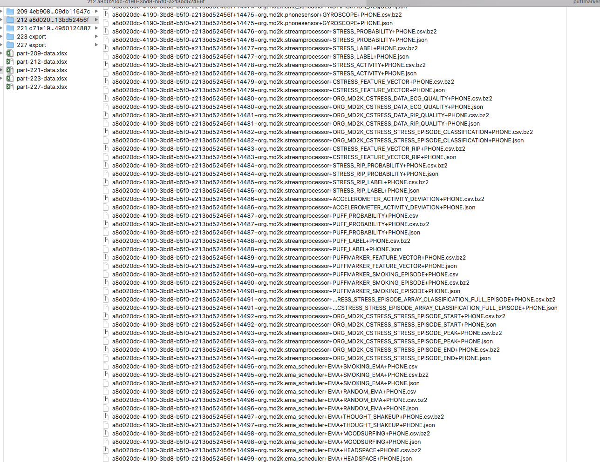
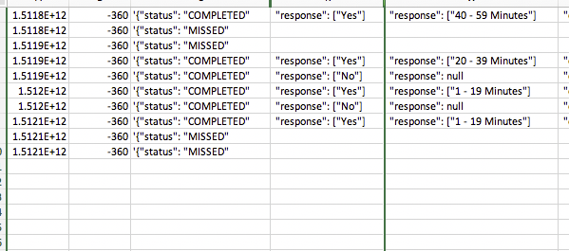
Recall the ugliness: Toward automated dataset construction
Extract Random EMAs and timestamps
Random EMAs
Response options
"1 - 19 Minutes”
"20 - 39 Minutes”
"40 - 59 Minutes”
"60 - 79 Minutes”
"80 - 100 Minutes”
"> 100 Minutes"
Notes:
Paper will outline the scientific problem of detection. We will detect smoking episodes in a manner that allows for error propagation. We are unable to ascertain precisely when a smoking episode occurs. We assume for now that we observe all times of hand-to-month gestures. Puffs can only occur as hand-to-mouth gestures. The measurement error problem is that this gesture is a 1 or 0 (1=puff, 0=otherwise). So the missing data is the 1, 0’s at each hand-to-mouth gesture. The measurements are at multiple time-scales and of mixed type (i.e., EMA and sensor).
Then the question is to use all the other information to figure out which hand-to-mouth are LABELLED as a puff inside a smoking episode
Imputation 1 is more “likely” and so we will impute these labels more often; however, the uncertainty in the measurements allows imputation 2 to also be likely (albeit less likely than imputation 1).

Slide 7
Pre-processing
Built an automated method for constructing the dataset for EOD, EC, and Random EMA as well as HTMGs and puffMarker!
N = 53 participants; <= 14 (4 pre-quit,10 post-quit) days of data per participant
Know ‘start date”, “quit date”, and “end date” for each participant
Processed both Phone and Cloud datasets
RULE: If phone backup exists for a particular data stream for that person, this data is always used in analysis
Phone backup doesn’t exist if participant didn’t return the phone
Cloud can lose the data due to syncing issues (not frequent, but happens often enough)

Slide 8
“Daily” protocol
At entry, participant picks “start” and “end” time of each day (approximately 12 hours apart)
At “start” time, the user is prompted to “begin the study day”
If yes, then begins to receive random prompts (3 4-hour buckets; 1 uniformly at random within each 4-hour bucket)
If no, then no random prompts that day
At “end” time, the user is prompted to “end the study day”
If yes, then they are provided the end-of-day self-report
If no, then no end-of-day provided
Event-contingent EMA can be provided at ANY time throughout the day
Sensor data (HTMGs and puffMarker) can be provided at ANY time throughout the day
Requires checking data quality

Slide 9
Step 2: Making sense of it all?
“What’s the significance? I don’t know!” – Pee-wee’s Big Adventure
Notes:
Paper will outline the scientific problem of detection. We will detect smoking episodes in a manner that allows for error propagation. We are unable to ascertain precisely when a smoking episode occurs. We assume for now that we observe all times of hand-to-month gestures. Puffs can only occur as hand-to-mouth gestures. The measurement error problem is that this gesture is a 1 or 0 (1=puff, 0=otherwise). So the missing data is the 1, 0’s at each hand-to-mouth gesture. The measurements are at multiple time-scales and of mixed type (i.e., EMA and sensor).
Then the question is to use all the other information to figure out which hand-to-mouth are LABELLED as a puff inside a smoking episode
Imputation 1 is more “likely” and so we will impute these labels more often; however, the uncertainty in the measurements allows imputation 2 to also be likely (albeit less likely than imputation 1).

Slide 10
Step 2a: Measurement error and self-report
“The most difficult thing in life is to know yourself” – Thales
Notes:
Paper will outline the scientific problem of detection. We will detect smoking episodes in a manner that allows for error propagation. We are unable to ascertain precisely when a smoking episode occurs. We assume for now that we observe all times of hand-to-month gestures. Puffs can only occur as hand-to-mouth gestures. The measurement error problem is that this gesture is a 1 or 0 (1=puff, 0=otherwise). So the missing data is the 1, 0’s at each hand-to-mouth gesture. The measurements are at multiple time-scales and of mixed type (i.e., EMA and sensor).
Then the question is to use all the other information to figure out which hand-to-mouth are LABELLED as a puff inside a smoking episode
Imputation 1 is more “likely” and so we will impute these labels more often; however, the uncertainty in the measurements allows imputation 2 to also be likely (albeit less likely than imputation 1).

Slide 11
Making sense of self-reports
Smoking Episodes
Beginning
Of day
End
Of day
>100
Yes
Missed
No
Random EMA
5-15
Various
Self-Report Measures
Of
Smoking
Episodes
Event-based EMA
End-of-day EMA
What is the measurement-error properties for each self-report? Can we use high sensitivity measures to triangulate reasonable priors?
Notes:
Paper will outline the scientific problem of detection. We will detect smoking episodes in a manner that allows for error propagation. We are unable to ascertain precisely when a smoking episode occurs. We assume for now that we observe all times of hand-to-month gestures. Puffs can only occur as hand-to-mouth gestures. The measurement error problem is that this gesture is a 1 or 0 (1=puff, 0=otherwise). So the missing data is the 1, 0’s at each hand-to-mouth gesture. The measurements are at multiple time-scales and of mixed type (i.e., EMA and sensor).
Then the question is to use all the other information to figure out which hand-to-mouth are LABELLED as a puff inside a smoking episode
Imputation 1 is more “likely” and so we will impute these labels more often; however, the uncertainty in the measurements allows imputation 2 to also be likely (albeit less likely than imputation 1).

Slide 12
Relationship with end-of-day
End-of-day EMA
Can we use other data sources to understand ME properties?
Does the bias/variance depend on which type of self-report we use?

Slide 13
Step 1: Use high sensitivity measures
Take times at which event-contingent smoking is reported
These are almost GUARANTEED to be smoking times (or proximal to smoking times)
Only take times between 8AM and 8PM (due to EOD range)
Take reports with response “<5”, “5-15”, or “15-30”.
Pretend the smoking event occurs at the mid-point of this range
If user provides end-of-day self-report,
Check if the user says they smoked in the same hour
Check if the user says they smoked in a nearby hour
For each user, keep track of how often these agree

Slide 14
Step 1: Quick example
5-15
Event-based EMA
End-of-day EMA
The first two smoking events were not recorded and so we don’t know that end-of-day is a good measure
The final smoking event we received an event-contingent self-report so we can check that against end-of-day
Note this check is conditional on event-contingent and therefore we should think of this as a conditional MEM information

Slide 15
Step 1: Use high sensitivity measures
Event-Contingent | Window | Average of aggregated counts | Average of fraction per user | Std. Dev. Of fraction per user
All | Current hour | 0.547 | 0.458 | 0.331
 | Plus-minus 1 hour | 0.844 | 0.743 | 0.337
Before 2pm | Current hour | 0.518 | 0.414 | 0.413
 | Plus-minus 1 hour | 0.857 | 0.812 | 0.331
After 2pm | Current hour | 0.565 | 0.503 | 0.375
 | Plus-minus 1 hour | 0.836 | 0.738 | 0.346
Suggest time-of-day did not conditionally impact the variance
Assuming no bias, this would suggest approximately 40-42 minute standard deviation around the event-contingent report

Slide 16
Step 2: Use medium sensitivity measures
Take times at which random self-reported smoking is reported
These are GUARANTEED to be smoking times (or proximal to smoking times)
Only take times between 8AM and 8PM (due to EOD range)
Take reports with response Response options "1-19”, “20-39”, “40-59”, “60-79”, “80-100”
Ignore “>100”
Pretend the smoking event occurs at the mid-point of this range
If user provides end-of-day self-report,
Check if the user says they smoked in the same hour
Check if the user says they smoked in nearby hour
For each user, keep track of how often these agree

Slide 17
Step 2: Use random EMA (medium sensitivity)
Event-Contingent | Window | Average of aggregated counts | Average of fraction per user | Std. Dev. Of fraction per user
All | Current hour | 0.429 | 0.431 | 0.364
 | Plus-minus 1 hour | 0.687 | 0.673 | 0.364
Before 2pm | Current hour | 0.477 | 0.457 | 0.399
 | Plus-minus 1 hour | 0.662 | 0.614 | 0.402
After 2pm | Current hour | 0.390 | 0.380 | 0.410
 | Plus-minus 1 hour | 0.707 | 0.700 | 0.390
Suggest time-of-day did not conditionally impact the variance
Suggest approximately 52-59 minute standard deviation around the random self-report

Slide 18
Step 3: Use “high” sensitivity measure
Take times at which puffMarker reports a smoking episode
We “believe” these will be smoking times
Only take times between 8AM and 8PM (due to EOD range)
If user provides end-of-day self-report,
Check if the user says they smoked in the same hour
Check if the user says they smoked in nearby hour
For each user, keep track of how often these agree

Slide 19
Step 3: Use puffMarker (“high” sensitivity)
puffMarker | Window | Average of aggregated counts | Average of fraction per user | Std. Dev. Of fraction per user
All | Current hour | 0.329 | 0.305 | 0.286
 | Plus-minus 1 hour | 0.589 | 0.579 | 0.376
Before 2pm | Current hour | 0.317 | 0.304 | 0.372
 | Plus-minus 1 hour | 0.553 | 0.549 | 0.412
After 2pm | Current hour | 0.337 | 0.294 | 0.288
 | Plus-minus 1 hour | 0.613 | 0.602 | 0.380
Suggest time-of-day did not conditionally impact the variance
Suggest approximately 70-73 minute standard deviation around the puffMarker

Slide 20
Step 2b: Measurement error and sensors
“Big brother is watching you” – 1984
Notes:
Paper will outline the scientific problem of detection. We will detect smoking episodes in a manner that allows for error propagation. We are unable to ascertain precisely when a smoking episode occurs. We assume for now that we observe all times of hand-to-month gestures. Puffs can only occur as hand-to-mouth gestures. The measurement error problem is that this gesture is a 1 or 0 (1=puff, 0=otherwise). So the missing data is the 1, 0’s at each hand-to-mouth gesture. The measurements are at multiple time-scales and of mixed type (i.e., EMA and sensor).
Then the question is to use all the other information to figure out which hand-to-mouth are LABELLED as a puff inside a smoking episode
Imputation 1 is more “likely” and so we will impute these labels more often; however, the uncertainty in the measurements allows imputation 2 to also be likely (albeit less likely than imputation 1).

Slide 21
Hand-to Mouth Gestures & Marked Point Process
Smoking Episodes
Beginning
Of day
End
Of day
Smoking Episodes
1
Smoking Puffs
2
Beginning
Of day
End
Of day
We will pretend that we get to see all the HTMGs but not if they come from a smoking episode
Notes:
Paper will outline the scientific problem of detection. We will detect smoking episodes in a manner that allows for error propagation. We are unable to ascertain precisely when a smoking episode occurs. We assume for now that we observe all times of hand-to-month gestures. Puffs can only occur as hand-to-mouth gestures. The measurement error problem is that this gesture is a 1 or 0 (1=puff, 0=otherwise). So the missing data is the 1, 0’s at each hand-to-mouth gesture. The measurements are at multiple time-scales and of mixed type (i.e., EMA and sensor).
Then the question is to use all the other information to figure out which hand-to-mouth are LABELLED as a puff inside a smoking episode
Imputation 1 is more “likely” and so we will impute these labels more often; however, the uncertainty in the measurements allows imputation 2 to also be likely (albeit less likely than imputation 1).

Slide 22
HTMGs: only useful if there’s signal
Smoking Episodes
Person A
“The Gesticulator”
Smoking Puffs
Person B
“The Quiet One”
Smoking Puffs
Can we use other data sources to understand the relationship between smoking and HTMGs?
What’s the expected # of HTMGs in each episode?
What’s the expected # of HTMGs away from smoking episodes?

Slide 23
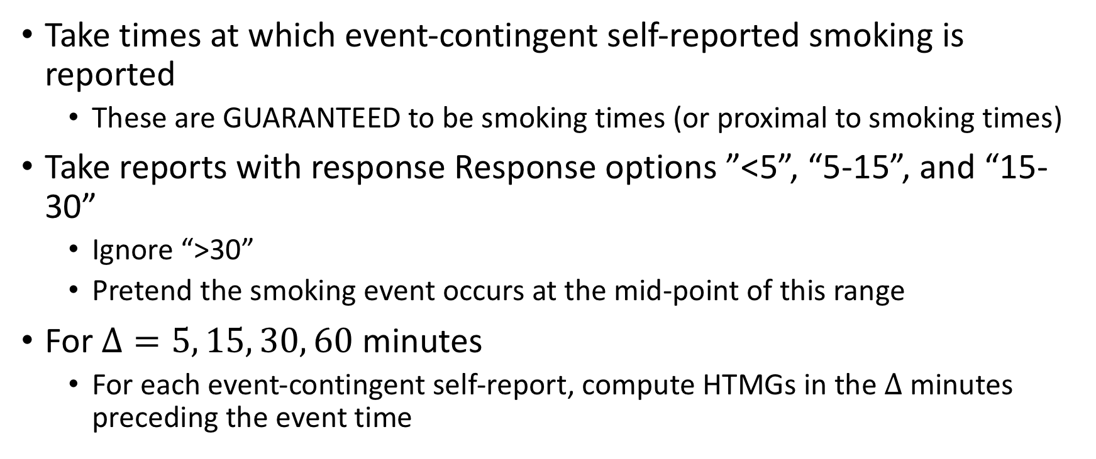
Step 1: Use high sensitivity measure for smoking episodes
Take times at which event-contingent self-reported smoking is reported
These are GUARANTEED to be smoking times (or proximal to smoking times)
Take reports with response Response options ”<5”, “5-15”, and “15-30”
Ignore “>30”
Pretend the smoking event occurs at the mid-point of this range
For $Δ=5, 15, 30, 60$ minutes
For each event-contingent self-report, compute HTMGs in the $Δ$ minutes preceding the event time

Slide 24
Prior on signal-to-noise of end-of-day self-report
Smoking Episodes
PuffMarker
Smoking Puffs
5-15
Event-based EMA
The first two smoking events were not recorded and so we don’t know that these correspond to smoking HTMGs
The final smoking event we received an event-contingent self-report so we can check the HTMGs prior to that time
Seems OK to assume conditional independence of HTMG and event-contingent reporting
Notes:
Paper will outline the scientific problem of detection. We will detect smoking episodes in a manner that allows for error propagation. We are unable to ascertain precisely when a smoking episode occurs. We assume for now that we observe all times of hand-to-month gestures. Puffs can only occur as hand-to-mouth gestures. The measurement error problem is that this gesture is a 1 or 0 (1=puff, 0=otherwise). So the missing data is the 1, 0’s at each hand-to-mouth gesture. The measurements are at multiple time-scales and of mixed type (i.e., EMA and sensor).
Then the question is to use all the other information to figure out which hand-to-mouth are LABELLED as a puff inside a smoking episode
Imputation 1 is more “likely” and so we will impute these labels more often; however, the uncertainty in the measurements allows imputation 2 to also be likely (albeit less likely than imputation 1).

Slide 25
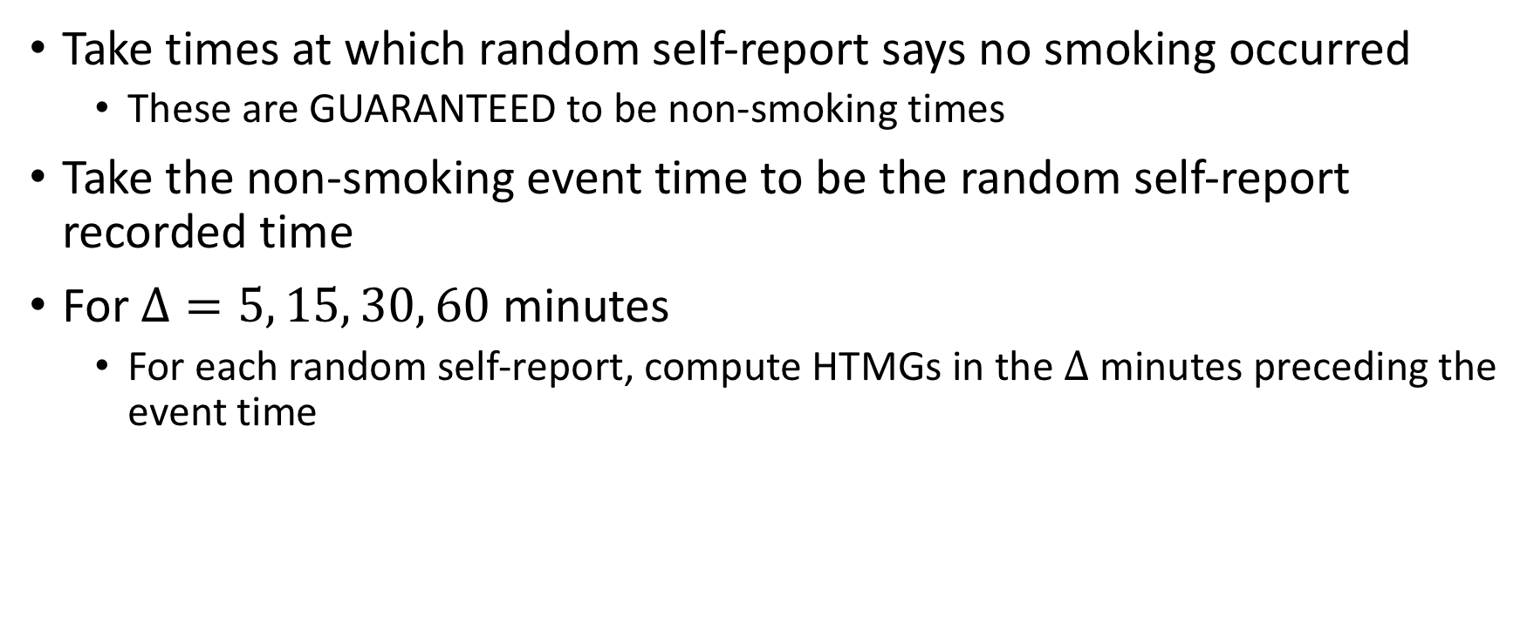
Step 2: Use high sensitivity measure of no smoking
Take times at which random self-report says no smoking occurred
These are GUARANTEED to be non-smoking times
Take the non-smoking event time to be the random self-report recorded time
For $Δ=5, 15, 30, 60$ minutes
For each random self-report, compute HTMGs in the $Δ$ minutes preceding the event time

Slide 26

Prior on signal-to-noise of end-of-day self-report
Smoking Episodes
PuffMarker
Smoking Puffs
$$Δ$$
>100
Yes
Missed
No
Random EMA
The final random EMA is a clear signal of no smoking in recent history!
Seems OK to assume conditional independence of HTMG and random EMA reporting
Notes:
Paper will outline the scientific problem of detection. We will detect smoking episodes in a manner that allows for error propagation. We are unable to ascertain precisely when a smoking episode occurs. We assume for now that we observe all times of hand-to-month gestures. Puffs can only occur as hand-to-mouth gestures. The measurement error problem is that this gesture is a 1 or 0 (1=puff, 0=otherwise). So the missing data is the 1, 0’s at each hand-to-mouth gesture. The measurements are at multiple time-scales and of mixed type (i.e., EMA and sensor).
Then the question is to use all the other information to figure out which hand-to-mouth are LABELLED as a puff inside a smoking episode
Imputation 1 is more “likely” and so we will impute these labels more often; however, the uncertainty in the measurements allows imputation 2 to also be likely (albeit less likely than imputation 1).

Slide 27
A few extra HTMGs in a smoking window
Event-Contingent | Window | Average of # of HTMGs per user | Std dev of # of HTMGs per user | Avg. Frac. Of time no HTMGs per user | Std. Dev. Frac. Of time no HTMGs per user
Positive Event-Contingent EMA | 5 minutes | 2.11 | 1.60 | 0.35 | 0.28
 | 15 minutes | 4.47 | 3.37 | 0.22 | 0.26
 | 30 minutes | 6.81 | 4.21 | 0.13 | 0.21
 | 60 minutes | 10.91 | 5.79 | 0.06 | 0.11
Negative Random EMA | 5 minutes | 0.63 | 0.56 | 0.66 | 0.23
 | 15 minutes | 1.88 | 1.32 | 0.42 | 0.24
 | 30 minutes | 3.68 | 2.46 | 0.31 | 0.26
 | 60 minutes | 7.11 | 4.47 | 0.25 | 0.26

Slide 28
Step 2c: Smoking at the day level
Does not include participants 246-253
Notes:
Paper will outline the scientific problem of detection. We will detect smoking episodes in a manner that allows for error propagation. We are unable to ascertain precisely when a smoking episode occurs. We assume for now that we observe all times of hand-to-month gestures. Puffs can only occur as hand-to-mouth gestures. The measurement error problem is that this gesture is a 1 or 0 (1=puff, 0=otherwise). So the missing data is the 1, 0’s at each hand-to-mouth gesture. The measurements are at multiple time-scales and of mixed type (i.e., EMA and sensor).
Then the question is to use all the other information to figure out which hand-to-mouth are LABELLED as a puff inside a smoking episode
Imputation 1 is more “likely” and so we will impute these labels more often; however, the uncertainty in the measurements allows imputation 2 to also be likely (albeit less likely than imputation 1).

Slide 29
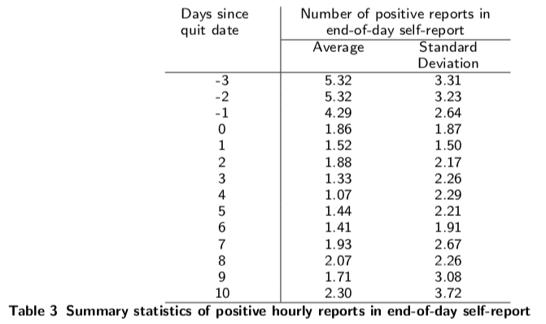
Step 1: Day level smoking based on EOD EMA

Slide 30
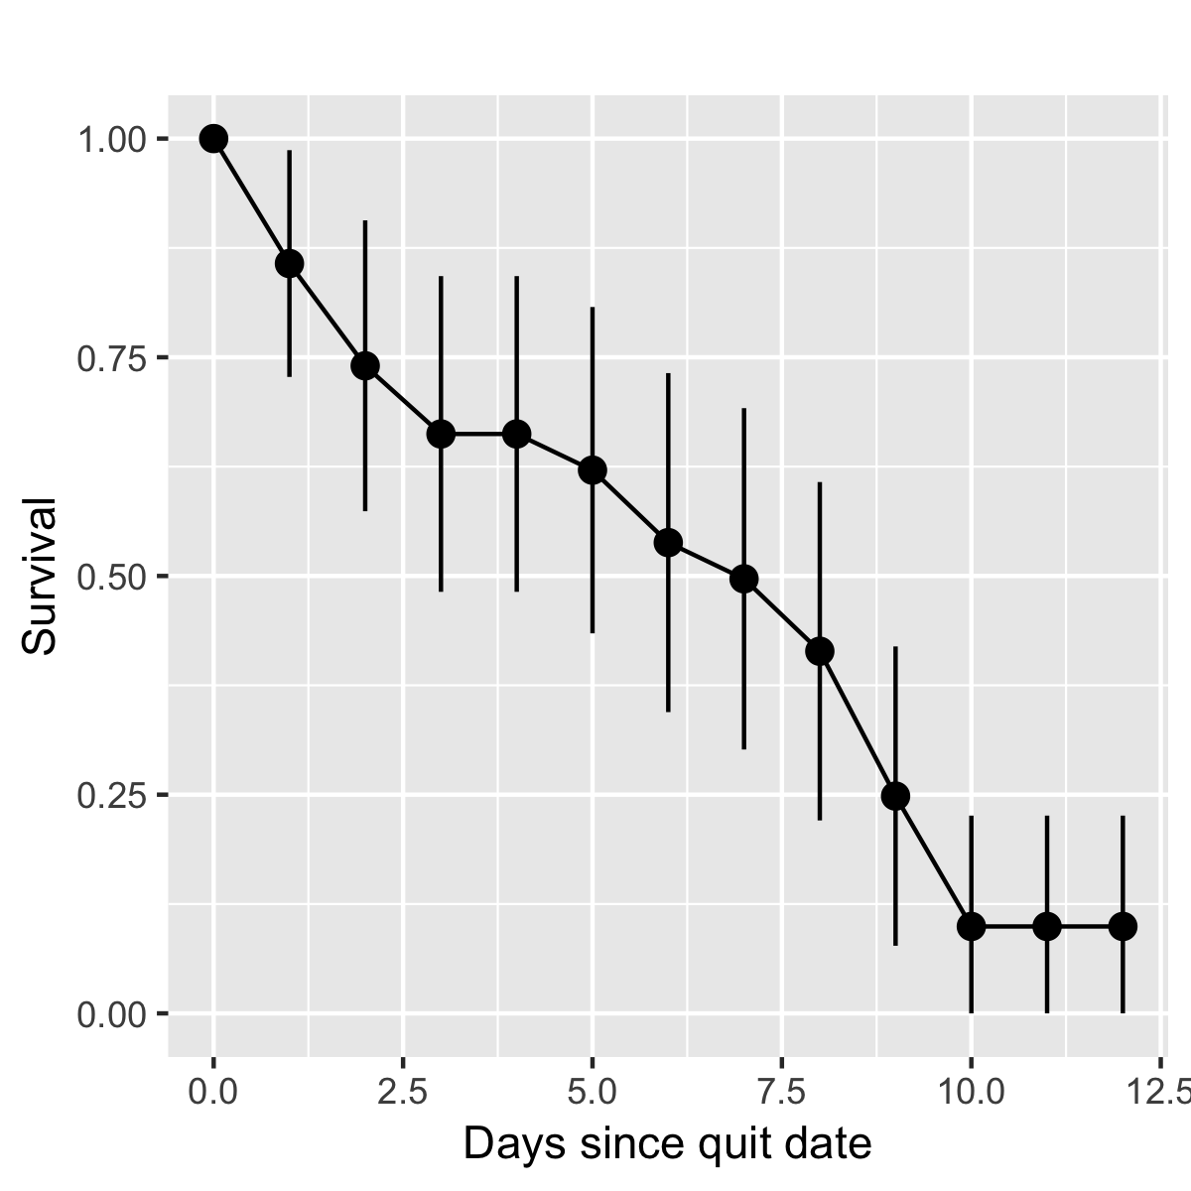
Step 2: Time until first reported smoking

Slide 31
Conclusions
Priors on random self-report, EC, and puffMarker
Versions of MAR assumption for self-report
Log-normal MEM for self-report
Low specificity for puffMarker
Now have prior variance on EOD given different types of self-report
MAR assumption
Normal or Log-normal with mild dependence on other measurements
Now have prior on # of HTMGs within and outside smoking intervals
Now have prior on time until first smoking episode post quit
Need further investigation into time until next smoking episode
Notes:
Paper will outline the scientific problem of detection. We will detect smoking episodes in a manner that allows for error propagation. We are unable to ascertain precisely when a smoking episode occurs. We assume for now that we observe all times of hand-to-month gestures. Puffs can only occur as hand-to-mouth gestures. The measurement error problem is that this gesture is a 1 or 0 (1=puff, 0=otherwise). So the missing data is the 1, 0’s at each hand-to-mouth gesture. The measurements are at multiple time-scales and of mixed type (i.e., EMA and sensor).
Then the question is to use all the other information to figure out which hand-to-mouth are LABELLED as a puff inside a smoking episode
Imputation 1 is more “likely” and so we will impute these labels more often; however, the uncertainty in the measurements allows imputation 2 to also be likely (albeit less likely than imputation 1).

Slide 32
Next Steps
Fix priors, and implement reverse-jump MCMC procedure for latent smoking event process
Get samples to see if the posteriors make sense for fixed MEMs
Move to MEMs allowed to adjust (full MCMC)
Build simulation study to understand how the posteriors depend on model assumptions
FUTURE: Add interventions and aim for causal effect of reminders on risk of smoking (marginal Cox model; Hernan, 2000)
Notes:
Paper will outline the scientific problem of detection. We will detect smoking episodes in a manner that allows for error propagation. We are unable to ascertain precisely when a smoking episode occurs. We assume for now that we observe all times of hand-to-month gestures. Puffs can only occur as hand-to-mouth gestures. The measurement error problem is that this gesture is a 1 or 0 (1=puff, 0=otherwise). So the missing data is the 1, 0’s at each hand-to-mouth gesture. The measurements are at multiple time-scales and of mixed type (i.e., EMA and sensor).
Then the question is to use all the other information to figure out which hand-to-mouth are LABELLED as a puff inside a smoking episode
Imputation 1 is more “likely” and so we will impute these labels more often; however, the uncertainty in the measurements allows imputation 2 to also be likely (albeit less likely than imputation 1).

