Slide 1

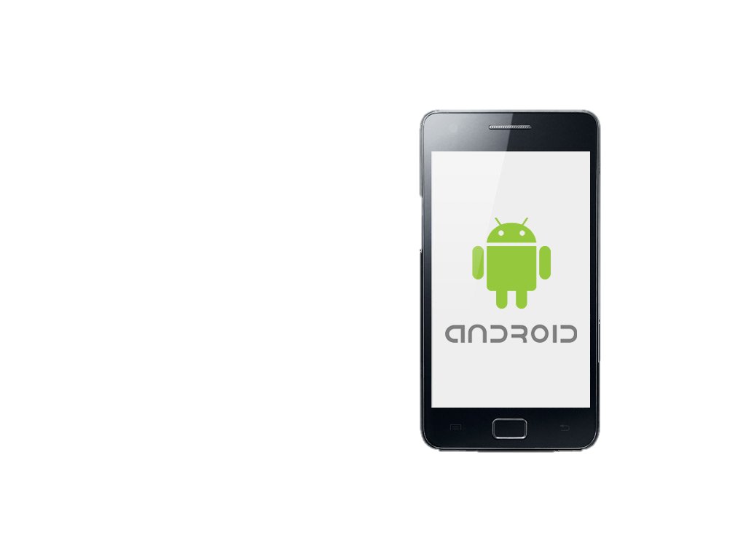
Hackday
Artist
Builder
Hacker
Hackday
Maker
Thinker

Slide 2

Skills for the future
Have fun!

Slide 3
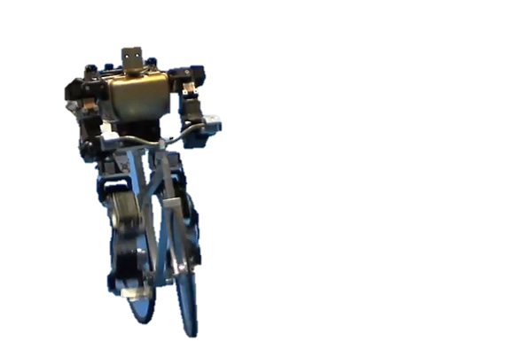
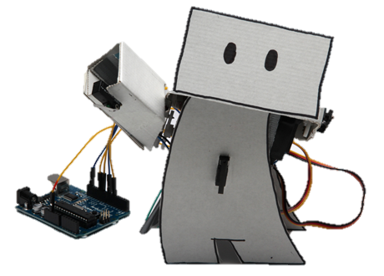
What & How

Slide 4



What & How

Slide 5
How
On each table (5 persons):
Decide on 2 apps
App 1 developed by 2 persons sharing 1 laptop
App 2 developed by 3 persons sharing 1 laptop
Pairprogramming (triprogramming)
No competition (this time:)

Slide 6
Task 1 – StatoilCanteen App
API 1 (fake):
http://canteen-app.herokuapp.com/canteens
http://canteen-app.herokuapp.com/canteens/stavanger
http://canteen-app.herokuapp.com/balance
API 2 (real thing):
http://itvdis.statoil.com/ (http://143.97.229.222/)
Explanation: See inside resource-folder in AndroidExampleApp repo on Github (https://github.com/Statoil/AndroidHelloWorld)
Be creative
Customer value

Slide 7
Task 2 – StatoilTravel App
API: https://b2bqa.statoil.com/Travel/TripService/TripService.asmx?WSDL
Explanation: See inside resource-folder in AndroidExampleApp repo on Github (https://github.com/Statoil/AndroidHelloWorld)
Be creative
Customer value

Slide 8
Task 3 – You choice
Find your own app-idea
Use external API (amazon, twitter (#Statoil) etc.)

Slide 9
Teams
See list

Slide 10
Image oppdatering
Image update to fix resolution:
Open VirtualBox → Run image (don’t start in scale mode. Use right-ctrl+C to swith on/off scale mode) → select Devices (in menu) → Install guest additions → Select new screen resolution inside windows image (control panel → Appearance and … → display → screen resolution)
Hotel Internet passord:

