Slide 1
Data Sandbox Conceptual design – Multi-tenant environment overview
Data Sandbox platform (powered by Azure)
Sandbox
(tenant, vendor)
Sandbox
(tenant, vendor)
Sandbox
(tenant, vendor)
Study
(experiment)
Study
(experiment)
Pod
(environment)
Sandbox
(tenant, vendor)
Sandbox
(tenant, vendor)
Data Sandbox Shared Services
Provisioning | Automation | Security | Management

Slide 2



Data Sandbox Conceptual design – Cloud resources structure
Subscription: Innovation Lab
SharedServices
Sandbox01-CommonComponents
Sandbox01-Study01-CommonComponents
Sandbox01-Study01-Pod01

Slide 3





Data Sandbox Conceptual design – Study & Pod core components
Pod subnet
Tenant-controlled
Provider-controlled
Network Security
Group
Storage Account
(Blob storage)
Gateway Service
Virtual Network

Slide 4



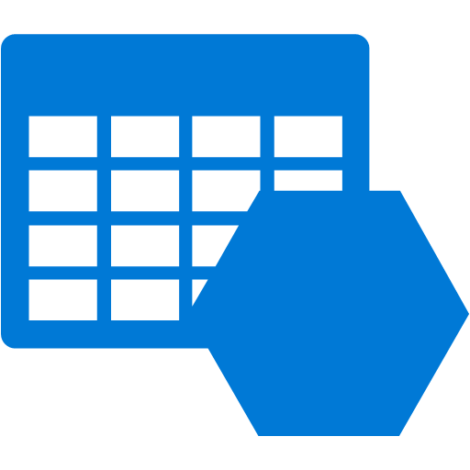






Data Sandbox Conceptual design – Shared Services
Identity and Access Services
Management Services
Automation Services
Azure AD
Azure AD B2B
Azure MFA
Azure Monitor
Diagnostics Logs
Storage
Automation
Account
Security Services
Network Services
Azure Security
Center
Azure Policy
Gateway Service
Deployment Services
Azure Key Vault
Firewall Service
Hub Virtual Network
Azure Pipelines
GitHub

Slide 5
Data Sandbox Conceptual design – Pod Lifecycle
Phase 1
Pod Setup
Provision and configure cloud resources for the Pod
Phase 2
Pod Lockdown
Pod is locked for access from/to Internet traffic
Phase 3
Pod Shutdown
Experiment results can be persisted to Cloud storage
Access from/to Internet granted, No access to data
Only allowed access point is the Secure Gateway
Access to data is granted and constrained to this closed network
The Pod is terminated (all components)

Slide 6





Data Sandbox Conceptual design – Phase 1 (Pod Setup)
Azure Resource Manager (control plane)
Resource provisioning
Tenant-controlled
Pod subnet
Direct access
PIP
Access to data
Vendor (tenant)
Access to external resources
Provider-controlled
Network Security
Group
Gateway Service
Virtual Network
Storage Account
(Blob storage)
Online resources
and services

Slide 7
Data Sandbox Conceptual design – Phase 2 (Pod Lockdown)
Azure Resource Manager (control plane)
Resource provisioning
Tenant-controlled
Pod subnet
Access to data
Vendor (tenant)
Direct access
Gateway access
Provider-controlled
Network Security
Group
Access to external resources
Gateway Service
Virtual Network
Storage Account
(Blob storage)
Online resources
and services

Slide 8
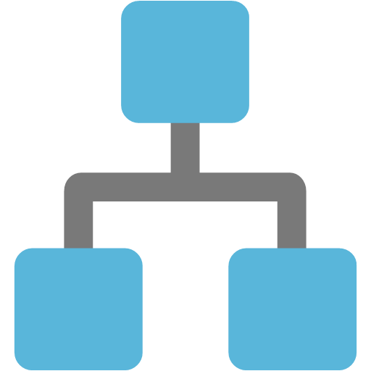
Data Sandbox Conceptual design – Phase 3 (Pod Shutdown)
Azure Resource Manager (control plane)
Resource provisioning
Tenant-controlled
Pod subnet
Sandbox01-Study01-Pod01
Automation
Account
Vendor (tenant)
TerminatePod
Runbook
Provider-controlled
Network Security
Group
Gateway Service
Virtual Network
Storage Account
(Blob storage)
Online resources
and services

Slide 9

Data Sandbox Create a new study workflow
PowerShell Script
new-studydeployment.ps1
(Requires Az module)
Azure Resource Manager API
Azure subscription
Create a Resource Group
Manually triggered
(from e.g. admin PC
Or Azure Cloud Shell)
Deploy the template
ARM Template
newstudy.json
(Creates a storage account)
authenticate
Azure Active
Directory
Input parameters: studyName, subscriptionId, location

