Slide 1
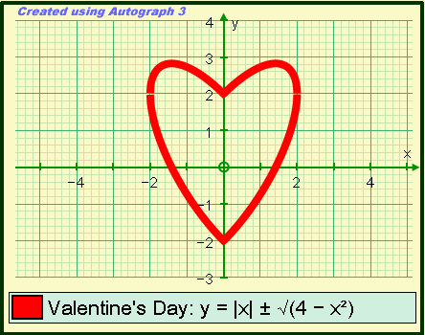
Valentine’s Day maths

Slide 2

9x – 7i > 3(3x – 7u)
i < 3 u

Slide 3

Mobius Hearts

Slide 4
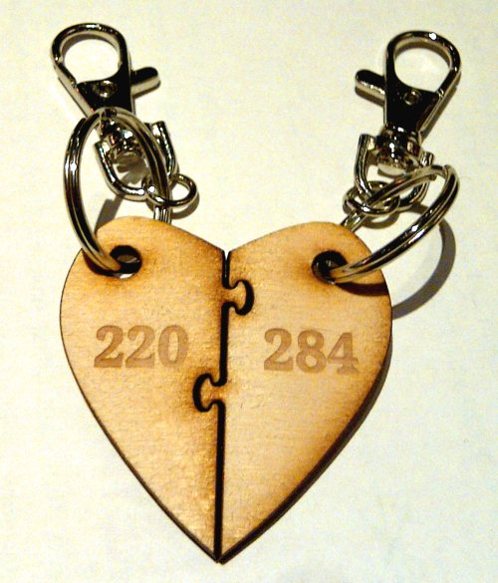
Amicable Numbers
1
2
4
5
10
11
20
22
44
55
110
1
2
4
71
142
284

Slide 5

Why Peter Backus can’t get a girlfriend
a woman between the age of 24 and 34
with a university degree
whom he finds attractive
she must find him attractive
she must herself be single
he must get along with her

Slide 6
The Stable Marriage Problem

Slide 7


Scenario
1
1
6
6
5
5
?
4
4
2
2
3
3
How do we pair them off?

Slide 8


What is a stable marriage situation?
A matching of men and women such that no two people of opposite sex would both rather have each other than their current partners.
Bobetta
Bob
Alice
Alan

Slide 9
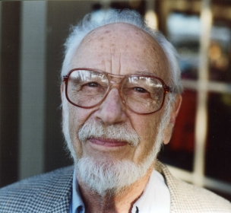
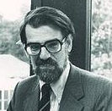
Gale – Shapley algorithm (1962)
Oberwolfach
Photo Collection
Male proposes to his preferred female
If available she always accepts his proposal, and we consider the next male.
If already engaged she chooses her favourite. The rejected male must now propose to his next preference.

Slide 10
A WXYZ
B XWYZ
C WZYX
D ZYWX
W ABCD
X DCBA
Y ABCD
Z CDAB

Slide 11
 | W ABCD | X DCBA | Y ABCD | Z CDAB
A WXYZ
B XWYZ
C WZYX
D ZYWX

Slide 12
Is it always stable?
Bobetta
Bob
Alice
Alan
?

Slide 13
Proof that G-S algorithm gives a stable pairing.
Suppose Bob prefers Alice to his wife Bobetta
During G-S, Bob must have proposed to Alice before proposing to Bobetta.
If Alice accepted his proposal, yet is not married to him at the end, she must have dumped him for someone she likes more, and therefore doesn't like Bob more than Alan.
If Alice rejected his proposal, she was already with someone she liked more than Bob.

Slide 14
 | W ABCD | X DCBA | Y ABCD | Z CDAB
A WXYZ
B XWYZ
C WZYX
D ZYWX

Slide 15
A
B
C
D
W
X
Y
Z
W X Y Z
W X Y Z
X W Y Z
X W Y Z
W Z Y X
W Z Y X
Z Y W X
Z Y W X
A B C D
A B C D
D C B A
D C B A
A B C D
A B C D
C D A B
C D A B

Slide 16
Other applications
Stable roommates problem
Medical interns and hospitals

Slide 17
Conclusion
Don’t wait to be asked,
always make the first move!

Slide 18
References
D. Gale and L. S. Shapley, College admissions and the stability of marriage, American Mathematical Monthly 69 (1962), 9-15
http://en.wikipedia.org/wiki/Stable_marriage_problem

