Slide 1
What is Operational Research?
Why chemists should consider a PhD in O.R

Slide 2
Introduction
Why am I here?
To introduce you to Operational Research (O.R.)
To show you how O.R. is used to help solve problems in lots of everyday situations
To prove that there are plenty of options for future research after an MSc/MChem

Slide 3
Operational Research
Operational Research (O.R.) is the application of mathematical methods to tackle the real-life problems associated with decision-making in businesses and other enterprises.
It’s very expensive to make a wrong decision!
O.R. combines
to provide the means to make more informed and better decisions.
+
A way of thinking
& communicating
Analytical
techniques

Slide 4
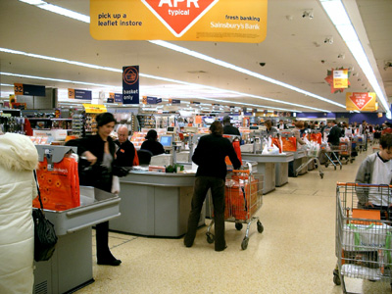
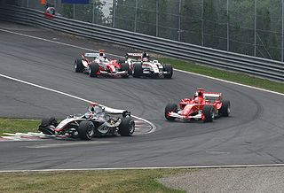

How is maths applied in the real world?
How do you think maths is used in supermarkets?
How do you think maths is used in sport?
How do you think maths is
used by airlines?

Slide 5
Operational Research is: the application of maths in the real world
O.R. is the maths used in supermarkets, e.g.
Understanding people’s buying patterns
Determining the number of staff needed on checkouts and at what times
Calculating how many of each product to be ordered and when to be delivered
O.R. is the maths used in sport, e.g.
Formula One pit stop strategy
Scheduling football games
Designing a stadium
O.R. is the maths used by airlines, e.g.
Calculating the number of staff required at check-in & bag drop desks
Scheduling the cabin crew
Setting the prices of tickets to reflect changing demand

Slide 6
O.R. is used all around us
your supermarket
low cost airlines
your telephone tariff
your gas supply
your local factory
one-day cricket
your pint of milk
English football
a 999 call
your doctor's surgery
satnav
new sports stadiums
factories and distribution channels

Slide 7
Examples of O.R. techniques
Optimisation is a way to solve problems in which one seeks to achieve the best outcome (such as maximum profit or lowest cost with limited resource).
Simulation allows you to try out different approaches by simulating events numerous times and answer the “What if…?” question.
Queuing theory is used to approximate a real queuing situation or system, so the queuing behaviour can be analysed mathematically.
Other techniques include:
System Dynamics
Heuristics
Soft Systems Methodology
Cognitive Mapping
Forecasting
Multi-criteria methods
Statistics
Data Mining

Slide 8
When is O.R. useful?
When it’s not clear what the main problem is
When it’s uncertain what the outcome of different actions will be
When you think things could work better
When you don’t know how well things are working
When you are worried about risks
When you need to take account of the views of different stakeholder groups
When you feel you are not making best use of the data you have
Whenever you are faced with a complex decision

Slide 9
OR and Chemistry?
Chemical Engineering
Process Systems Engineer (PSE)
Many key algorithms developed by Chem Engineers
Strong numerical skills
Modelling
Balancing Inputs and Outputs
New opportunities
“Chemists make good OR’s because they can understand abstract models but also keep the inputs/outputs balanced” – Gene Woolsey
Optimal design of plants
Planning/scheduling
Fault detection

Slide 10
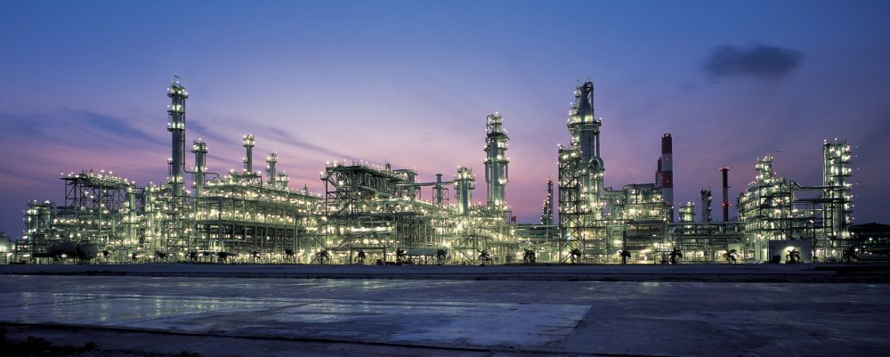
Petroleum Refinery
Three types of petrol (minimum Octane rating: 85, 90, 95)
Four types of raw oils (Octane rating: 68, 86, 91, 99)
Blending oils ➔ petrol, with proportional Octane rating
Objective: How much of each petrol to make?

Slide 11
The Blending Problem
Raw oil | OcR | Available amount (barrels/day) | Cost/barrel
1 | 68 | 4000 | 31.02
2 | 86 | 5050 | 33.15
3 | 91 | 7100 | 36.35
4 | 99 | 4300 | 38.75
Petrol Type | Min OcR | Selling Price | Demand (barrels/day)
1 (Premium) | 95 | 45.15 | ≤ 10,000
2 (Super) | 90 | 42.95 | No limit
3 (Regular) | 85 | 40.99 | ≥ 15,000

Slide 12
What do we need to consider?
How much raw oil is available?
Does our petrol meet the minimum OcR?
Do we have enough Regular petrol?
Do we have too much Premium petrol?
What exactly are we trying to maximise?
What are the constraints?

Slide 13
Your turn
x_{ij} = number of barrels/day of oil i used to make petrol j
In terms of x_{ij}, write down:
Total amount of premium petrol made each day
What we are trying to maximise
The raw oils constraints
The demand constraints
The OcR constraints

Slide 14
Total amount of premium petrol made each day
Total premium petrol per day = x₁₁ + x₂₁ + x₃₁ + x₄₁

Slide 15
Objective Function
Maximize [
45.15(x₁₁ + x₂₁ + x₃₁ + x₄₁) +
42.95(x₁₂ + x₂₂ + x₃₂ + x₄₂) +
40.99(x₁₃ + x₂₃ + x₃₃ + x₄₃) ]

Slide 16
Available raw oil constraints
x₁₁ + x₁₂ + x₁₃ ≤ 4000 Amount of Oil 1 available
x₂₁ + x₂₂ + x₂₃ ≤ 5050 Amount of Oil 2 available
x₃₁ + x₃₂ + x₃₃ ≤ 7100 Amount of Oil 3 available
x₄₁ + x₄₂ + x₄₃ ≤ 4300 Amount of Oil 4 available

Slide 17
Demand for petrol constraints
x₁₁ + x₂₁ + x₃₁ + x₄₁ ≤ 10,000 Demand for Premium petrol
x₁₃ + x₂₃ + x₃₃ + x₄₃ ≥ 15,000 Demand for Regular petrol

Slide 18
Minimum OcR constraints
68x₁₁ + 86x₂₁ + 91x₃₁ + 99x₄₁ - 95(x₁₁ + x₂₁ + x₃₁ + x₄₁) ≥ 0
68x₁₂ + 86x₂₂ + 91x₃₂ + 99x₄₂ - 90(x₁₂ + x₂₂ + x₃₂ + x₄₂) ≥ 0
68x₁₃ + 86x₂₃ + 91x₃₃ + 99x₄₃ - 85(x₁₃ + x₂₃ + x₃₃ + x₄₃) ≥ 0
Octane Rating for Premium Petrol:
68x₁₁ + 86x₂₁ + 91x₃₁ + 99x₄₁
≥ 95,
x₁₁ + x₂₁ + x₃₁ + x₄₁

Slide 19
Maximize:
45.15(x₁₁ + x₂₁ + x₃₁ + x₄₁) + 42.95(x₁₂ + x₂₂ + x₃₂ + x₄₂) + 40.99(x₁₃ + x₂₃ + x₃₃ + x₄₃)
Subject to:
68x₁₁ + 86x₂₁ + 91x₃₁ + 99x₄₁ - 95(x₁₁ + x₂₁ + x₃₁ + x₄₁) ≥ 0
68x₁₂ + 86x₂₂ + 91x₃₂ + 99x₄₂ - 90(x₁₂ + x₂₂ + x₃₂ + x₄₂) ≥ 0
68x₁₃ + 86x₂₃ + 91x₃₃ + 99x₄₃ - 85(x₁₃ + x₂₃ + x₃₃ + x₄₃) ≥ 0
x₁₁ + x₁₂ + x₁₃ ≤ 4000
x₂₁ + x₂₂ + x₂₃ ≤ 5050
x₃₁ + x₃₂ + x₃₃ ≤ 7100
x₄₁ + x₄₂ + x₄₃ ≤ 4300
x₁₁ + x₂₁ + x₃₁ + x₄₁ ≤ 10,000
x₁₃ + x₂₃ + x₃₃ + x₄₃ ≥ 15,000
x_{ij} ≥ 0 for I = 1, 2, 3, 4, and j = 1, 2, 3.

Slide 20
Where can O.R. take you?
O.R. is a profession where initiative, creativity and enthusiasm are every bit as important as technical ability. There is great scope for you to make your mark and, consequently, your future is very much in your own hands.
O.R. teams are involved in projects which draw on a wide range of business skills and have dealings with anyone from shop floor to boardroom.
As an Operational Researcher you will have the opportunity to undertake a variety of roles including:
Analytical/consultancy
Project management
General management
Lecturer/researcher
Notes:
You could apply your analytical and numeracy skills to real world problems. Now, more than ever before, the public and private sectors require the involvement of those who can approach highly complex problems in a systematic, creative and pragmatic manner.
You can make a difference to the way things are run, to the way people think and improve the use of resources
OR is an evolving discipline - because the world is ever changing. Over the years, OR has firmly embedded itself in a wide range of sectors, including manufacturing, transport, retailing, marketing, the financial and service sectors as well as local and central government.
Because the skills required to undertake good OR - an analytical mind, pro-active and sound people skills - are precisely what are needed in all successful managers, OR is a significant recruiting ground for senior management talent.

Slide 21
Why OR - summary
You can help solve real problems
You can make a difference
To the way things are run
To the way people think
To improve the use of resources or to increase profit
Your skills are potentially valuable in a wide range of organisations
OR Post Graduates are highly sought after
You can make use of a range of skills
Analytical skills
Communication skills
Ability to see the big picture and to focus on detail
Adaptable, flexible, “can do”
Quick to learn
And you can have fun

Slide 22

Are you interested in OR?

