Slide 1


Calculating the Comorbidity Index with user designed flexibility using SAS and R
Geonhyeok Jeong, University of North Carolina, Chapel Hill, NC
Ting Shi, Merck & Co., Inc., Rahway, NJ, USA

Slide 2

Outline
1. Introduction
2. Comorbidity
3. Example Process of SAS Macro / R function with CCI
4. Logistic Regression for Weight
5. Advantages of new macro/ function
6. Conclusion
7. Q/A

Slide 3
Introduction

Slide 4
Introduction
Charlson CI
Elixhauser CI
NCI Comorbidity
Existing SAS / R function
Flexibility
user defined comorbidity indexes

Slide 5
Comorbidity

Slide 6


What is Comorbidity
two or more medical conditions or disease
complicate diagnosis,
treatment

Slide 7


Example of Comorbidity

Slide 8
Comorbidity Index Score
A method of categorizing comorbidities of patients
The sum of weight*occurrence of each comorbid condition

Slide 9
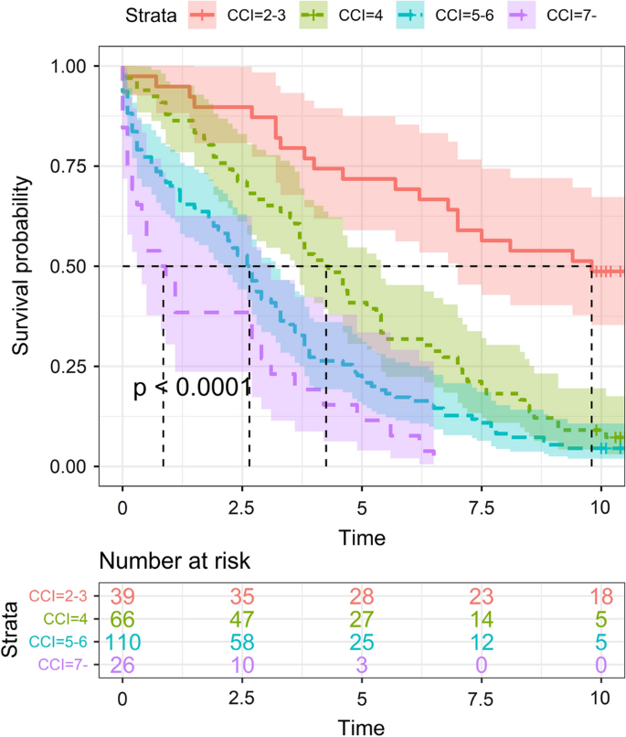
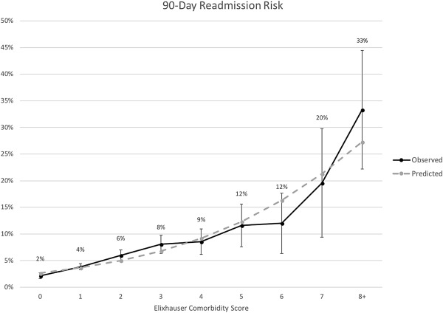
Comorbidity Index Score
Charlson comorbidity index score
Elixhauser Comorbidity index score

Slide 10
Example process of
Calculating Comorbidity Index Score

Slide 11
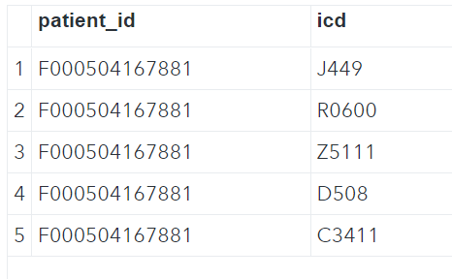
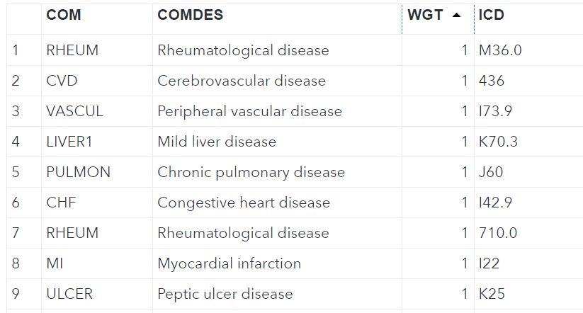
Example process of calculating CI Score
Dataset about patient
Charlson Comorbidity index

Slide 12
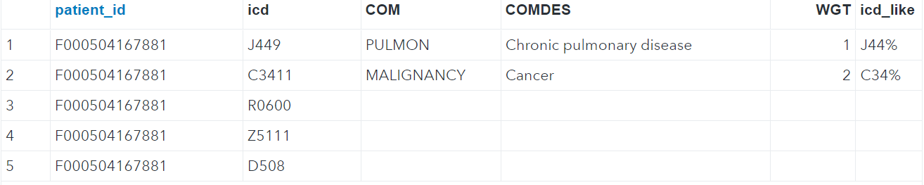
Example process of calculating CI Score
Merging dataset with Charlson comorbidity index
EX) CCI score for F000504167881 = 1 + 2 = 3

Slide 13
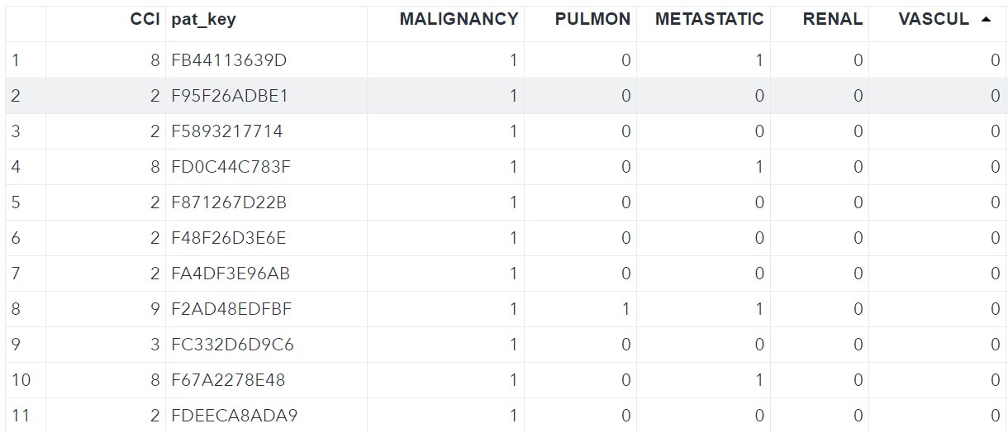
Example process of calculating CI Score
The final result with CCI Score

Slide 14
Logistic regression for Weight

Slide 15
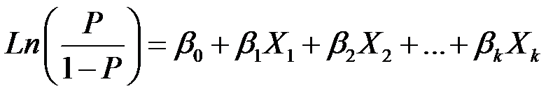
Logistic regression for Weight
P / 1 - P= odds ratio ^ AIDS * odds ratio ^ diabete * odds ratio ^ depression
Weight = round( odds ratio )
Link : A New Elixhauser-based Comorbidity Summary Measure to Predict In-Hospital Mortality - PMC (nih.gov)

Slide 16
Advantages of the new function

Slide 17
Example of c0a0cis macro / function
c0a0cis SAS macro
c0a0cis R function
c0a0cis( INPUT = ClaimsDatabase,
WHERE = diag_date>=’01Jan2015’d,
ICDVAR = diagnosis_code,
PATID = patient_id,
ADJ_AGE = age,
# Comorbidity index file
INEXFILE = comorb_index .xlsx,
SHEET = cci,
SUBSET = if ver eq 10 and alg = 'QUAN';,
OUTPUT = cci_score_ClaimsDatabase );
c0a0cis ( INPUT = ClaimsDatabase , WHERE = diag_date >= ’01-01-2015’ , ICDVAR = ‘diagnosis_code’ ,
PATID = ‘patient_id’,
ADJ_AGE = ‘age’,
# Comorbidity index file
INEXFILE = ‘comorb_index.xlsx’,
SHEET = ‘cci’,
SUBSET = “ver == 10 & alg == 'QUAN'” )

Slide 18
Flexibility
Existing Comorbidity R function
c0a0cis R function
comorbidity(x
,id
,code
,map
,assign0
, labelled = TRUE
, tidy.codes = TRUE
)
c0a0cis ( INPUT
,WHERE
,ICDVAR
,PATID
,ADJ_AGE
# Comorbidity index file
,INEXFILE
,SHEET
,SUBSET
)
Comorbidity R package : https://cran.r-project.org/web/packages/comorbidity/comorbidity.pdf

Slide 19
Input Excel file
COM | COMEDS | WGT | ICD | VER | ALG | SEL | INEX
Abbreviation of comorbidities | Description of the comorbidity from column COM | Weight for the specified comorbidity | ICD code list for the comorbidity | Version of the ICD code from column ICD | Algorithm for calculating the comorbidity index | matching type for the specified ICD code(Blank: Exact Match, 1: Start with, 2: End with, 3: Included) | Flag to indicate if the ICD code needs to be included for calculation

Slide 20



Quicker
Existing Comorbidity R function
c0a0cis R function
score(comorbidity(x = set, id = 'patient_id', code = 'ICDVAR', map = "charlson_icd10_quan", assign0 = FALSE), assign0 = F)

Slide 21
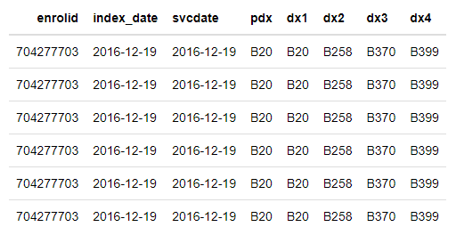
Able to process multiple columns
Multiple ICD column dataset
c0a0cis R function
c0a0cis ( INPUT
,WHERE
,ICDVAR = c(‘pdx’,’dx1’,’dx2’,’dx3’,’dx4’)
,PATID
,ADJ_AGE
# Comorbidity index file
,INEXFILE
,SHEET
,SUBSET
)

Slide 22
Proc transpose vs Array for big dataset
%if %sysfunc(scan(&ICDVAR,2,' ')) ne %then %do;
data revised_input;
length dx $100.;
set &input;
pat_key = &patid;
%if %length(&adj_age) > 0 %then %do; age = &adj_age; %end;
array dxicd &ICDVAR;
do over dxicd;
if dxicd ne '' then icd_full_like = compress(dxicd ,'.');
output;
end;
keep pat_key icd_full_like
%if %length(&adj_age) > 0 %then %do; age %end;
;
run;
%end;
%else %do;

Slide 23
Proc transpose vs Array for big dataset
array dxicd &ICDVAR;
do over dxicd;
if dxicd ne '' then icd_full_like = compress(dxicd ,'.');
output;
end;

Slide 24
Proc transpose vs Array for big dataset
Proc transpose
Array
in-memory operations
Disk access

Slide 25
Conclusion
A big improvement over current methods
Offers handling multiple columns, providing greater flexibility.
speed up analyzing patient health issues, making it easier to make smart decisions.

Slide 26
Q/A section
Any question?
Geonhyeok Jeong : statsergeant@gmail.com
Ting Shi : ting.shi@merck.com

