Slide 1
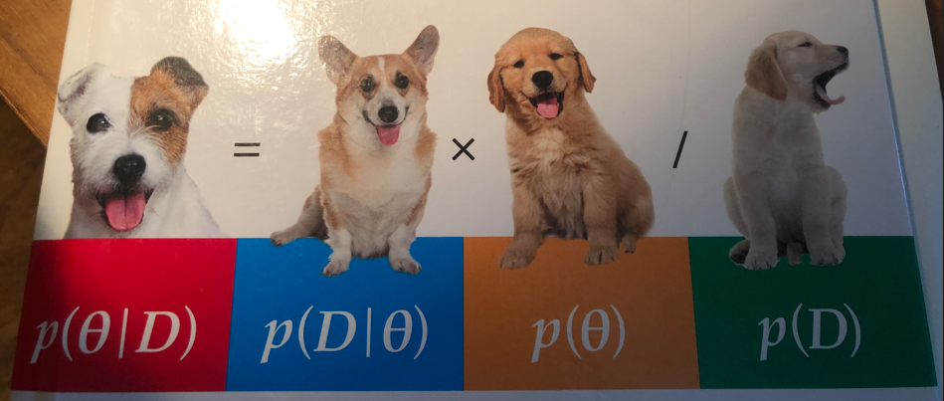

Bayes Application
Introduction
Hochschule Koblenz,
Fachbereich Mathematik, Informatik und Technik
Dr. Denise Welsch
4.10.2024

Slide 2
Learning Objectives
Learn to apply Bayes theory on a certain data analytical problem
Learn to code with R
Learn to work with Git and GitHub
Learn to collaborate in software engineering projects

Slide 3
Open-Source Software with GitHub
The repository reyar/BayesTwoprop is currently private
When finalized, the repository will be set on public and will be open-source
Open-source software is a great source of learning and motivation for humans
Your contribution will be visible everywhere besides the issues (these will be deleted in advance)
Your contribution increases your reputation in your future career
If we will not finalize the app during this semester, then your contribution within the issues will be visible for future students working on the app
You agree with the terms of GitHub

Slide 4
GitHub reyar/BayesTwoProp Repository
GitHub Master
Location of the start version 4.10.2024 and final version 31.01.2025
Students ask to write on Master by creating a „Pull Requests“
GitHub Branch
Temporary working copy of the master
Pull/Push to GitHub Master by Pull Requests
Local Master or R Posit Master
Copy of the Master
Pull/Push by Client or in the R Posit Cloud
Clients: Tortoise, GitHub Desktop
Local Branch or R Posit Branch
Copy of the working branch
Pull/Push by Client or in the R Posit Cloud
Clients: Tortoise, GitHub Desktop

Slide 5
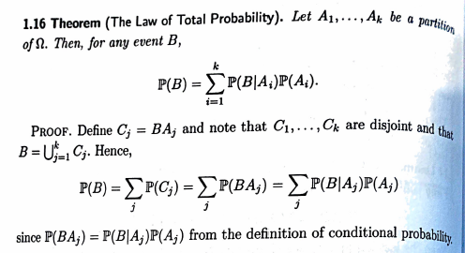
Bayes Theory Introduction
All of Statistics, Wasseman, 2004

Slide 6
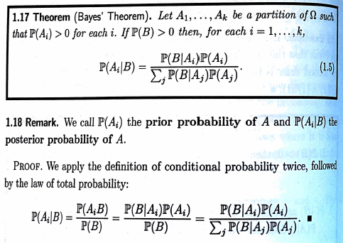
Bayes Theory Introduction
All of Statistics, Wasseman, 2004

Slide 7
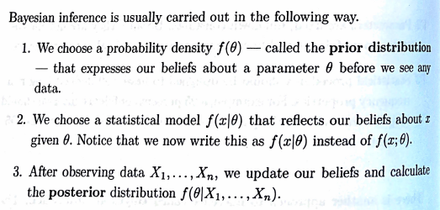
Bayes Theory Introduction
All of Statistics, Wasseman, 2004

Slide 8
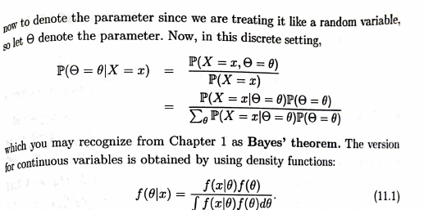
Bayes Theory Introduction
All of Statistics, Wasseman, 2004

Slide 9
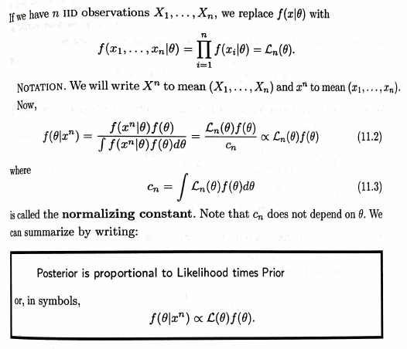
Bayes Theory Introduction
All of Statistics, Wasseman, 2004

Slide 10
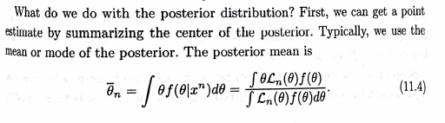
Bayes Theory Introduction
All of Statistics, Wasseman, 2004
Out of the posterior, we build credibility intervals and methods for testing.

Slide 11
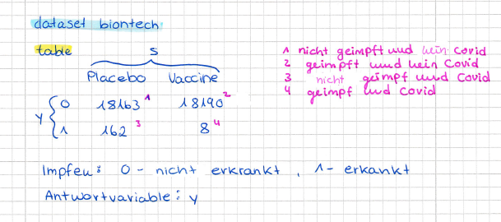
Datasets and Related Problems

Slide 12
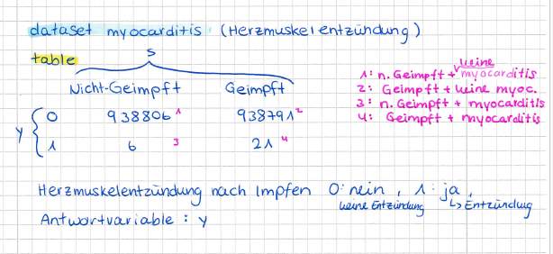
Datasets and Related Problems

Slide 13
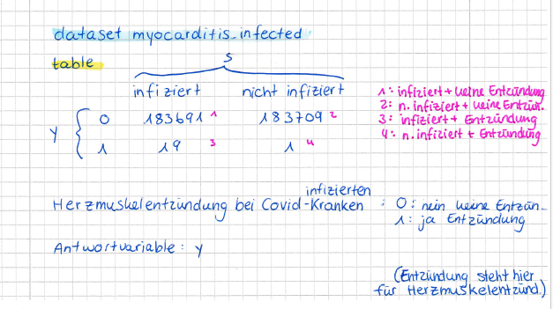
Datasets and Related Problems

Slide 14
Theory for the BayesTwoProp App
Read in DBDA: 6.1, 6.2, 6.3, 7.4.1, 7.4.2, 8.4

