Slide 1

Bayes Application
Introduction
Hochschule Koblenz,
Fachbereich Mathematik, Informatik und Technik
Dr. Denise Welsch
4.10.2024

Slide 2
Issues to be added.
Revise the code and split it into parts so that it can be executed in the R Posit Cloud (as an automated report) and under shinyapps.com (as the Shiny app) (from a RAM perspective).
The Automated Report and the Shiny App will be publicly available and executable.
Complete the report with interpretation of all required tables and graphics into natural language
Issue: Data entry options
Issue: Functions of the parameters
Issue testing and automated testing
Issue revision of previous interpretations

Slide 3
Clouds and Communication

Slide 4
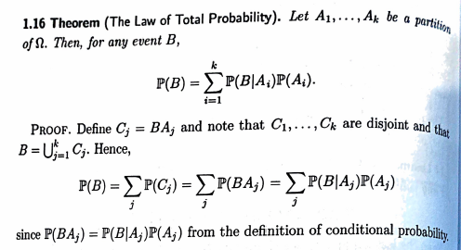
Bayes Theory Introduction

Slide 5
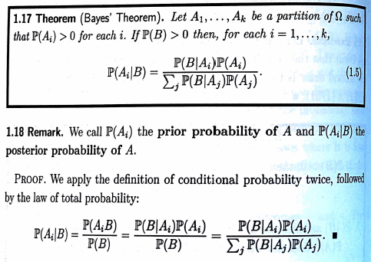
Bayes Theory Introduction

Slide 6
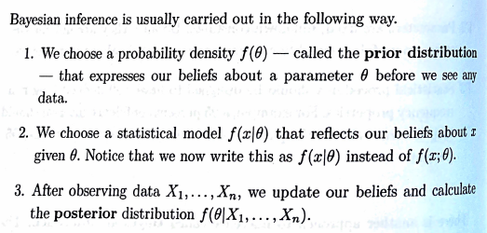
Bayes Theory Introduction

Slide 7
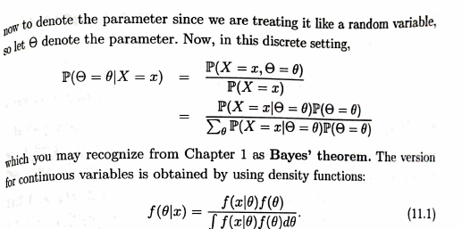
Bayes Theory Introduction

Slide 8
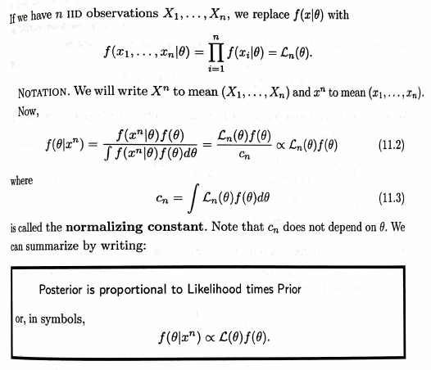
Bayes Theory Introduction

Slide 9
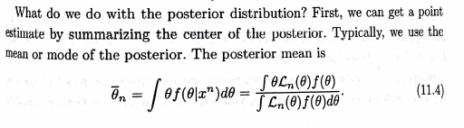
Bayes Theory Introduction
Out of posterior, credibility intervals and methods for testing.

Slide 10
Problem and Data

Slide 11
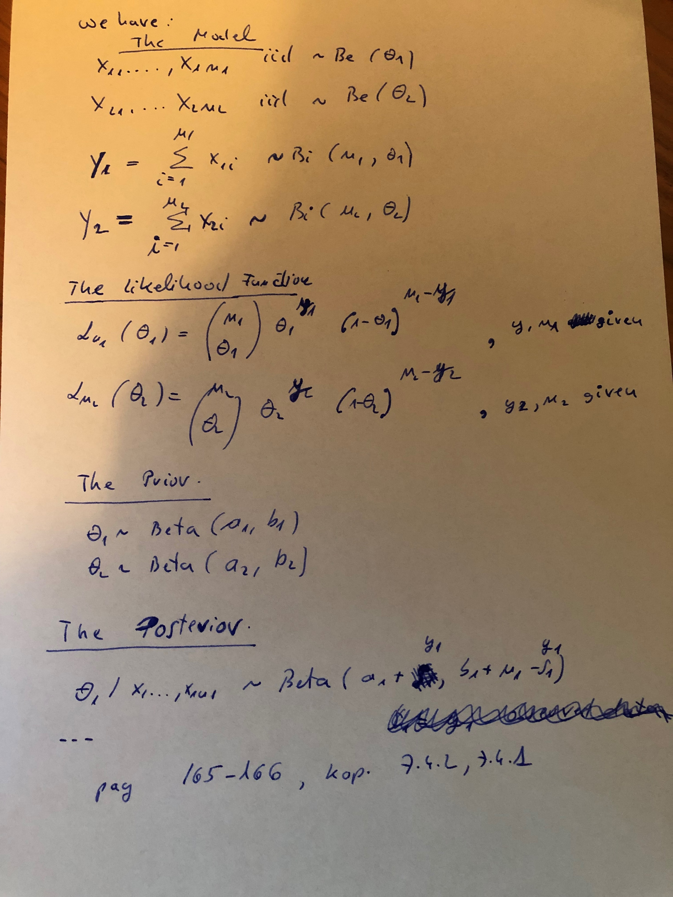
Bayes Estimation

Slide 12
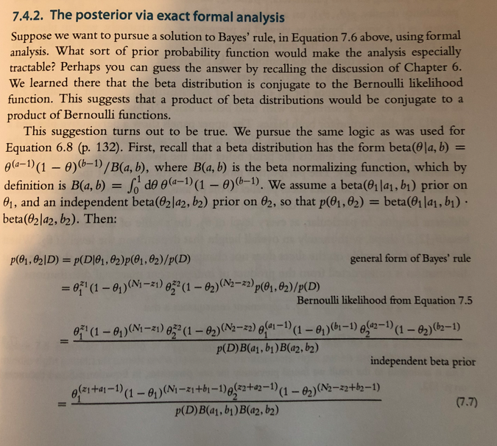
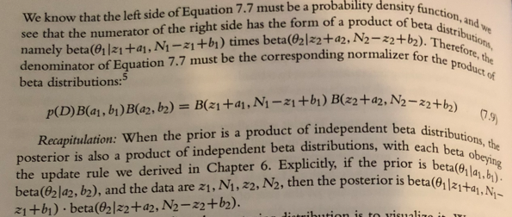
Bayes Estimation

Slide 13
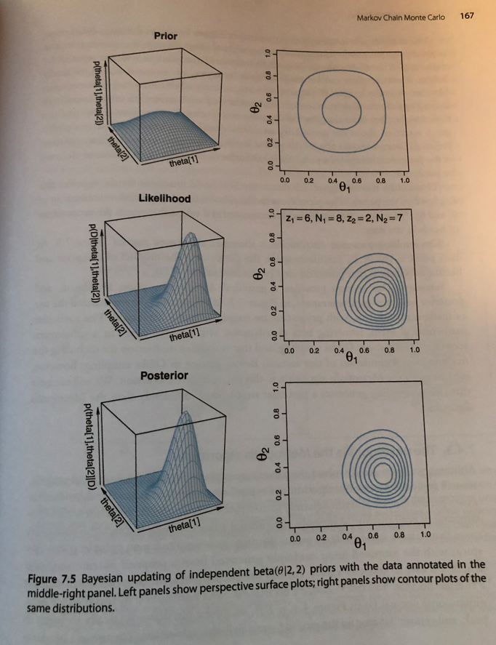
Bayes Estimation

