Slide 1
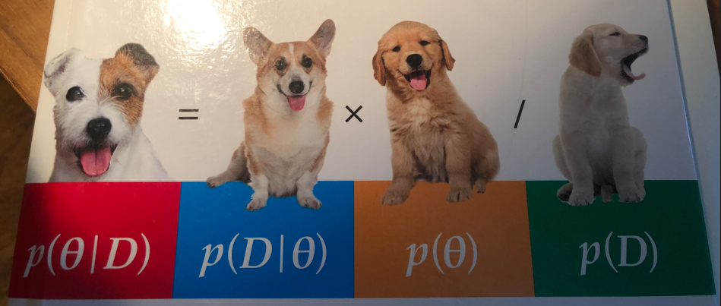

Intro Theory Bayes TwoProp App
Hochschule Koblenz,
Fachbereich Mathematik, Informatik und Technik
Dr. Denise Welsch
24/25

Slide 2
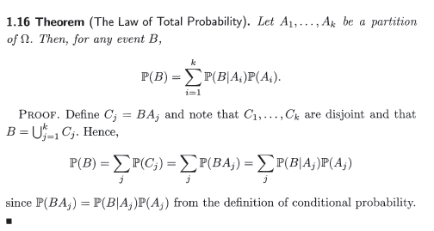
Bayes Theory Introduction
All of Statistics, Wasseman, 2004

Slide 3
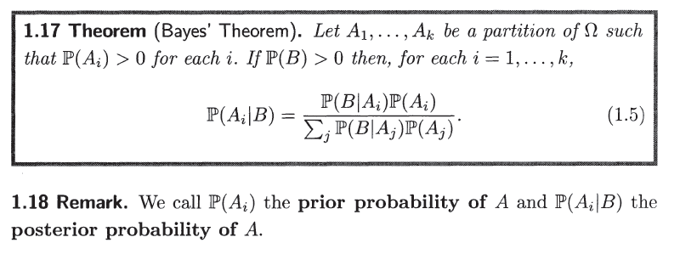
Bayes Theory Introduction
All of Statistics, Wasseman, 2004

Slide 4
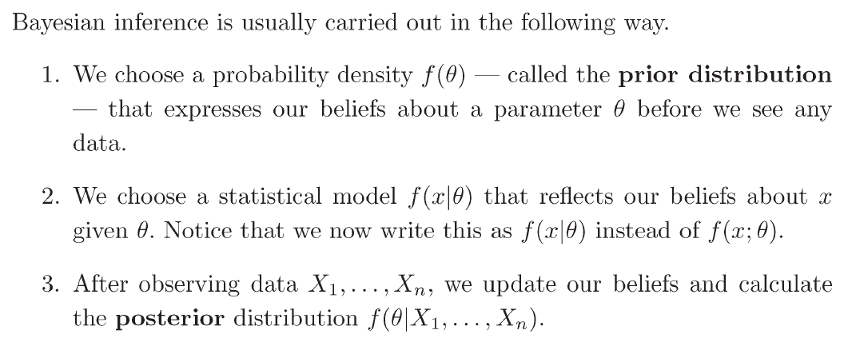
Bayes Theory Introduction
All of Statistics, Wasseman, 2004

Slide 5

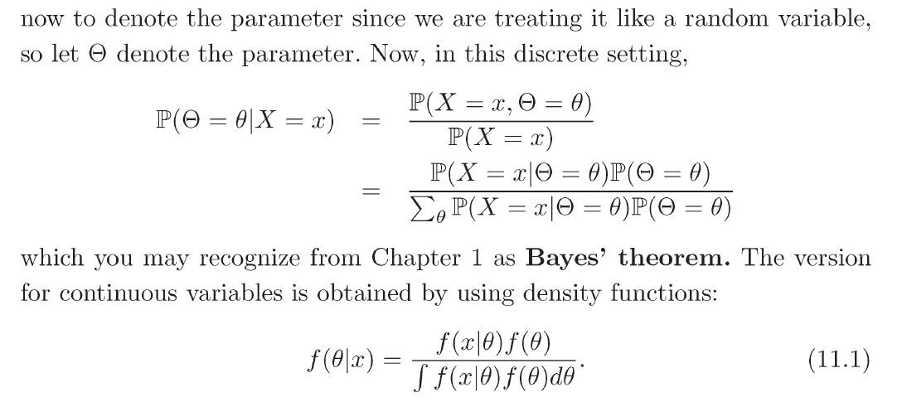
Bayes Theory Introduction
All of Statistics, Wasseman, 2004

Slide 6
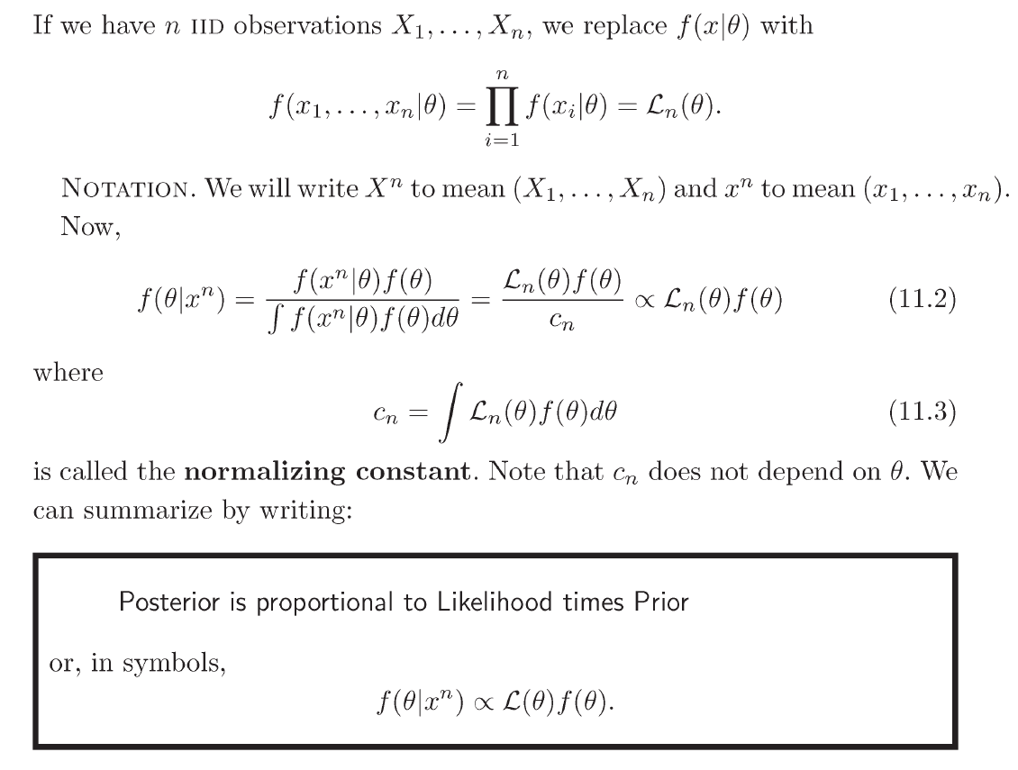
Bayes Theory Introduction
All of Statistics, Wasseman, 2004

Slide 7
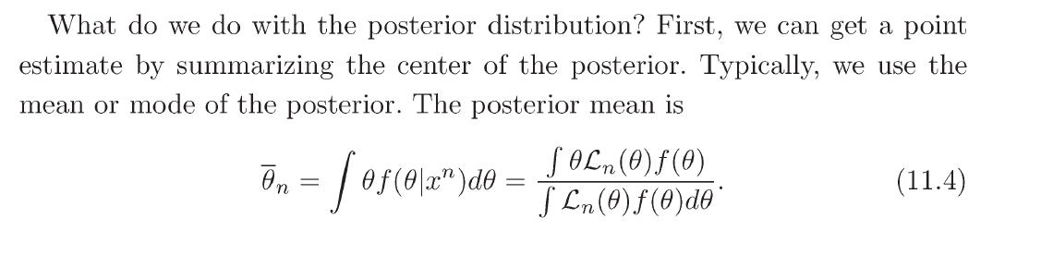
Bayes Theory Introduction
All of Statistics, Wasseman, 2004
Out of the posterior, we build credibility intervals and methods for testing.

Slide 8
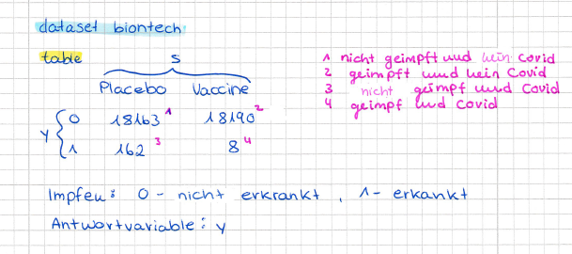
Datasets and Related Problems Used in Development

Slide 9
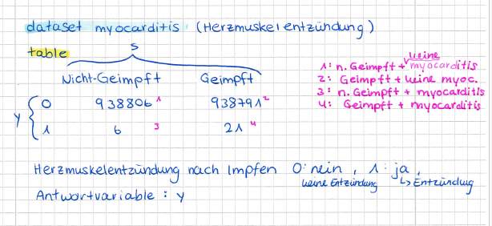
Datasets and Related Problems Used in Development

Slide 10
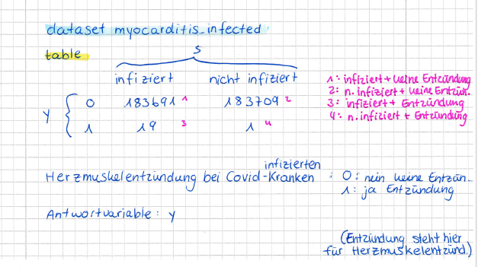
Datasets and Related Problems Used in Development

Slide 11
Main Theory for the BayesTwoProp App
Chapters in the book Doing Bayesian Data Analysis (DBDA):
6.1, 6.2, 6.3, 7.4.1, 7.4.2, 8.4

