Slide 1
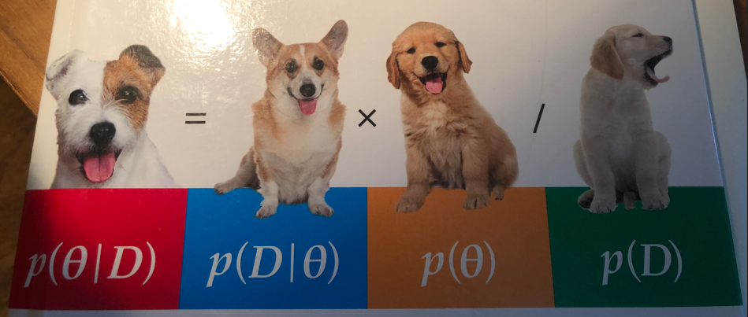

Intro Theory Bayes TwoProp App
Hochschule Koblenz,
Fachbereich Mathematik, Informatik und Technik
Dr. Denise Welsch
24/25

Slide 2
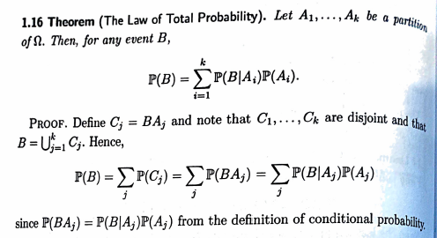
Bayes Theory Introduction
All of Statistics, Wasseman, 2004

Slide 3
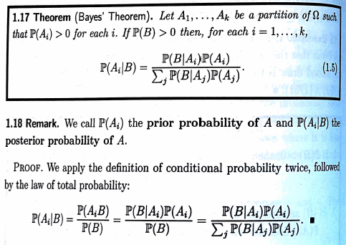
Bayes Theory Introduction
All of Statistics, Wasseman, 2004

Slide 4
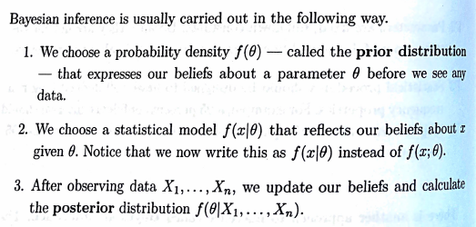
Bayes Theory Introduction
All of Statistics, Wasseman, 2004

Slide 5
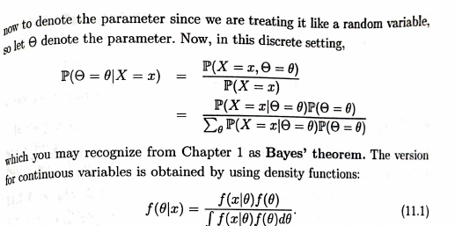
Bayes Theory Introduction
All of Statistics, Wasseman, 2004

Slide 6
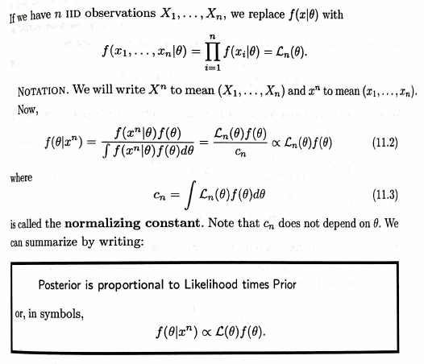
Bayes Theory Introduction
All of Statistics, Wasseman, 2004

Slide 7
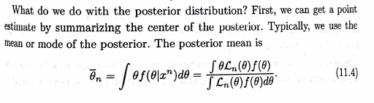
Bayes Theory Introduction
All of Statistics, Wasseman, 2004
Out of the posterior, we build credibility intervals and methods for testing.

Slide 8
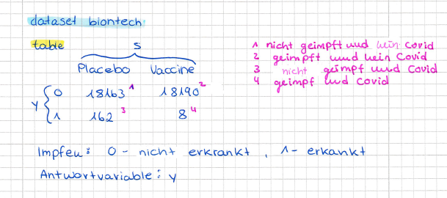
Datasets and Related Problems

Slide 9
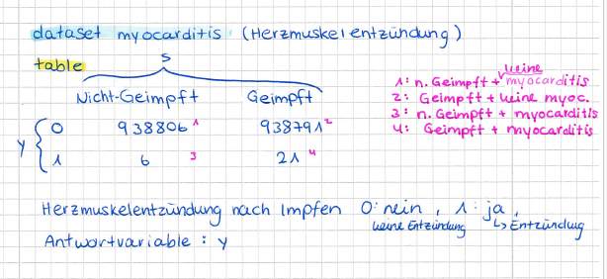
Datasets and Related Problems

Slide 10
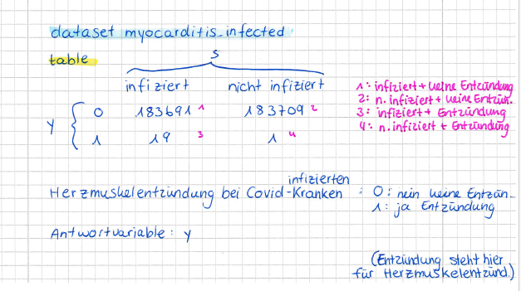
Datasets and Related Problems

Slide 11
Theory for the BayesTwoProp App
Read in DBDA: 6.1, 6.2, 6.3, 7.4.1, 7.4.2, 8.4

