Slide 1


| Tech Management, SRI-B
CLAWS
CLASH OF THE
R V College of Engineering_ FinSight
FinSight — An Autonomous Cross-Domain Financial Intelligence Agent
Team : 1. Vittal Mukunda 2. Suraj Gupta 3. Nikhilesh Gupta
4. Stavan Rahul Khobare

Slide 2
Idea
Problem Statement
Theme: Gen AI Research
Scale of the problem:
25.79 crore unique NSE investor accounts as of May 2026
91% of retail traders in India incurred losses in F&O in 2025 (SEBI study)
Average retail investor holds 10-20 stocks with no systematic event-monitoring tool
The information gap:
Bloomberg Terminal: $27,000/year — used by institutions, inaccessible to retail
Zerodha, Groww, Upstox: deliver price quotes and charts — zero causal reasoning
News apps: deliver headlines — no portfolio linkage
What no existing tool answers: "The RBI just hiked rates by 50 bps. Which of my holdings is exposed, in which direction, by how much, and what happened the last time this occurred?"

Slide 3
Idea
Current Solution & Gaps
Tool | What it offers | Critical gap
Bloomberg / Refinitiv | Institutional-grade event mapping | ₹22L+/year, zero retail reach
Zerodha / Groww / Upstox | Price, charts, basic news feed | No event-to-portfolio reasoning
Tickertape / Smallcase | Screeners, thematic baskets | Static — no live event response
Sentiment APIs (e.g. Refinitiv) | Aggregate sentiment score | Black-box, no causal chain
ChatGPT / Gemini (manual) | On-demand analysis | Not autonomous, not portfolio-aware
What is structurally missing:
No tool connects: Global Event → Sector Impact → Your Specific Holding → Explainable Signal
No retail tool runs autonomously on a heartbeat without user intervention
No free tool provides a historical analogue to ground its reasoning
Market opportunity:
India's retail equity participation grew from 3.7 crore to 13.1 crore unique accounts between 2020–2026; this represents 9.4 crore new investors, the vast majority of whom still lack access to institutional-grade event intelligence.

Slide 4
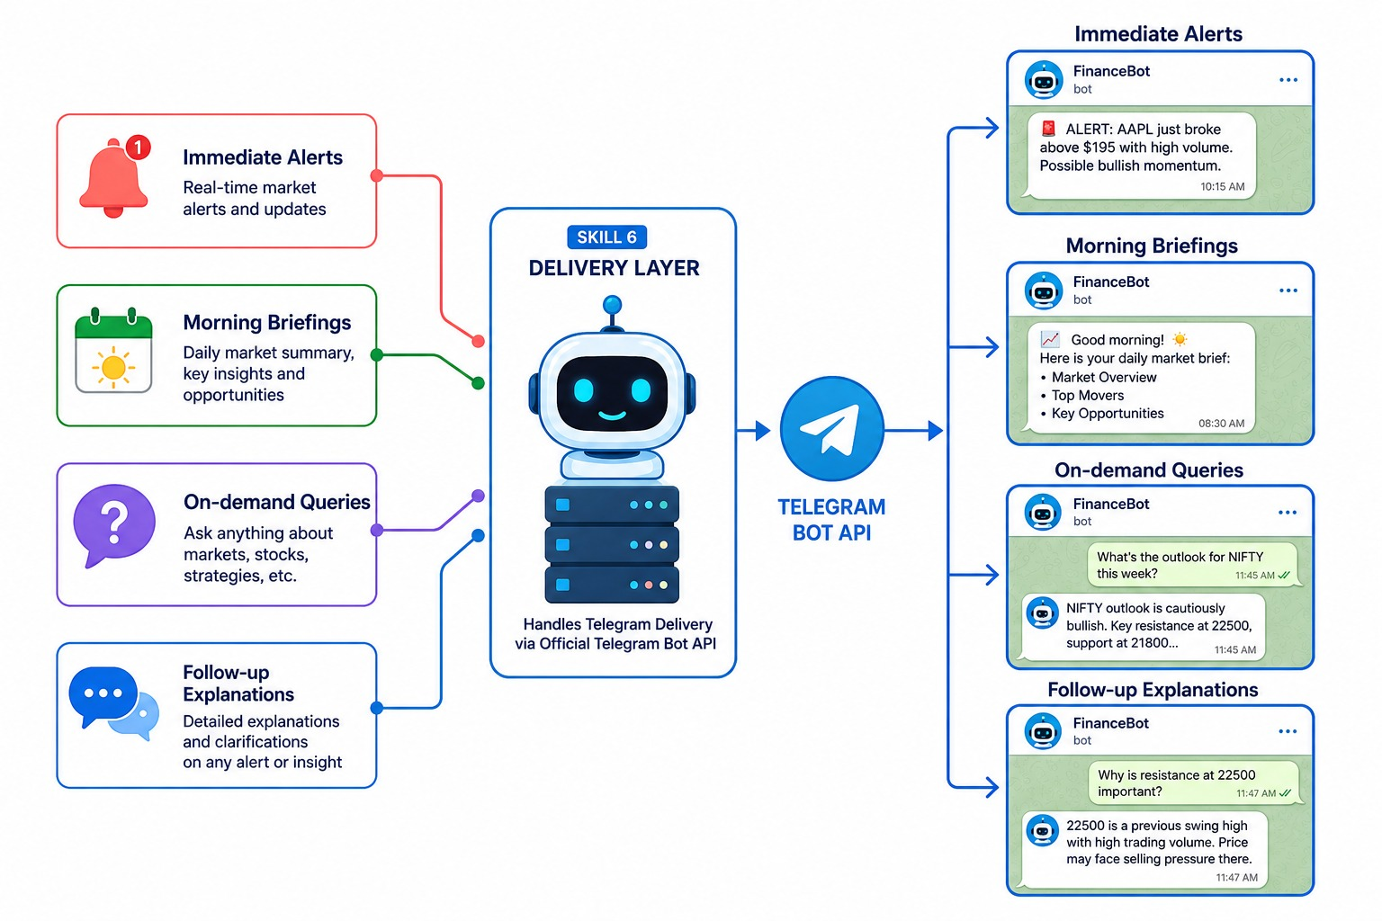
Idea
Our Solutions
FinSight: A 6-skill autonomous agent pipeline
What it does: Monitors live financial news, extracts financial entities, retrieves historical analogues via RAG, maps impact to your exact portfolio holdings, generates directional signals, and delivers explainable Telegram alerts — automatically, every 30 minutes.
Core insight: Every signal cites a real, verifiable historical analogue from a curated dataset. The output is an auditable argument, not a black-box score.

Slide 5
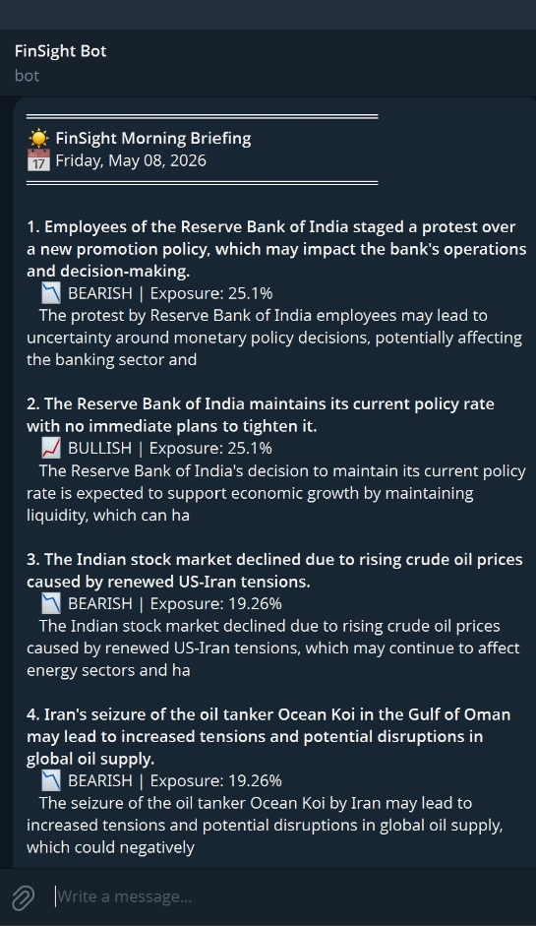
Idea
Demo/Product Walkthrough
Real example: RBI off-cycle rate hike, May 2026
Step 1 — Ingest: 14 articles fetched across 3 sources. 9 pass deduplication.
Step 2 — Extract: Significance: 9/10. Sectors identified: banking, NBFC, realty. Event type: monetary policy.
Step 3 — Analyze: Closest analogue retrieved — RBI emergency hike, May 2022 (40 bps). Causal mechanism: rate hikes compress NIM for PSU banks short-term; private banks historically recover within 6–8 weeks.
Step 4 — Portfolio: HDFC Bank (18.2%) + SBI (12.9%) = 31.1% of portfolio exposed → ₹1.24L of ₹3.98L affected.
Step 5 — Signal: BEARISH · HIGH confidence · Horizon: weeks
Step 6 — Deliver: Immediate alert triggered — HIGH confidence + exposure > 5%
FinSight Alert :
RBI off-cycle hike: 50 bps — monetary policy shock
Exposure: ₹1.24L / ₹3.98L portfolio (31.1%) — NEGATIVE BEARISH | HIGH confidence
Horizon: weeks
Analogue: RBI May 2022 — HDFC Bank fell 4.3% in 2 weeks
Risk: Realty sector secondary exposure via home loan demand

Slide 6
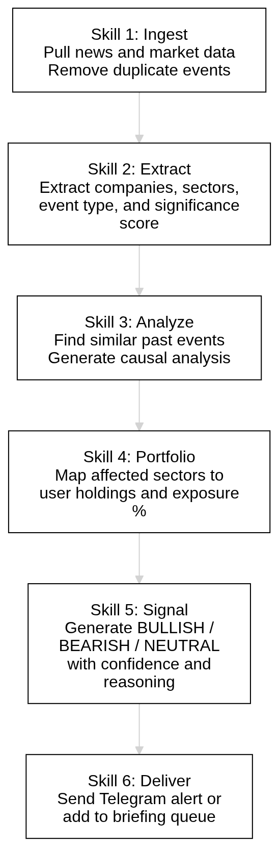
Idea
Tech & Architecture
Stack: fully open-source, zero cloud cost
Agent Runtime: OpenClaw 2026.4 — self-hosted, heartbeat scheduler, declarative SKILL.md skills
LLM: Groq llama-3.3-70b-versatile — free tier, 100K tokens/day, sub-2s latency
Embeddings: sentence-transformers all-MiniLM-L6-v2 — 384-dim, 90MB, CPU-only, MIT licensed
Vector Store: ChromaDB on local SQLite — zero-config, no server, persistent across runs
Knowledge Graph: NetworkX serialised as JSON — maps 2nd-degree sector exposures
Live Prices: yfinance — free, no API key
News Sources: Google News RSS + GDELT 2.0 + Finnhub — all zero-cost
Delivery: Telegram Bot API via direct REST — no SaaS dependency, instant mobile push
AI usage per event: ~7,000 tokens · 4 LLM calls across Skills 2, 3, and 5 Supports approximately 14 fresh events per day on the Groq free tier.
System flow: News APIs → Ingest → Extract (LLM) → RAG Analyze (LLM) → Portfolio (deterministic) → Signal (LLM) → Telegram

Slide 7
Idea
Impact & Use cases
Four real scenarios, Indian market context:
1. 🛢️ Geopolitical — Hormuz Strait tension (May 2025) Brent crude +4.2% overnight. FinSight flags ONGC, Oil India holdings as positively exposed (18% portfolio). Analogue cited: 2019 Saudi Aramco drone attack — ONGC +6.1% in 5 trading days.
2. 🏦 Monetary policy — RBI rate hike cycle (2022–23) 250 bps cumulative hike. FinSight flags HDFC Bank, SBI as BEARISH short-term, with 6–8 week recovery horizon. Analogue: 2013 taper tantrum — PSU banks fell avg 11% before recovery.
3. 💊 Regulatory — USFDA fast-track approval (generic oncology) FinSight detects pharma sector positive signal. Sun Pharma, Dr. Reddy's flagged as BULLISH. Analogue: 2020 COVID API demand surge — pharma index +34% in 90 days.
4. 💻 Macro — US Fed holds rates, USD weakens INR strengthens → IT sector margin expansion. FinSight flags Infosys, TCS as BULLISH. Analogue: Q3 FY23 — Infosys revenue beat driven by USD/INR tailwind.
Scale potential:
25.79 crore NSE demat accounts in India (2026)
₹0/month infrastructure cost on free tiers
Deployable on any laptop; no cloud required

Slide 8
Idea
Differentiation
MOAT 1 — Explainability with Historical Grounding
FinSight does not produce a sentiment score. It produces a causal argument: trigger → mechanism → historical analogue → affected holdings → signal → risk flags. Every output is verifiable — the cited analogue can be independently looked up.
This is architecturally enforced. The LLM must retrieve from the hand-curated Golden Dataset in ChromaDB. Hallucinated analogues are structurally impossible. Sentiment APIs give a number. Bloomberg gives a headline. Neither explains what a given event means for a user’s portfolio.
MOAT 2 — Autonomous Zero-Cost Operation
The full stack — news ingestion, LLM reasoning, RAG retrieval, portfolio mapping, delivery — runs on free API tiers with a 30-minute autonomous heartbeat. No Bloomberg subscription. No cloud bill. No manual query required.
This creates a defensible cost structure: institutional-grade reasoning at retail-accessible cost, with no ongoing dependency on paid infrastructure.
Finsight’s Novelty Over Existing Tech :
Bloomberg Terminal : Delivers India-specific portfolio-aware financial event intelligence in a lightweight, retail-accessible, mobile-first workflow without the infrastructure and licensing overhead of institutional platforms.
Traditional Sentiment APIs : Provides explainable causal-chain analysis grounded in historical analogues rather than opaque aggregate sentiment scores.
General-Purpose LLMs : Operates as a fully autonomous, continuously running agent pipeline with persistent portfolio context, retrieval memory, and automated alert delivery instead of one-shot conversational queries.

Slide 9
Idea
Demo Link
GitHub Repository 🔗 github.com/zero-raven/samsung-prism
Demo Video 🎥 youtube.com/watch?v=LP3W1RlkdJQ
AI Usage Disclosure Submitted alongside this presentation — OpenClaw / FinSight · R V College of Engineering
First run: 3–6 minutes. Telegram alert delivered automatically on completion.

Slide 10
Idea
Built for the Indian Financial Ecosystem
India-Centric Financial Intelligence :
Tracks RBI policies, Union Budget updates, crude oil shocks, PSU developments, and Indian market-moving events relevant to retail investors.
Portfolio-Aware for Indian Investors :
Analyzes NSE/BSE-focused portfolios and maps macroeconomic events to sectors such as banking, NBFCs, realty, energy, and IT.
Explainable Indian Market Context :
Uses India-relevant historical analogues and causal-chain reasoning instead of opaque sentiment scores.
Accessible & Retail-First :
Designed as a lightweight, mobile-first alternative to institutional financial intelligence platforms using free-tier and self-hosted infrastructure.

