Slide 1

Detecting fakenews
Artificial Intelligence as aid for human fact checkers

Slide 2
WORRY ABOUT QUALITY OF INFORMATION PERCENT WHO AGREE
The media I use are contaminated with untrustworthy information
I worry about flase information or fake news beign used as a wepon
57%
76%
+6
pts
Change,
2018 to 2020
2020 Edelman Trust Barometer, published Feb 2020

Slide 3


is frequently used to describe a political story which is seen as damaging to an agency, entity, or person.
General speaking fake news is about misleading stories and people’s motivation for staring and spreading falsehoods
https://www.merriam-webster.com/words-at-play/the-real-story-of-fake-news

Slide 4
“Fakenews” : Improving story fact checking through stance detection by using NLP and ML techniques
Recognize kind of content
Identify sources and their bias
Identify evidence, its transparency and detailing
Determine if main point is supported by the evidence
Determine story completeness: Inform, Provide Understanding and way forward
Process of Critical Thinking about media from Rosenstiel & Kovach book: “Blur: How to Know What to Believe in the Age of Information Overload” ISBN-13: 978-1608193011
“Assessing the veracity of a news story is a complex and cumbersome task, even for trained experts” Dhruv Ghulati, 2016
Author: Basilio Stavros Karamanos
Mentor: Carlos Alfonso Ruiz

Slide 5

Where are we?
0. Identify problem to solve
1. Consult process layout and data lifecycle with Subject Matter Experts
2. Choose Data and perform data preparation
3. Choose the algorithm
4. Tune the algorihm
5. Present results and re-tune as needed
Next Steps:
Fine-tune model conversion
Implement LASSO in Ridge Regression
Send article proposal for publication

Slide 6
Project Hypothesis: Ridge Logistic Regression classifier will perform relative as well as ANN model
Training and testing examples were taken from http://www.fakenewschallenge.org/
Based on Lara Quijano-Sánchez, et al work published in Knowledge-Based Systems 2018/6/1
Methods for predicting the veracity (deception) of felony victims' statements
Model includes feature selection by L1 penalization and heuristics rules
Model transparency allows for simple understanding of how felony victims may lie to police
This work will compare the results for several prediction models to detect deception using stance detection. A Gradient Boosting Classifier baseline with an accuracy score of 79.53% is set
Ridge Logistic Regression
Random Forrest
Naive Bayes
Multilayer perceptron (MLP) on hidden layer

Slide 7
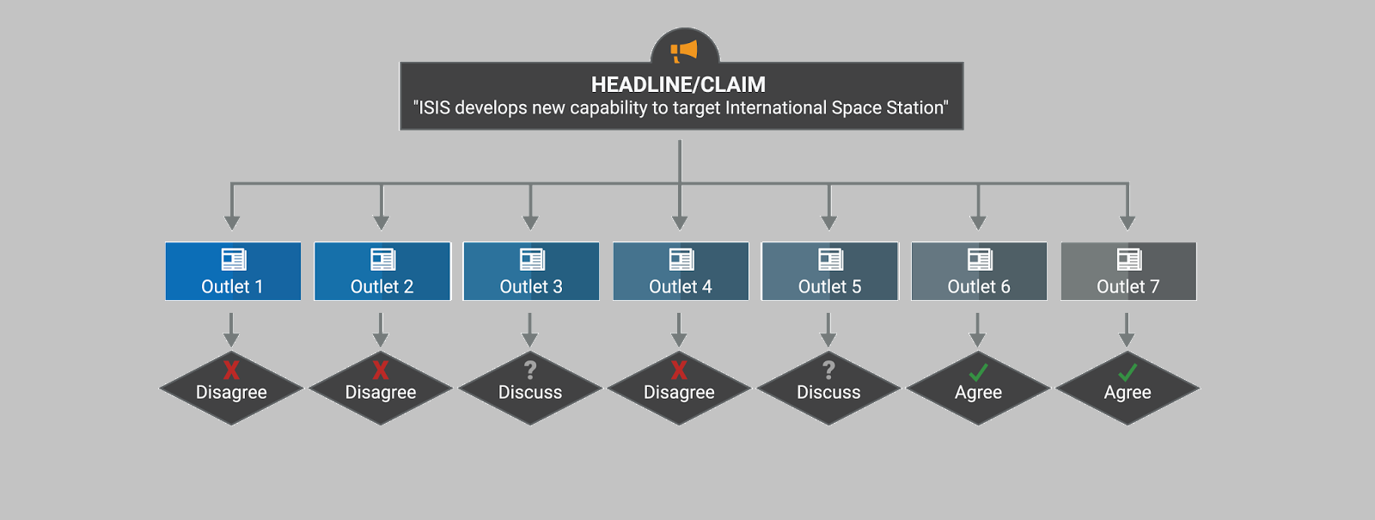
Data Example

Slide 8
Scoring results
Rank | Model | Score | Hyperparameters
 | Gradient Boosting Classifier | 79.53% | n_estimators = [200, 800] max_features = ['auto', 'sqrt’] max_depth = [10, 40] | min_samples_split = [10, 30, 50] min_samples_leaf = [1, 2, 4] learning_rate = [.1, .5] subsample = [.5, 1.]
 | Ridge Logistic Regression
 | Random Forrest
 | Naive Bayes
 | Multilayer perceptron (MLP) on hidden layer | 81.72% | r = random.Random() lim_unigram = 5000 target_size = 4 hidden_size = 100 train_keep_prob = 0.6 | l2_alpha = 0.00001 learn_rate = 0.01 clip_ratio = 5 batch_size_train = 500 epochs = 90

Slide 9
Lessons Learned
what worked well…
Even better if…
Using Colab for project
Using Python Packages
Separating data before coding model definition
Not trying many algorithms
Start with data available
Identify potential code compatibilty issues with packages
what would you do again?…
What would you never do again?…
Pick a problem that pushes you through the process
Explore the work of others before coding
Start with problem
Having just one individual cover all project tasks

Slide 10
STANCE DETECTION
Input :
A headline and a body text - either from the same news article or from two different articles.
Output
Classify the stance of the body text relative to the claim made in the headline into one of four categories:
Agrees: The body text agrees with the headline.
Disagrees: The body text disagrees with the headline.
Discusses: The body text discuss the same topic as the headline, but does not take a position
Unrelated: The body text discusses a different topic than the headline

Slide 11
Accuracy Scoring Model
The related/unrelated classification task is expected to be much easier and is less relevant for detecting fake news, so it is given less weight in the evaluation metric. The Stance Detection task (classify as agrees, disagrees or discuss) is both more difficult and more relevant to fake news detection, so is to be given much more weight in the evaluation metric
Agrees
Headline
75% score-weight
25% score-weight
yes
Related?
Relationship?
Discusses
no
Body
Unrelated
Disagrees

Slide 12
Methodology
Context and Data
Model Design
Step 1 – Text Preprocessing: Using text standarization NLP techniques: lowercasing, tokenization, lemmatization and stopword removal
Step 2 – Feature Generation: Using unigram lemma frequencies as model features
Step 3 - Feature Selection: Using multistep feature selection and LASSO model
Step 4 – Probability Estimation with Ridge Logistic Regression

Slide 13
Data Description & Preparation
pre-processing text,
splitting data carefully to avoid bleeding of articles between training and test,
k-fold cross validation,
features include word/ngram overlap features,
and indicator features for polarity and refutation.

Slide 14
Thank you

