Slide 1
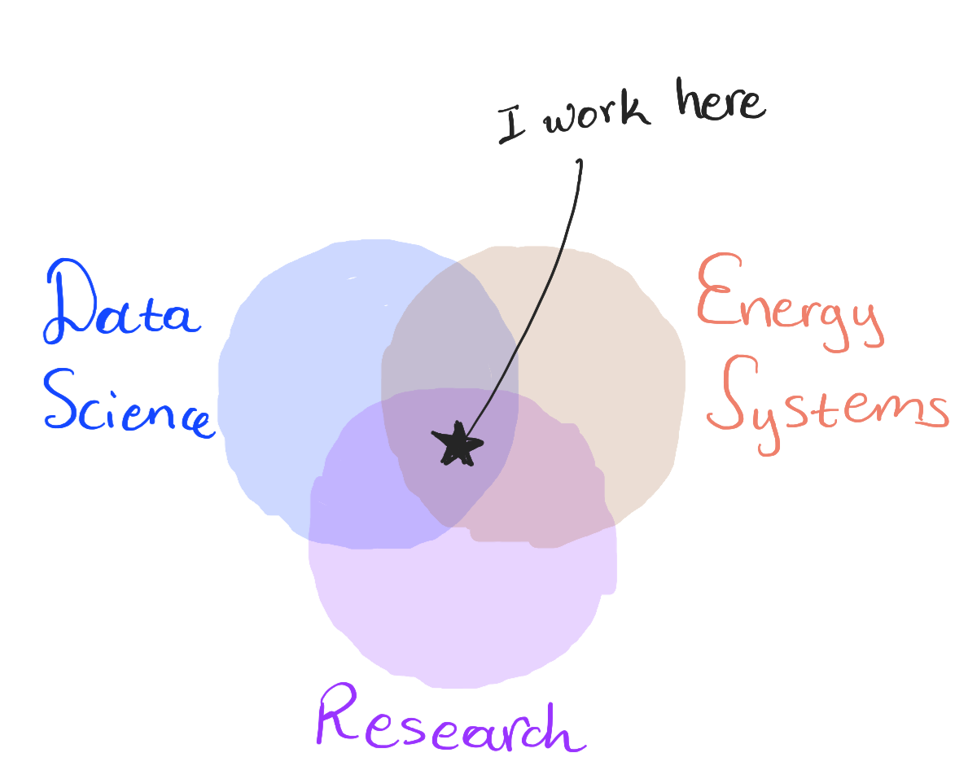
I work as a Research & Digitalization Manager at the Swiss Transmission System Operator, Swissgrid, focusing on Data Science.
I develop prototypes and Proof of Concepts projects to create new value in energy-related topics.

Slide 2
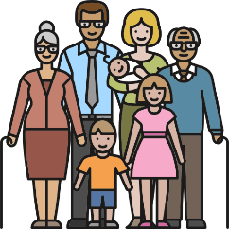

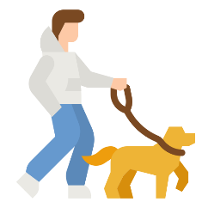
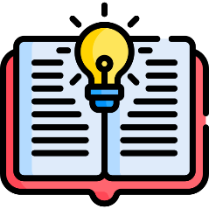



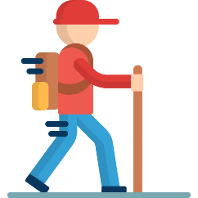
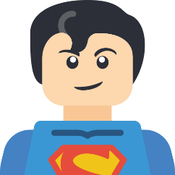
Generally, I am a big fan of:
Family Coffee
Dogs Reading
Aris Podcasts
Loooong Walks
Friends
Superman

Slide 3
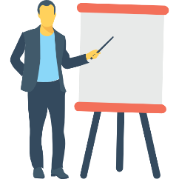
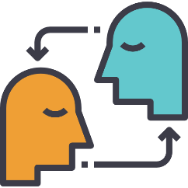



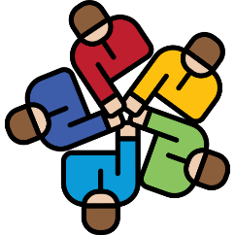
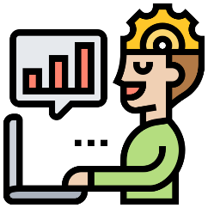
Things I find important in life:
Storytelling
Empathy
Work-life balance
Personal Growth & Development
Music
Teamwork
Metalearning

Slide 4
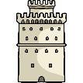




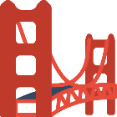
My (professional) Story:
I grew up in Thessaloniki, Greece, where I spent the first 24 years of my life. I used to play Basketball at a local club and I studied Electrical & Computer Engineering there. We always had a dog in the family, and I feel grateful to have been raised in a sunny city close to the sea!
Afterwards I moved to Zürich, Switzerland for a Master’s degree in Energy, where I discovered the Swiss Chocolate and mountains. Ok, mostly the chocolate I admit, at least with Toblerone I combined both. I did my internship & Master Thesis at Swissgrid and after my studies, I worked as an associate scientist at ABB Corporate Center at Dättwil, Baden.
The interactions with intelligent people led me towards doing a PhD at Power Systems Laboratory of ETH Zürich, where I was mostly converting Nespresso coffee into academic papers. I spent an awesome semester at UC Berkeley, enjoying exciting research, delicious food and a warm winter in California .
After my PhD, I stayed one more year as a post-doc researcher collaborating with MIT, and since 2020, I am back in the industry. I enjoy applying some knowledge I gained over the years and I am always trying to learn new things and skills.

Slide 6
