Slide 1
CONCURRENT PROGRAMMING ASSIGNMENT 2 - SEMAPHORES
Dimitris Voitsidis 03480
Iordana Gaisidou 03570
Stavros Stathoudakis 03512

Slide 2
Project Tasks Summary
2.1. Binary semaphores library
2.2. Primary NUMBERS TESTER
2.3. Narrow bridge
2.4. Train ride

Slide 3
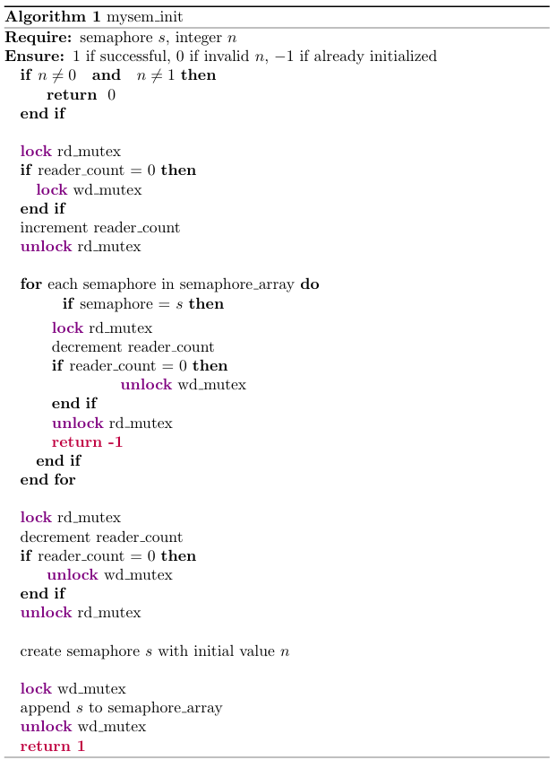
2.1. Binary Semaphores Library
a) binarySemaphores.c
mysem_init (mysem_t, int n)
mysem_down (mysem_t *s)
mysem_up (mysem_t *s)
mysem_destroy (mysem_t *s)
Checking if n is not equal to 0 or 1
b) mysem_t
struct mysem_t {
int semid;}
Checking if semaphore is already initialized
c) global variables
static mysem_t **sem_arr -> Array of pointers to semaphores that have been created.
static int sem_arr_size -> size of the array of the previous array.
static int rds -> keeping track of readers
semget with IPC_PRIVATE flag for a unique id
semctl with SETVAL flag for initializing to n
d) global mutexes
static pthread_mutex_t rd_mutex
static pthread_mutex_t wd_mutex
Put the semaphore in the array

Slide 4
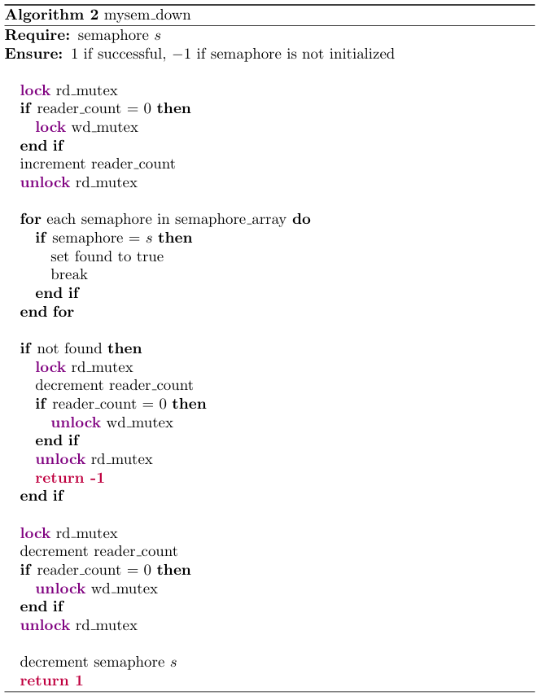
2.1. Binary Semaphores Library
Checking if semaphore is already initialized
Return -1 if semaphore not initialized
decrease (-1) using semop

Slide 5
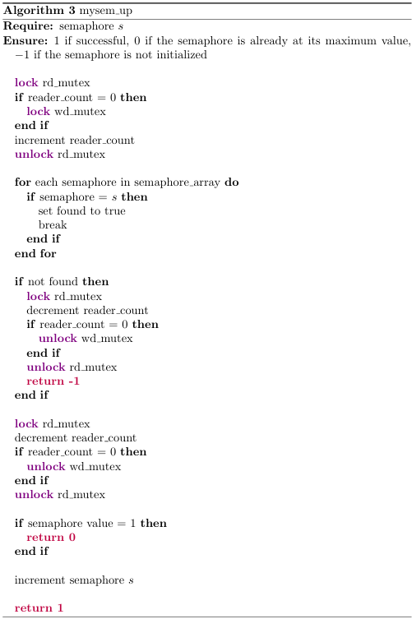
2.1. Binary Semaphores Library
Checking if semaphore is already initialized
Return -1 if semaphore not initialized
GETVAL using semctl
If == 1 then return 0 because we have two up’s in a row
increase using semop

Slide 6
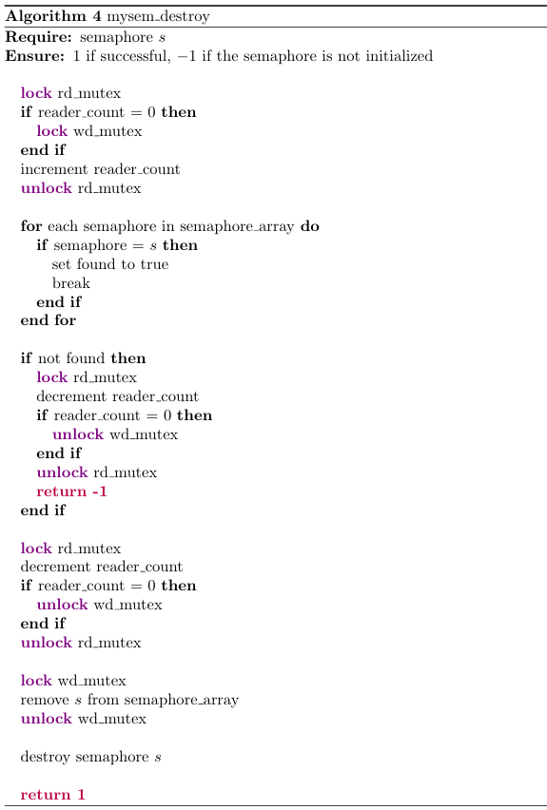
2.1. Binary Semaphores Library
Checking if semaphore is already initialized
Return -1 if semaphore not initialized
Remove the semaphore from the array and realloc it
semctl using IPC_RMID flag

Slide 7
2.2. Primary Numbers Tester
Main Function:
Get number of workers from command line as workersNo
Initialize semaphores semMain to 1 and semWorker to 0
Assign the following to worker_args:
job = address of num
semWorker = address of semWorker
semMain = address of semMain
terminate = address of terminate
Allocate memory for worker threads array t
For each worker:
Create a worker thread and pass worker_args
For each job:
mysem_down(semMain)
Assign job number from command line to num
mysem_up(semWorker)
mysem_down(semMain)
Set terminate flag to True
mysem_up(semWorker)
For each worker:
Wait for worker thread to finish using pthread_join
Destroy semaphores semMain and semWorker
struct workerArg {
int *job
bool *terminate
mysem_t *semWorker
mysem_t *semMain }
void *worker(void *Wargs)
while (1):
mysem_down(semWorker)
if terminate
mysem_up(semWorker)
print terminate message and terminate
get the job (number to check)
mysem_up(semMain)
if num <= 1
print number is not equal
else
use square root algorithm to check if the number is prime
print result (prime or not prime)
Worker x took the job offered by Main
Wake the rest workers to terminate
Sleep till a worker take the job main offered
Inform main that I took the job to let her give the rest. (wake Main)
Wake workers to take the job main offers
Main should sleep till the last job is taken by a worker
Wake workers to let them terminate

Slide 8
2.3. Narrow Bridge
struct carArg {
int maxCarsCrossing; // Maximum number of cars of the same color that can cross the bridge consecutively
int maxCarsCrossed; // Maximum number of cars allowed on the bridge at the same time
int *carsCrossing; // Current number of cars crossing the bridge
int *carsCrossed; // Current number of cars (same colored) that have passed the cross consecutively
int *waitingUs; // Current number of cars of my color waiting to cross the bridge
int *waitingOthers; // Current number of cars of the other color waiting to cross the bridge
carColorE color; // My color
carColorE *color_bridge; // Current color of cars crossing the bridge
mysem_t *semUs;
mysem_t *semOthers;
mysem_t *mtx;
}

Slide 9
void *car(void *Cargs):
mysem_down(mtx)
increase waiting cars
mysem_up(mtx)
while (1) {
mysem_down(mtx)
if (bridge is empty && bridge color != color) {
change bridge color
reset cars_crossed (0)
}
if (bridge color != color || bridge is full ||
(max cars crossed = cars_crossed && other cars waiting > 0)) {
mysem_up(mtx)
mysem_down(semUs)
continue
}
decrease waiting cars
increase crossing cars
increase crossed cars
if (same color cars are waiting) {
mysem_up(semUs)
}
mysem_up(mtx)
break
}
simulate passing bridge time using sleep
mysem_down(mtx)
Decrease cars crossing
if (bridge is empty && other cars waiting > 0) {
mysem_up(semOthers)
}
if ((cars_crossed < max_cars_crossed || other cars waiting = 0)
&& same color cars waiting > 0) {
mysem_up(semUs)
}
mysem_up(mtx)
}
If a car of the other team is waiting and the bridge is empty, we wake it
Wake us
Main Function:
initialize_semaphores (semBlue, semRed, mtx) to 1
while (1) {
read_user_input(carColor)
if (carColor == 'R' || carColor == 'r') {
create_red_car_thread
} else if (carColor == 'B' || carColor == 'b') {
create_blue_car_thread
} else {
break
}
}
wait for threads to join using pthread_join
destroy_semaphores(semBlue, semRed, mtx)
Sleep
If a car of our team is waiting to cross the bridge , we wake it
2.3. Narrow Bridge

Slide 10
2.4. Train Ride
struct Targs {
int train_capacity; // Train capacity
bool* destroy; // Flag to terminate train
int* boarded_passengers; // Number of passengers boarded
int* waiting_passengers; // Number of passengers waiting
mysem_t* mtx; // Semaphore to signal waiting passengers
mysem_t* semBoarding; // Semaphore to signal boarding passengers
mysem_t* semTrain; // Semaphore to signal train
mysem_t* semDisembark; // Semaphore to signal disembarking passengers
}

Slide 11
2.4. Train Ride
void *train(void *Targs)
print_train_start_message()
while (destroy_flag == false) {
mysem_down(semtrain)
if (destroy_flag = true && passengers_boarded = 0) {
break
}
sleep()
mysem_up(semdisembark)
}
mysem_up(mtx)
if (waiting_passengers != 0) {
mysem_up(semBoarding)
}
mysem_up(mtx)
while (boarded_passengers != 0) {
mysem_down(semTrain)
}
return
}
void *passenger(void *Pargs)
passenger(args) {
mysem_up(mtx)
increase waiting passengers
mysem_down(mtx)
mysem_down(semBoarding)
mysem_up(mtx)
decrease waiting passengers
mysem_down(mtx)
if (destroy_flag = true) {
mysem_up(semboarding)
return
}
increase boarded_passengers
if (train is full) {
mysem_up(semTrain)
} else {
mysem_up(semBoarding)
}
mysem_down(semDisembark)
decrease boarded_passengers
If train is not full then sleeps
Waits till someone tells it to board
Disembark the boarded passengers
Wakes up the next waiting passenger to destroy itself
Tell the waiting passengers to leave
If the train is full, wake it up to start its journey
else wakes the next passenger to board
Tell the waiting passengers to leave
Waits the train to complete its journey

Slide 12
2.4. Train Ride
…rest of passenger
if (destroy_flag = true && boarded_passengers = 0) {
mysem_up(semTrain)
}
if (train is empty && destroy_flag = false) {
mysem_up(semBoarding)
} else {
mysem_down(semDisembark) // Signal other passengers to disembark
}
}
Wakes up train to terminate
Main Function:
main() {
mysem_init(semTrain (0) , semBoarding(1) , semDisembark(0) , mtx(1))
while (1) {
read_user_input()
if (user input = enter) {
destroy_flag = true
mysem_up(semTrain)
break
}
create_passenger_thread(passengers, i, passenger_args)
}
join threads
mysem_destroy(semTrain, semBoarding, semDisembark, mtx)
}
Tell waiting passengers to board the train if its empty
Else
Tell the rest of the boarded passengers to disembark
Wake up the train if the user wants to terminate it

Slide 13
Thank you

