Slide 1
Loop Stream Detector project
Andrikopoulos Konstantinos
Stavros Stathoudakis
Spyros Stamoulis

Slide 2
The idea
A loop stream detector is a part of Intel’s microarchitecture that targets tight small loops. The LSD detects when a tight loop is present and it loads its contents in a small uop cache. Then the program continues executing from the uop cache skipping the Instruction Fetch and Instruction Decode. Thus, this microarchitecture saves power and execution cycles.

Slide 3
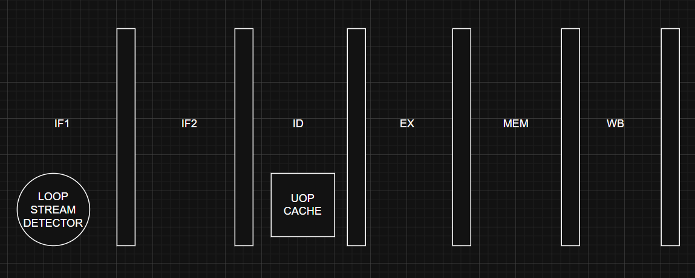
OuR IMPLEMENTATION: RISC DIAGRAM

Slide 4
OUR IMPLEMENTATION:uop cache
For the uop cache we will use one of Xilinx’s BRAMs.
The size of the uop cache is still to be determined (the amount of uops that will be stored) probably around 28 uops like one of Intel’s first implementations.
The uop cache will store the loops when it is allowed by the LSD and then RISC will treat the cache as the instruction cache continuing the execution of the loop from there.

Slide 5
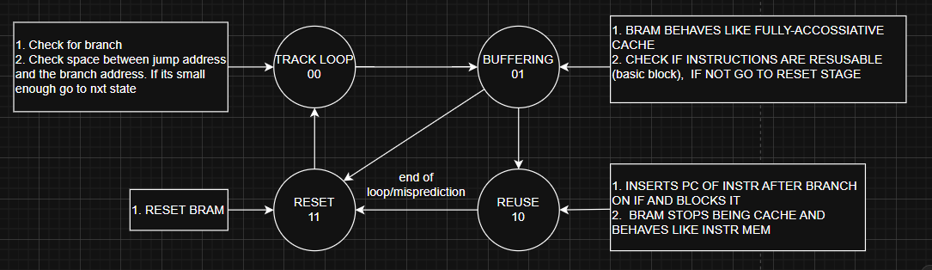
OUR IMPLEMENTATION:FSM

Slide 6
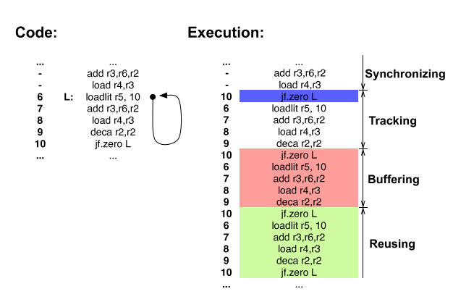
Code EXAMPLE

