Slide 1
Loop Stream Detector project
Andrikopoulos Konstantinos
Stavros Stathoudakis
Spyros Stamoulis

Slide 2
RTl - complete
Completed RTL
Run behavioral Simulation
Run Synthesis
Run Post-Synthesis Functional and Timing Simulation
Run Implementation
Run Post-Implementation Functional and Timing Simulation

Slide 3
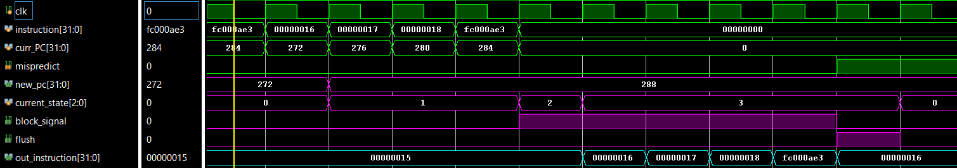
Post-Implementation functional Simulation
INPUTS
FSM
BRAM
BRAM output

Slide 4
Next steps
Integration in RISC-V ?

Slide 5
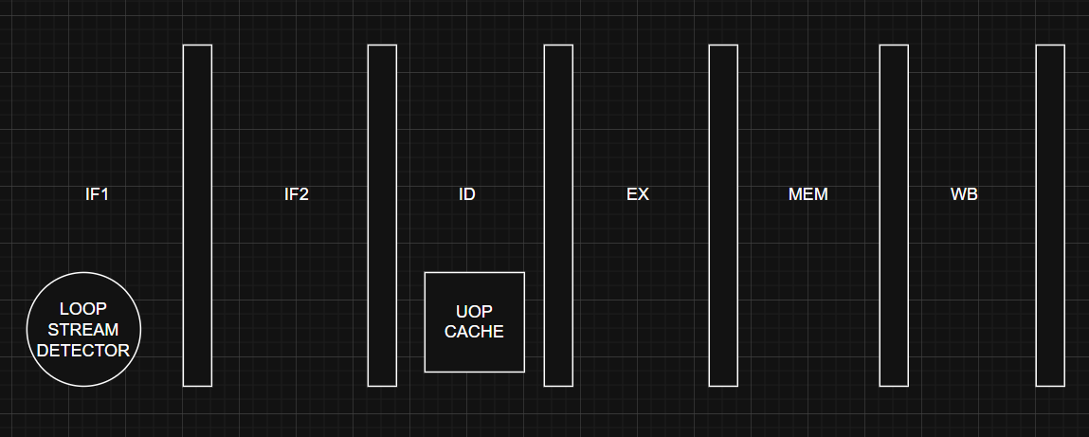
OuR IMPLEMENTATION: RISC DIAGRAM

Slide 6
OUR IMPLEMENTATION:uop cache
For the uop cache we will use one of Xilinx’s BRAMs.
The size of the uop cache is still to be determined (the amount of uops that will be stored) probably around 28 uops like one of Intel’s first implementations.
The uop cache will store the loops when it is allowed by the LSD and then RISC will treat the cache as the instruction cache continuing the execution of the loop from there.

Slide 7
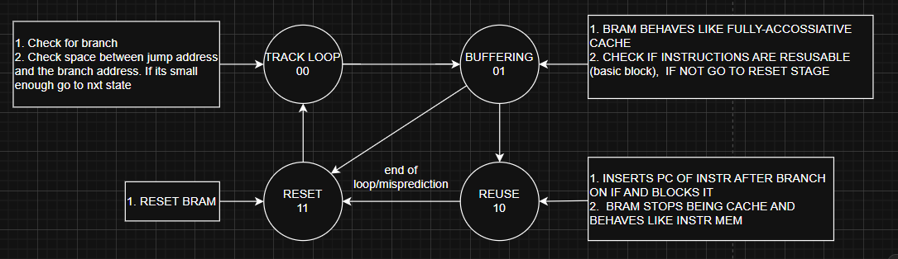
OUR IMPLEMENTATION:FSM

Slide 8
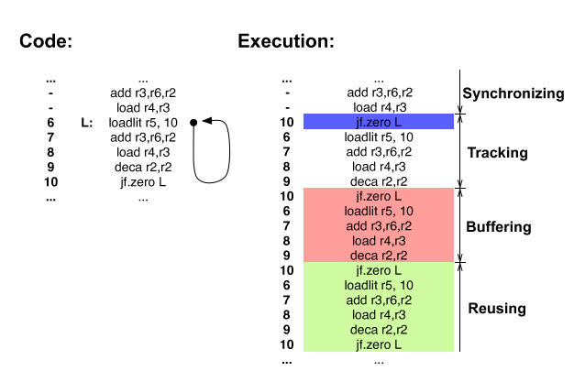
Code EXAMPLE

