Slide 1
Loop Stream Detector project
Andrikopoulos Konstantinos
Stavros Stathoudakis
Spyros Stamoulis

Slide 2
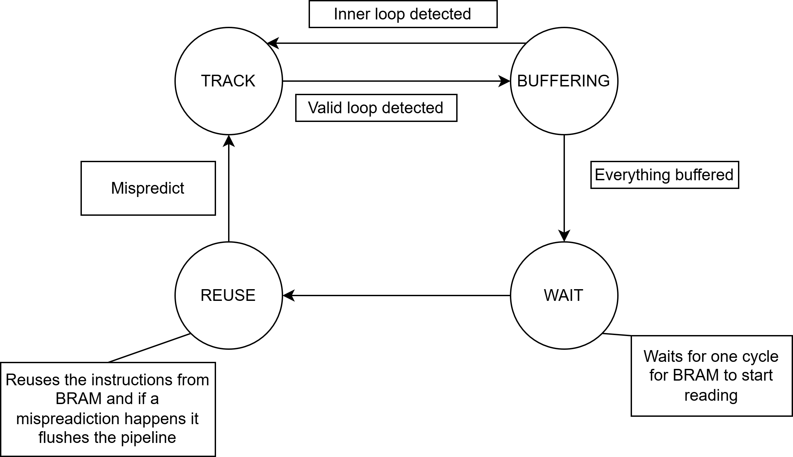
Change in fsm
Added an extra state in order to give time to the BRAM to write
Removed RESET state

Slide 3
RTl - complete
Completed RTL
Run behavioral Simulation
Run Synthesis
Run Post-Synthesis Functional and Timing Simulation
Run Implementation
Run Post-Implementation Functional and Timing Simulation

Slide 4
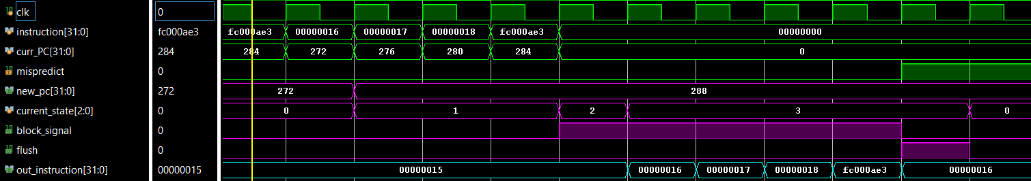
Post-Implementation functional Simulation
INPUTS
FSM
BRAM
BRAM output

Slide 5
Integration in Risc-v

Slide 6
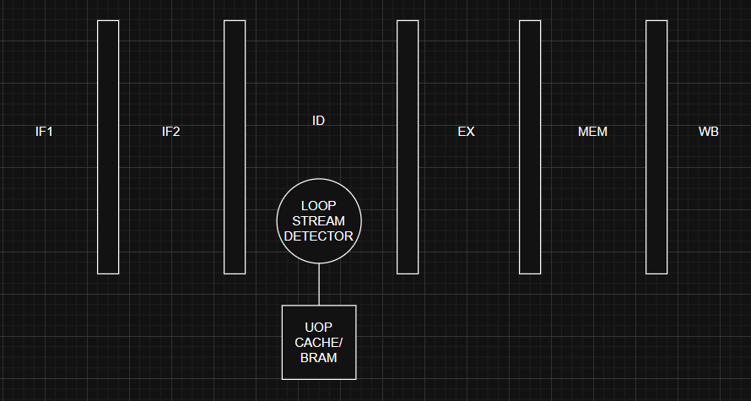
Stream loop detector in RISC

Slide 7
Thank you

