Slide 1

GRUOP28
PRECISE SCHEDULER FOR FREERTOS
Alberto Toscano - Stefano Liberati - Davide Rotondo - Giuseppe Sciacovelli - Marco Di Bernardo
Page 1

Slide 2

INTRODUCTION
This project implements a time-triggered scheduler extension built upon the FreeRTOS kernel, with source code and documentation sourced from the official FreeRTOS GitHub repository.
The target architecture for deployment and testing is the MPS2-AN385 platform (ARM Cortex-M3). This environment was selected to leverage QEMU emulation, enabling deterministic, tick-by-tick simulation to validate Hard and Soft Real-Time task constraints, deadline enforcement, and regression test suites.
LIST OF THE FILES:
  Makefile
  FreeRTOSconfig.h
  scheduler.h
  scheduler.c
  task.c
  test_scheduler.h
  test_scheduler.c
  main.c
  uart.c
  uart.h
  Precise Scheduler Documentation
  MIT LICENSE
Page 2

Slide 3
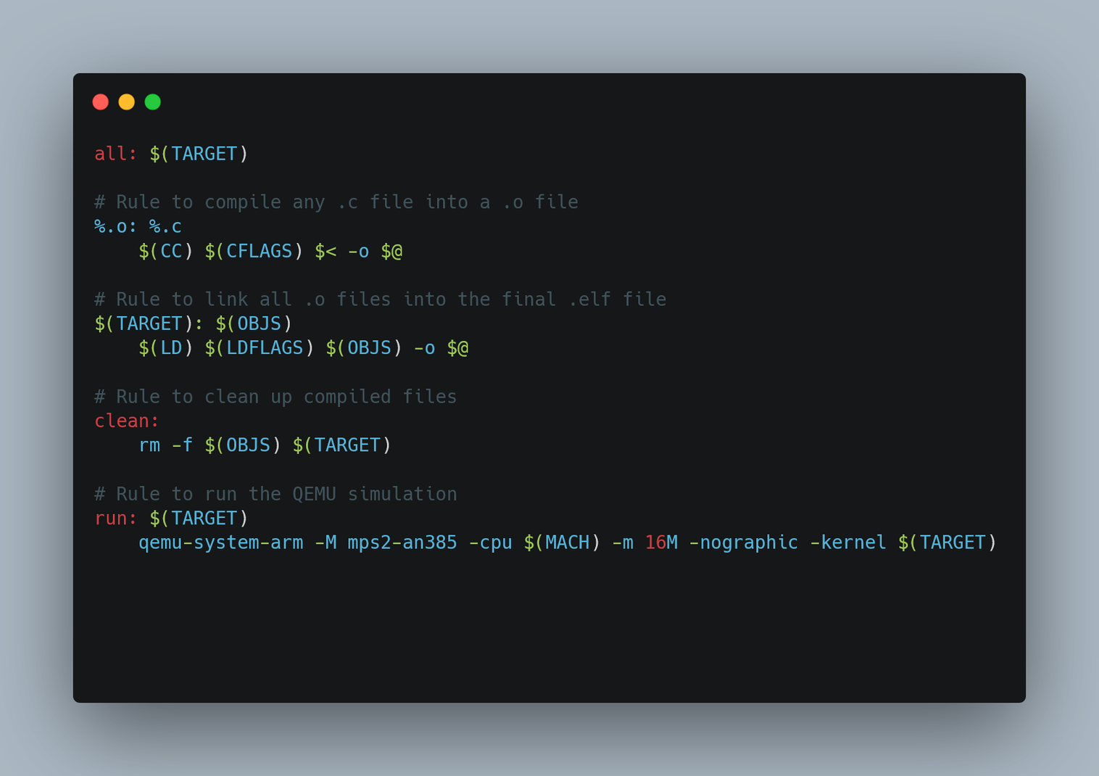
MAKEFILE
Page 3

Slide 4
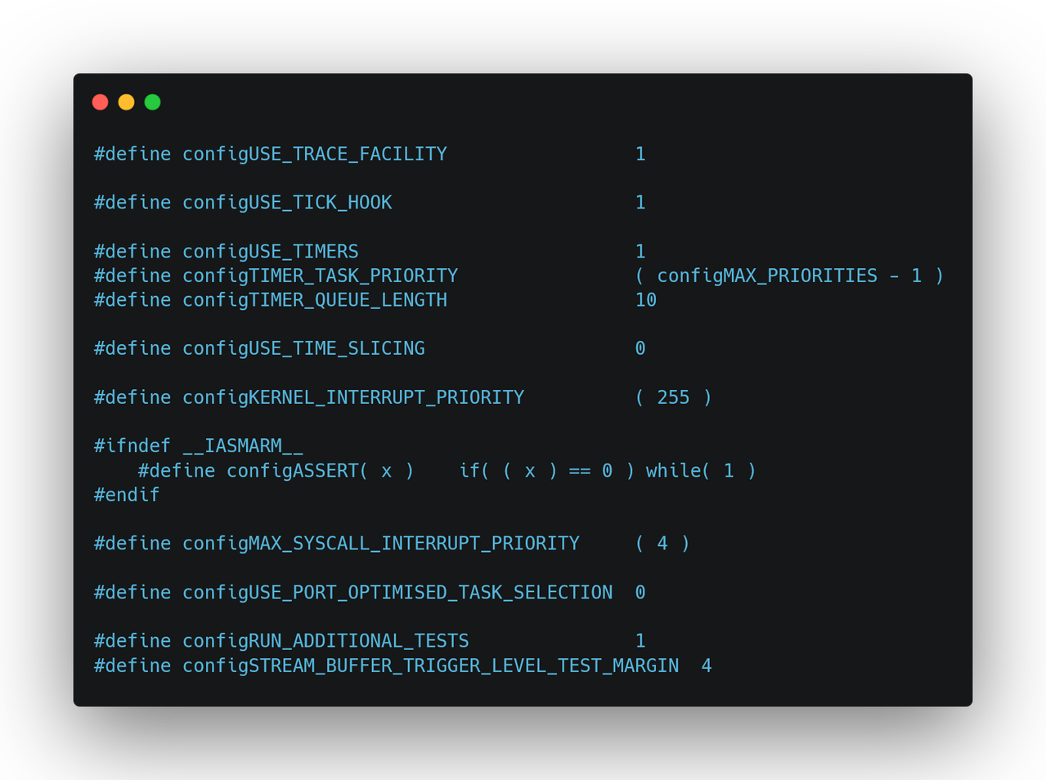
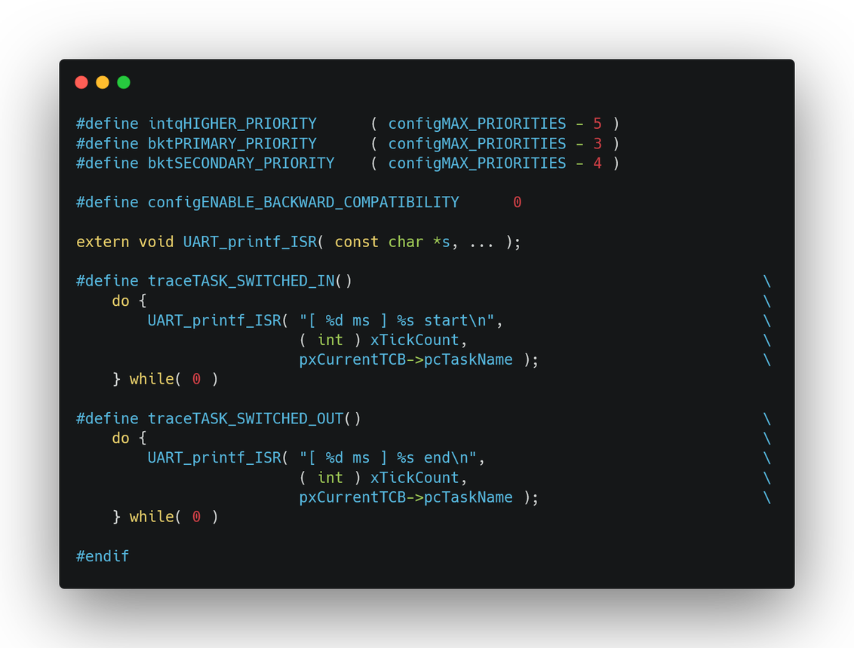
FREERTOSCONFIG.H
Page 4

Slide 5
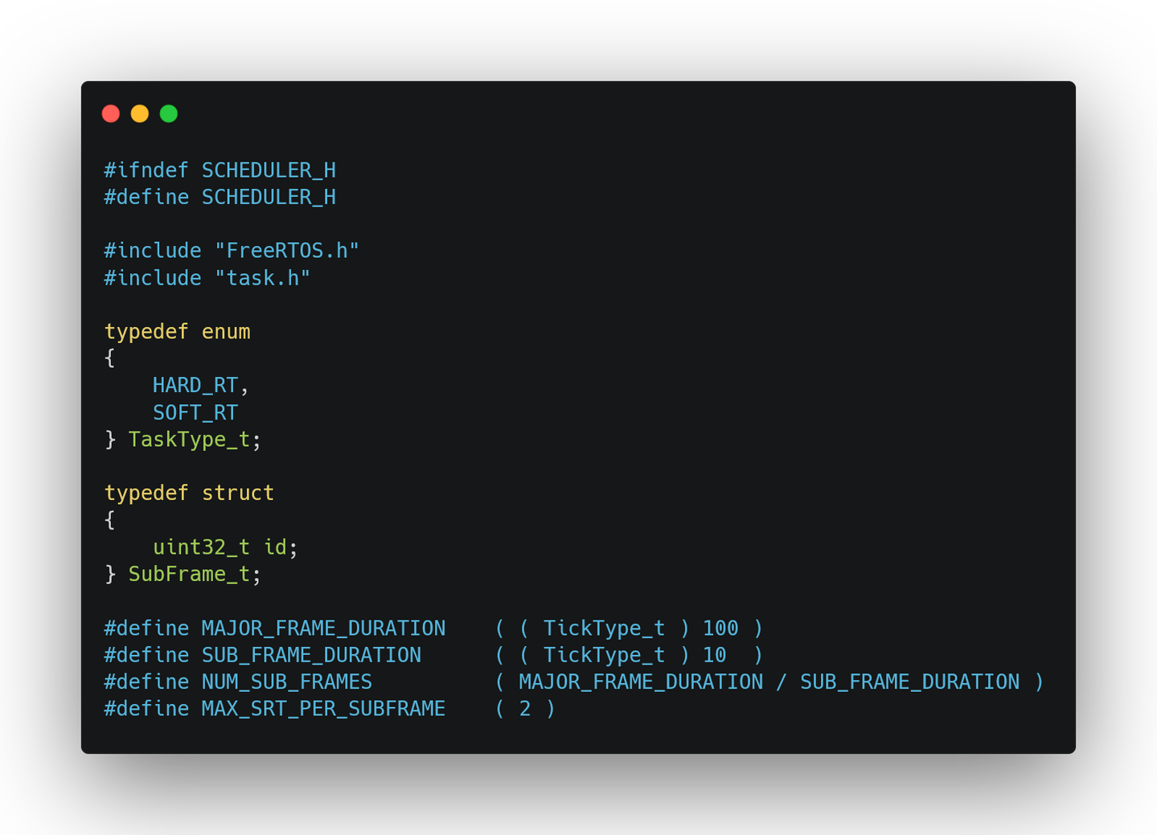
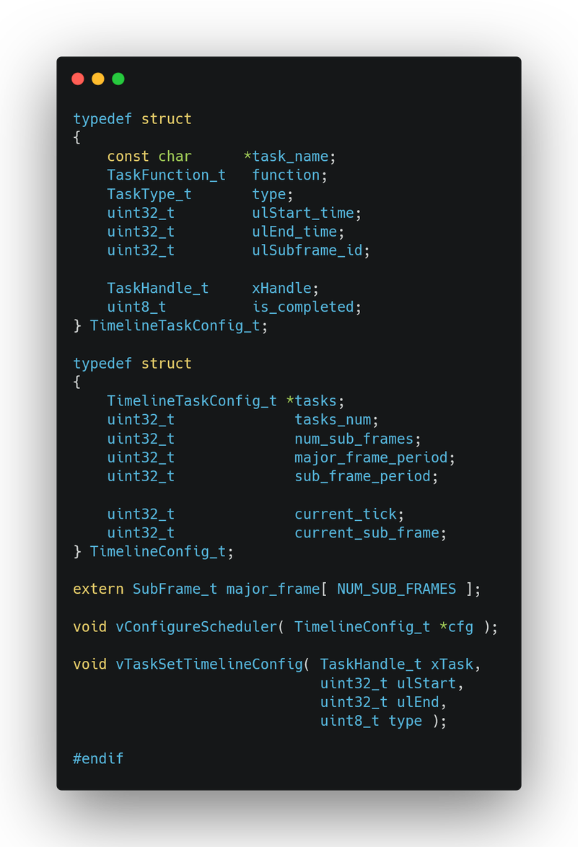
SCHEDULER.H
Page 5

Slide 6
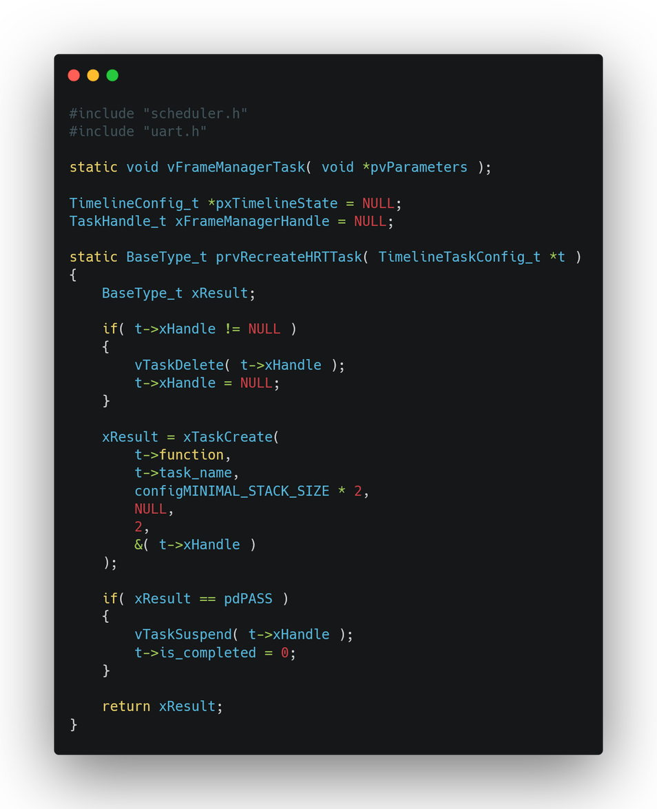
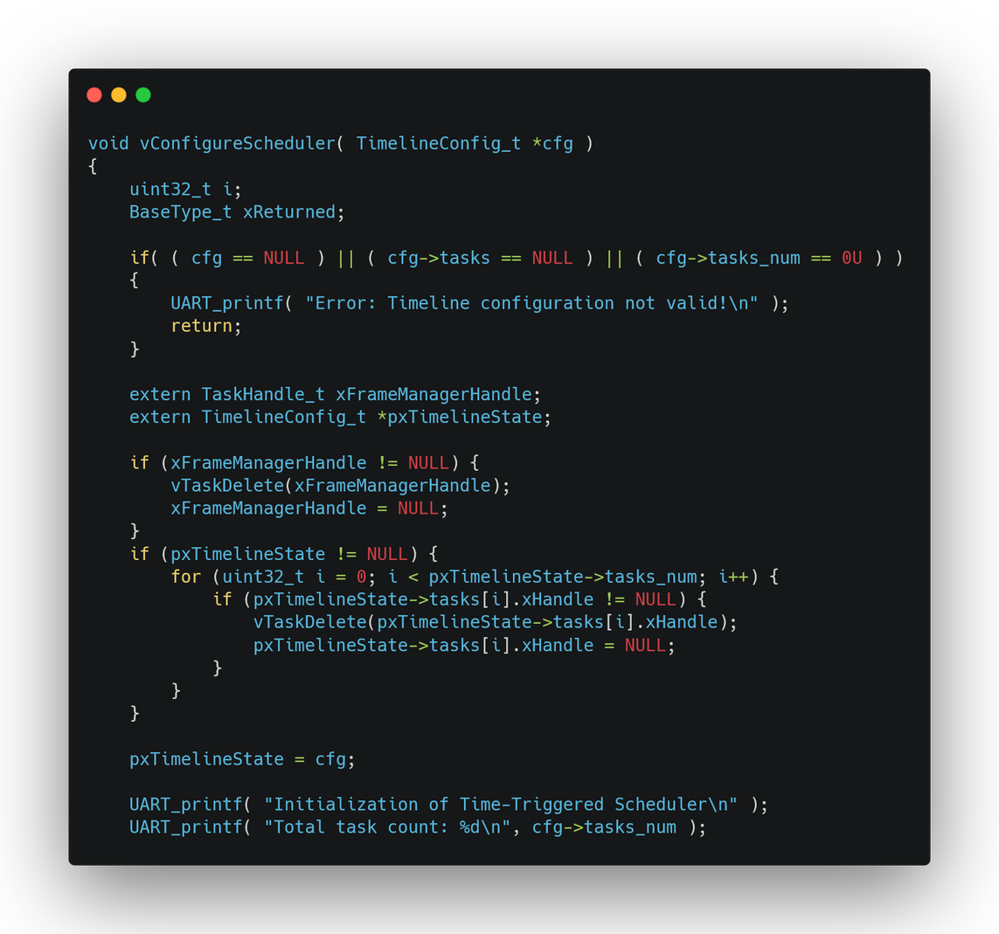
SCHEDULER.C
Page 6

Slide 7
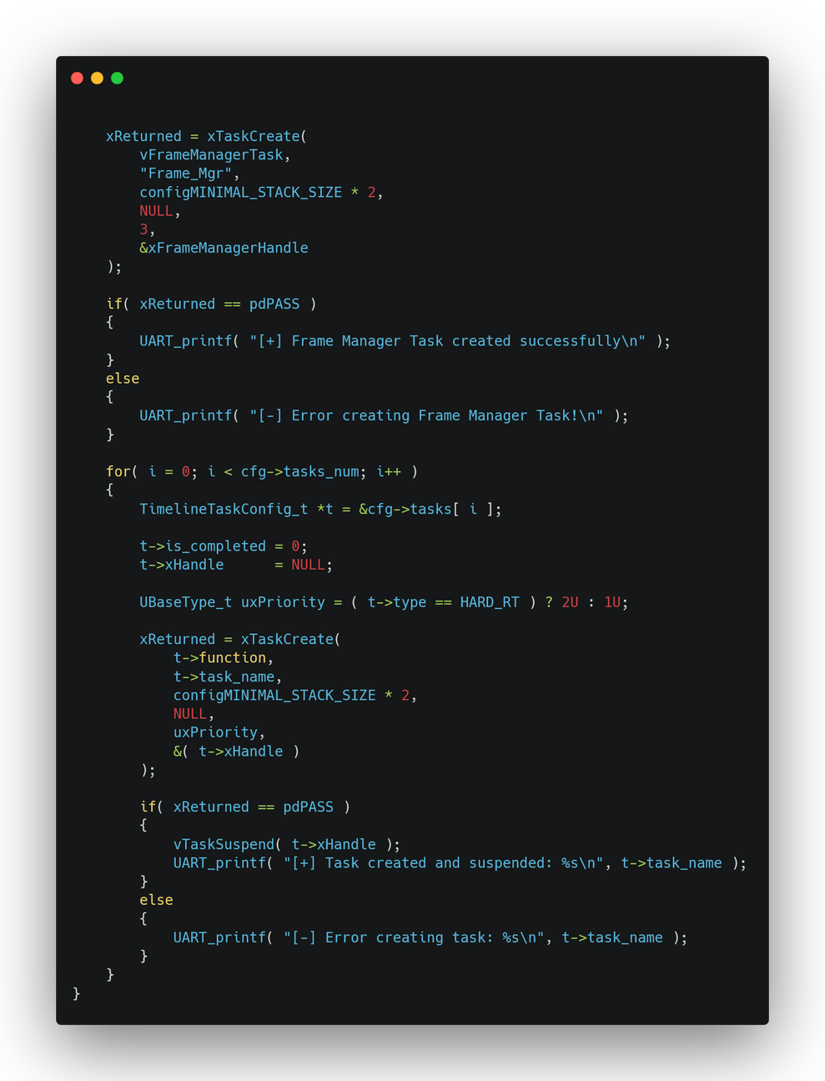
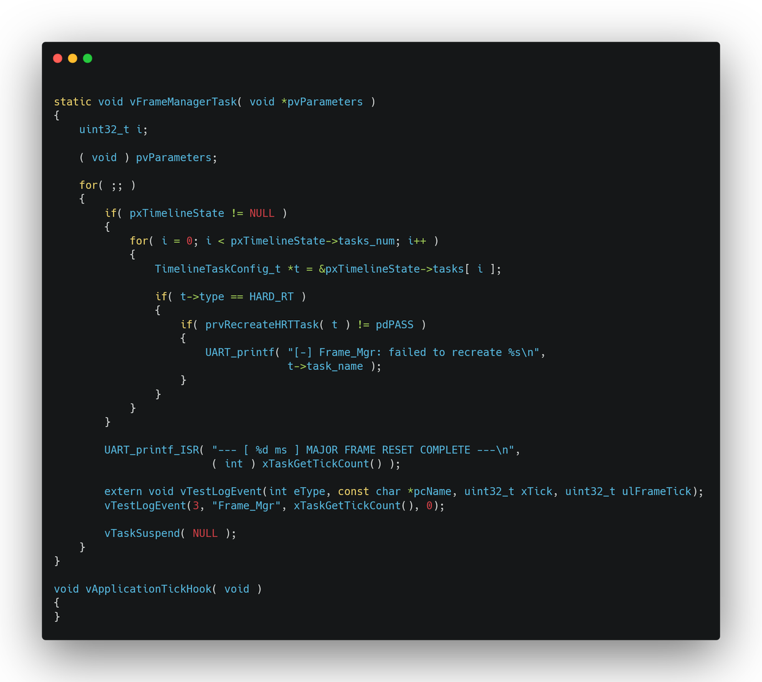
SCHEDULER.C
Page 7

Slide 8
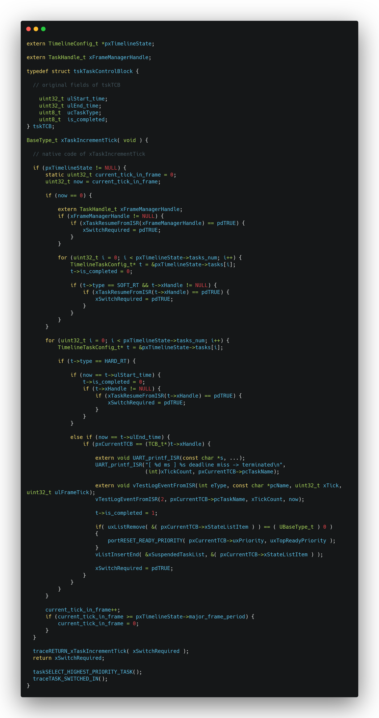
TASK.C
Page 8

Slide 9
TASK.C
Page 9

Slide 10
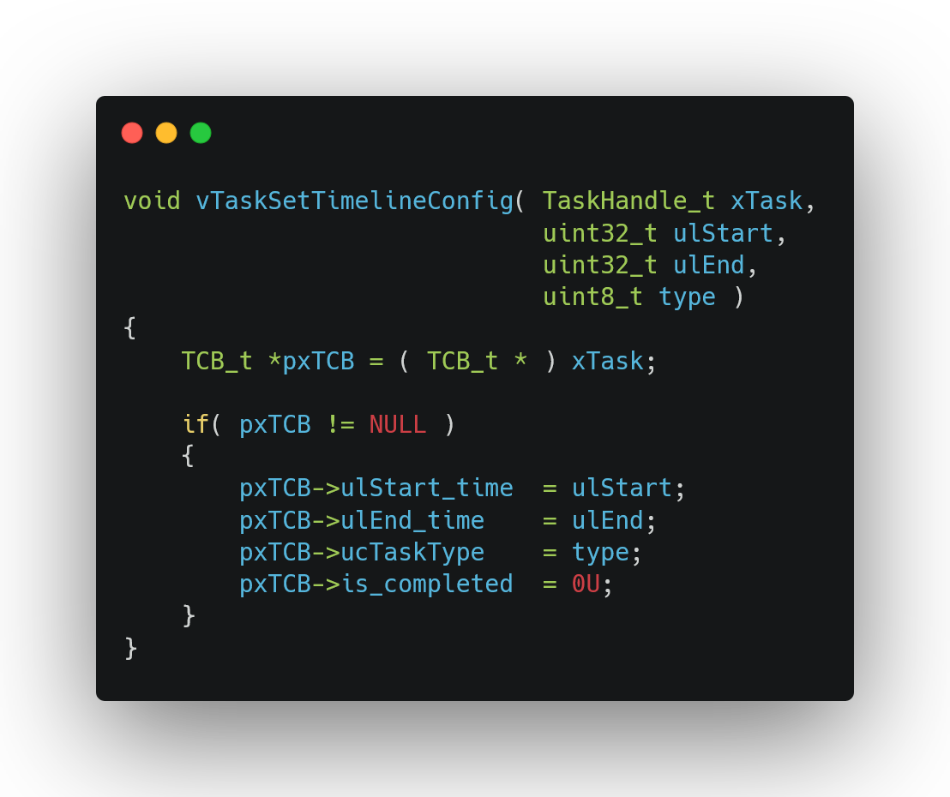
TASK.C
Page 10

Slide 11
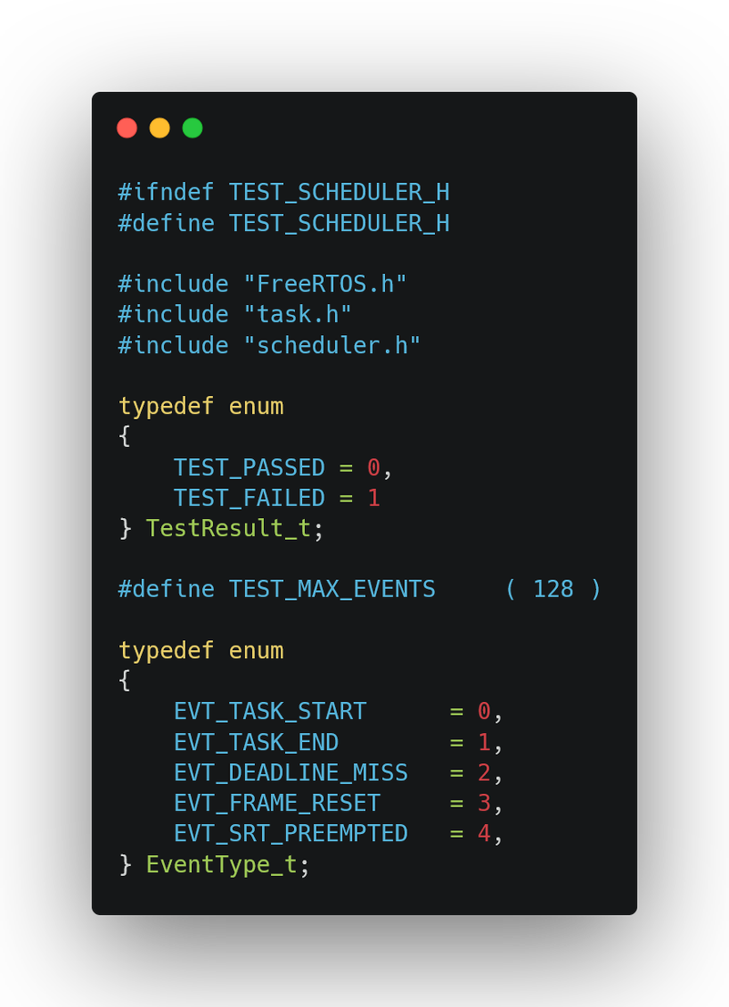
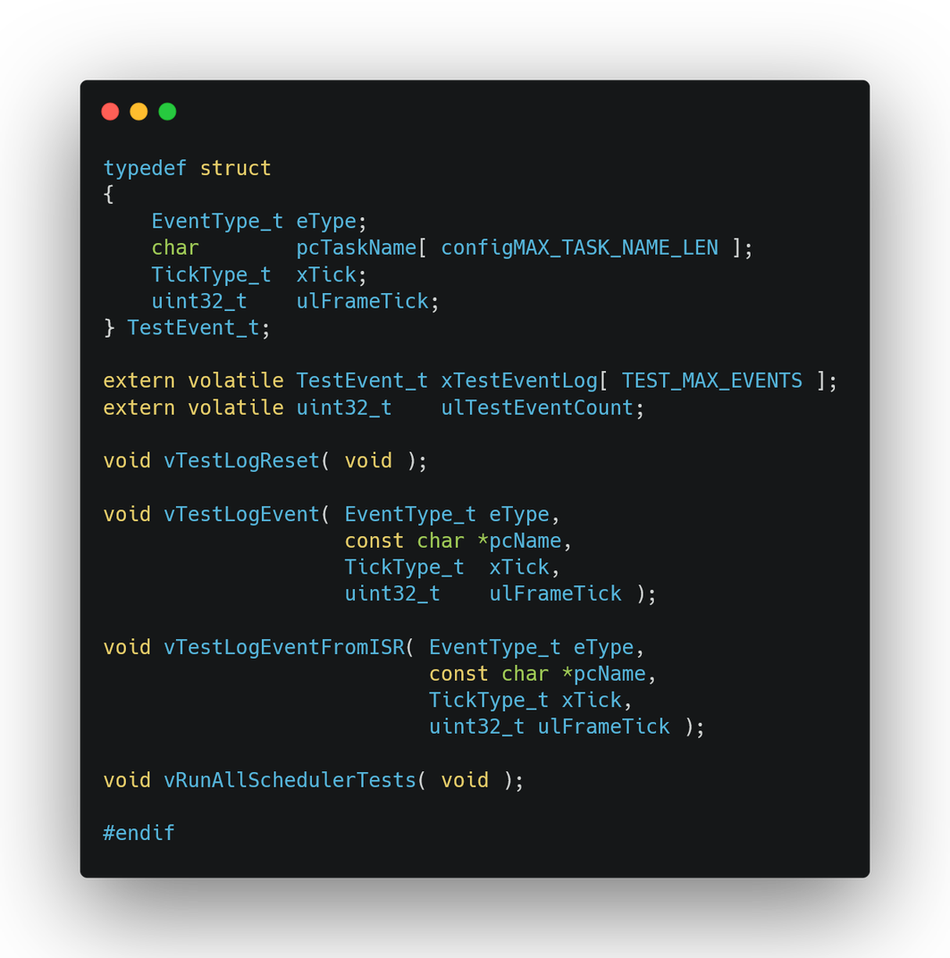
TEST_SCHEDULER.H

Slide 12
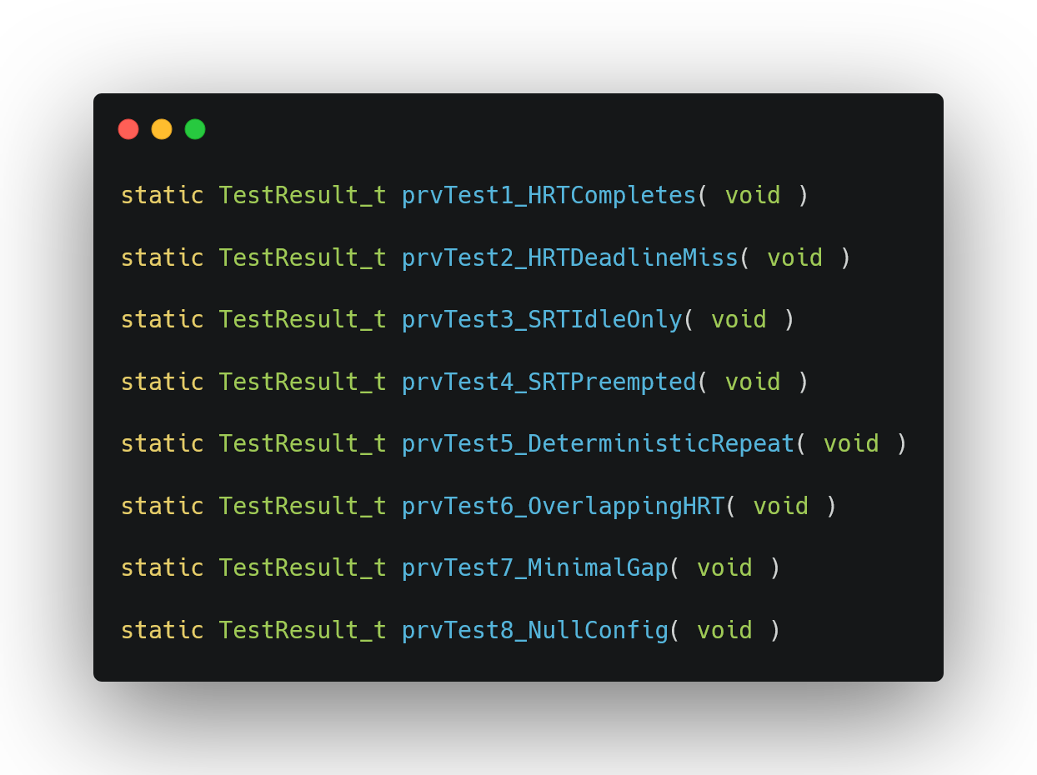
TEST_SCHEDULER.C
Page 12

Slide 13
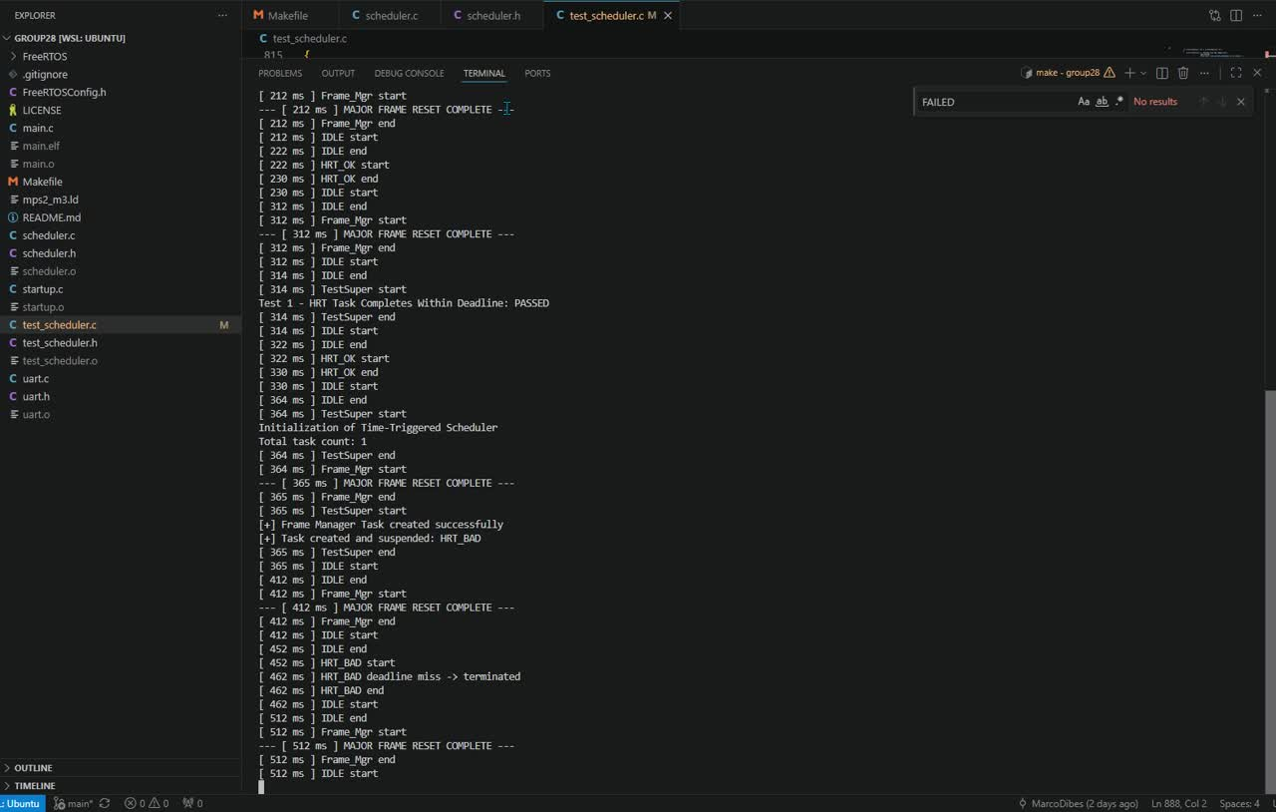
Page 13

Slide 14
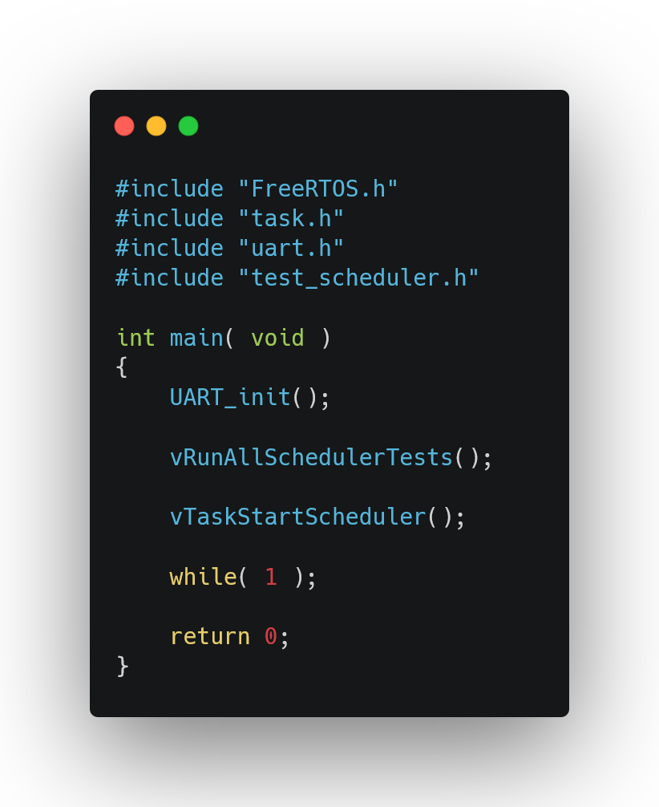
MAIN.C
Page 14

Slide 15
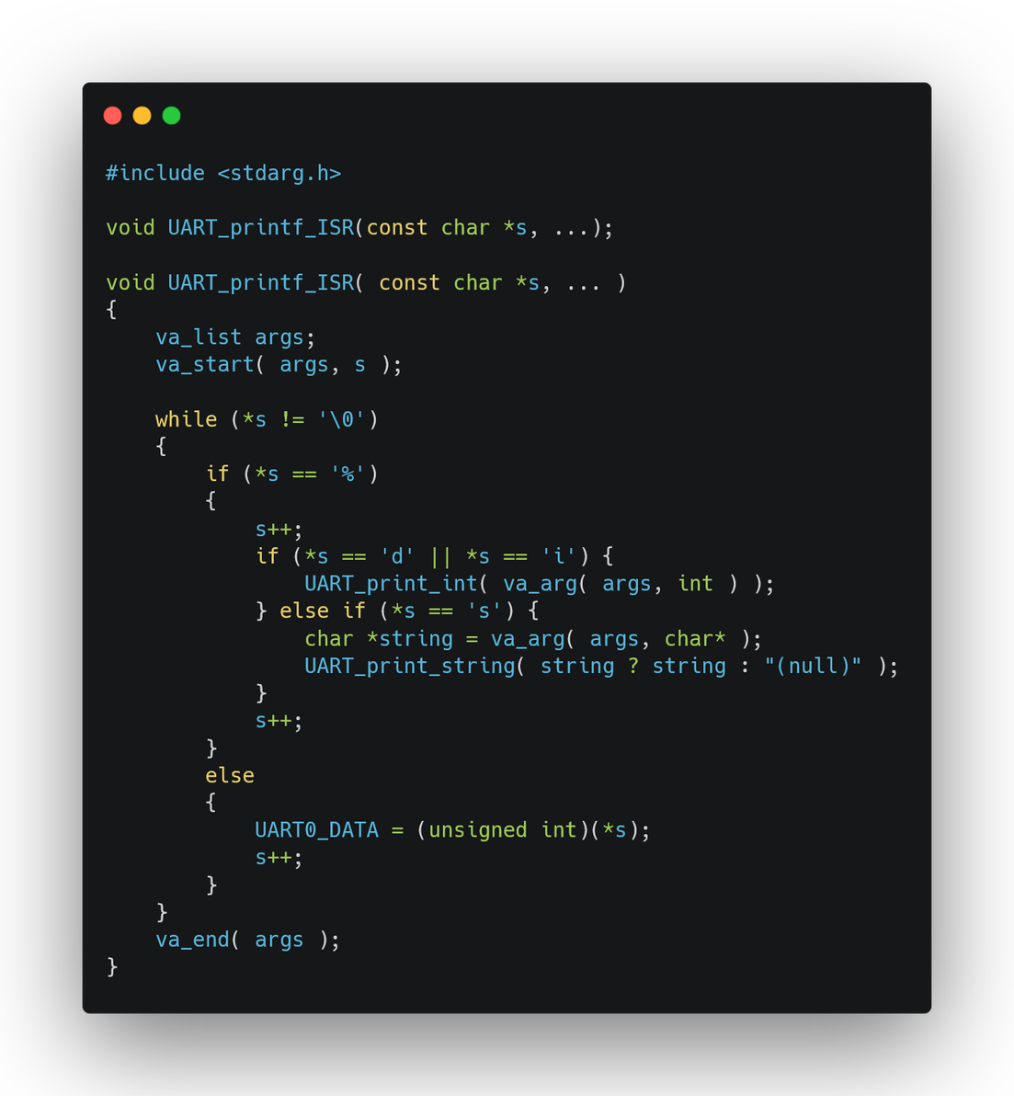
UART.C
Page 15

Slide 16
THANK YOU
Page 16

