Slide 1
Cloud Computing Project Presentation
Alessandro Madonna, Francesco Ronchieri, Andrea Klaus Tubak, Stefano Petrocchi

Slide 2
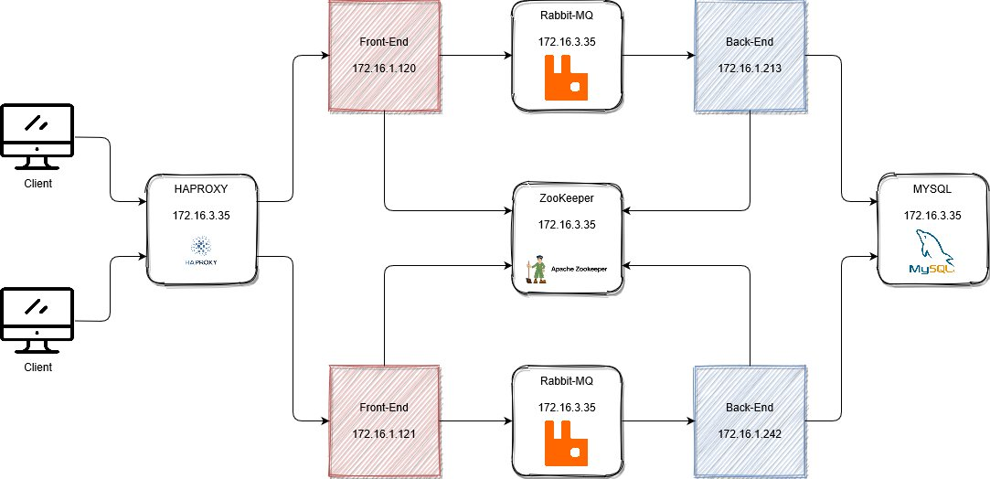
Schema

Slide 3
OVERVIEW
All component are deployed in a docker.
There is a controller node, that is the machine 172.16.3.35, in which all components except the front-end and back-end are deployed. These component could be replicated for availabity on other node.

Slide 4
HAPROXY & FRONT-END
HAProxy is deployed as single istance, in the VM with ip 172.16.3.35.
For this architecture, every front-end instance must be connected with one back-end istance.
There are 2 front-end istances, and are on the VM with ip 172.16.1.120 and 172.16.1.121
The front-end is obtained starting from a yaml declaration.
The front-end use rabbitmq to communicate with the corrispective back-end.

Slide 5
RABBITMQ
RabbitMQ is deployed as single istance in the VM with IP 172.16.3.35.
For each pair front-end back-end two exhange are declared, one from the front-end to the back-end and another from the back-end to the front-end.
The message from the front-end to the back-end are sent with different routing key, based on the function to perform.

Slide 6
ZOOKEEPER
ZooKeeper is deployed as single istance in the VM with IP 172.16.3.35, although more istances are usually preferred.
Zookeeper is used to save the configuration setting of the front-end and back-end.

Slide 7
BACK-END & MYSQL
As said before, every istance of the back-end is connected with an istance of the front-end, and use RabbitMQ to excange message
There are 2 istances of the back-end and are on the node with ip 172.16.1.213 and 172.16.1.242.
Back-end instances is connected to mysql server.
Mysql is deployed as single istance, in the VM with ip 172.16.3.35.

