Slide 1
Cloud Computing Project Presentation
Alessandro Madonna, Francesco Ronchieri, Andrea Klaus Tubak, Stefano Petrocchi

Slide 2
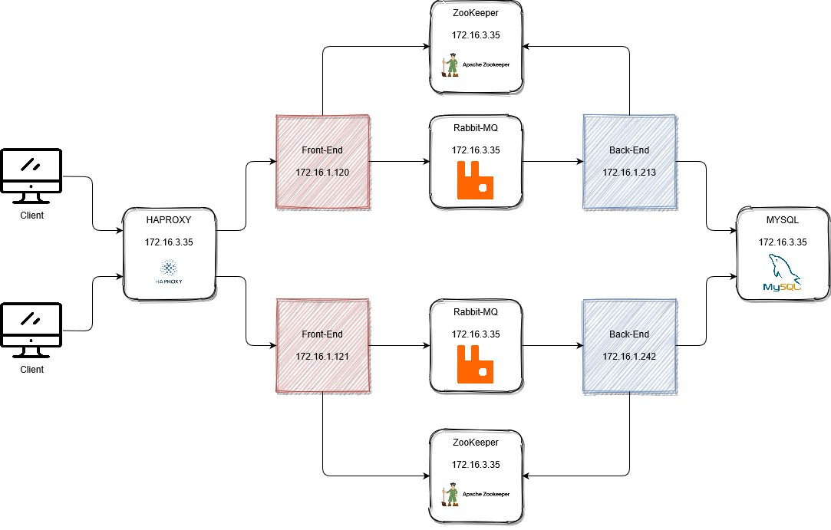
Schema

Slide 3
HAPROXY & FRONT-END
HAProxy is deployed as single istance, in the VM with ip 172.16.3.35 in a docker.
For this architecture, every front-end instance must be connected with one back-end istance.
The front-end istance is obtained starting from a yaml declaration.
The front-end use rabbitmq to communicate with the corrispective back-end istance.
Also the front-end is deployed on docker

Slide 4
RABBITMQ
RabbitMQ is deployed as single istance in the VM with IP 172.16.3.35 in a docker.
For each pair front-end back-end two exhange are declared, one from the front-end to the back-end and another from the back-end to the front-end.
The message from the front-end to the back-end are sent with different routing key, based on the function to perform.

Slide 5
ZOOKEEPER
ZooKeeper is deployed as single istance in the VM with IP 172.16.3.35 in a docker, although more istances are usually preferred.
Zookeeper is used to save the configuration setting of the front-end and back-end.

Slide 6
BACK-END & MYSQL
Also Back-end and mysql istances are in a docker.
There are 2 istances of the back-end.
Back-end instances is connected to mysql server.
Mysql is deployed as single istance, in the VM with ip 172.16.3.35.

