Slide 1
Cloud Computing Project Presentation
Alessandro Madonna, Francesco Ronchieri, Andrea Klaus Tubak, Stefano Petrocchi

Slide 2
Schema

Slide 3
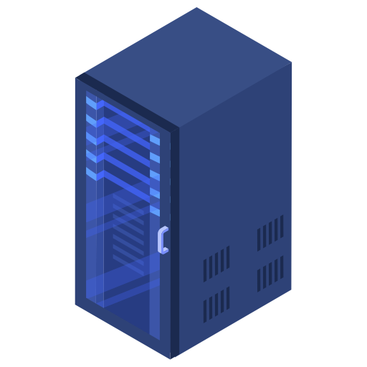
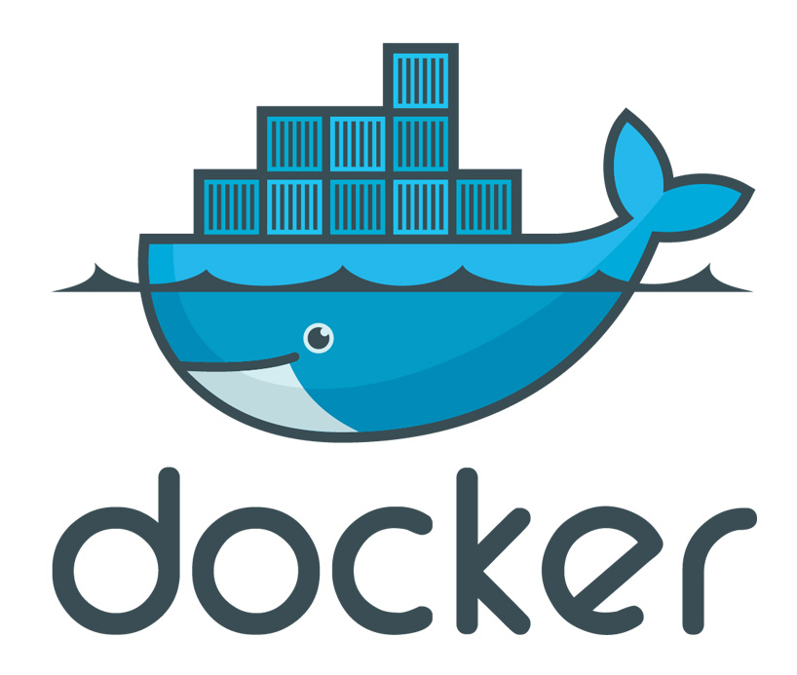



OVERVIEW
All components are deployed in Docker containers.
The Controller node contains all the support modules needed to run the application. Can be replicated to ensure high availability.
Worker nodes also run their software in containers and take care of the front-end and back-end tasks, they can be replicated to ensure scalability.
Controller Node 172.16.3.35
Worker Nodes
172.16.1.120
172.16.1.213
172.16.1.121
172.16.1.242

Slide 4
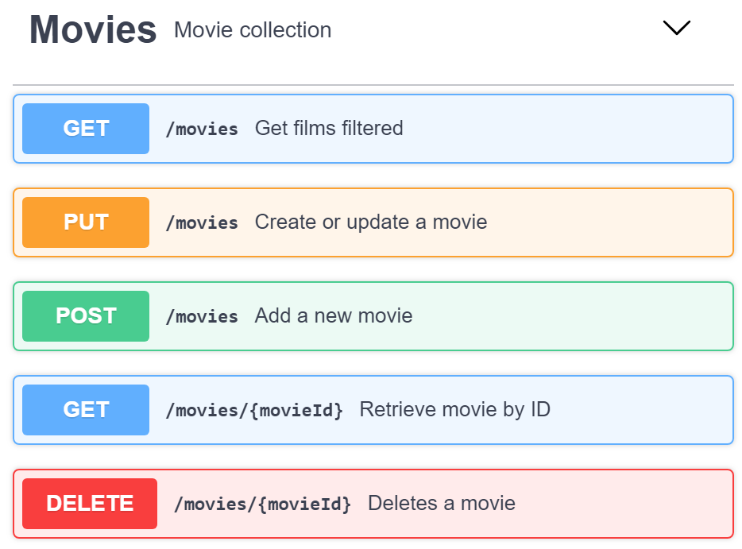
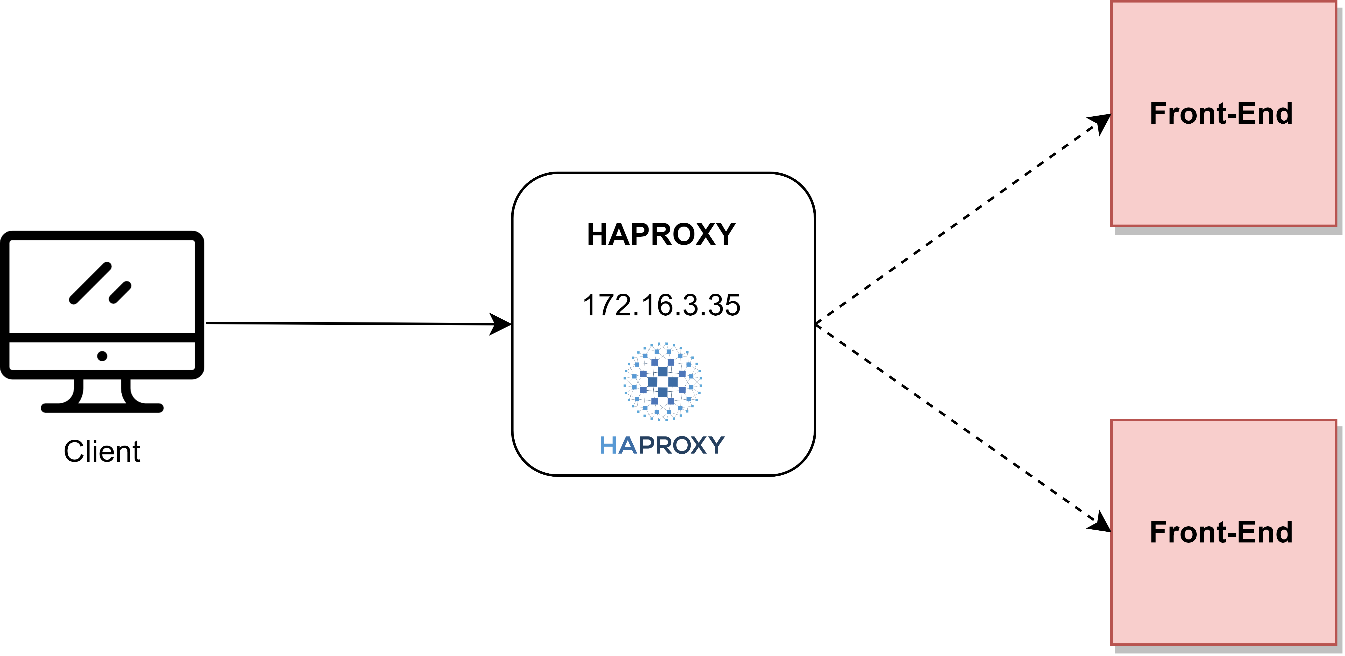
HAPROXY & FRONT-END
HAProxy is deployed using a dedicated node model to load-balance the requests to the front-ends.
The front-ends are obtained from a yaml declaration.

Slide 5
RABBITMQ
RabbitMQ is deployed as single istance on the controller.
Communications between front-end and back-end are managed by the message broker using the configuration in the figure.
Descrizione exchange e code
Each front-end instance communicates with a single back-end instance in order to maintain the load-balancing performed by HAProxy.
Schema code e exchange

Slide 6
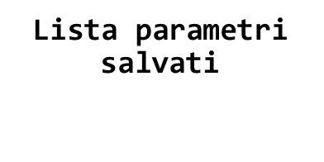
BACK-END & MYSQL
Back-end instances are connected to MySQL server.
MySQL is deployed as single instance, in the controller node.
Zookeeper is deployed as single instance in the controller, although more instances are usually preferred.
Zookeeper is used to save the configuration setting of the front-end and back-end.

