Slide 1
Univ
size
Session
Info
Job
info
App
info
App
info
Proc
data
Proc
data
info
Local
size
Session
ID
Job
ID
App
num
App
num
Rank
Rank
Local
Peers
Num
nodes
Node
map
App
size
App
size
Local
rank
Local
rank
Local
cpusets
Proc
map
App
ldr
App
ldr
Node
rank
Node
rank
Job
size
Node
ID
Node
ID
Max
procs
App
num
App
num
App
rank
App
rank

Slide 2
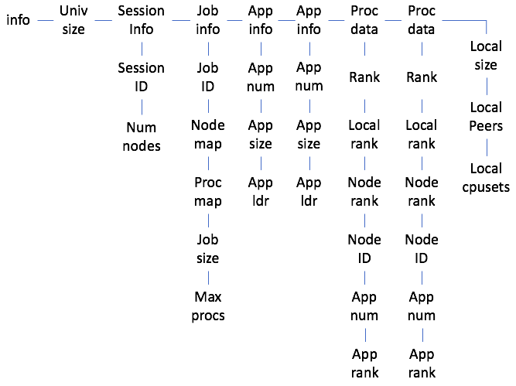

Slide 3
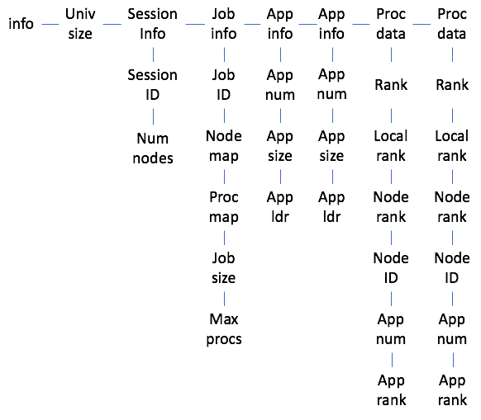

Slide 4
