Slide 1
Univ
size
Session
Info
Job
info
App
info
App
info
Proc
info
Proc
info
info
Local
size
Session
ID
Job
ID
App
num
App
num
Rank
Rank
Local
Peers
Num
nodes
Node
map
App
size
App
size
Local
rank
Local
rank
Local
cpusets
Proc
map
App
ldr
App
ldr
Node
rank
Node
rank
Max
Procs
Max
Procs
Job
size
Node
ID
Node
ID
Local
Ldr
Local
Ldr
Max
procs
App
num
App
num
Hostname
Hostname
Node
Info
App
rank
App
rank
Node2
Node1

Slide 2
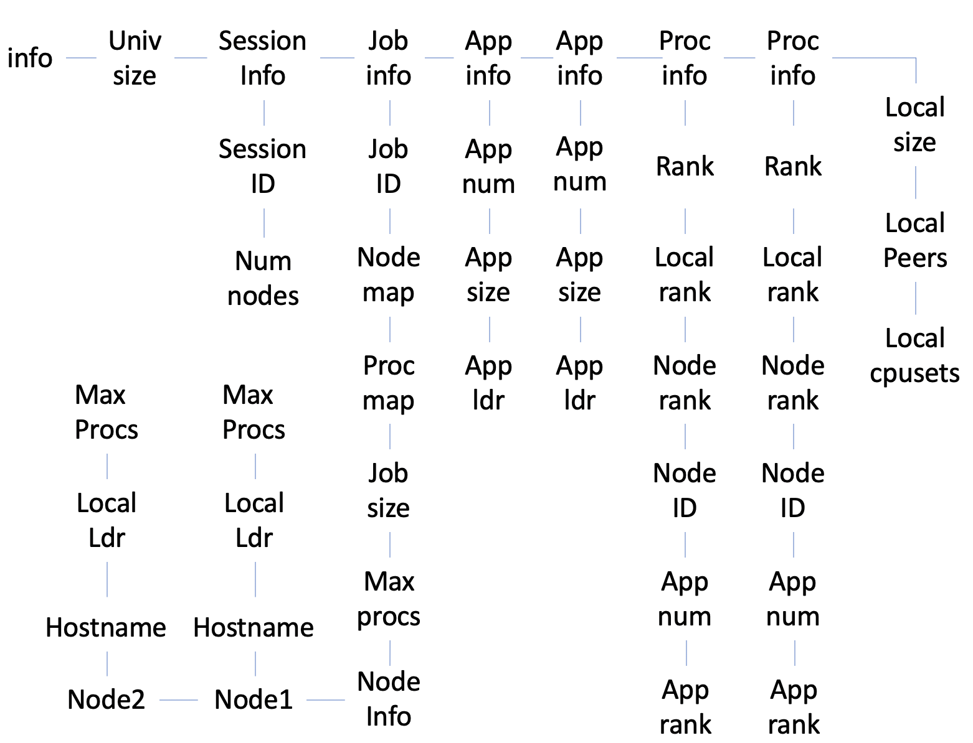

Slide 3
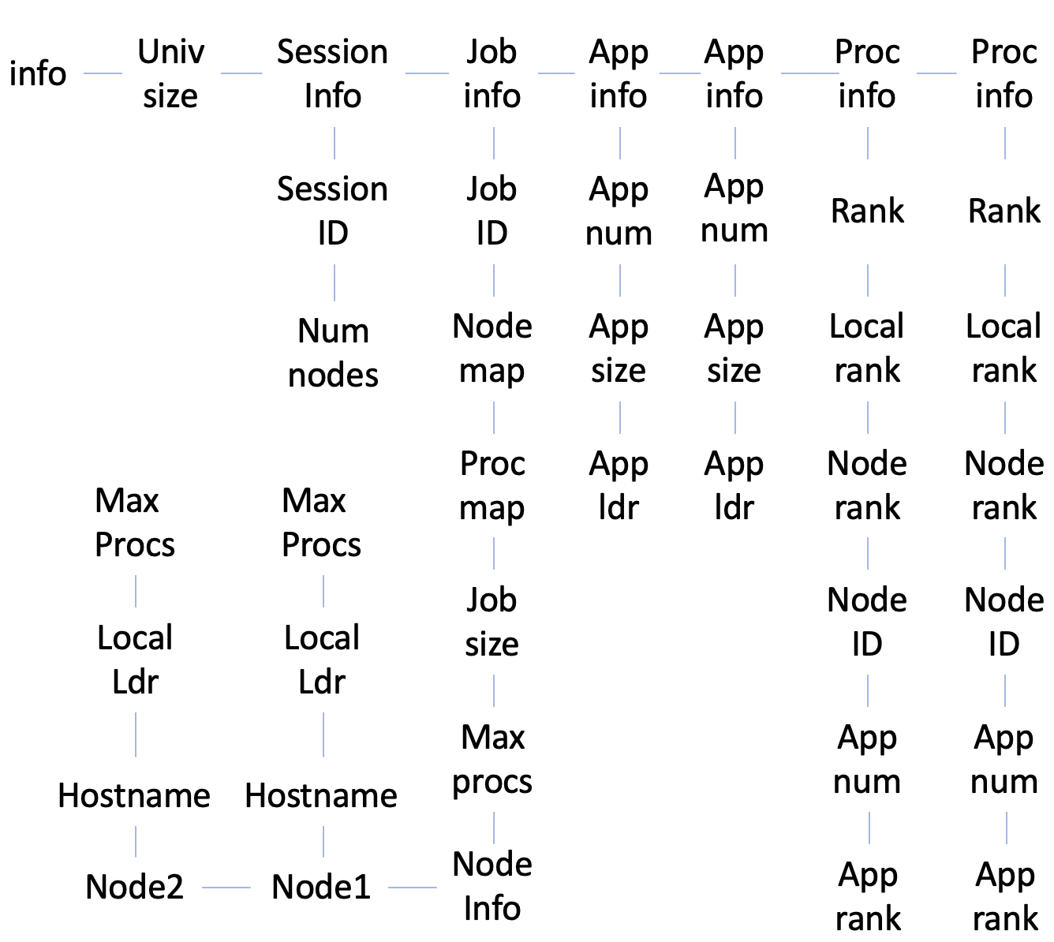

Slide 4
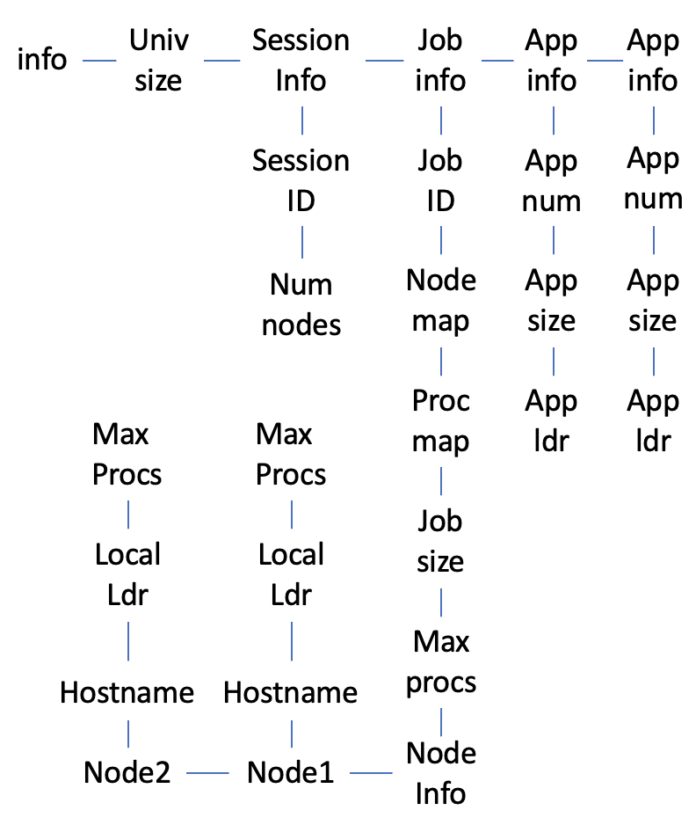

Slide 5
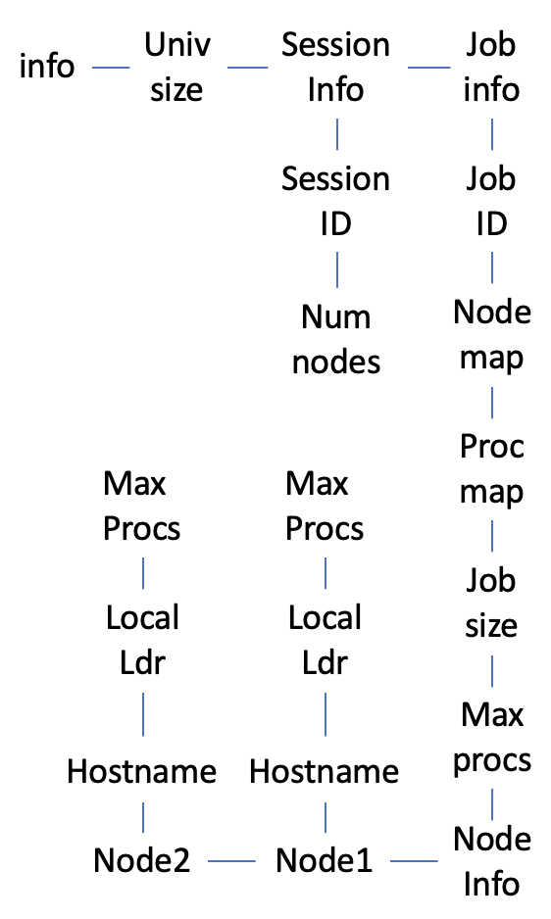

Slide 6
Returned
Info array
PMIx_Get
PMIx_Allocate
Client
Level
Client
Level
Attr1
Attr2
Attr1
Attr2
Server
Level
Server
Level
Attr1
Attr2
Attr1
Data array
Host
Level
pmix_info_t
Attr1
Attr2
Attr3
Attr4
pmix_regattr_t

Slide 7
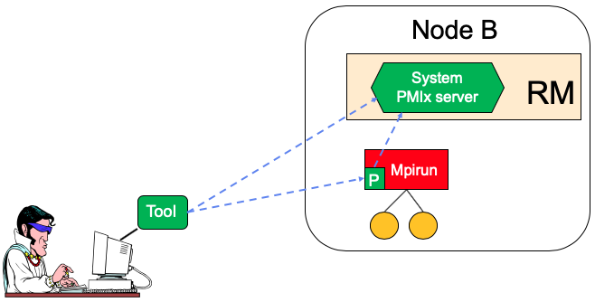
Rendezvous File Locations
System TMPDIR
pmix.sys.host
Server TMPDIR
(per nspace)
pmix.host.tool.nspace
pmix.host.tool.pid
pmix.host.tool
rndvsFile

Slide 8
Direct Launch
RM
RM
PMIx
Server
PMIx
Server
Dbgr
Dmn
Proc
Proc

Slide 9
Forwarding Stdin
RM
RM
PMIx
Server
stdin
PMIx
Server
PMIx Client
Collects
Dbgr
Dmn
Proc
Proc
Sent via PMIx
Tool
Collects

Slide 10
Forwarding of Output
RM
RM
PMIx
Server
stdout
stderr
PMIx
Server
Dbgr
Dmn
Proc
Proc
Sent via PMIx

Slide 11
Indirect Launch
RM
RM
fork/exec
PMIx
Server
PMIx
Server
mpiexec
PMIx_Spawn
PMIx
Server
fork/exec

Slide 12
Indirect Launch
RM
RM
PMIx
Server
PMIx
Server
mpiexec
PMIx
Server

Slide 13
Direct Launch – Fork/Exec Agent
RM
fork/exec
RM
fork/exec
PMIx
Server
Dbgr
Dmn
PMIx
Server
FEA
FEA
fork/exec
Proc
Proc
fork/exec

Slide 14
Direct Launch –Exec Agent
RM
fork/exec
RM
fork/exec
PMIx
Server
Dbgr
Dmn
PMIx
Server
EA
EA
Proc
Proc

