Slide 1
Univ
size
Session
Info
Job
info
App
info
App
info
Proc
info
Proc
info
info
Local
size
Session
ID
Job
ID
App
num
App
num
Rank
Rank
Local
Peers
Num
nodes
Node
map
App
size
App
size
Local
rank
Local
rank
Local
cpusets
Proc
map
App
ldr
App
ldr
Node
rank
Node
rank
Max
Procs
Max
Procs
Job
size
Node
ID
Node
ID
Local
Ldr
Local
Ldr
Max
procs
App
num
App
num
Hostname
Hostname
Node
Info
App
rank
App
rank
Node2
Node1

Slide 2
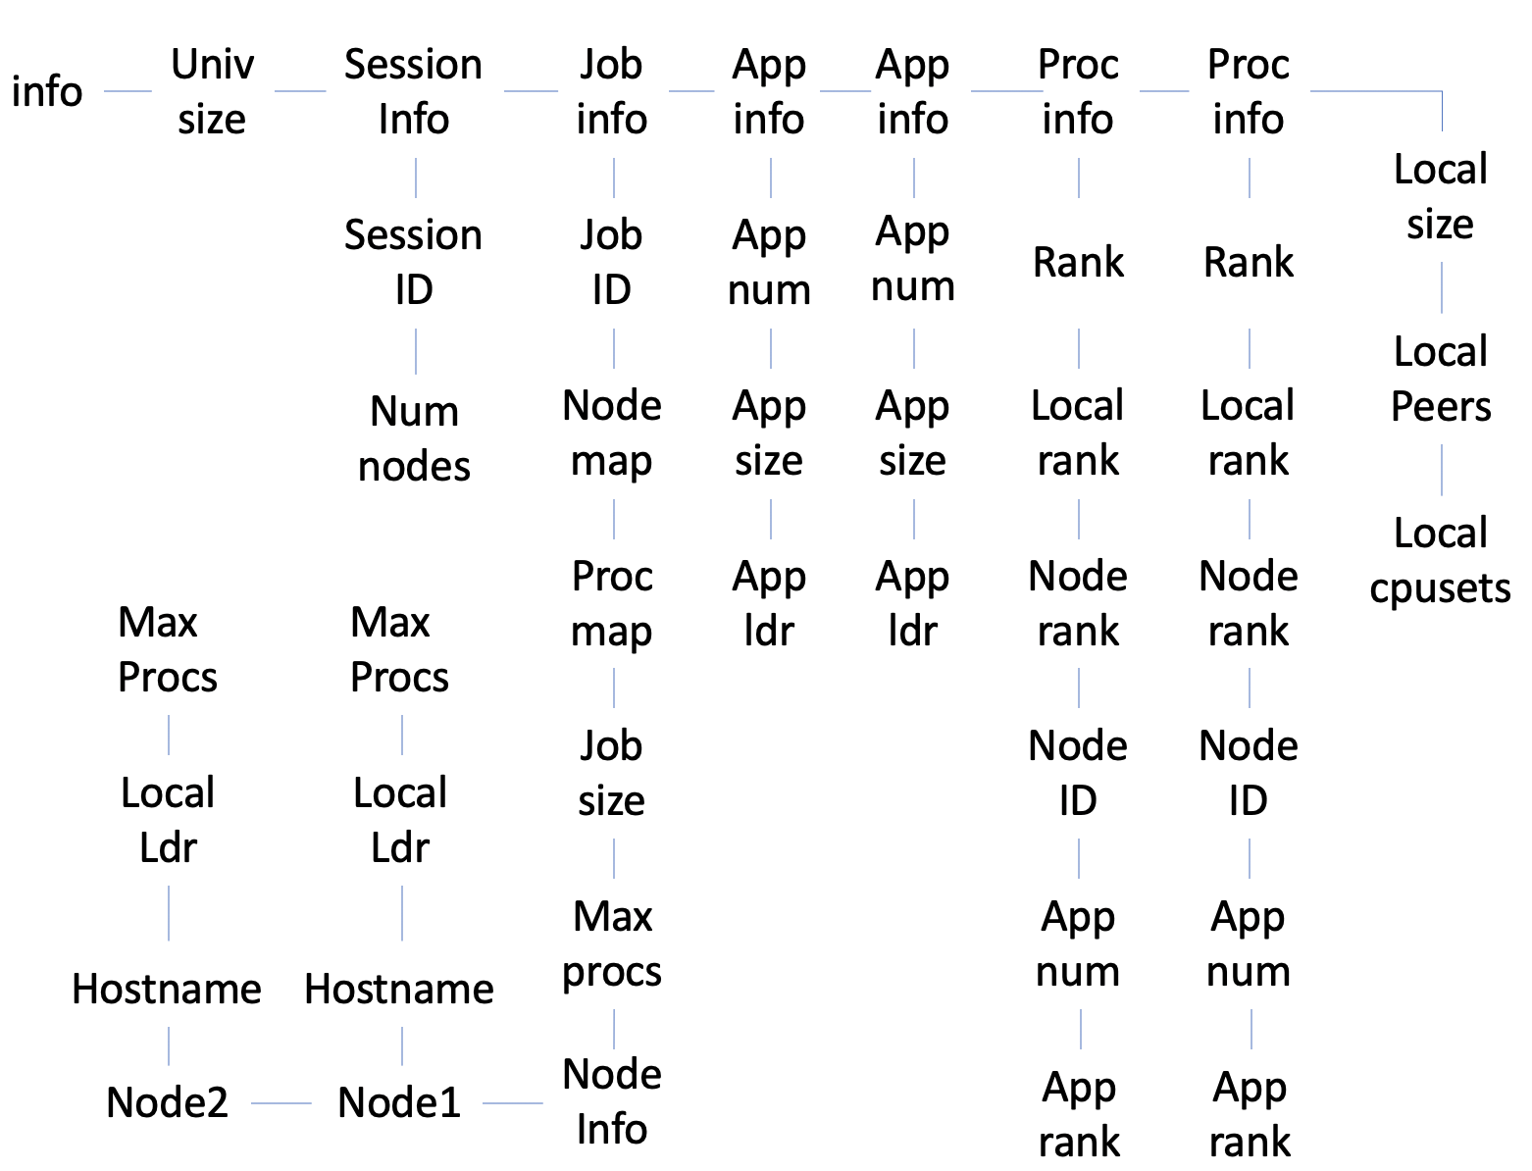

Slide 3
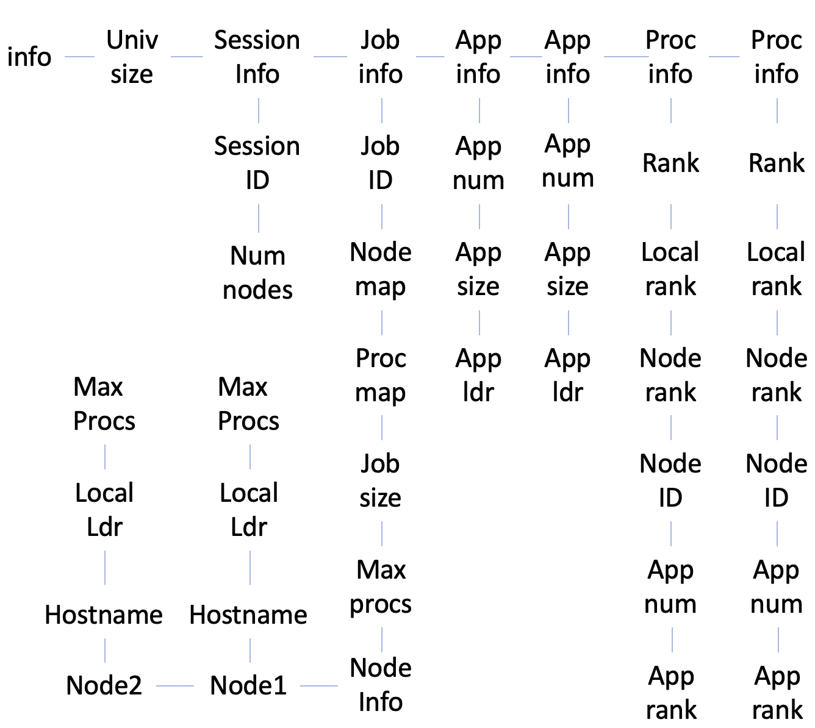

Slide 4
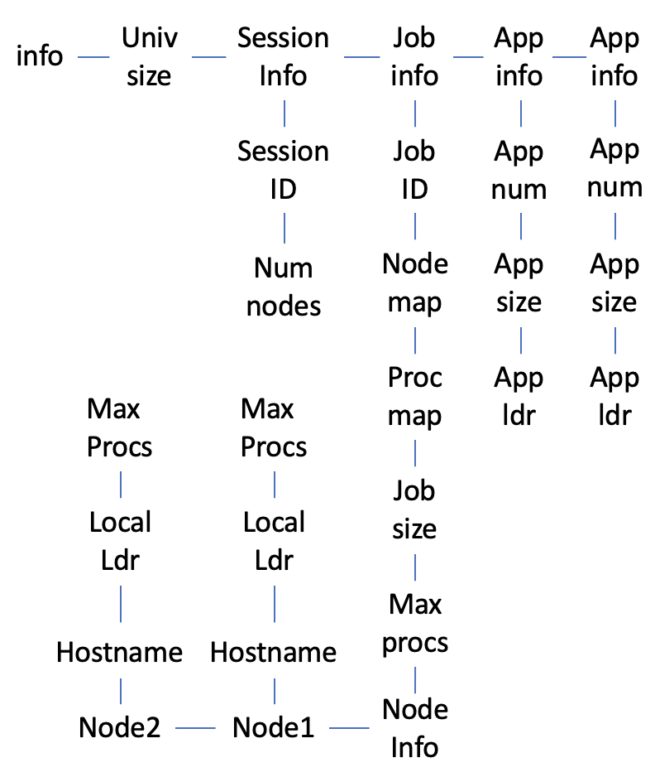

Slide 5
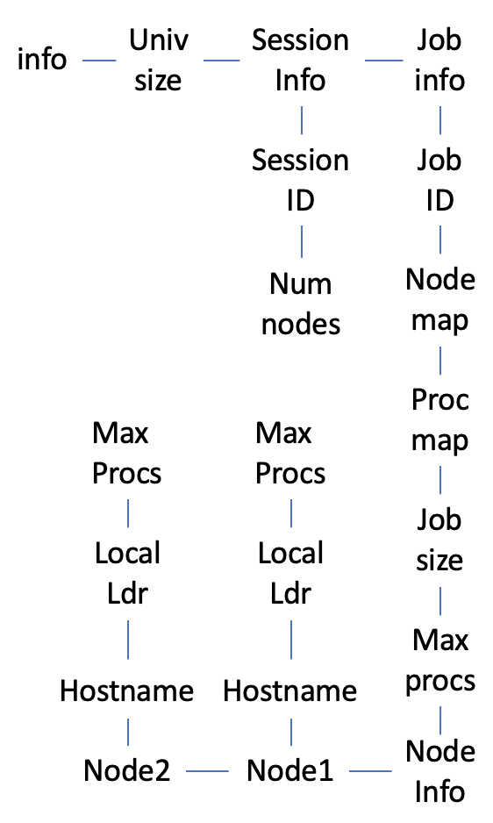

Slide 6
Returned
Info array
PMIx_Get
PMIx_Allocate
Client
Level
Client
Level
Attr1
Attr2
Attr1
Attr2
Server
Level
Server
Level
Attr1
Attr2
Attr1
Data array
Host
Level
pmix_info_t
Attr1
Attr2
Attr3
Attr4
pmix_regattr_t

