Slide 1
Clinopyroxene Tectonic Setting Classification
43-Feature Model: Machine Learning Analysis of 211,773 Geochemical Analyses
April 2026
Data source: GEOROC / GRO.data DOI:10.25625/SGFTFN
XGBoost | SHAP Interpretation | 90/10 Stratified Split | 43 Geochemical Features (Major + Trace)

Slide 2
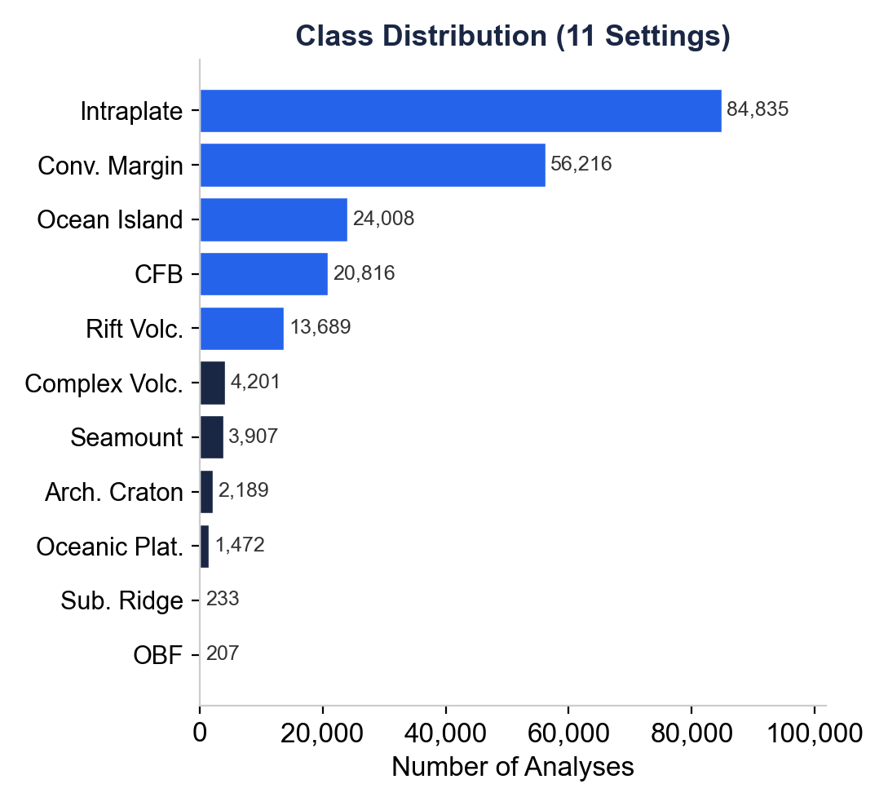
Dataset Overview
Total records: 216,809
Valid (with tectonic label): 211,773
Columns: 451
Tectonic settings: 11
Class imbalance ratio: 409.8 : 1
Rows with complete majors: 0 (zero)
Rows missing ALL trace: 172,142 (81%)
Feature groups used: 43
Major oxides: 11
Trace elements: 32

Slide 3
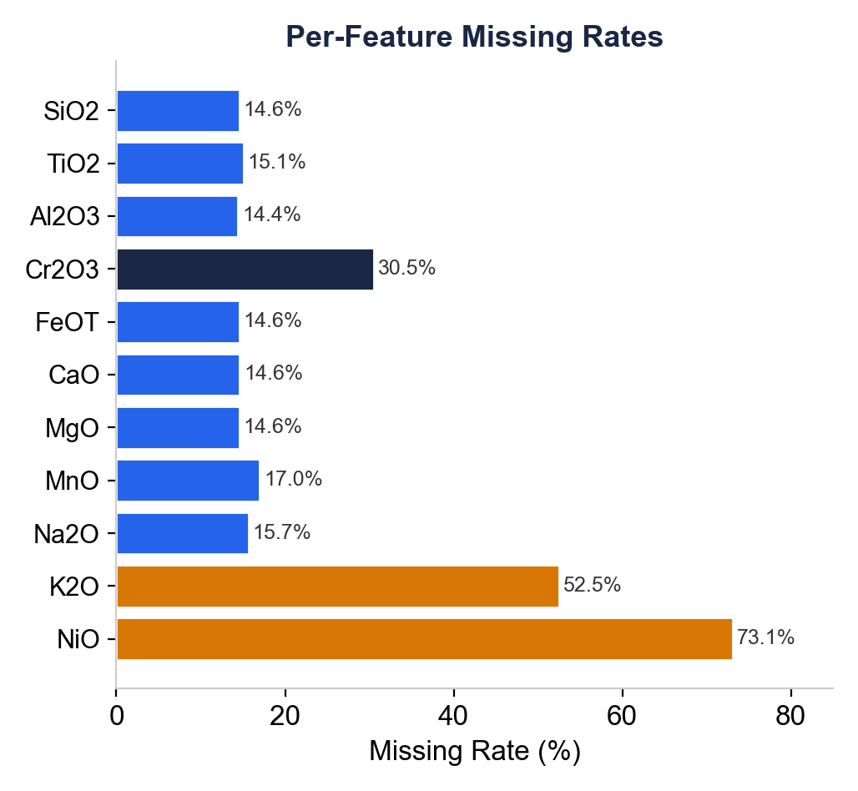
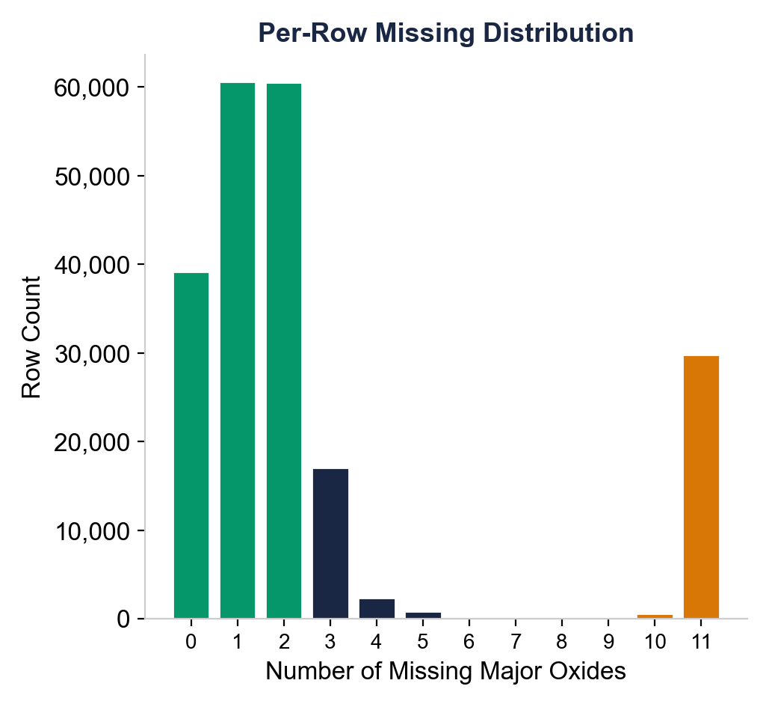
Missing Data Challenge
Zero rows have complete major oxide coverage. 81% of rows (172,142) are missing ALL 32 trace elements.

Slide 4
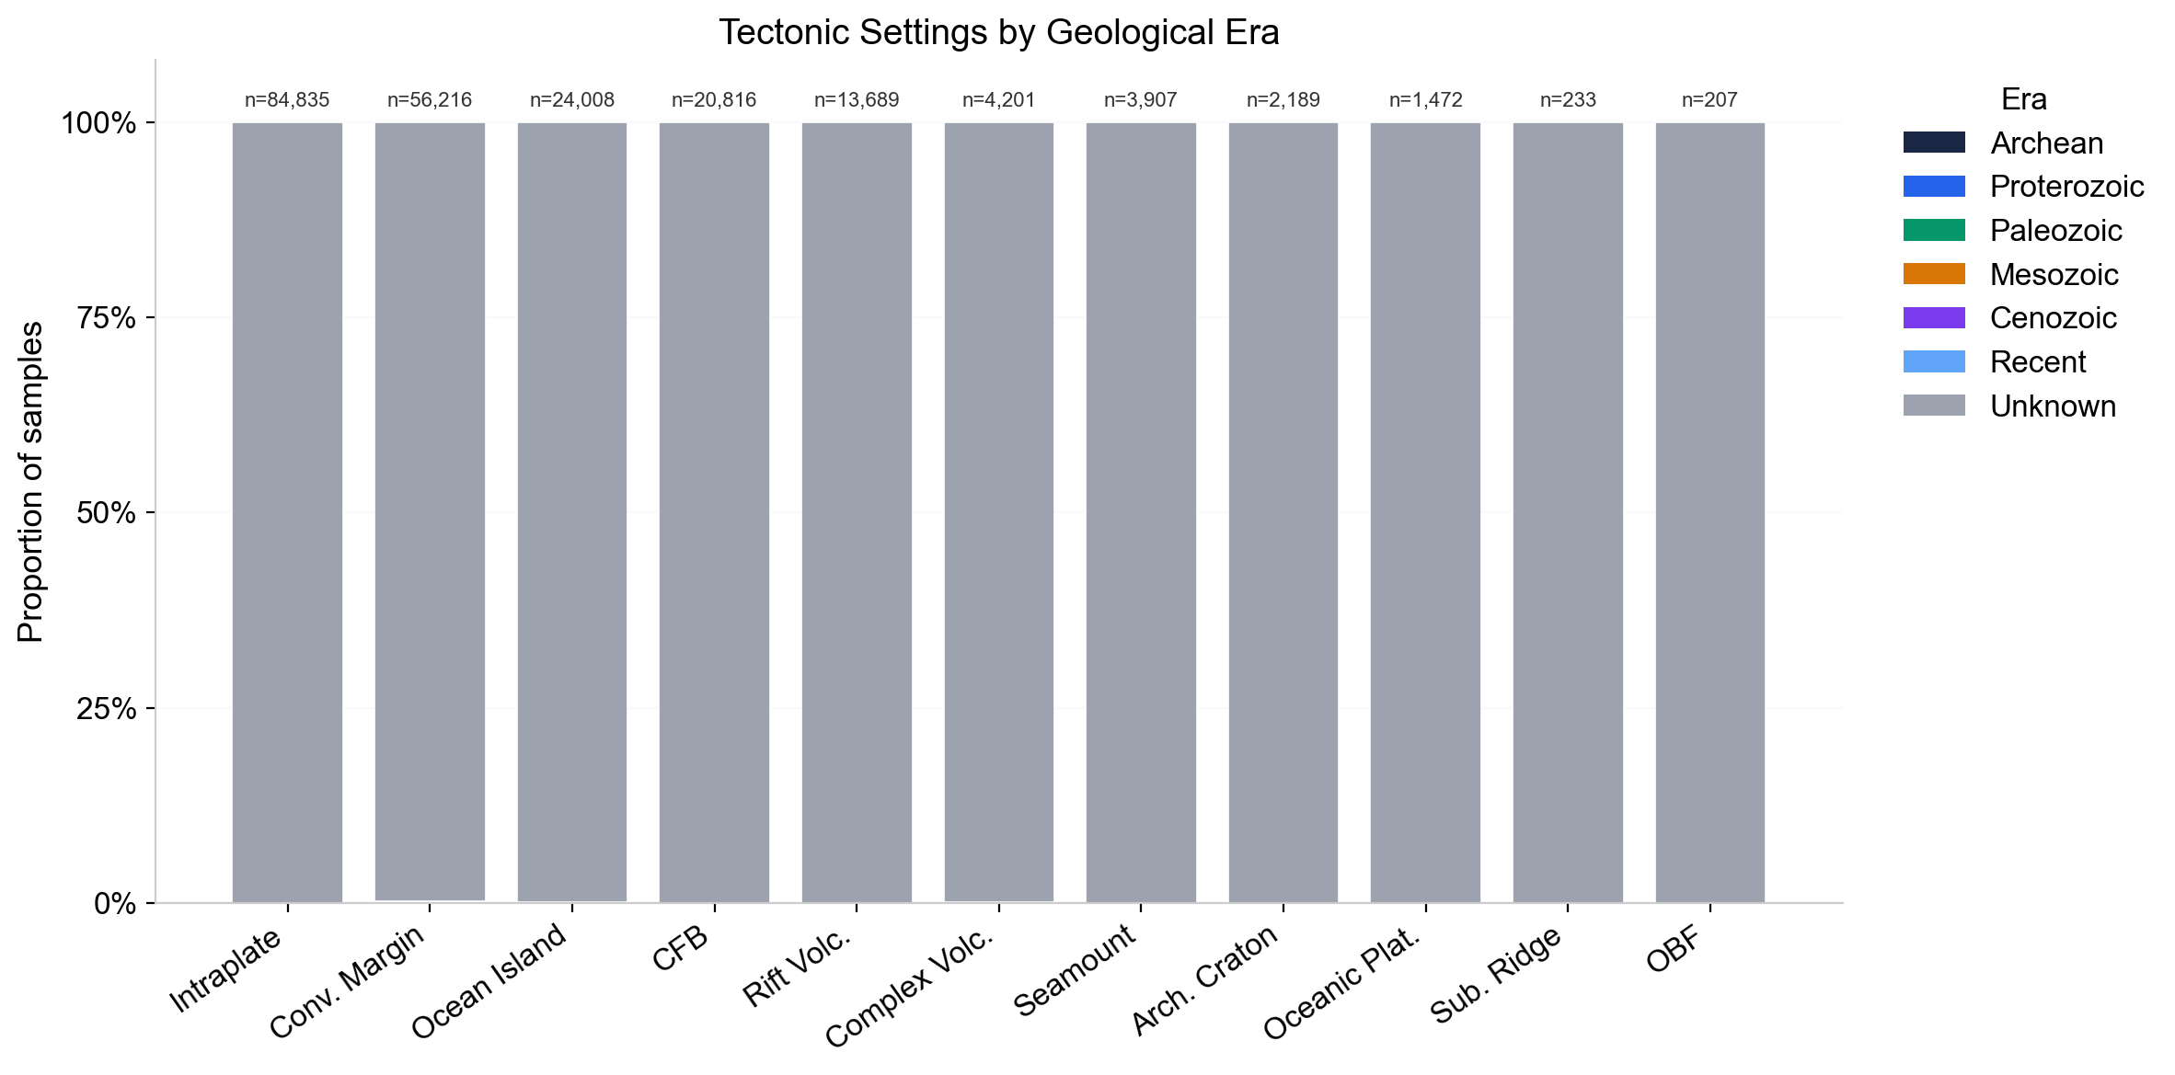
Data Availability -- Temporal Metadata Gap
Only 0.076% of samples have AGE(MA) metadata (161 / 211,773)
Age coverage: 0.076%
6 / 11 classes have ZERO aged samples
Intraplate: 16 / 84,835
Conv. Margin: 125 / 56,216
Ocean Island: 11 / 24,008
CFB: 0 / 20,816
Rift Volc.: 3 / 13,689
Complex Volc.: 6 / 4,201
Seamount: 0 / 3,907
Arch. Craton: 0 / 2,189
Oceanic Plat.: 0 / 1,472
Sub. Ridge: 0 / 233
OBF: 0 / 207
Age metadata cannot be used for feature engineering or stratification. Recommend flagging to GEOROC / GRO.data maintainers.

Slide 5
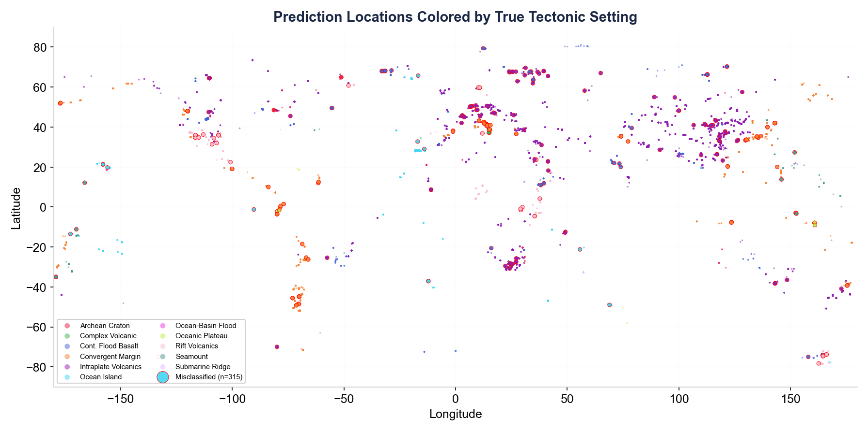
Spatial Distribution of 39,631 Predictions
39,631 predictions: 39,316 correct (99.2%), 315 misclassified (red edges). Misclassifications are geographically dispersed, not clustered.

Slide 6
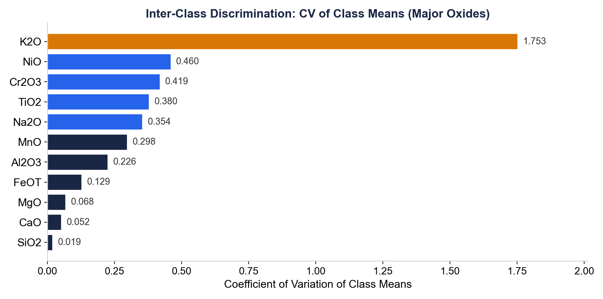
Feature Discrimination Power
K2O shows by far the strongest inter-class separation (CV = 1.753) -- not traditionally considered a key CPX discriminator.

Slide 7
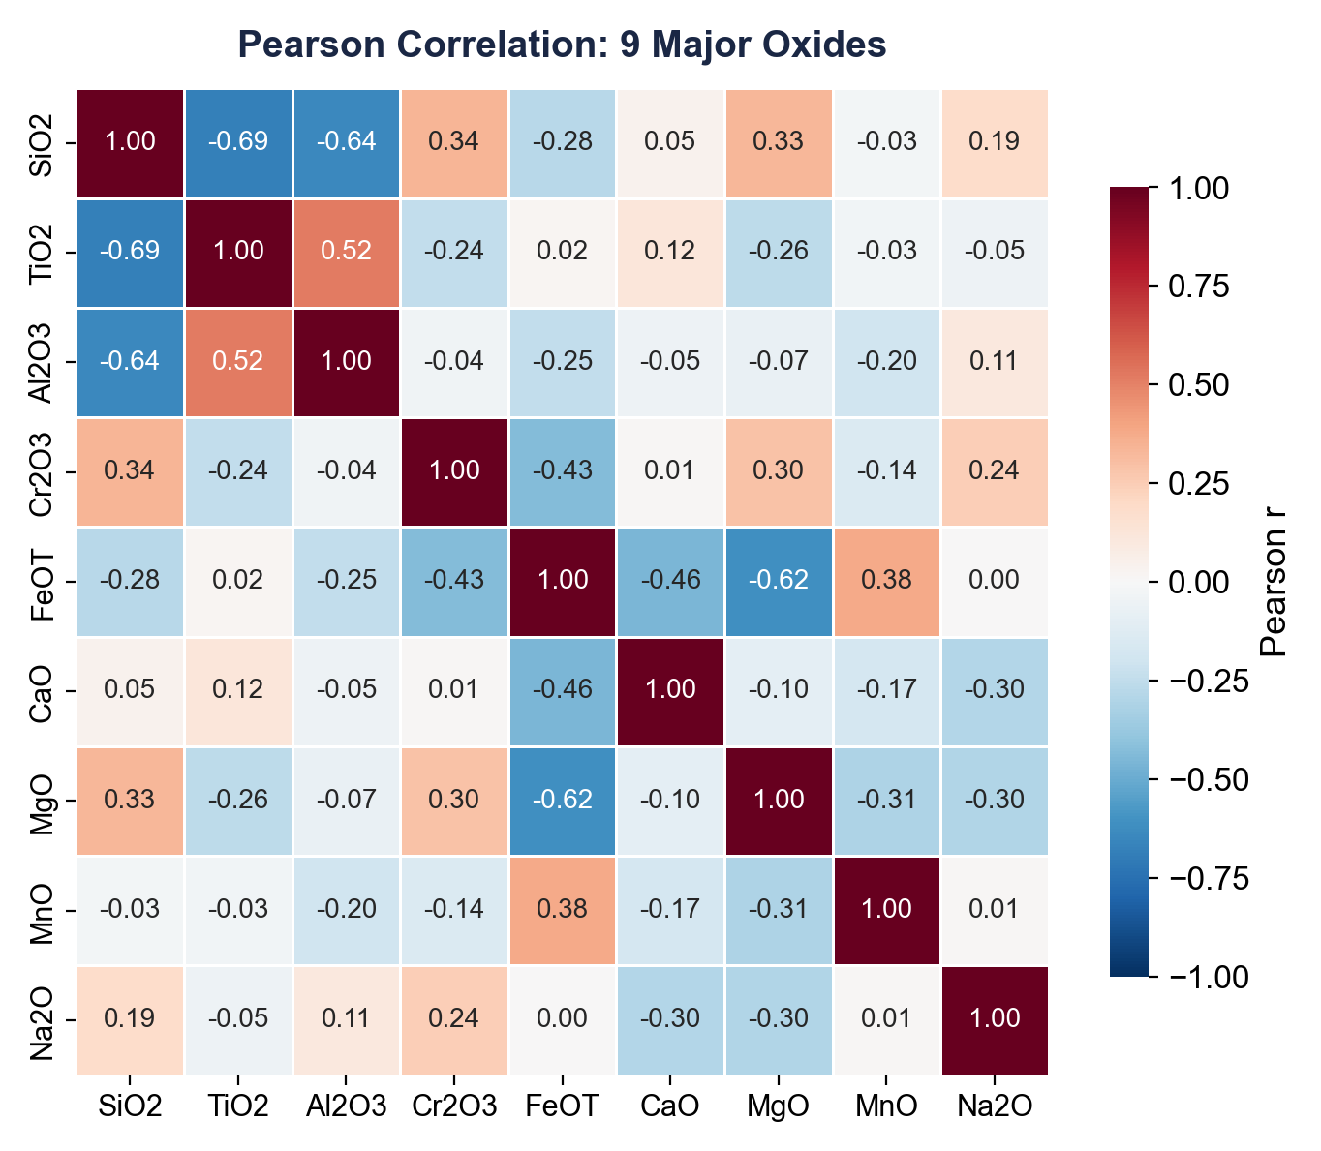
Major Oxide Correlation Matrix
Strong correlations: FeOT-MgO (r=-0.62), SiO2-TiO2 (r=-0.69), SiO2-Al2O3 (r=-0.64). These affect model interpretation via feature collinearity.

Slide 8
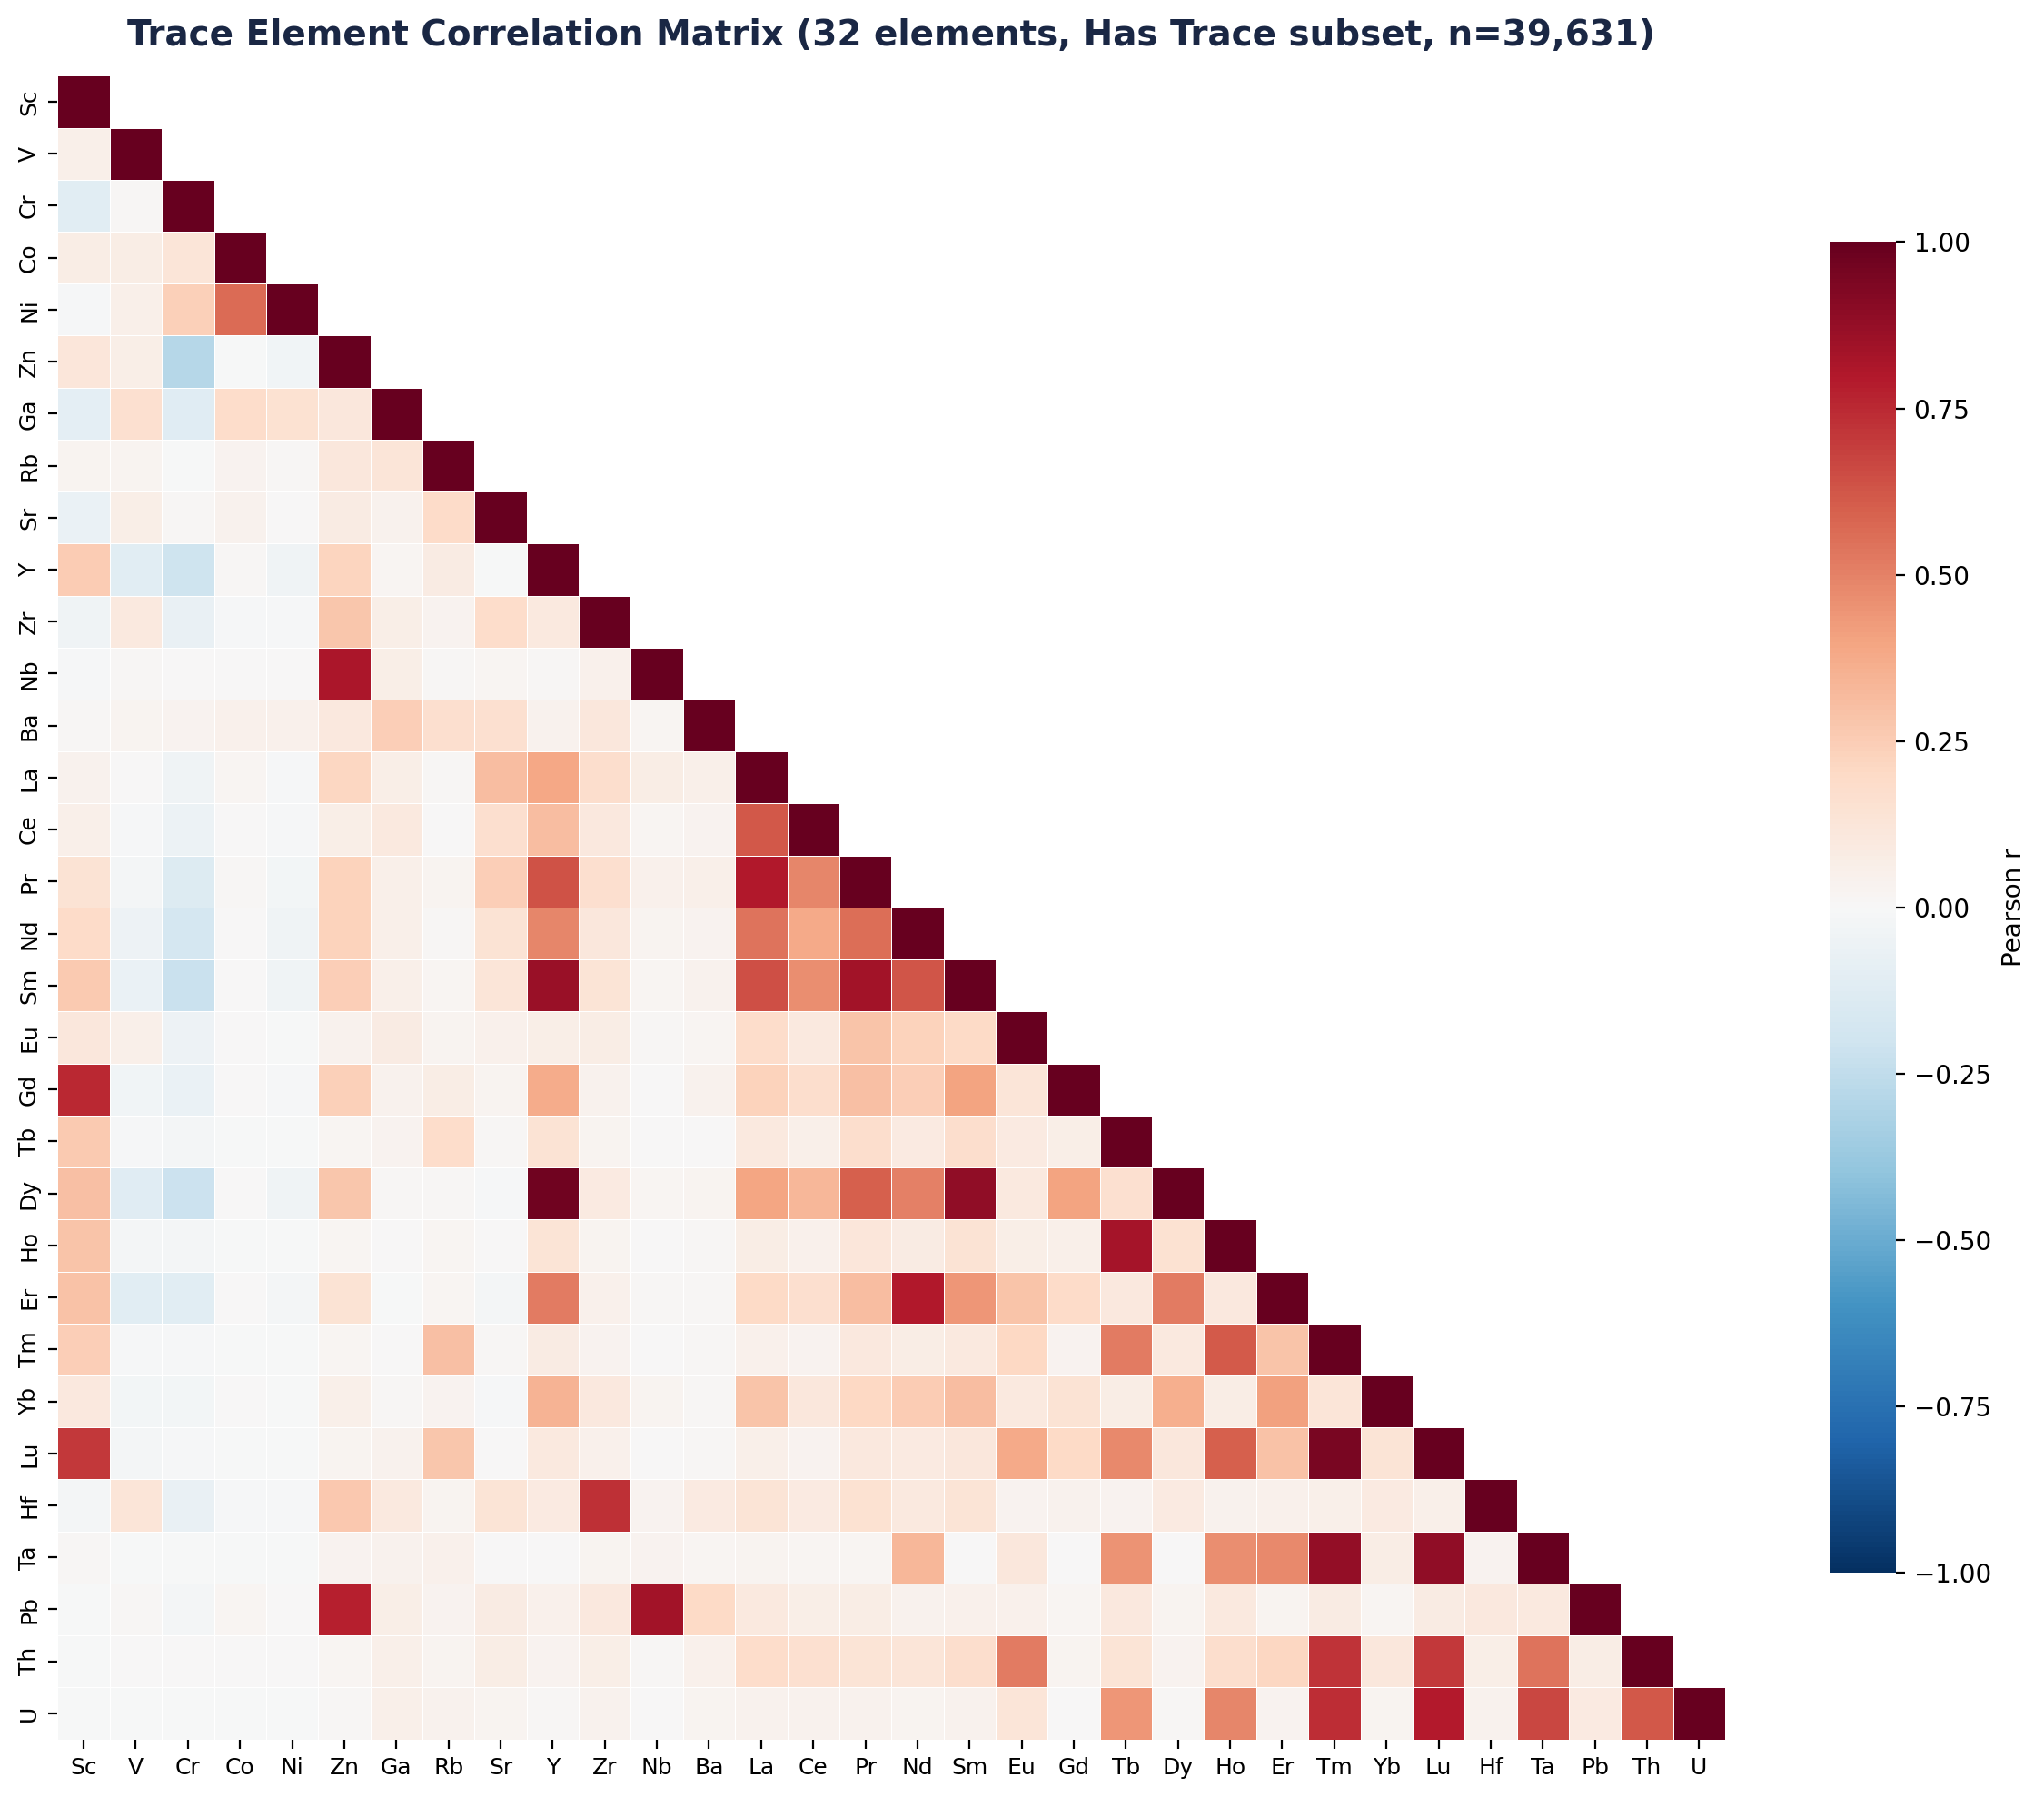
Trace Element Correlation Matrix
REE block (La-Lu) shows strong internal correlations (r > 0.8). HFSE (Zr, Hf, Nb, Ta) form a second correlated group. These clusters inform feature importance interpretation.

Slide 9
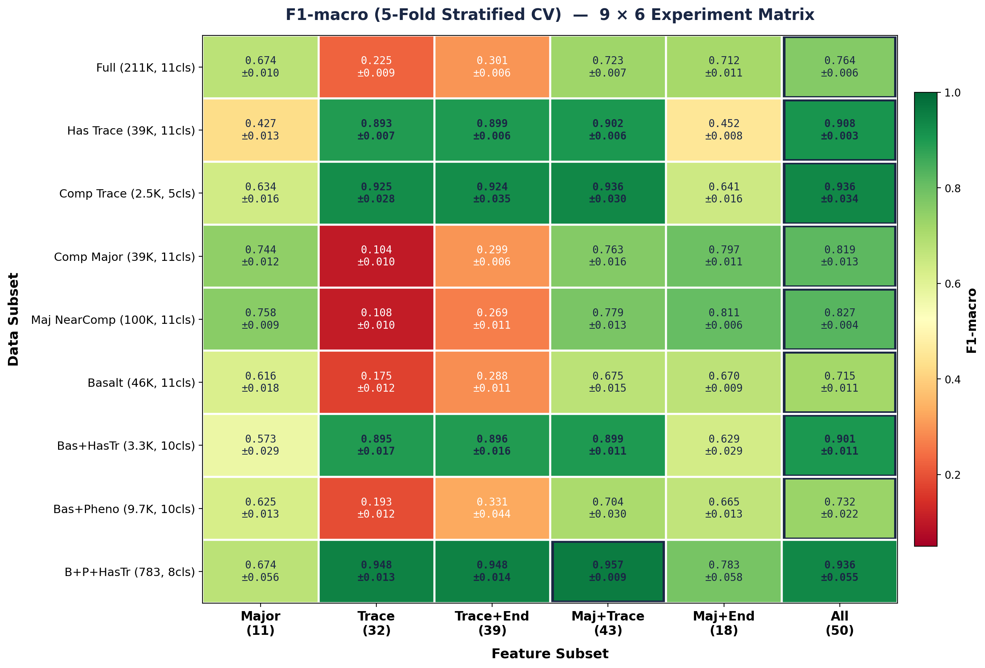
Experiment Matrix: 9 Data Subsets × 6 Feature Groups
54 experiments, 5-fold stratified CV each. Best practical: Has Trace × Major+Trace (43 feat) = F1m 0.902. Black border = best per row.

Slide 10
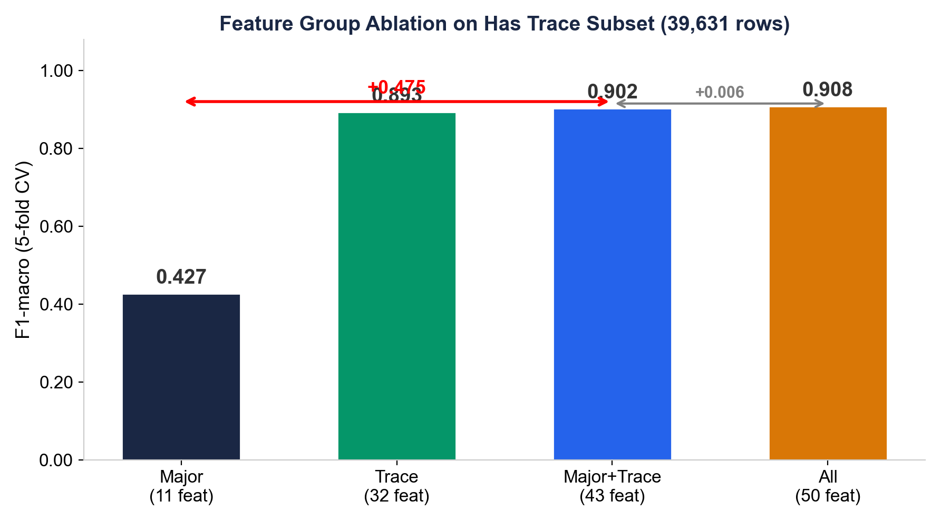
Trace Elements Are the Decisive Discriminator
Trace elements add +0.475 F1 over major oxides alone. Endmembers add only +0.006 over Major+Trace -- dropped for parsimony (43 features).

Slide 11
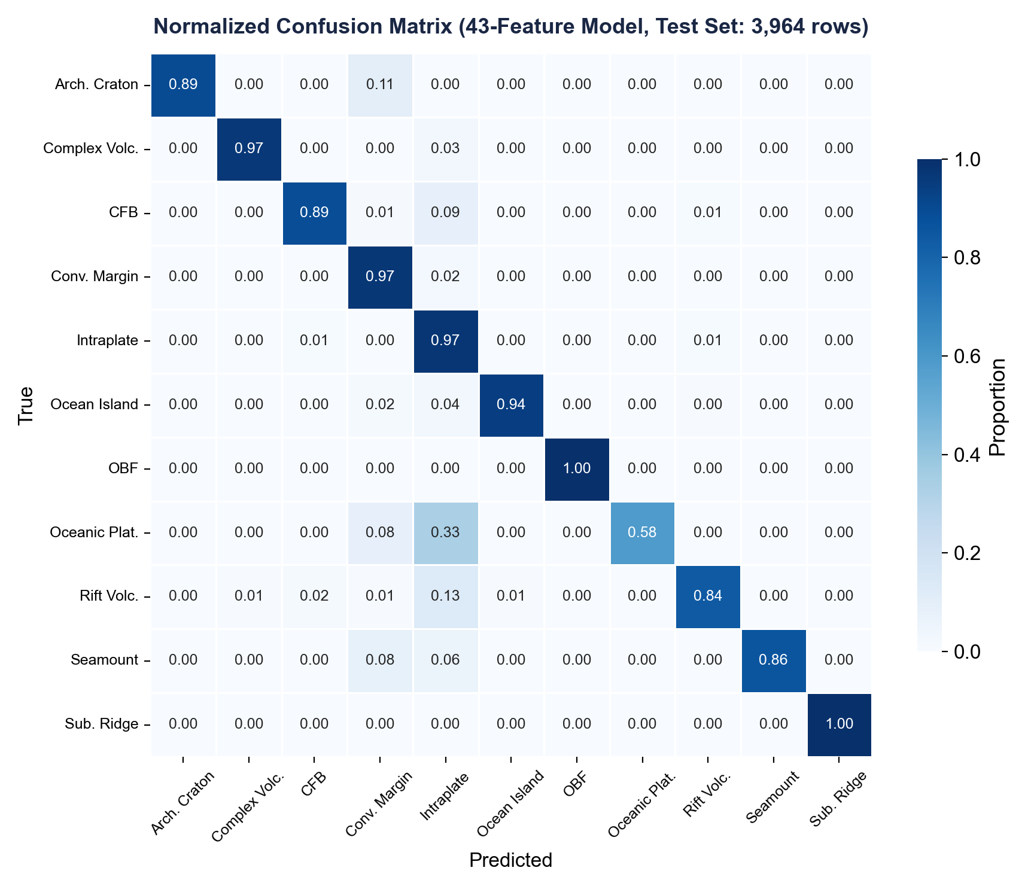
43-Feature Model, 90/10 Split: Test Set Confusion Matrix
43-feature model test set: F1-macro = 0.914. Diagonal dominance is strong across all 11 classes.

Slide 12
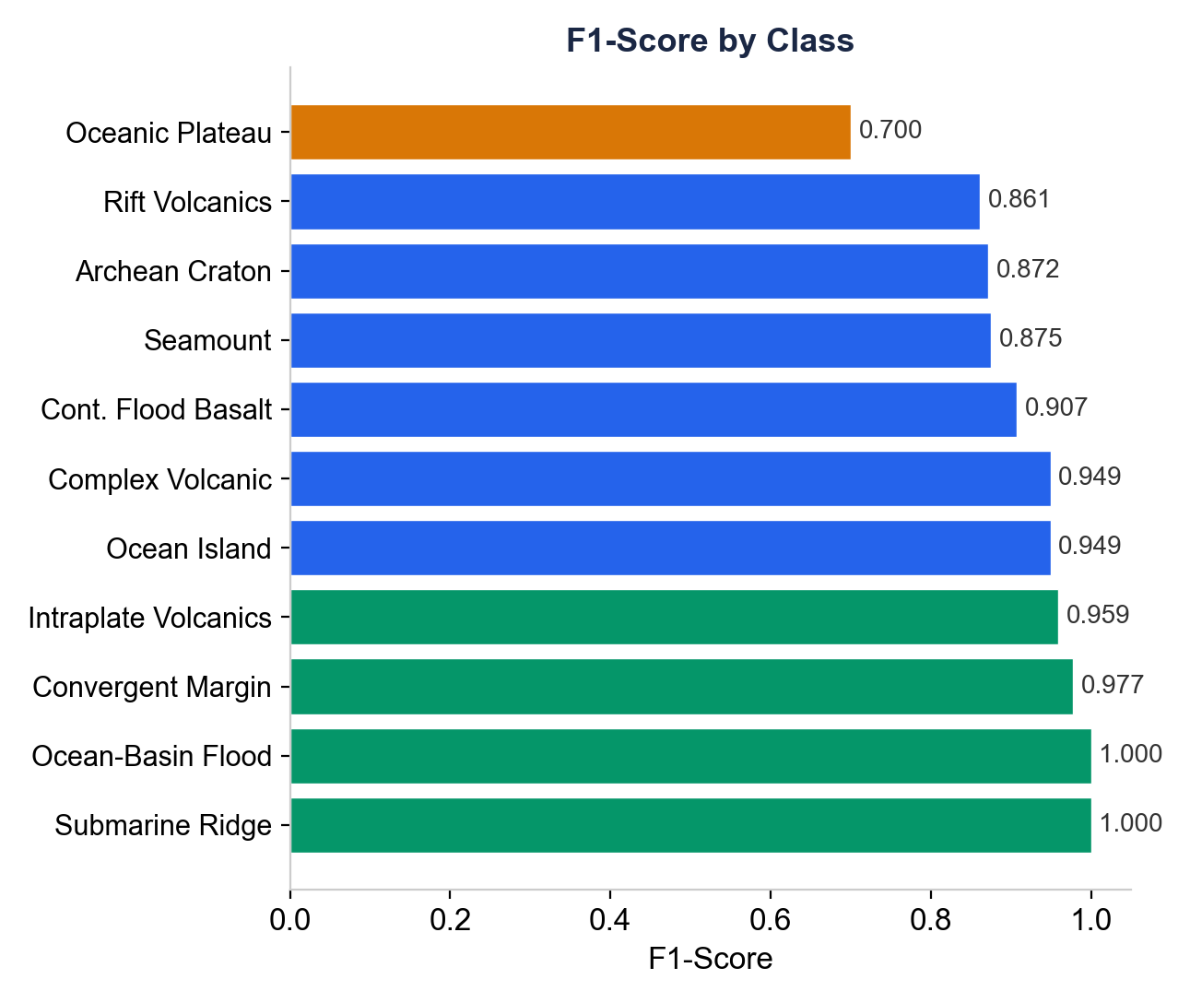
Per-Class Classification Performance
Class | n | F1
Oceanic Plateau | 12 | 0.700
Rift Volcanics | 189 | 0.861
Archean Craton | 19 | 0.872
Seamount | 49 | 0.875
Cont. Flood Basalt | 292 | 0.907
Complex Volcanic | 58 | 0.949
Ocean Island | 228 | 0.949
Intraplate Volcanics | 1,699 | 0.959
Convergent Margin | 1,408 | 0.977
Ocean-Basin Flood | 6 | 1.000
Submarine Ridge | 4 | 1.000
Hardest classes: Archean Craton (F1=0.76, n=194), Oceanic Plateau (F1=0.82, n=116) -- both confused with Intraplate Volcanics. Easiest: Ocean-Basin Flood (F1=0.98, n=59).

Slide 13
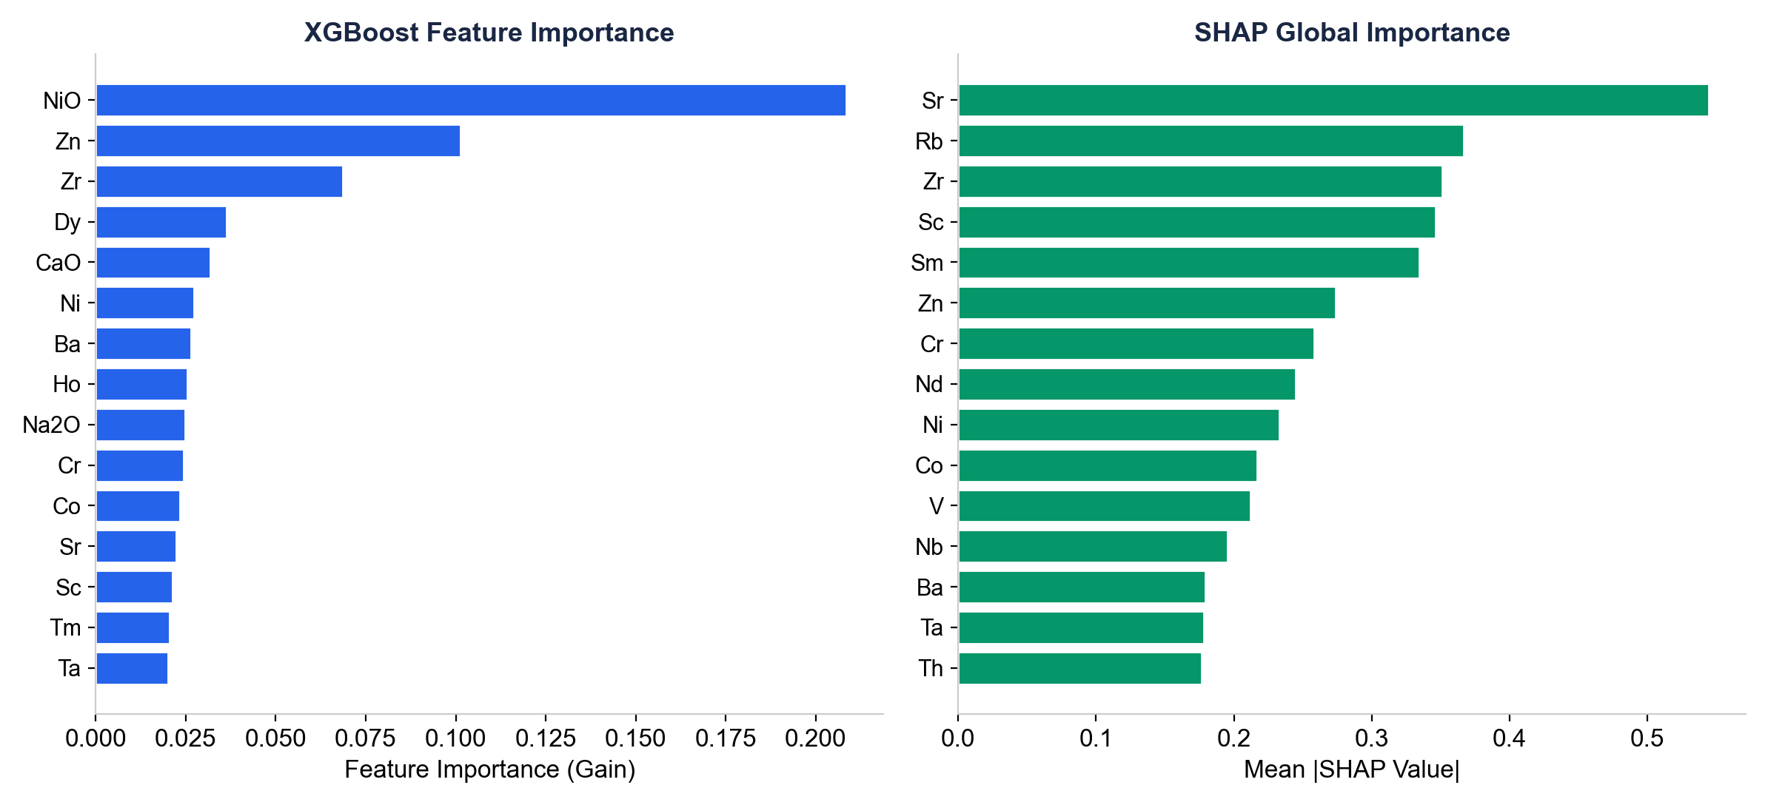
Feature Importance: XGBoost Gain vs. SHAP
43-feature model (Major+Trace, no endmembers). Both Gain and SHAP highlight trace elements (Sr, Sm, Zr) as key prediction drivers.

Slide 14
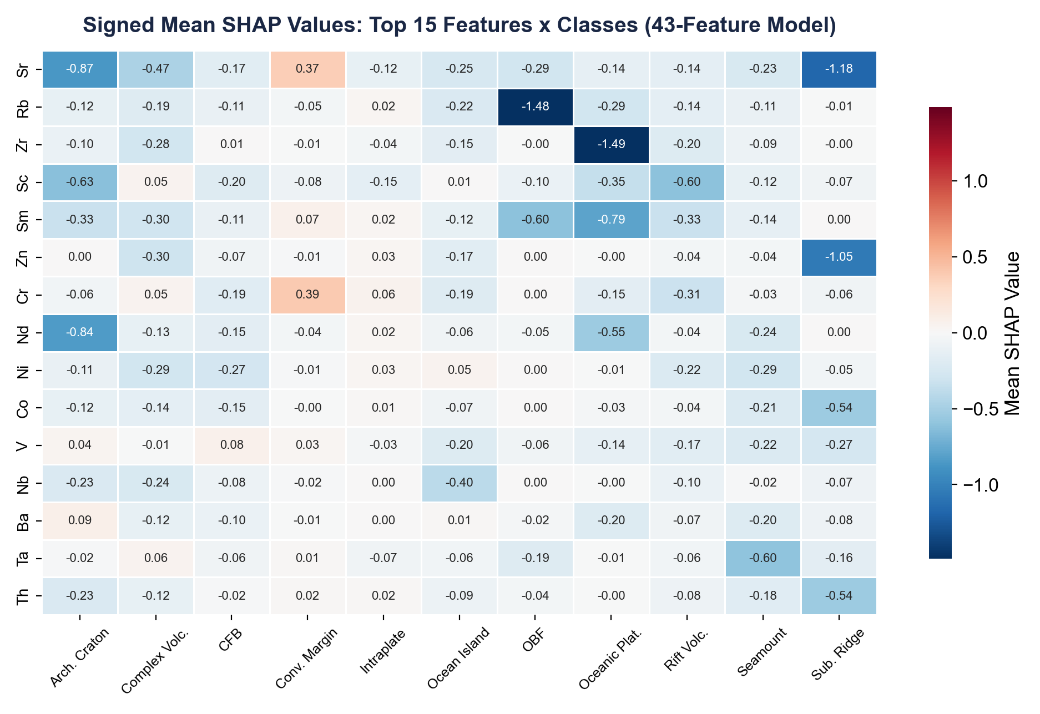
SHAP Per-Class Feature Importance
Signed SHAP shows feature-class relationships. Sr pushes toward Convergent Margin but away from Archean Craton and Submarine Ridge.

Slide 15
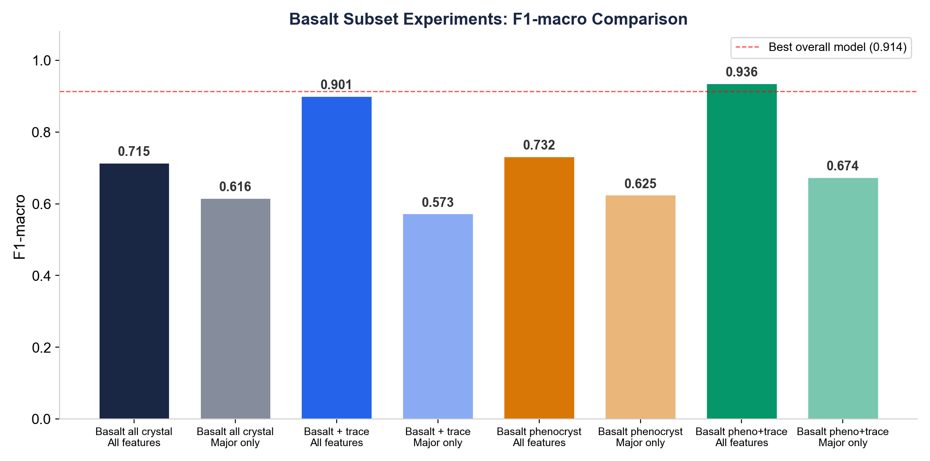
Basalt Subset Classification
Basalt phenocryst + trace data achieves F1-macro = 0.936 (5-fold CV, 8 classes). Trace elements consistently provide the decisive performance boost.

Slide 16
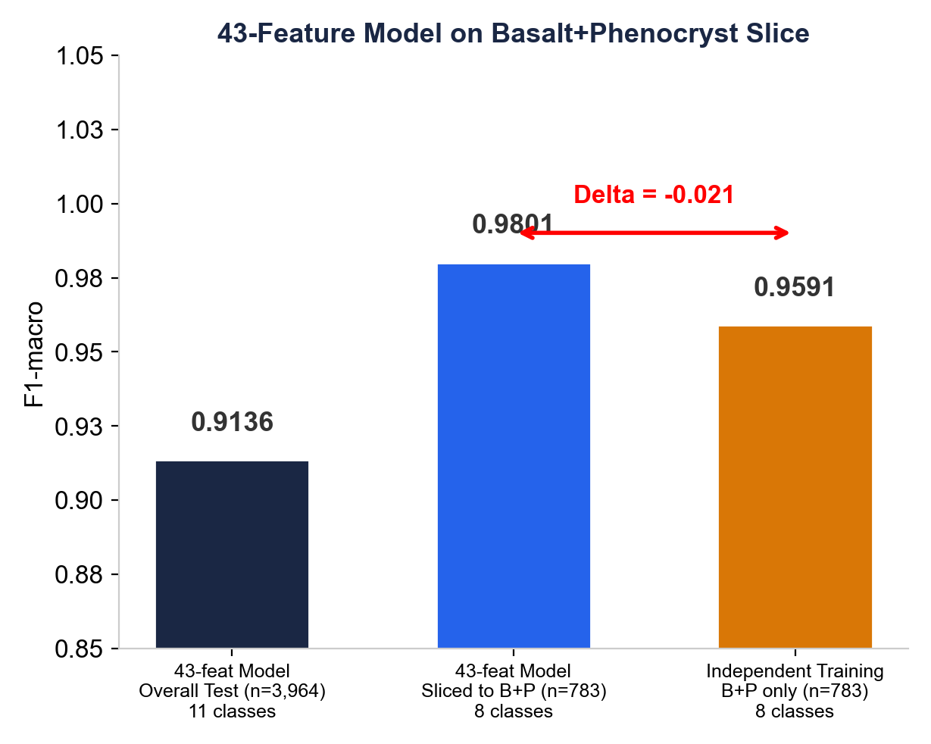
Stratified Evaluation: Best Practical on Basalt + Phenocryst
Class | n | Sliced F1 | Indep F1 | Δ (I−S)
Convergent Margin | 424 | 0.997 | 0.961 | -0.036
Seamount | 106 | 0.986 | 0.873 | -0.113
Ocean Island | 90 | 1.000 | 0.972 | -0.028
Intraplate Volcanics | 57 | 0.983 | 0.904 | -0.079
Complex Volcanic | 46 | 1.000 | 0.978 | -0.022
Rift Volcanics | 39 | 0.987 | 0.987 | +0.000
Oceanic Plateau ! | 16 | 1.000 | 1.000 | +0.000
Cont. Flood Basalt ! | 5 | 0.889 | 1.000 | +0.111
43-feature model on the 783 basalt+phenocryst samples gives F1m = 0.980. The gap to the independently trained model is driven mainly by small-class overfitting. No specialised model needed.

Slide 17
Key Conclusions
■ 43-feature model (Major+Trace, no endmembers): F1-macro = 0.914 on test set (90/10 split, 39,631 rows)
■ Endmembers contribute <0.006 F1; dropped for parsimony (43 vs 50 features)
■ Trace elements are decisive: +0.475 F1-macro contribution when added to major oxides
■ K2O is the strongest statistical discriminator among major oxides (CV = 1.753)
■ SHAP analysis: Sr, Sm, Zr, Sc have the highest individual prediction impact
■ Intraplate Volcanics dominated by mantle xenoliths -- F1 drops on basalt+phenocryst slice
■ 54-experiment matrix (9 subsets x 6 feature groups) confirms robustness across configurations
■ Class imbalance (409.8 : 1) managed via balanced sample weights, not resampling

Slide 18
Methodology Summary
Model
Features
• XGBoost (tree_method='hist')
• max_depth = 12, learning_rate = 0.08
• n_estimators = 400
• Native NaN handling (no imputation)
• Balanced sample weights for class imbalance
• 11 major oxides (SiO2 through NiO)
• 32 trace elements (Sc through U)
• 43 total features (no endmembers)
Interpretation
• SHAP TreeExplainer (1,000 sample subset)
• Global and per-class feature importance
• Signed SHAP values for directional effects
Validation
• 90/10 stratified split (primary model)
• 54-experiment matrix with 5-fold CV
• F1-macro as primary metric (equal class weighting)
Data: GEOROC / GRO.data (DOI:10.25625/SGFTFN) | 211,773 clinopyroxene analyses | 11 tectonic settings

