Slide 1

RFQ Participation
AgileApt Solutions Pvt Limited

Slide 2
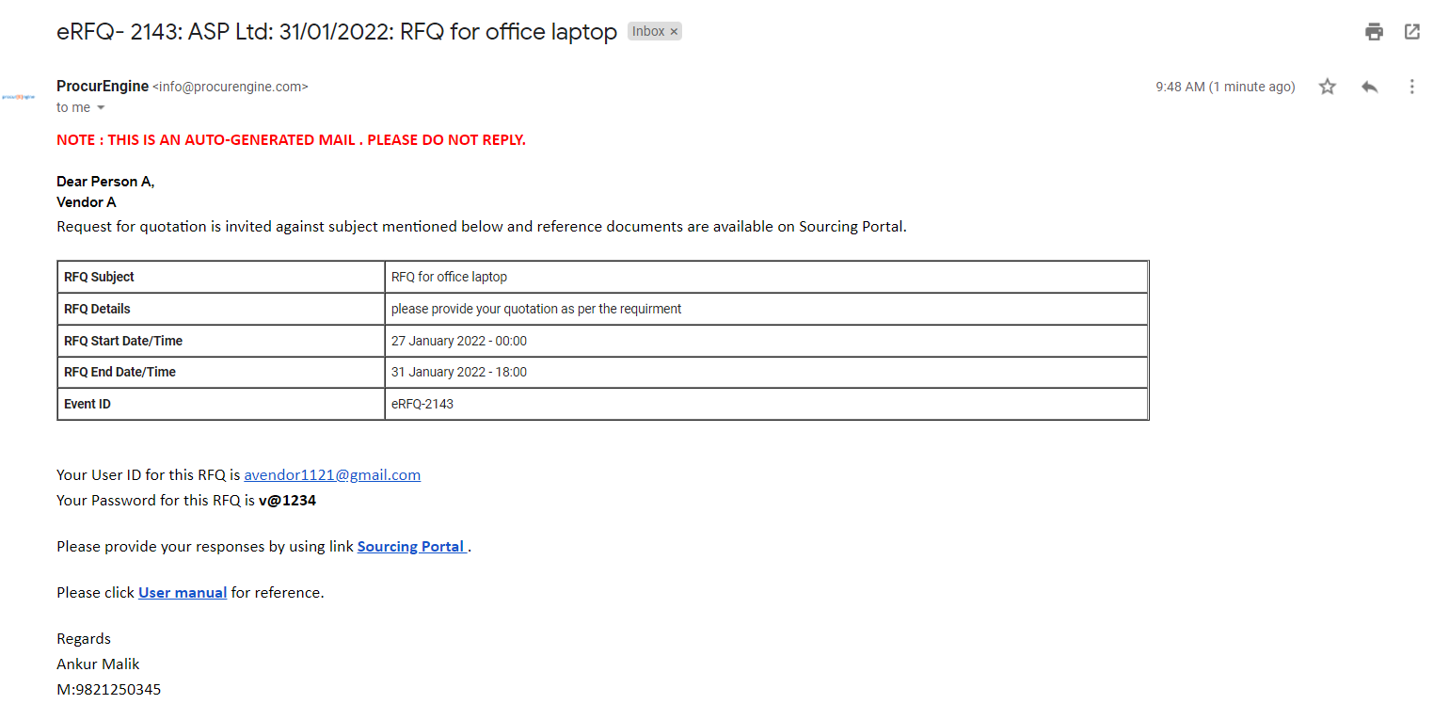
The vendor will receive a mail notification from their client like this
RFQ event ID
Vendor username and password
XXXXX
To login to the portal click on Sourcing Portal

Slide 3
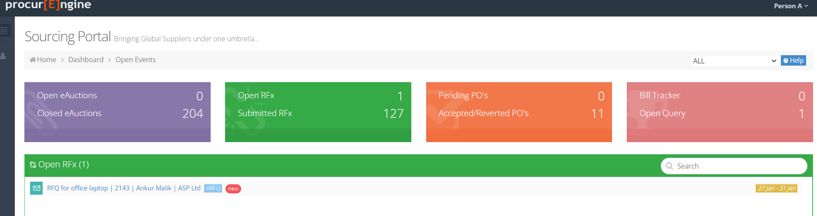
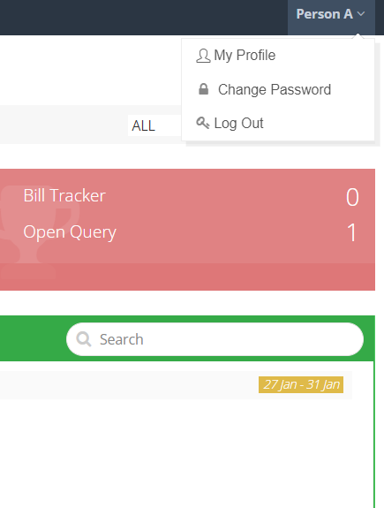
To change the password click on profile on the right side of the portal

Slide 4
You can view the count of open RFQs or bids
You will find the live RFQ details here

Slide 5
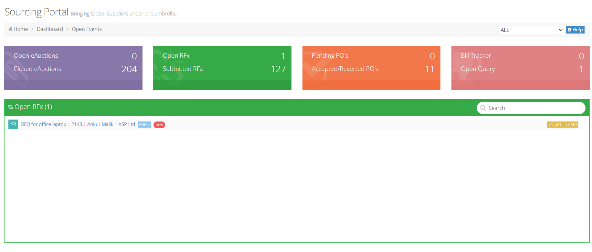
This is the event ID of the open RFQ

Slide 6
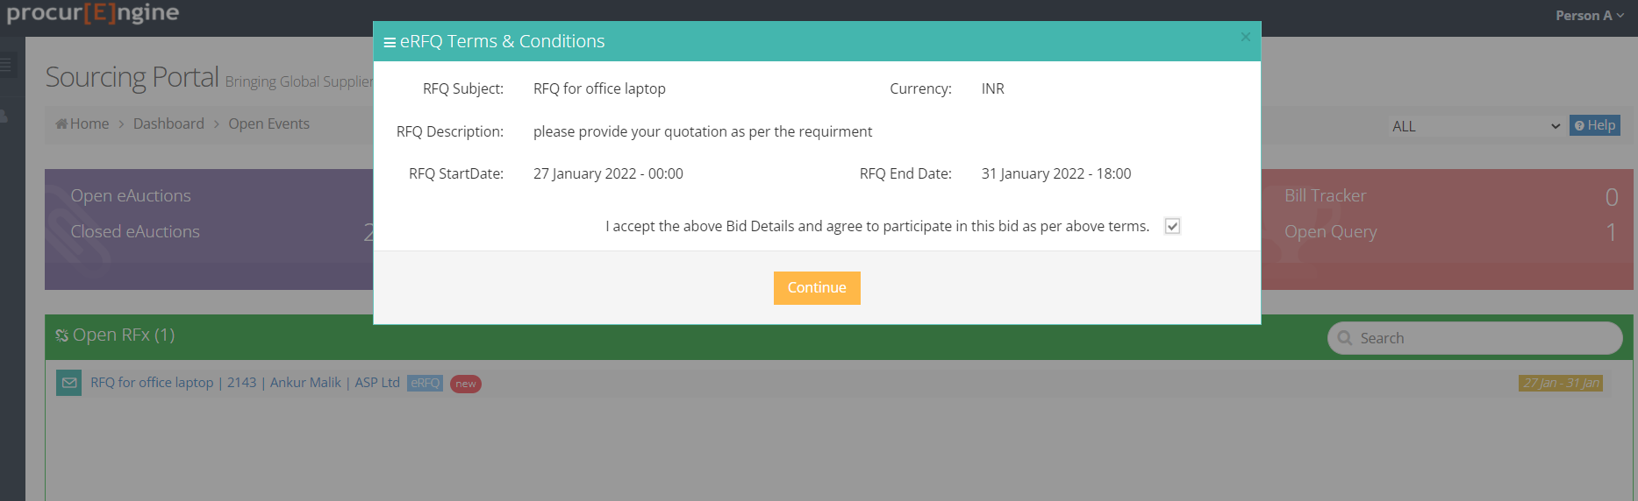
When you click on the RFQ, this message will popup, click on the box to accept the participation

Slide 7
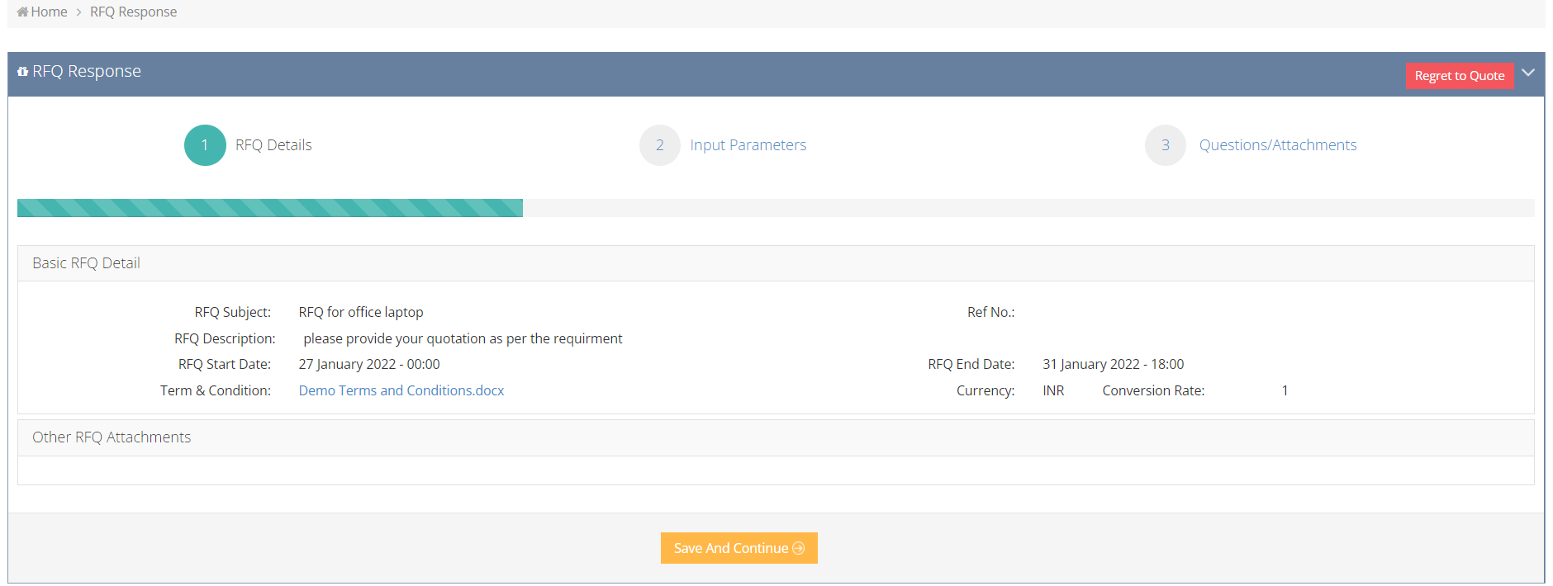
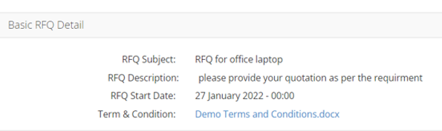
You can check and download the terms & conditions to quote accordingly
Check RFQ description for more details before moving forward

Slide 8
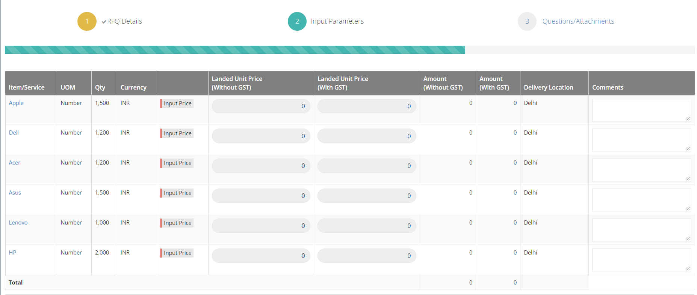
There might be a single item or multiple items in the RFQ to quote

Slide 9
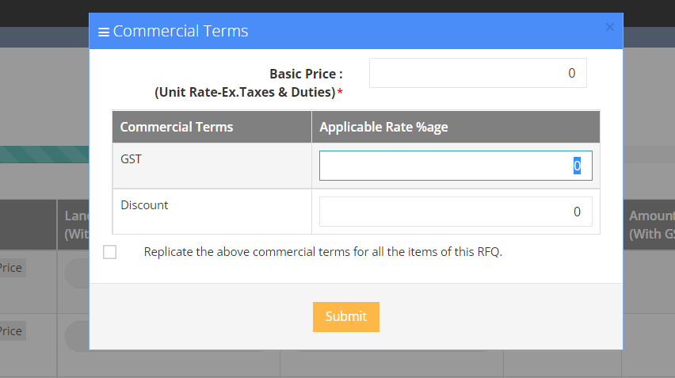
Click on input price to give your quotation

Slide 10
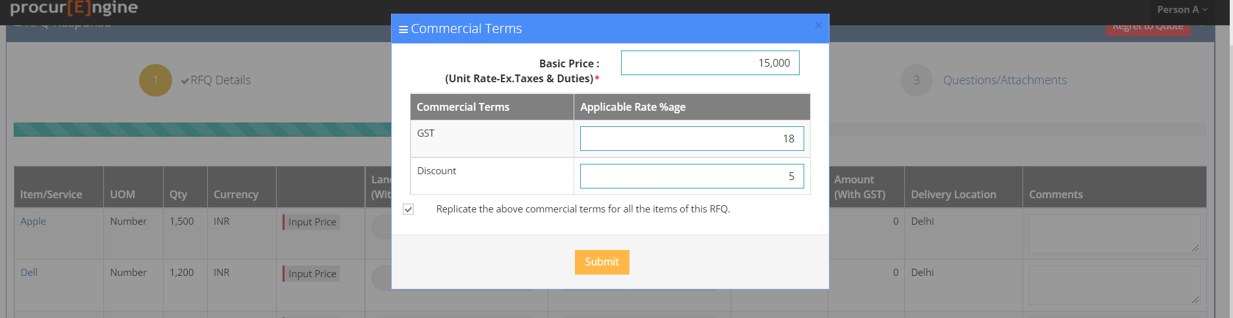
Enter your basic price. Also enter GST, discount and other commercial terms in numbers without ‘%’ sign

Slide 11
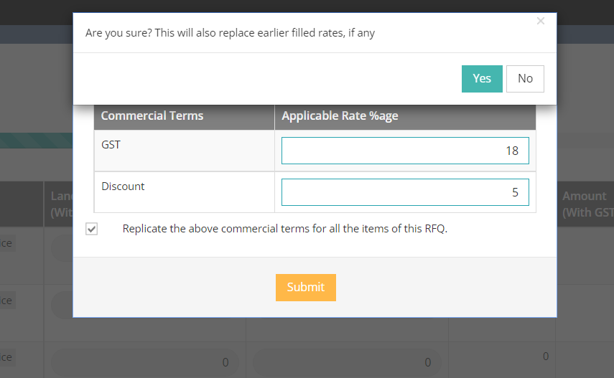
If you want to add the same GST, discount & other commercial terms for all items then click replicate and then click yes

Slide 12
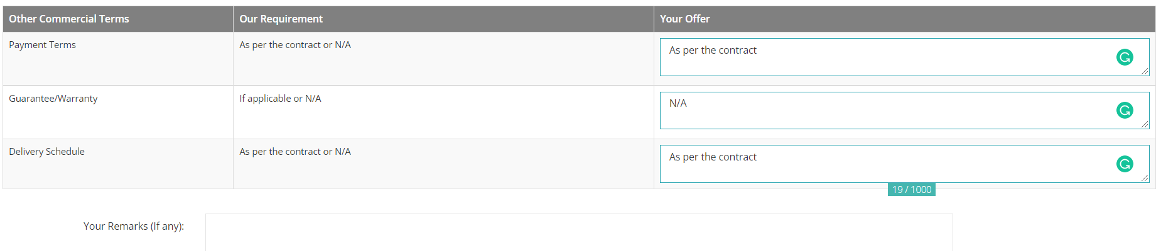
You can add your comments if any
Please fill all the necessary details

Slide 13
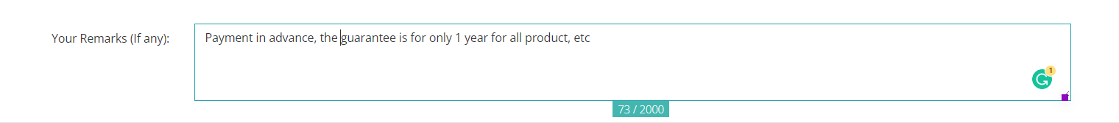
You can add extra remarks in this box if required

Slide 14
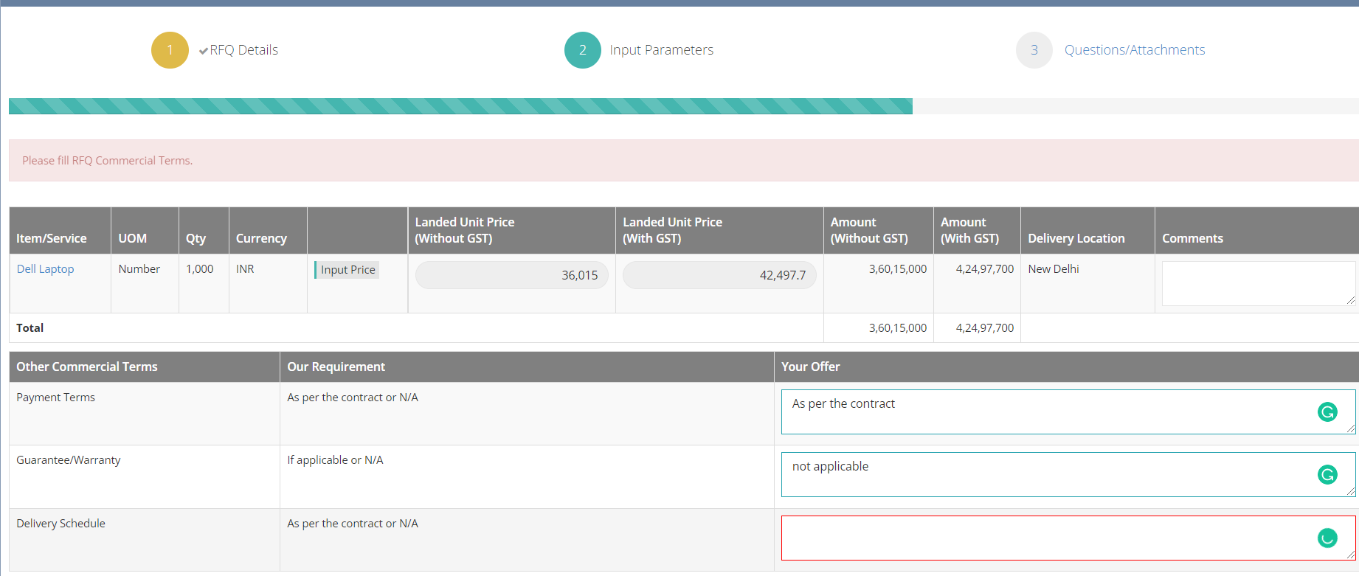
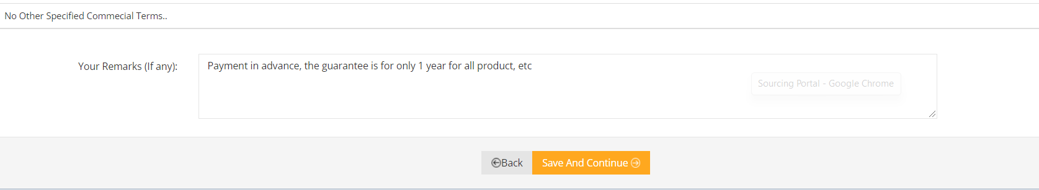
Make sure that no box is left unfilled otherwise it will not allow you to move forward
After filling details click save and continue

Slide 15
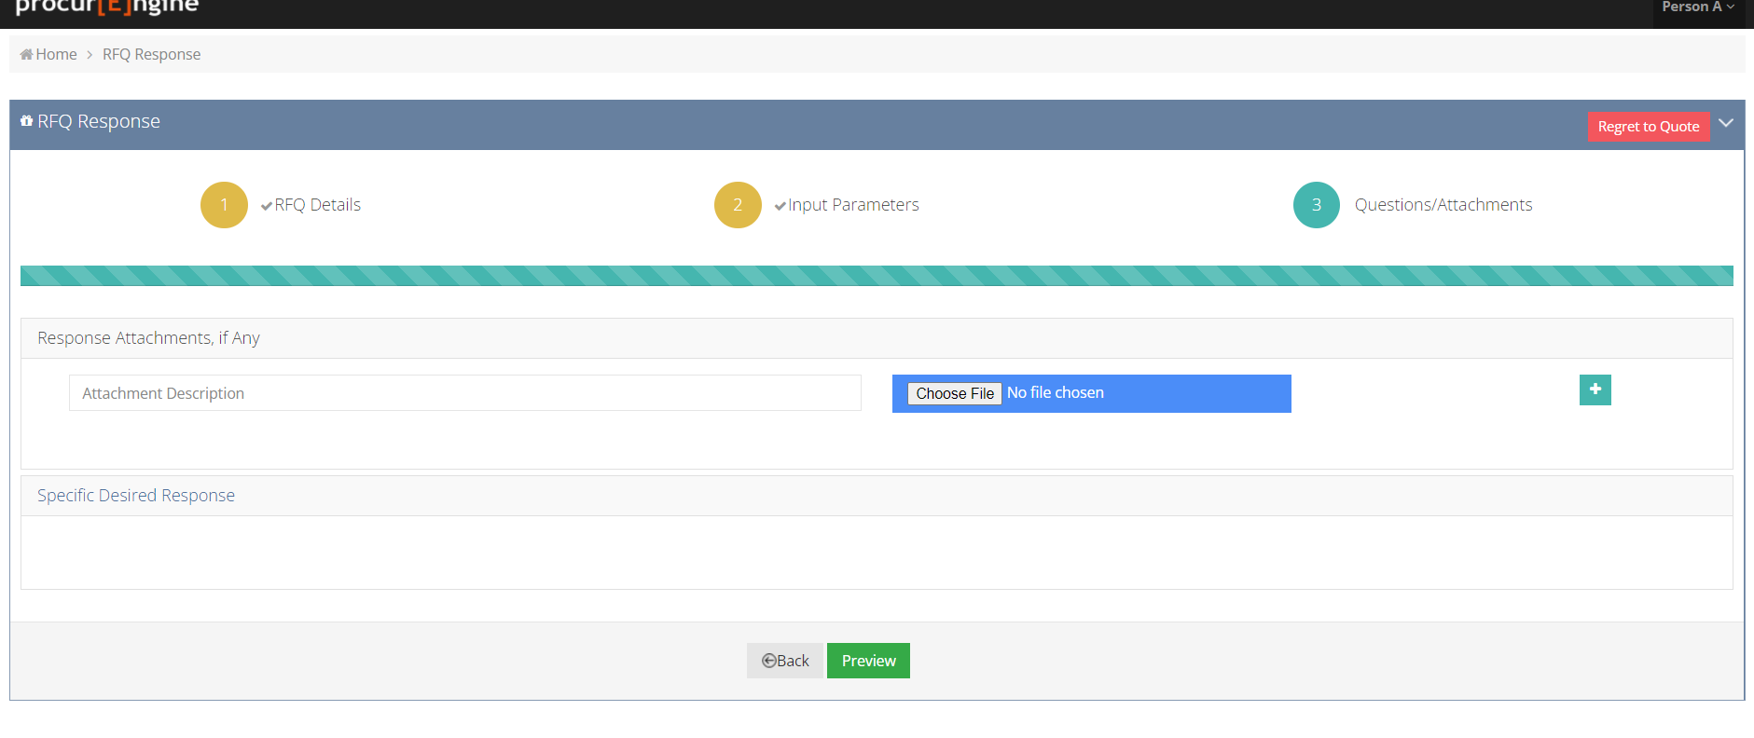

If you want to attach file then chose your file give it a name and click sign, if you don’t want to add a file then click Preview

Slide 16
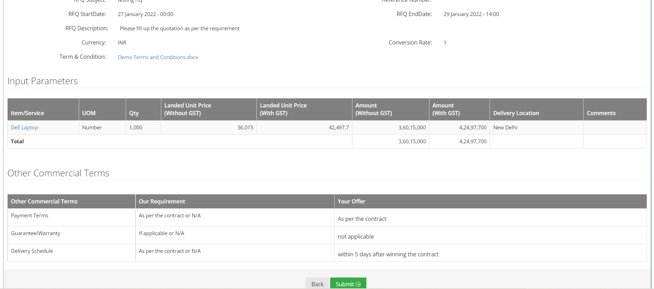
Go through all the details which you have filled in and then submit

Slide 17

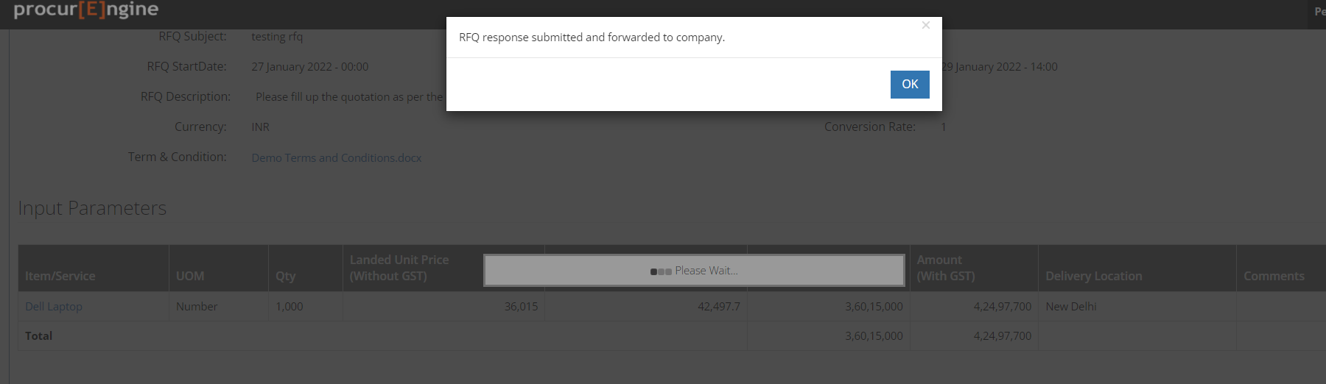
Press Ok when its done
You will receive a confirmatory email on your registered email ID upon successful submission

Slide 18
Thank You

