Slide 1

PHISHING AWARENESS
Done By,
S. Kamar Nisha
III Year - CSE
SCAD College of Engineering and Technology
TRAINING
RECOGNIZE - RESIST -REPORT

Slide 2


AGENDA
01
What is Phishing ?
07 Real-World Examples
02 Types Of Phishing Attacks
05 Social Engineering Tactics
08 Best Practices & Tips
03 Recognizing Phishing Emails
06 Mobile & SMS Threats
09 Incident Response
04 Spotting Fake Websites
10 Interactive Quiz

Slide 3

WHAT IS PHISHING ?...
*Phishing is a type of cybercrime in which attackers pretend to be trusted entities through emails, messages, or bogus websites to deceive people into handing over confidential information like login credentials, bank details, or personal data.
Why It Works?..
😰 Exploits fear & urgency
🎭 Uses trusted brand logos
📧 Mimics real email formats
3.4 B
36%
$17.7K
🤖 AI now makes it convincing
Phishing emails per day.
Of breaches involve phishing.
Lost per minute to phishing.
📱 Works across all devices

Slide 4






TYPES OF PHISHING ATTACKS....
Email Phishing
Spear Phishing
Whaling
Mass emails impersonating banks, retailers, or IT. Most common form
— billions sent daily.
Highly targeted emails using personal info (name, role, org). 65% of all cyberattacks start here.
Spear phishing aimed at executives (CEO, CFO). Goal: large wire transfers or confidential data.
Smishing (SMS)
Phishing via text message. 'Your parcel is held — click here.' Very high open rates.
Vishing
Phishing via text message. 'Your parcel is held — click here.' Very high open rates.
Clone Phishing Exact copy of a real email
with a malicious link swapped in. Appears to be a re-send.

Slide 5

RECOGNIZING PHISHING EMAILS....
🔴 Suspicious Sender Address
e.g. support@paypa1-secure.net instead of paypal.com
⚠ Urgent / Threatening Language
"Your account will be suspended in 24 hours!"
🔗 Suspicious Links
Hover first — real URL often doesn't match display text
✍ Poor Grammar & Spellingg
Typos, odd phrasing, or machine-translated text
📎 Unexpected Attachments
.exe, .zip, .docm with macros, or password-protected ZIPs
🏦 Request Infos for Sensitive
Banks, PayPal, and Google never ask for passwords via email

Slide 6

SPOTTING FAKE WEBSITES...
❌ FAKE
✅ REAL
http ://payp a1-secure.login-verify.com/account t
https://www.paypal.com/signin
No HTTPS / padlock icon
Misspelled domain (paypa1 not paypal)
Suspicious subdomain chain
Non-standard TLD (.net, .xyz, .info)
HTTPS + padlock (valid certificate)
Exact domain match
Clean, minimal URL path
Known, trusted TLD (.com, .gov, .edu)
📋
Type URLs directly — don't
🛡
Password managers
won't fill fakes
🔒
Always check
HTTPS padlock
🔍
Verify exact domain
spelling

Slide 7



SOCIAL ENGINEERING TACTICS...
Attackers exploit human psychology — not just technology...
URGENCY
AUTHORITY
FEAR
Create panic to bypass rational thinking. 'Act NOW or lose access!'
Impersonate CEO, IT dept, banks, or government agencies.
Threaten consequences: fines, account closure, legal action.
CURIOSITY
RECIPROCITY
SOCIAL PROOF
'You have a package.' 'Someone tagged you.' Bait content.
Offer something free (gift card, prize) to get something valuable.
'Your colleagues already updated their details.' Peer pressure.

Slide 8
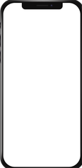


MOBILE AND SMS THREATS (SMISHING)...
98 %
of texts are read within 3 minutes
10 X
higher click rate vs. phishing emails
Common Smishing Lures
📦 Fake package delivery
🏦 Bank fraud alerts
🎁 Prize / lottery wins
Unknown +1-800-XXX:
USPS: Your parcel #94748 has been held. Confirm address: http://usps-delivery-us.com
⚠ FAKE — note suspicious domain
Your Bank (Spoofed):
ALERT: Unusual login detected. Verify NOW: http://bankofamerica-secure.net/login
⚠ FAKE — banks text, not link to password
IRS Text:
IRS: You owe $3,217 in back taxes. Pay immediately to avoid arrest: bit.ly/irs-pay
⚠ FAKE — IRS never texts payment demands

Slide 9
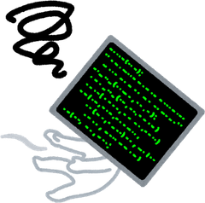



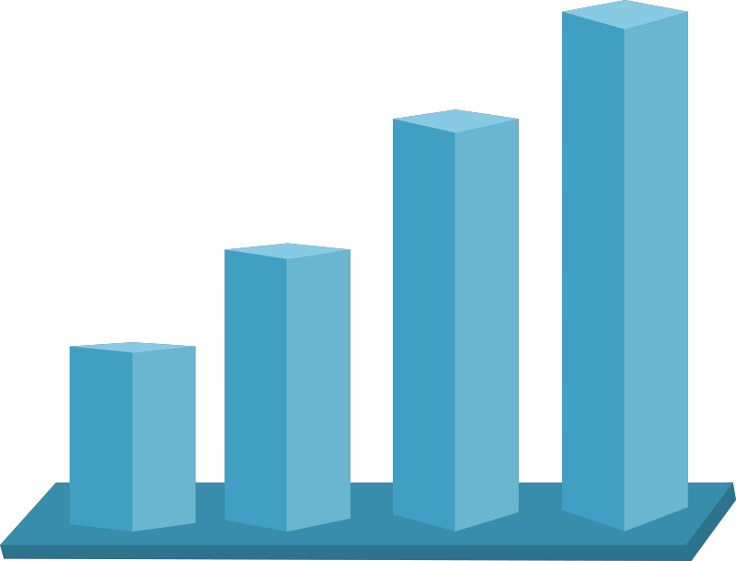



EVOLVING THREATS AI-POWERED PHISHING
AI-Written Emails
ChatGPT-style tools generate grammatically perfect, personalized phishing emails — no more typos to spot.
Deepfake Voice & Video
Data-Driven Targeting
Scraped LinkedIn/social data enables ultra-personalized attacks referencing real projects, names, and events.
Attackers clone a CEO's voice or create video calls. Employees have been tricked into wiring millions.
AI Phishing Kits
Polymorphic Phishing
QR Code Phishing (Quishing)
Malicious QR codes bypass email filters since they contain no clickable URLs — scanning leads to fake sites.
Drag-and-drop tools on the dark web allow even non-technical criminals to launch sophisticated campaigns.
Each email is slightly different to evade signature-based spam filters.
No two emails are identical.

Slide 10


REAL WORLD PHISHING CASE STUDIES
Google & Facebook (2013–2015)
Loss: $100M+
Fake vendor invoices from a domain impersonating Quanta Computer. Finance employees wired funds repeatedly.
💡 Always verify vendor identity via a separate communication channel.
Twitter Hack (2020)
Loss: BTC Scam
Phone spear-phishing tricked Twitter employees into giving admin access.
Hackers hijacked celebrity accounts.
💡 Even tech giants fail. Phone-based social engineering bypasses
email filters entirely.
Sony Pictures (2014)
Loss: Breach
Spear-phishing emails to executives led to full network compromise and terabytes of confidential data stolen.
💡 Executive-targeted attacks (whaling) can destroy entire organizations
Colonial Pipeline (2021)
Loss: $4.4M
Attackers accessed VPN with a leaked password likely obtained via phishing. Caused US fuel supply disruption.
💡 A single phished credential can shut down critical national
infrastructure.

Slide 11




BEST PRACTICES TO STAY SAFE
✅ DO
Verify sender email addresses carefully
❌ DON'T
❌ Click links in unexpected emails
Enable Multi-Factor Authentication (MFA)
❌ Open attachments from unknown senders
Use unique passwords + a password manager
❌ Enter credentials on unfamiliar sites
Think before you click — hover over links
❌ Share passwords or OTPs via phone/email
Report suspicious emails to IT/Security
❌ Ignore browser security warnings
Keep software and antivirus up to date
❌ Use public WiFi for sensitive accounts

Slide 12

IF YOU’VE BEEN PHISHED-- ACT FAST
1.
Stay Calm
2.
Disconnect
3.
Change Passwords
From a CLEAN device, change all compromised account passwords now.
Panic leads to more mistakes.
Take a breath and act methodically.
Unplug from the network immediately to stop potential data exfiltration.
4.
Enable MFA
5.
Report It
6.
Monitor Accounts
Add multi-factor authentication to every account if not already set.
Notify your IT/Security team, your bank, and authorities immediately.
Notify your IT/Security team, your bank, and authorities immediately.

Slide 13

INTERACTIVE QUIZ — TEST YOUR KNOWLEDGE
Q1. You get an email from 'security@amaz0n-alerts.com' asking you to verify your account. What do you do?
✅ Delete it. 'amaz0n-alerts.com' is NOT Amazon — it uses '0' instead of 'o'. Never click links from lookalike domains
Q2. A text says your Netflix account closes in 2 hrs. It has a link to 'login'. What's the red flag?
✅ Urgency + unverified SMS link. Real companies don't threaten immediate closure via text. Go directly to netflix.com instead.
Q3. Your 'CEO' emails asking you to urgently wire $5,000 to a new vendor — from your mobile. What now?
✅ Stop and verify via a phone call to the CEO's known number. This is a classic BEC (Business Email Compromise) whaling attack.
Q4. You receive a QR code in a printed flyer saying 'Scan to claim your free gift card.' Should you?
✅ Be cautious! QR codes can redirect to phishing sites. Only scan from trusted, verified sources. Use a QR scanner that previews URLs.

Slide 14

YOU ARE THE BEST FIREWALL
Your awareness is your organization's strongest line of defense.
🔍 Think before you click — every single time
🔒 Enable MFA on all accounts
📢 Report suspicious emails immediately
🔄 Stay updated — threats evolve daily Stay Secure. Stay Alert. Stay Safe.

