Slide 1
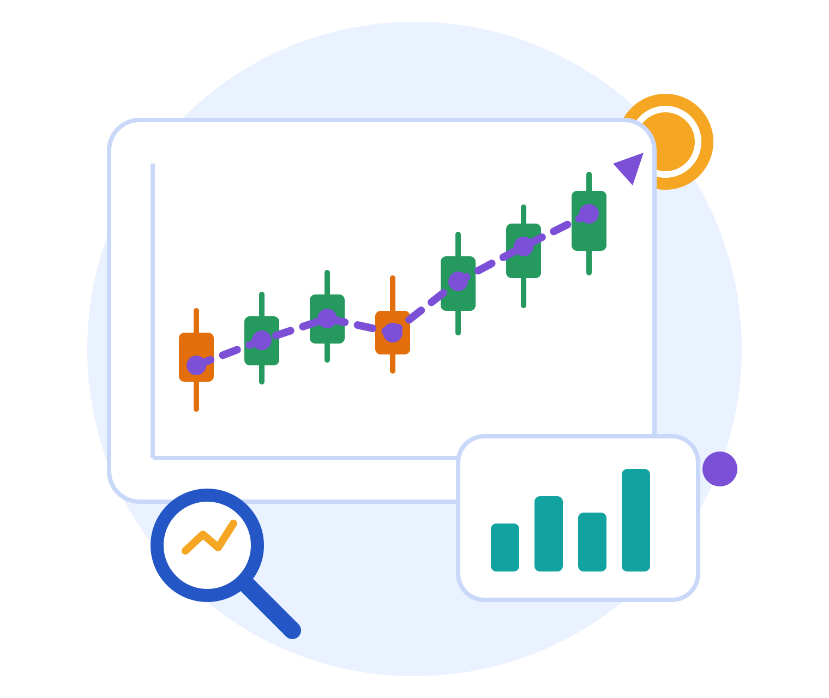
Stock Price Prediction
सांदीपनी उच्चतर माध्यमिक विद्यालय, छतवई, शहडोल, मध्य प्रदेश
Predicting a company's monthly closing price using Linear Regression
Class 11-12th
Notes:
Introduce the project: we use Machine Learning to predict the closing price of a company's stock.

Slide 2
The Problem
Share prices go up and down every day.
Many beginners guess, and lose money.
Risky 'F&O' trades (futures and options) hurt many people.
Data can give a smarter, safer estimate.
13.1 crore
8.5%
91%
+41%
unique investors registered on NSE (May 2026)
Indian households own a demat (share) account
individual F&O traders lost money in FY25
rise in their net losses, FY24 to FY25
Sources: NSE, May 2026 (13.1 crore); SEBI Investor Survey 2025 (8.5%); SEBI study on F&O traders, July 2025 (91%, ₹74,812 crore to ₹1,05,603 crore)
Notes:
F&O means Futures and Options, a risky type of share trading. Chart values are in thousands of crores of rupees.

Slide 3


Our Solution
Uses real company data from 12 months.
Learns patterns with Linear Regression (a best-fit straight line).
Predicts the closing price of a stock.
Tests accuracy on months it has never seen.
Shows clear charts to understand the market.
Helps students learn data-based thinking.
Before
Guessing prices. No data. High risk.
After
A data-based estimate. Tested and easy to explain.
Notes:
Linear Regression finds the straight line that best fits the data, then uses it to estimate new prices.

Slide 4
Project Architecture
1. Input
2. Cleaning
3. Features
4. ML Model
5. Output
data.csv with prices, volume, EPS, sector
pandas removes bad or repeated rows
Add month and sector columns
Linear Regression learns from past months
Predicted close price, charts, scores
Technologies used
Language
Data
ML
Charts
Hosting
Python
Jupyter Notebook
pandas
NumPy
scikit-learn
Linear Regression
Matplotlib
Seaborn
GitHub (code)
Notes:
Data flows left to right: file, cleaning, new columns, model, then results.

Slide 5



How It Works (1/2)
ML Model
Libraries
Data and APIs
Linear Regression: draws the best straight line through data
Inputs: Open, High, Low, Volume, EPS, Month, Sector
Output: the Close price
Why: simple, fast, easy to explain
pandas: loads and cleans the data table
NumPy: quick maths on numbers
scikit-learn: trains the model, checks errors
Matplotlib, Seaborn: draw charts
No external API is used
data.csv: 12 months of company prices
Train on early months
Test on the last 2 months
Notes:
This project does not call any outside API. All data comes from the data.csv file.

Slide 6
How It Works (2/2)
Input
Preprocessing
Model
Prediction
Display
Scores we check
model = LinearRegression()
model.fit(X_train, y_train)
y_pred = model.predict(X_test)
r2 = r2_score(y_test, y_pred)
mae = mean_absolute_error(y_test, y_pred)
print(f'R² Score : {r2:.4f}')
R²
how well the line fits (1 is perfect)
MAE
average price error
RMSE
error that punishes big misses
MAPE
average error in percent
The model learns from old months, then predicts months it has not seen.
Notes:
Code flow: load and clean data, split into train and test, fit the model, predict, then measure errors.

Slide 7


Demo and Conclusion
What we achieved
Project Code
Scan or click:
Built a working price prediction model
github.com/StealthSilver/
Classroom-Projects/
8_stock-prediction
It learns from prices, volume, EPS and sector
Tested on months it had never seen
Live link: Add live link here
No website yet. Paste the link and a QR code here.
ML helps us learn, but cannot promise profit
Notes:
Live link was not provided. Replace the placeholder box with the live link and a new QR code when the project is hosted.

Slide 8




Future Improvements
Add more years of data for better results
Try smarter models like Random Forest
Thank You
Use a live stock price API
Build a web or mobile app
Student / Team Names
Add names here
Add Hindi and other languages
Notes:
Close with thanks. Add the names of the students in the team before presenting.

