Slide 1


Post Hoc Explanations
in Knowledge Representation and Reasoning (KRR)

Slide 2
Definition of Post Hoc
1.
What is Post Hoc Explanation?
Methods to explain AI decisions after the fact.
Includes visual, textual, and counterfactual explanations.
Aim: Improve transparency without altering the underlying model.

Slide 3
Why Post Hoc Explanations Matter
2.
Many AI models function as black boxes, providing accurate predictions without transparency.
Post hoc explanations are crucial for interpreting AI decisions.
Especially important in fields like healthcare, law, and ethics.

Slide 4
Key Characteristics
3.
Desirable Properties of Post Hoc Methods
Local Fidelity: Explains the model’s behavior for specific cases.
Interpretability: Simple and understandable for target users.
Model-Agnostic: Works across diverse models, including neural networks.

Slide 5
Techniques for Post Hoc
4.
Types of Post Hoc Methods
Feature Importance (Identifies critical features):
SHAP
LIME
Sensitivity Maps (Visualize influential areas in inputs):
SmoothGrad
Integrated Gradients

Slide 6
Why Should I Trust You? Explaining the Predictions of Any Classifier
An Introduction to LIME and Model Explainability

Slide 7
Model Transparency & The Need for Explanations
Machine learning models are often black boxes, making them hard to trust.
Two Types of trust:
Trusting individual predictions.
Trusting the model’s overall behavior.
Understanding predictions helps:
Evaluate whether to act on a prediction.
Improve trust in deploying models.
Issues like data leakage and dataset shift highlight the necessity of explanations.

Slide 8
LIME
Explains predictions by approximating the model locally with an interpretable one.
Examples: Text classification, Image classification
Key Features:
Interpretability
Local Fidelity
Model-Agnostic

Slide 9
Mathematical Equations
The goal is to minimize a combination of local fidelity and complexity.
ξ(x)=arg_{(g∈G)}min​ L(f,g,π_{x}​)+Ω(g)
Loss Function:
L(f,g,π_{x}​)=_{(z∈Z)}∑ ​π_{x​}(z)(f(z)−g(z))^2
Kernel Function:
π_{x​}(z)=exp(−D(x , z)^2 / σ^2​)
Complexity Measure:
Ω(g)=∥w_{g}​∥₀

Slide 10
Submodular Pick (SP-LIME)
Provides a global understanding of the model.
Selects representative and non-redundant instances for explanation using submodular optimization.
Useful for explaining large datasets within a limited “user attention budget”.
c(V,W,I)=_{j=1}∑^{d′}​ I_{j} ​⋅(_{i∈V}∑​ W​_{ij} > 0)
Maximizing coverage function:
Pick(V,W,I)=arg_{( ∣V∣≤B )}max​ c(V,W,I)

Slide 11
Limitations and Future Work
Limitations:
Explaining very non-linear behaviors remains challenging.
Selecting interpretable representations can be domain-specific.
Future Directions:
Explore other explanation models like decision trees.
Expand to speech, video, and medical domains.
Optimize explanations for real-time applications.

Slide 12
A Unified Approach to Interpreting Model Predictions
Introducing SHAP for Model Explainability

Slide 13
Background
Significance:
Balancing interpretability with accuracy is vital for real-world applications
Problem:
Complex models achieve high accuracy but remain difficult to interpret.
Limitations of Existing Solutions:
Current interpretation methods are fragmented, unclear, and lack unified principles.
Goal:
Present a unified framework, SHAP for model interpretation.

Slide 14
What is SHAP? - SHapley Additive exPlanation
SHAP assigns feature importance values to individual predictions.
Examples: Text classification, Image classification
Desirable Properties:
Local Accuracy: Matches model output for specific inputs.
Missingness: Features missing in input have no attributed impact.
Consistency: Feature importance increases with higher contribution.

Slide 15
Mathematical Equation
Core Equation:
𝑔(𝑧′)=𝜙0+∑𝑖=1𝑀𝜙𝑖𝑧𝑖′g(z ′ )=ϕ 0​ +∑ i=1M​ ϕ i​ z i′​ 𝜙𝑖
1. 𝜙𝑖​: Feature contributions.
2. 𝑧′z ′: Binary input features.
Unified Methods: SHAP encompasses six existing methods
1. LIME
2. DeepLIFT
3. Layer-wise Relevance Propagation (LRP)
4. Shapley Regression Values
5. Shapley Sampling Values
6. Quantitative Input Influence (QII)

Slide 16
SHAP Value Estimation
Techniques:
1. Model-Agnostic: Kernel SHAP.
2. Model-Specific: Deep SHAP, Linear SHAP.
Improvement:
Combines game theory and linear regression for better computational efficiency.

Slide 17
Experimental Validation
Comparisons:
SHAP vs. LIME vs. DeepLIFT.
Findings:
1. SHAP aligns better with human intuition in user studies.
2. Improved feature importance estimates, especially for nonlinear models.

Slide 18
Key Contributions
Key Contributions:
Unified additive feature attribution framework.
Theoretical uniqueness of SHAP values in satisfying desirable properties.
Improved computational and intuitive alignment.
Future Work:
Faster model-specific methods.
Integration with interaction effects and new model classes.

Slide 19
Integrated Gradients: A Reliable Attribution Method for Deep Learning Models
Understanding How Models Make Predictions

Slide 20
Introduction to Attribution in Deep Learning
What is attribution?
Understanding how input features contribute to a model's prediction.

Slide 21
The Two Key Rules for Attribution Methods
Axiom 1: Sensitivity
If an input changes, the attribution should change accordingly.
Axiom 2: Implementation Invariance
Attribution should be consistent for models producing the same
output, regardless of their architecture.

Slide 22
The Problem with Existing Methods
Current Attribution Methods
Many existing methods fail to provide reliable and consistent explanations.
Key Issues:
Sensitivity and Implementation Invariance are not well-maintained.
Misleading attributions can make debugging and improving models difficult.

Slide 23
Introducing Integrated Gradients
What is Integrated Gradients (IG)?
A new method for attributing model predictions.
Key Benefits:
No Model Modification
Easy to compute using gradients.
Works across different types of models: image, text, and chemistry models.

Slide 24
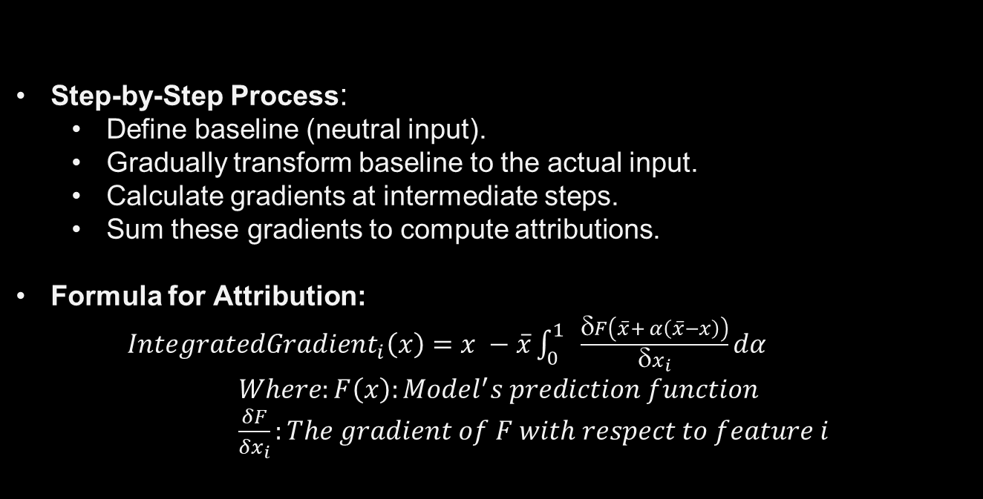
How Integrated Gradients Works

Slide 25
Why Integrated Gradients is Effective
Key Strengths:
Completeness: All attributions add up to the model's output difference.
Sensitivity: Non-zero attributions for features that change the output.
Implementation Invariance: Consistent attribution across models.
Practical Use Cases:
Debugging, rule extraction, and improving model trust.

Slide 26
Unique Features of Integrated Gradients
Symmetry-Preserving:
Treats symmetric input features equally, ensuring fairness in attribution.
Comparison with Other Methods:
IG is computationally more efficient than methods like Shapley- Shubik, and it avoids issues with adversarial baselines.

Slide 27
Applications of Integrated Gradients
Wide Range of Applications:
Image Recognition
Text Analysis
Predicting Chemical Reactions
Improvement Areas:
Debugging models
Extracting rules
Enhancing model transparency and trust

Slide 28
SmoothGrad: Removing noise by adding noise
Reducing Noise in Sensitivity Maps with Simple and Effective Techniques

Slide 29
Background
Context:
1. Deep networks need interpretability for sensitive applications.
2. Sensitivity maps are used to identify influential pixels in image classification.
Challenges:
1. Raw sensitivity maps are often visually noisy.
2. Noise may obscure meaningful regions in the images.
Goal:
Get a technique to visually enhance gradient-based sensitivity maps by reducing noise

Slide 30
SmoothGrad - Key Idea
How It Works:
1. Add noise to the input image.
2. Compute gradients for noisy images.
3. Average results for smoother maps.
Features:
1. Works with existing gradient-based methods.
2. Improves visual coherence without requiring model changes.

Slide 31
Mathematical Formula
M c​ (x)= n1​ 1∑n​ Mc(x+N(0,σ 2 ))𝑁(0,𝜎2)
N(0,σ 2 ): Gaussian noise
Output: Reduced-noise, visually coherent maps

Slide 32
Applications/Extensions
Extensions:
Works with other methods (e.g., Integrated Gradients).
Enhances feature focus in complex scenarios.
Potential for diverse deep learning tasks.

Slide 33
Conclusion & Comparative Results
Tested on ImageNet (Inception v3) and MNIST
Benefits:
Simple, effective, model-agnostic.
Reduces noise for clearer insights.
Better visual clarity and discriminatively.
Effective with uniform backgrounds and distinct objects.
Outperformed raw gradients and Integrated Gradients.
Future Work:
New metrics for evaluating sensitivity maps.
Extend de-noising to other architectures.

Slide 34
References
Ribeiro, M. T., Singh, S., & Guestrin, C. (2016). 'Why Should I Trust You?': Explaining the Predictions of Any Classifier.
Lundberg, S. M., & Lee, S.-I. (2017). A Unified Approach to Interpreting Model Predictions (SHAP).
Smilkov, D. et al. (2017). SmoothGrad: removing noise by adding noise.
Sundararajan, M., Taly, A., & Yan, Q. (2017). Axiomatic Attribution for Deep Networks.

