Slide 1
PUBLIC TEMPLATE
Paper Report
Read
Paper and evidence
A reusable workflow for evidence-backed paper discussions
Write
Outline and notes
Synthetic public example
Render
PPTX and PDF
8 slides | Planned talk: 8 min
Paper Report | Synthetic public example
1
Notes:
Paper Report
展示不绑定特定论文的公开汇报模板入口
这是公开模板的封面示例。全部文字和图形均为合成教学内容，不对应任何论文、机构或个人。实际使用时应完全替换为当前论文的信息。
来源与证据限定
[teaching] 展示不绑定特定论文的公开汇报模板入口
Paper Report handoff protocol; outline-contract.md; outline-contract.md: cover layout; version: v1; collected: 2026-09-05
适用范围: Synthetic workflow and layout demonstration; no research result
限定: Layout demonstration only

Slide 2
WORKFLOW
From Evidence to Slides
Review the claims first; render the approved content second.
Paper Report | Synthetic public example
2
Notes:
From Evidence to Slides
分开内容审校和视觉渲染
章节页展示报告如何分段。这里强调内容审校和视觉渲染是两个阶段，但都由同一个 deck.json 连接。
来源与证据限定
[teaching] 分开内容审校和视觉渲染
Paper Report handoff protocol; outline-contract.md; outline-contract.md: content source and outputs; version: v1; collected: 2026-09-05
适用范围: Synthetic workflow and layout demonstration; no research result
限定: Workflow explanation

Slide 3
One Content Source
WORKFLOW
Visible content
Titles, explanations, figures and takeaways
Speaker notes
Definitions, limitations and transitions
Evidence
Source locations, conditions and file hashes
One source keeps slides, notes and evidence aligned.
Paper Report | Synthetic public example
3
Notes:
One Content Source
同一内容源保持页面、备注和证据一致
要点页展示三个并列信息层次。实际报告中每页应只回答一个主要问题，完整解释放在备注中。
来源与证据限定
[teaching] 同一内容源保持页面、备注和证据一致
Paper Report handoff protocol; outline-contract.md; outline-contract.md: deck.json and generated views; version: v1; collected: 2026-09-05
适用范围: Synthetic workflow and layout demonstration; no research result
限定: Workflow explanation

Slide 4
Two Responsibilities
WORKFLOW
Paper to outline
Outline to slides
Read the paper, verify claims and write the presentation content.
Build editable objects, render every page and review the exact candidate.
Approve the reasoning before polishing the layout.
Paper Report | Synthetic public example
4
Notes:
Two Responsibilities
说明阅读与渲染阶段的不同职责
比较页适合呈现两个并列职责。左侧负责理解论文和核验主张，右侧负责生成可编辑页面并完成视觉检查。
来源与证据限定
[teaching] 说明阅读与渲染阶段的不同职责
Paper Report handoff protocol; outline-contract.md; outline-contract.md: handoff boundary; version: v1; collected: 2026-09-05
适用范围: Synthetic workflow and layout demonstration; no research result
限定: Workflow explanation

Slide 5
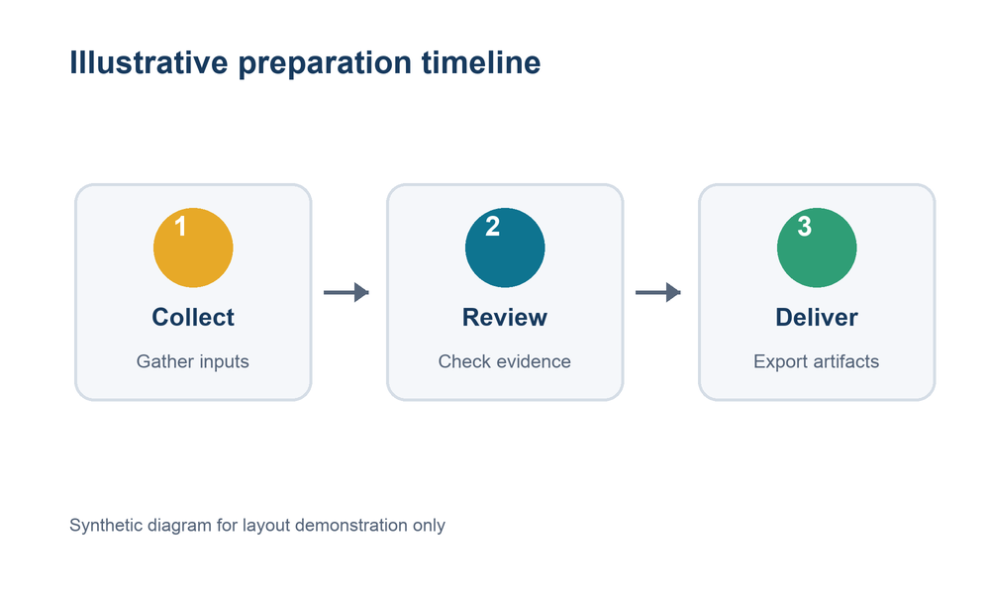
Explain a Figure
EVIDENCE
Show the source
Preserve labels and proportions when using a real paper figure.
State the limit
Keep experimental conditions visible and specific.
Synthetic process diagram for layout demonstration only.
A figure supports only the claim and conditions stated beside it.
Synthetic diagram | Layout demonstration only
5
Notes:
Explain a Figure
展示单图版式及证据边界
这是单图版式示例。合成图只演示版面和读图顺序，不代表任何论文机制或测量结果。
来源与证据限定
[teaching] 展示单图版式及证据边界
Paper Report handoff protocol; outline-contract.md; Bundled synthetic process diagram; version: v1; collected: 2026-09-05
适用范围: Synthetic workflow and layout demonstration; no research result
限定: Synthetic image; no scientific claim

Slide 6
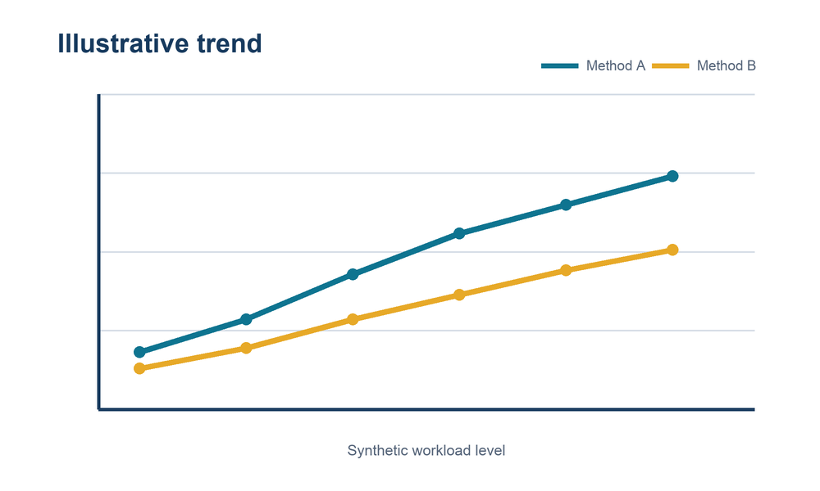
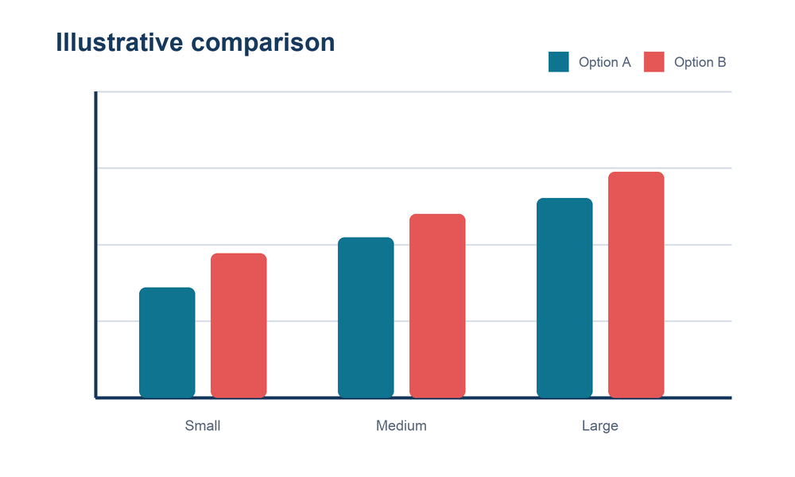
Compare Without Conflating
EVIDENCE
Trend
Comparison
Describe axes, conditions and comparable points.
Keep groups, units and baselines explicit.
All values are synthetic and exist only to demonstrate the layout.
Read each chart under its own stated assumptions.
Synthetic charts | Layout demonstration only
6
Notes:
Compare Without Conflating
展示两图版式并区分不同图的角色
两张合成图分别展示趋势和分组比较。它们没有共同实验条件，不能组合成论文结论。
来源与证据限定
[teaching] 展示两图版式并区分不同图的角色
Paper Report handoff protocol; outline-contract.md; Bundled synthetic line and bar charts; version: v1; collected: 2026-09-05
适用范围: Synthetic workflow and layout demonstration; no research result
限定: Synthetic charts; no scientific claim

Slide 7
An Editable Table
LAYOUT
Illustrative route | Reading | Discussion
Short | 10 min | 5 min
Long | 20 min | 10 min
Illustrative time budgets; not measured research results.
Tables remain native, editable slide objects.
Paper Report | Synthetic public example
7
Notes:
An Editable Table
展示可编辑的原生表格
表格中的时间预算完全是教学示例，不来自实验。真实报告应保留指标、单位和比较条件。
来源与证据限定
[teaching] 展示可编辑的原生表格
Paper Report handoff protocol; outline-contract.md; outline-contract.md: table layout; version: v1; collected: 2026-09-05
适用范围: Synthetic workflow and layout demonstration; no research result
限定: Illustrative values only

Slide 8
Review Before Delivery
DELIVERY
Validate
Render
Review
Check content, notes and source assets.
Convert the candidate to PDF and page images.
Inspect every slide and revise the shared content source.
Deliver the exact candidate that passed review.
Paper Report | Synthetic public example
8
Notes:
Review Before Delivery
展示交付前的检查顺序
流程页展示结构校验、渲染和人工视觉检查的先后关系。正式交付物必须来自已经检查的同一轮候选文件。
来源与证据限定
[teaching] 展示交付前的检查顺序
Paper Report handoff protocol; outline-contract.md; outline-contract.md: build and delivery outputs; version: v1; collected: 2026-09-05
适用范围: Synthetic workflow and layout demonstration; no research result
限定: Workflow explanation

