Slide 1

Personal Tutor App
COMP6239 – Mobile Application Development Jun Zhou (30074142) Yiu Ting Lai (30473438)

Slide 2
Implemented Features
Administrator
Manage Subjects (Add/ Modify/ Delete)
Manage Tutors (Approve Tutor Requests)
Tutor
Instant Messaging (Receive and Reply to Students)
Manage Appointments (View Approved & Requested Appointments from Students)
Student
Search Tutors (Search by Subject, Tutor Name, Tutor Location)
Instant Messaging (Receive, Reply, and Send to Tutors)
Booking (Send Appointment Requests to Tutors)
Public Users
Registration (Register as Student/ non-approved Tutor)

Slide 3
Back-End Structures
AWS-RDS: MySQL Database 5.6
AWS-EC2: PHP Web APIs
AWS-EC2: Notification Server

Slide 4
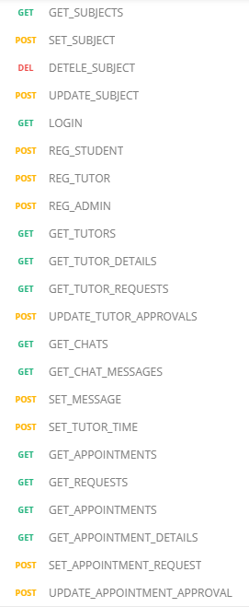
Back-End Structure: MySQL & PHP Web APIs
MySQL

Slide 5
Notification Server
AWS-EC2:9999
I would like to have a lesson with you
Tutor
Received
Student

Slide 6
Prototype Demonstration

