Slide 1
UML diagrams

Slide 2

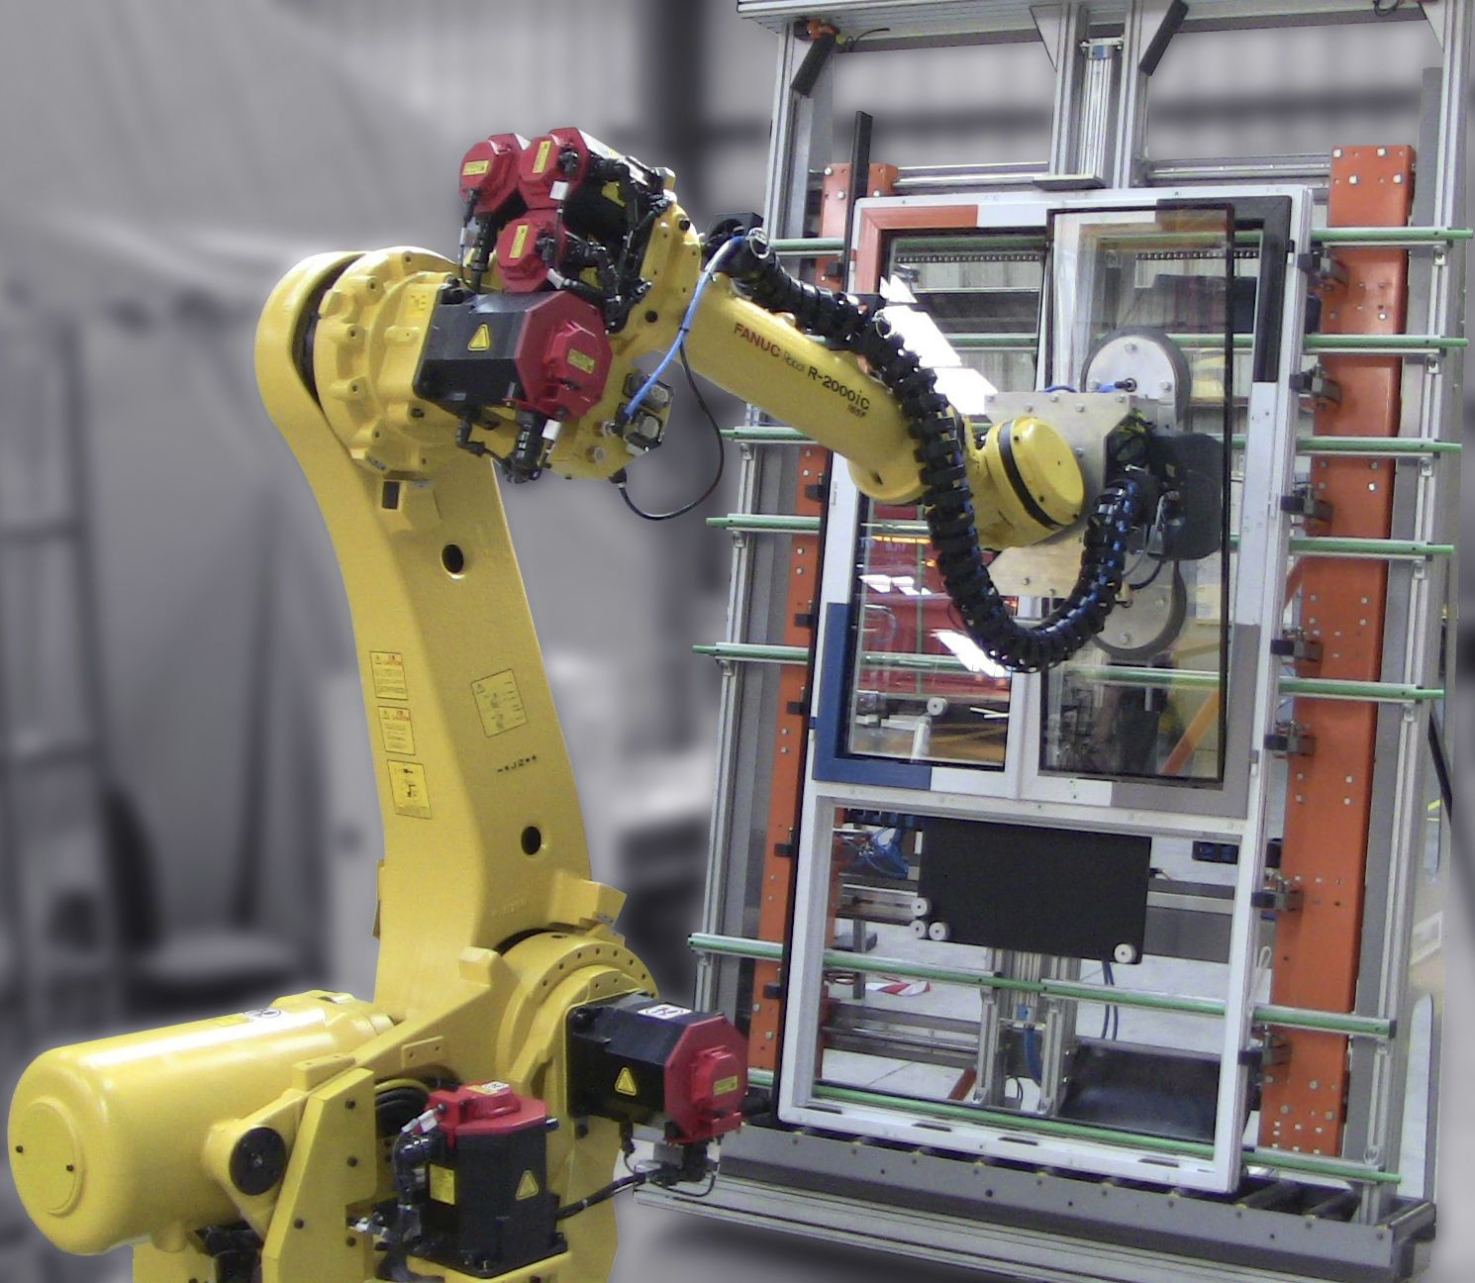
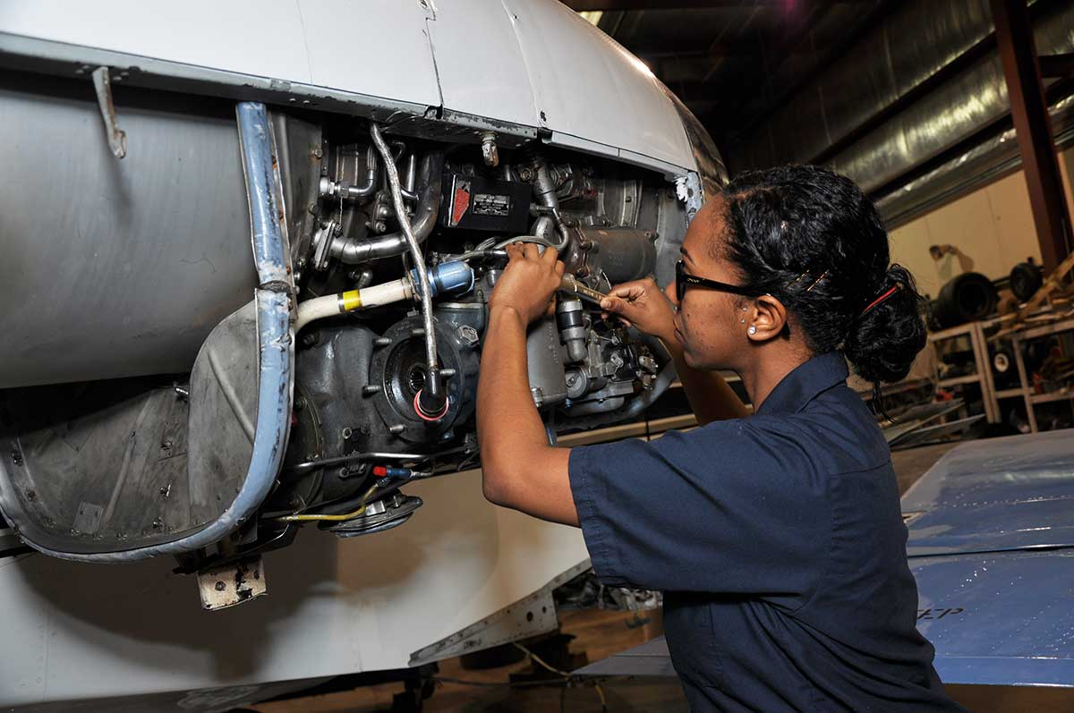

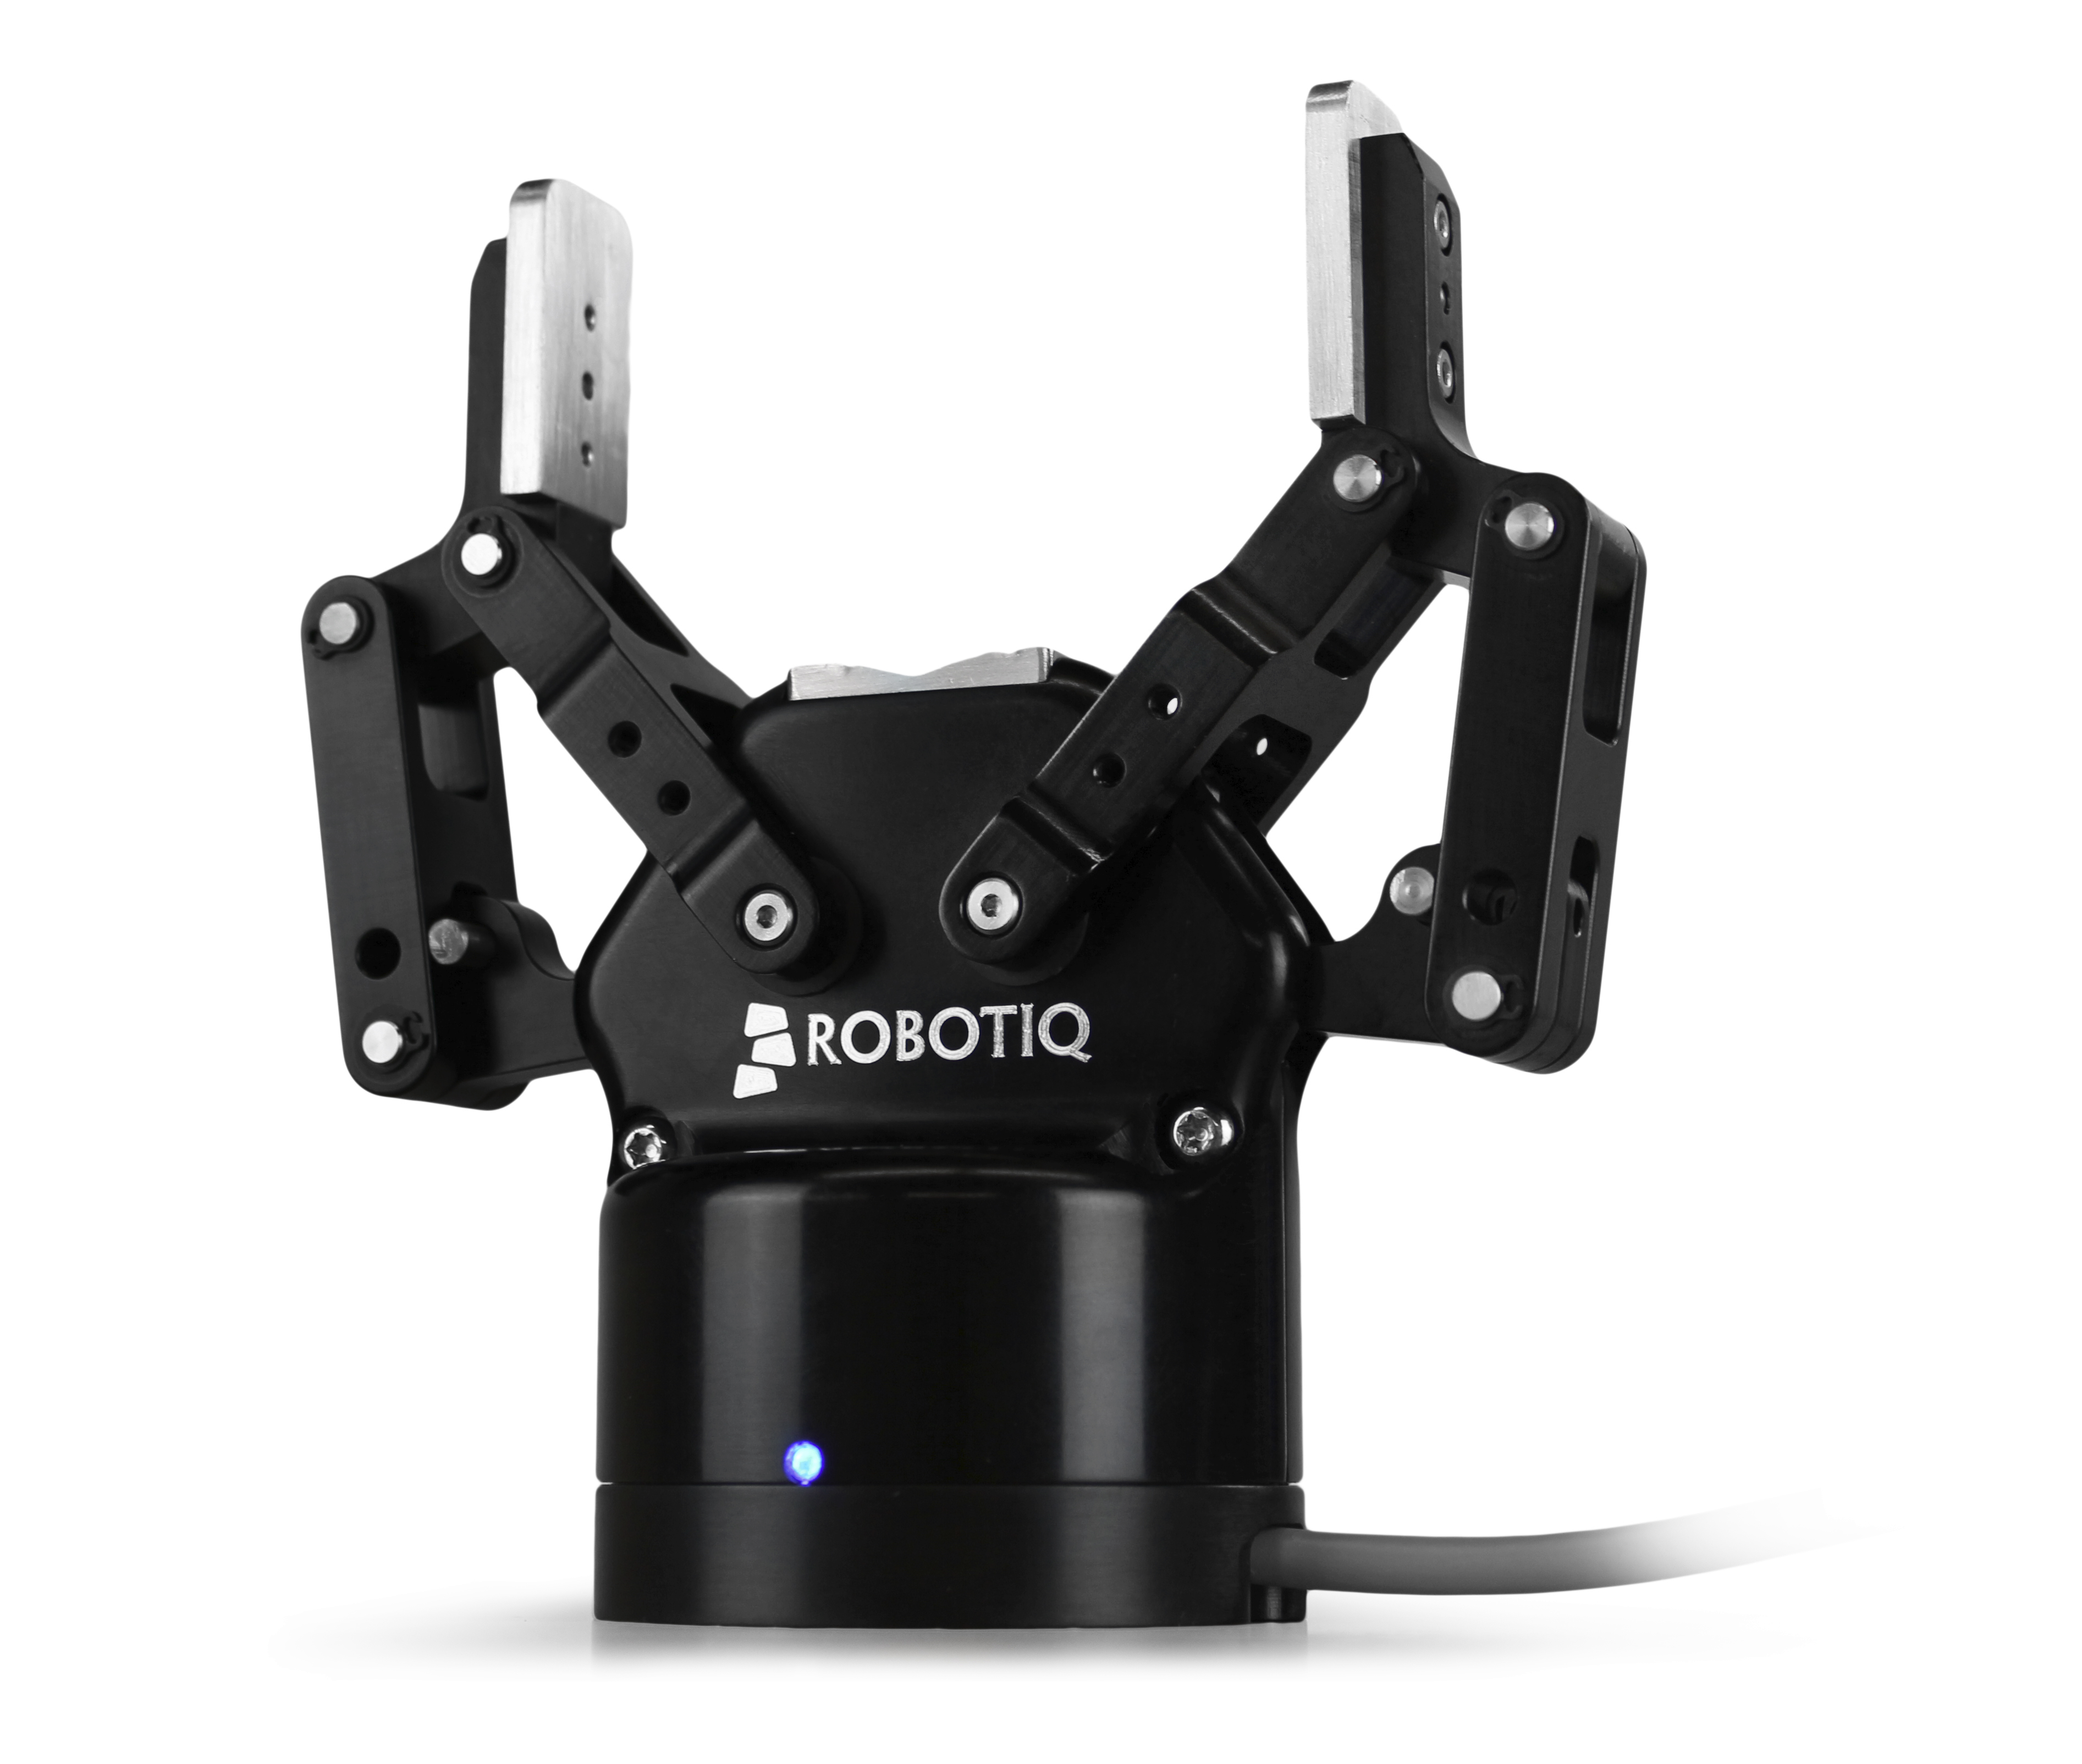
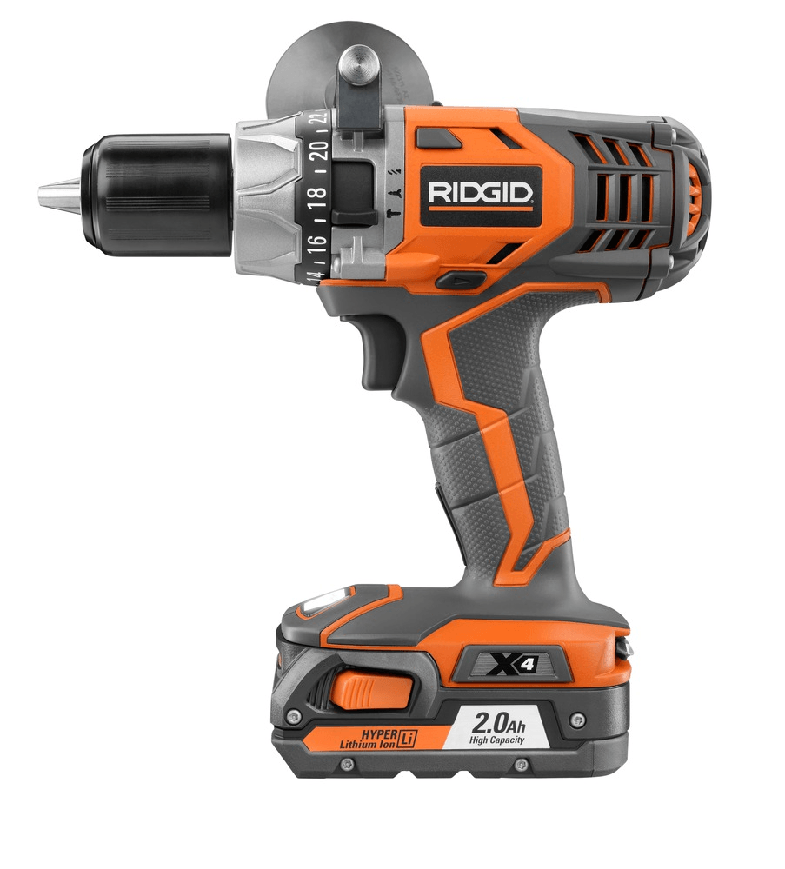

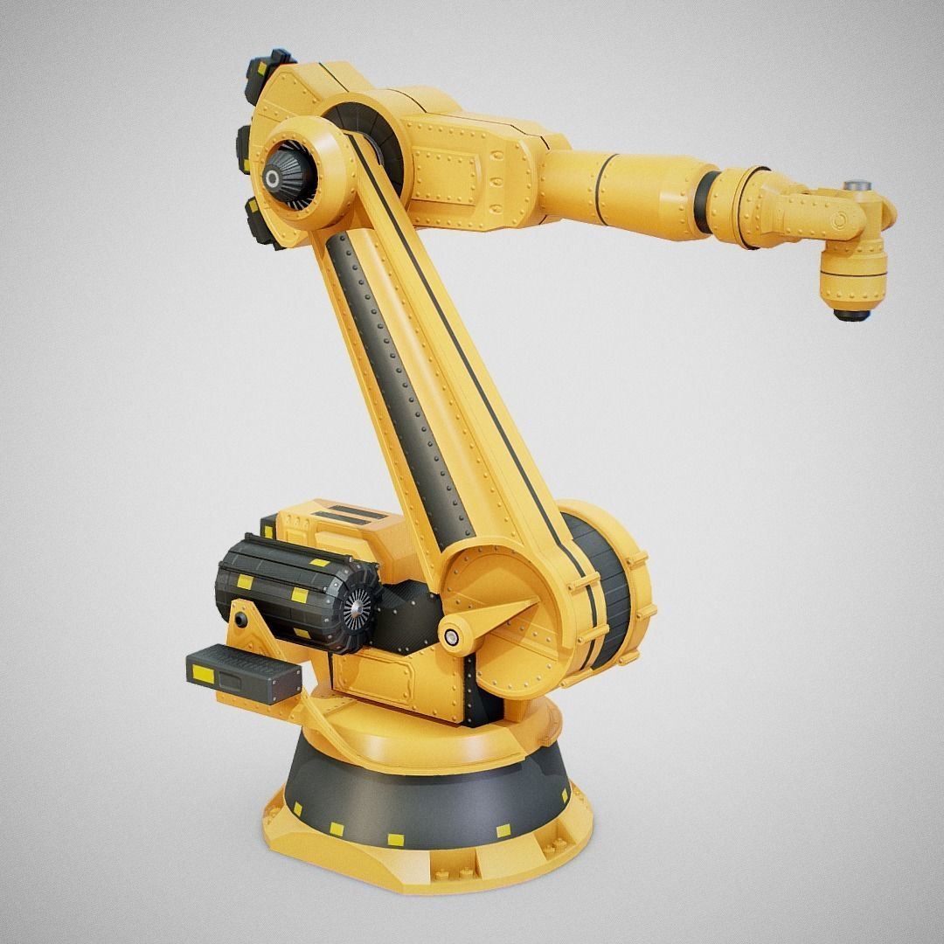

Software: “easy-to-change” systems
Application
Application or task
Software
Easy-to-change layer
Hardware
Hard-to-change but functionally flexible resources

Slide 3
Client-server isolates effect-of-change
Client-server interaction
Kitchen as system
...
Fryer1
Client
Server
Fryer2
<<Client>>
<<Server>>
Note how changes in the system do not affect the client

Slide 4

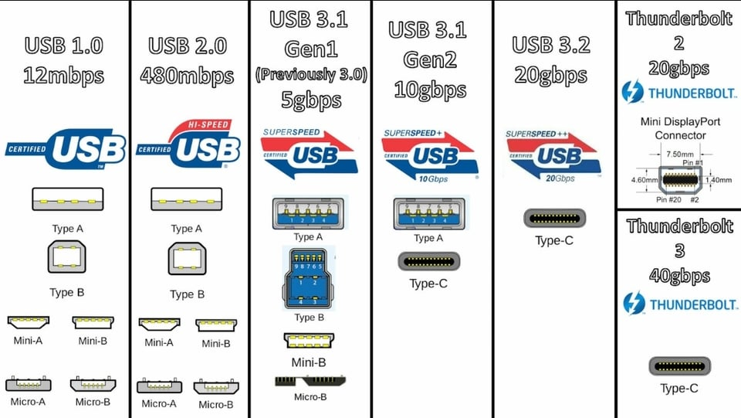


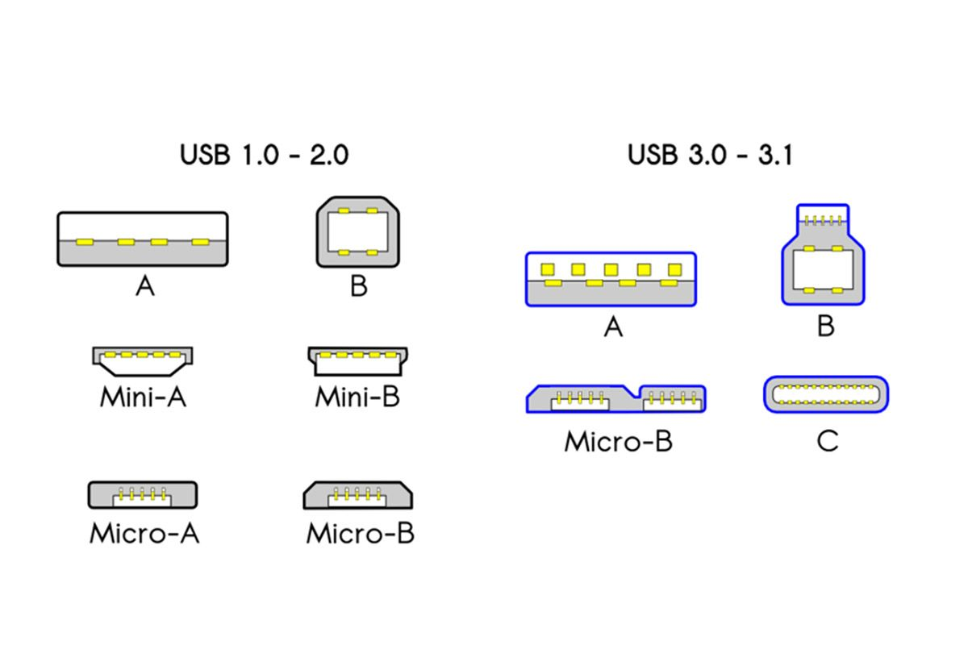



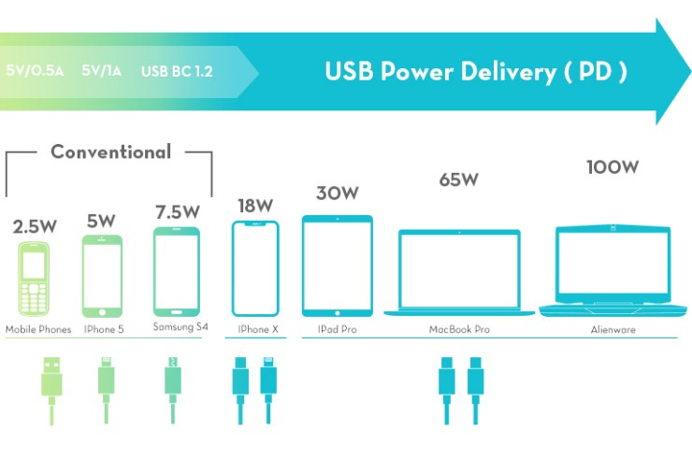


USB success-story
Peripheral (Client)
USB
<<Interface>>
Functional Server
Expanding client applications
Evolving communication
Unifying physical interface
Evolving power delivery
Battery charging

Slide 5



Mock database example
UI
Mocking involves using a model to test or develop a system component under specific conditions
...
Mock DBs for testing and development
Due to a standardized <<interface>>, mocks are indistinguishable to the other components in the system.
<<Database>>
----------------------------
Functionality
Locked DB
Production DB
Full DB
Empty DB

Slide 6
Digital mocking development
Operator
<<Workstation>>
----------------------------
Functionality
Smart systems
----------------------------
Data requirements
Response Actions
Used to develop the system without investing in hardware. The data-flow, data-acquisition/sensors, and workstation configuration can be improved.
Using the operator in the loop results in more valid data and the ability for the operators to suggest improvements to workstations.
Learning/training occurs
Suggests improvements
Plan DAQ
Actions
Virtual Workstation
Physical Workstation
The system cannot differential between a virtual and physical workstation.
Easily modified
Delayed implementation, hardware purchase, and vendor lock-in.

Slide 7
Dynamic scheduling
Operator
<<Workstation>>
----------------------------
Functionality
<<Scheduler>>
----------------------------
Data requirements
Response Actions
Decides what actions to take in response to data-measured.
Virtual Workstation
Start
End
Task specification/
rest
Repeat?
Present schematic
Select components
Transport components
Submit

Slide 8
Sample efficient experimentation

Slide 9
Dynamic scheduling as human control

Slide 10
Investigation structure
Introduction
------------------
Chapter 1
Design methodology
Conjecture
------------------
Chapter 2
Methodology reflection Discussion
------------------
Chapter 6
Published works
Complex HITL simulation Demonstration
------------------
Chapter 3
Closing remarks
Conclusion
------------------
Chapter 7
Sample efficiency Demonstration
------------------
Chapter 4
Design for assembly Demonstration
------------------
Chapter 5

