Slide 1

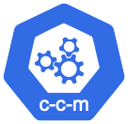
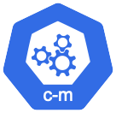
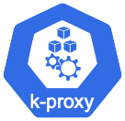
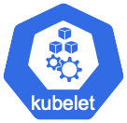



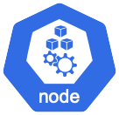
Control Plane Components icons
Infrastructure Components icons

Slide 2


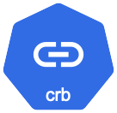
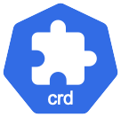

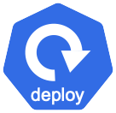
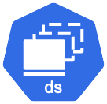


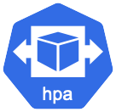








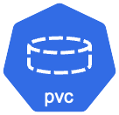



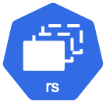



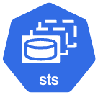
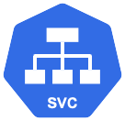


Kubernetes Resources icons

Slide 3



Control Plane Components icons
Infrastructure Components icons

Slide 4









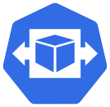



















Kubernetes Resources icons

Slide 5
End

Slide 6
Icons

Slide 7
Compute
OCI Compute
Instance
OCI Functions
Virtual
Autoscaling
Flex VM
Burstable VM
Virtual
Virtual
Virtual
Pools
Machine
Machine
Machine
Machine
GPU
Application
generic

Slide 8
Storage
Block Storage
Block Storage
Back Up/
Block Storage
File Storage
File Storage
File Storage
File Storage
File Storage
File Storage
File Storage
Multiple
Restore
Cloning
Cloning Process
Clone
Replica
Replication
Snapshots
Mount Target
Process
OCI Object
OCI Object
Storage
Elastic
Local
Persistent
Storage
Storage Buckets
Gateway
Performance
Storage
Volume

Slide 9
Networking
Load
Flexible Load
DNS
Customer
BYOIP
IP Pools
VTAP
CDN
On-premises
Backbone
Network
VNIC
Balancer
Balancer
Premises
data center
Switch
Equipment
VCN
Route
Route Table
DRG
Service
Internet
NAT
Local Peering
Oracle
Network
Inter-Region
Network Path
Network
(Region Identifier)
Table
and
Gateway
Gateway
Gateway
Gateway
Services
Performance
Latency
Analyzer
Visualizer
Security List
Network
Inspector

Slide 10
Database
Oracle Base
Database
Oracle
OCI Migrate
Oracle Autonomous
ADW-D
Oracle Autonomous
ATP-D
Oracle Exadata
Oracle Compute
Exadata
Exadata
Database
Autonomous
Autonomous
Data Warehouse
Transaction
Database Service
Cloud@Customer
Cloud@Customer
Fleet Update
Database
Database
Processing ATP
ADB-D
ADB Exadata
Data Safe
NoSQL
MySQL
RAC
OpenSearch
Cloud@Customer
Database
Database
System
Database
Data
Data
MySQL
Data
Data Lake
Oracle REST
Database
Migration
Estate
Oracle Database
OCI Database
Management
Guard
Guard
HeatWave
Lakehouse
Data Services
Flashback
Workbench
Explorer
Migration Service
with PostgreSQL
Recovery
GoldenGate
GoldenGate
GoldenGate
GoldenGate
GoldenGate
GoldenGate
GoldenGate
GoldenGate
GoldenGate
GoldenGate
GoldenGate
On-Premises
Director
Studio
Application
Plug-in
Stream
Veridata
Monitor
HP Non-Stop
Free
Adapter
Analytics
Guardian

Slide 11
Analytics and AI
Oracle
Big Data
Data Catalog
OCI Data
Data Flow
OCI Streaming
Service
OCI
Machine
Artificial
Digital
Document
Analytics Cloud
Integration
Connector Hub
Data Science
Learning
Intelligence
Assistant
Understanding
Essbase
Message
Message
Forecasting
OCI
OCI Language
OCI Generative AI
OCI Speech
OCI Vision
Listener
Producer
Generative AI

Slide 12
Developer Services
OCI Container Engine
OCI Container
Container
Multiple
Container
Service Mesh
APEX
Private
API Gateway
API Service
Integration
Notifications
for Kubernetes
Registry
Containers
Instances
Endpoint IP
Visual Builder
DevOps
Content
Resource
Email Delivery
Jet
Logic Flow
Application
OKE Virtual
OCI Process
Management
Manager
Dependency
Node
Automation
Management

Slide 13
Identity & Security
Oracle Identity
IAM
User
User
User
User Group
User Group
User Group
Policies
Compartments
Cloud Guard
Cloud Service
Maximum
Threat
Firewall
WAF
Certificates
Vulnerability
Vault
Bastion
Security
DDoS
Key
Security Zone
Intelligence
Scanning
Lists
Protection
Vault
Security
Key
Encryption
Threat
NSG
Active
Lists
Management
Defense
Directory

Slide 14
Observability and Management
Application
Logging
Search
Auditing
Monitoring
Alarms
Health
Logging
Events
Operations
VCN Flow
OCI Queue
Workflow
Full Stack
Performance
Checks
Analytics
Insights
Logs
Disaster
Monitoring
Recovery

Slide 15
Hybrid
Roving Edge
Roving Edge
Roving Edge
Roving Edge
Dedicated
Service
Device (RED)
Ultra
Infrastructure
Region

Slide 16
Migration
Data
Database
Oracle Cloud
Transfer
Migration
Migration Advisor

Slide 17
Governance and Administration
Cloud
Organization
License
Oracle Cloud
Tagging
Cloud
Advisor
Manager
Identifier
Migrations
Notes:
Fix the License Manager Icon

Slide 18
Marketplace
Marketplace

Slide 19
Applications
HCM
Oracle
ERP
E-Business
Supply Chain
Innovation
Project Financial
Inventory
Product
BI Cloud
Cloud
Engagement
SOA Suite
Suite
Planning
Management
Managment
Management
Master Data
Connector
Operations
Management
Order
Procurement
CPQ
Manufacturing
Project
Financials
Healthcare
EPM
Fusion
CRM
Management
Management
Media
Digital
Media
Flow
Media
Streams

Slide 20
Other
Cloud Native
Private
Transaction
Data
Blockchain
Remote
IoT
OCI Multicloud
Other Oracle
Internet
Content Delivery
Zero Data Loss
Cross
Environment
Cloud
Manager
Integrator
Agent
Cloud Service
Network Service
Recovery Appliance
Domain

Slide 21




