Slide 1
The Game
Darts
A sports simulation game which allows the user to simulate, or participate in, a game of 501 darts.

Slide 2
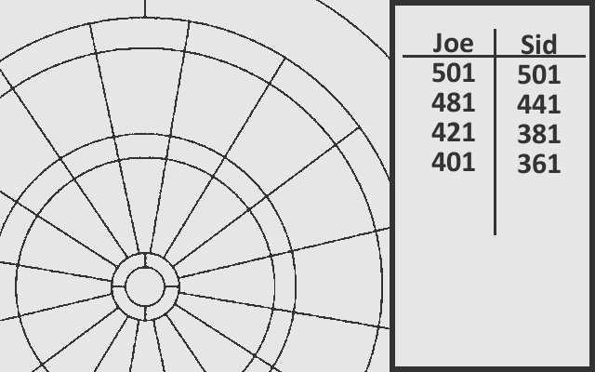
The Ideogram

Slide 3
The Plan
Background Layers:
The Dartboard (pannable)
The Window (stationary)
The Text (stationary)
Sprites:
The Cursor (controlled)

Slide 4
The Design
Player
- TakeAShot():void
- TargetSelect():void
- Inaccuracy():void
- BullsEye():void
- Bull():void
- Single():void
- Double():void
- Treble():void
- CheckLegality():void
- points:int
- target:int
- accuracy:int
- targetindex:int
- throws:int
- turnthrows:int
- ishuman:bool
- name[]:char
+ SetName(char name[]):void
+ DrawName(x:int, y:int):void
+ SetPoints(points:int):void
+ DrawPoints(x:int, y:int):void
+ TakeTurn():void
+ GetPoints():int

Slide 5
The Changes
Another Background Layer, for text and tile-based cursors.
Extra attributes and methods in the player class, plus a new “dart” class and Sprite set.
- darts[]:Dart
- hit:int
- targettype:int
- pointsdisplay[]:int
- innersingle:bool
- darthitloc[]:int
- GetPointsValue(cursorpos[]int, BGPos[]:int):void
- DartLocationDecide():void
Dart
- location[]:int
- dartnumber:int
- age:int
- rotation:int
+ UpdateDart(BGpos[]:int):void
- Animate():void

