Slide 1
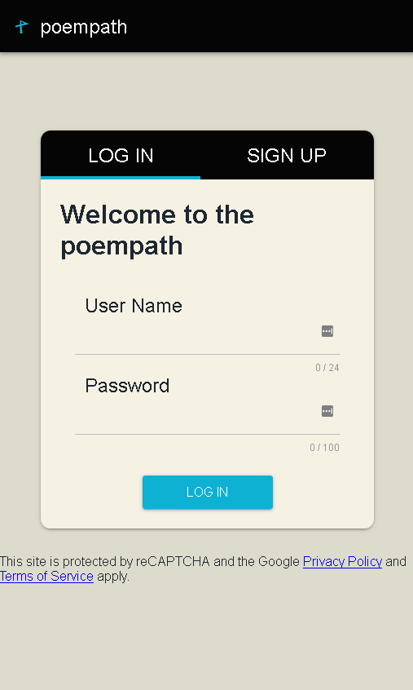
poempath.com
On the path to experience
Tyler Steele

Slide 2
Product Motivations
Create project related to poetry consumption and suggestion
Maintain scale that allows clean and complete execution
Leverage my prior experience with web-based technology
Learn new technologies and expand development toolset
Prove overall competence as a developer

Slide 3
Product Goal
Build a full stack, web application that presents users with poems and employs a neural network to suggest specific poems to users based on their history of preferences.

Slide 4
Product Requirements
Clean, simple interface that gives poems the spotlight and focuses on readability
Large and diverse source of poems that allow for easy manipulation data-wise
Neural network tuned towards poetry recommendation
Binary rating of poems (like/dislike)
User login and signup
Website hosting and domain

Slide 5

Frontend: Vue.js
Vue File
This app does not need a frontend framework
Single-file component based design is easy to build upon
I was already familiar with React.js and vanilla JavaScript
Development experience is enjoyable, excellent tutorials
Markup
Logic
Styling

Slide 6

Backend: Koa.js
Preference towards Node.js over PHP
Backend for this app is straightforward
Lightweight version of Express.js

Slide 7

Database: MongoDB
No need for relational DB
Queries are simple (find one record with this ID)
JSON structure is easy to work with

Slide 8

Web Server: Nginx
Some experience with Nginx
Excellent load balancing and rapid setup
Between Apache and Nginx, differences are not clear at this scale of a project

Slide 9

Operating System: Linux
Command line interface is incredibly powerful
More and more commonplace in the industry
Almost all tutorials are Linux or MacOS based
Fast and light-weight compared to Windows

Slide 10
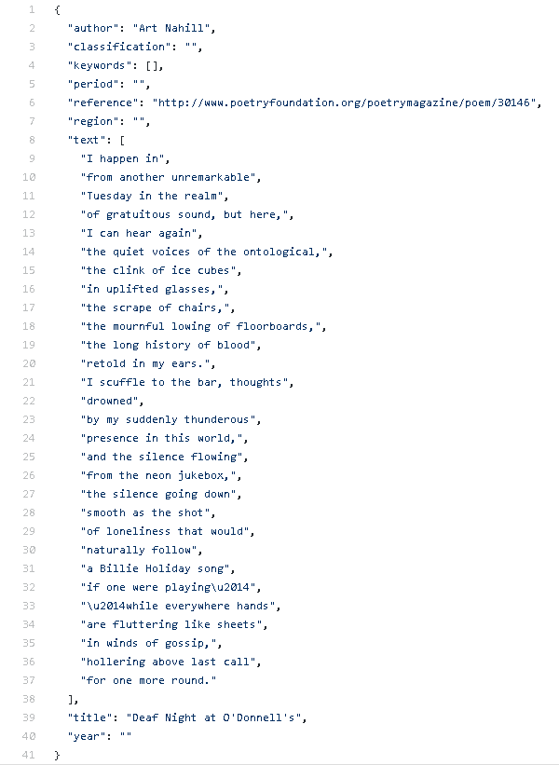
Poetry Collection
GitHub repository with 12K+ poems online in the form of JSON
Quality is inconsistent: no italics, line breaks, or indentation
Good enough for proof of concept

Slide 11
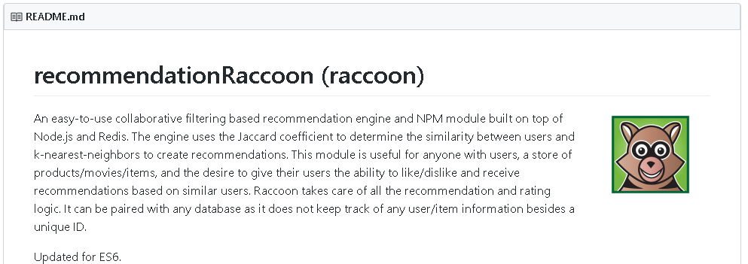
Neural Network
Recommendation Engine
No time or real need for a neural network
Recommendation engines are perfect for this application
Raccoon Recommendation Engine meets all specifications
Easy to implement into my project

Slide 12
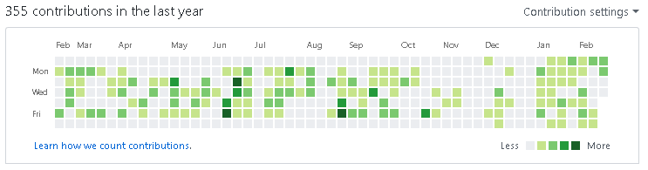
Challenges and Takeaways
Learning new things (on your own)
Maintaining consistent progress and dedication
Leaving the recommendation portion for the end
Realizing nobody cares about your website
Git contributions across the term
… not an even distribution

Slide 13
Thank you

Slide 14
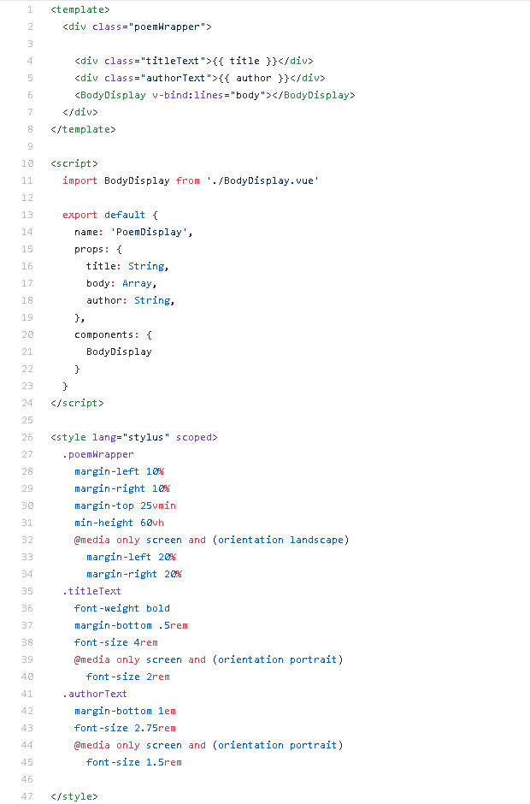
Vue Code Example – PoemDisplay.vue
<template> Here I render BodyDisplay, a custom component I made to display the body of a poem
<script> title, body, and author variables are passed down from the parent component (component that renders PoemDisplay)
<style> Scoped styling for this specific component. poemWrapper, titleText, and authorText classes are used in the <template>

Slide 15
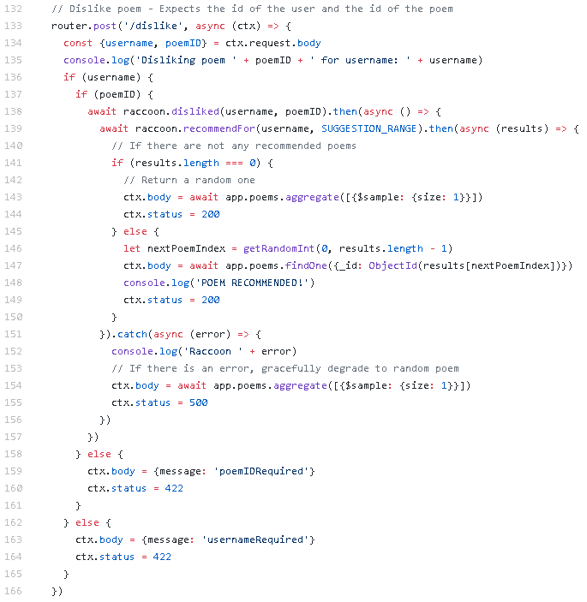
Koa Code Example –
Dislike poem route
Raccoon registers the dislike and then provides a recommendation (if enough data is available)
If the recommendation engine has a recommendation, return it. Otherwise, return a random poem
ctx.body and ctx.status are returned. Different HTTP codes signify different results.

Slide 16
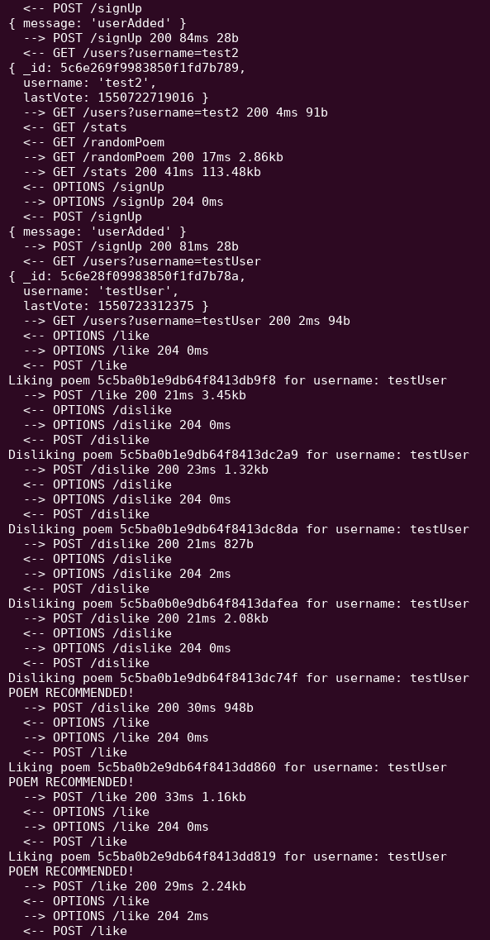
Server logs throughout normal user flow
Server receives /signUp POST and returns the created user
User likes a poem
User dislikes a poem
Raccoon has enough information to begin recommending poems, rather than returning random poems

