Slide 1
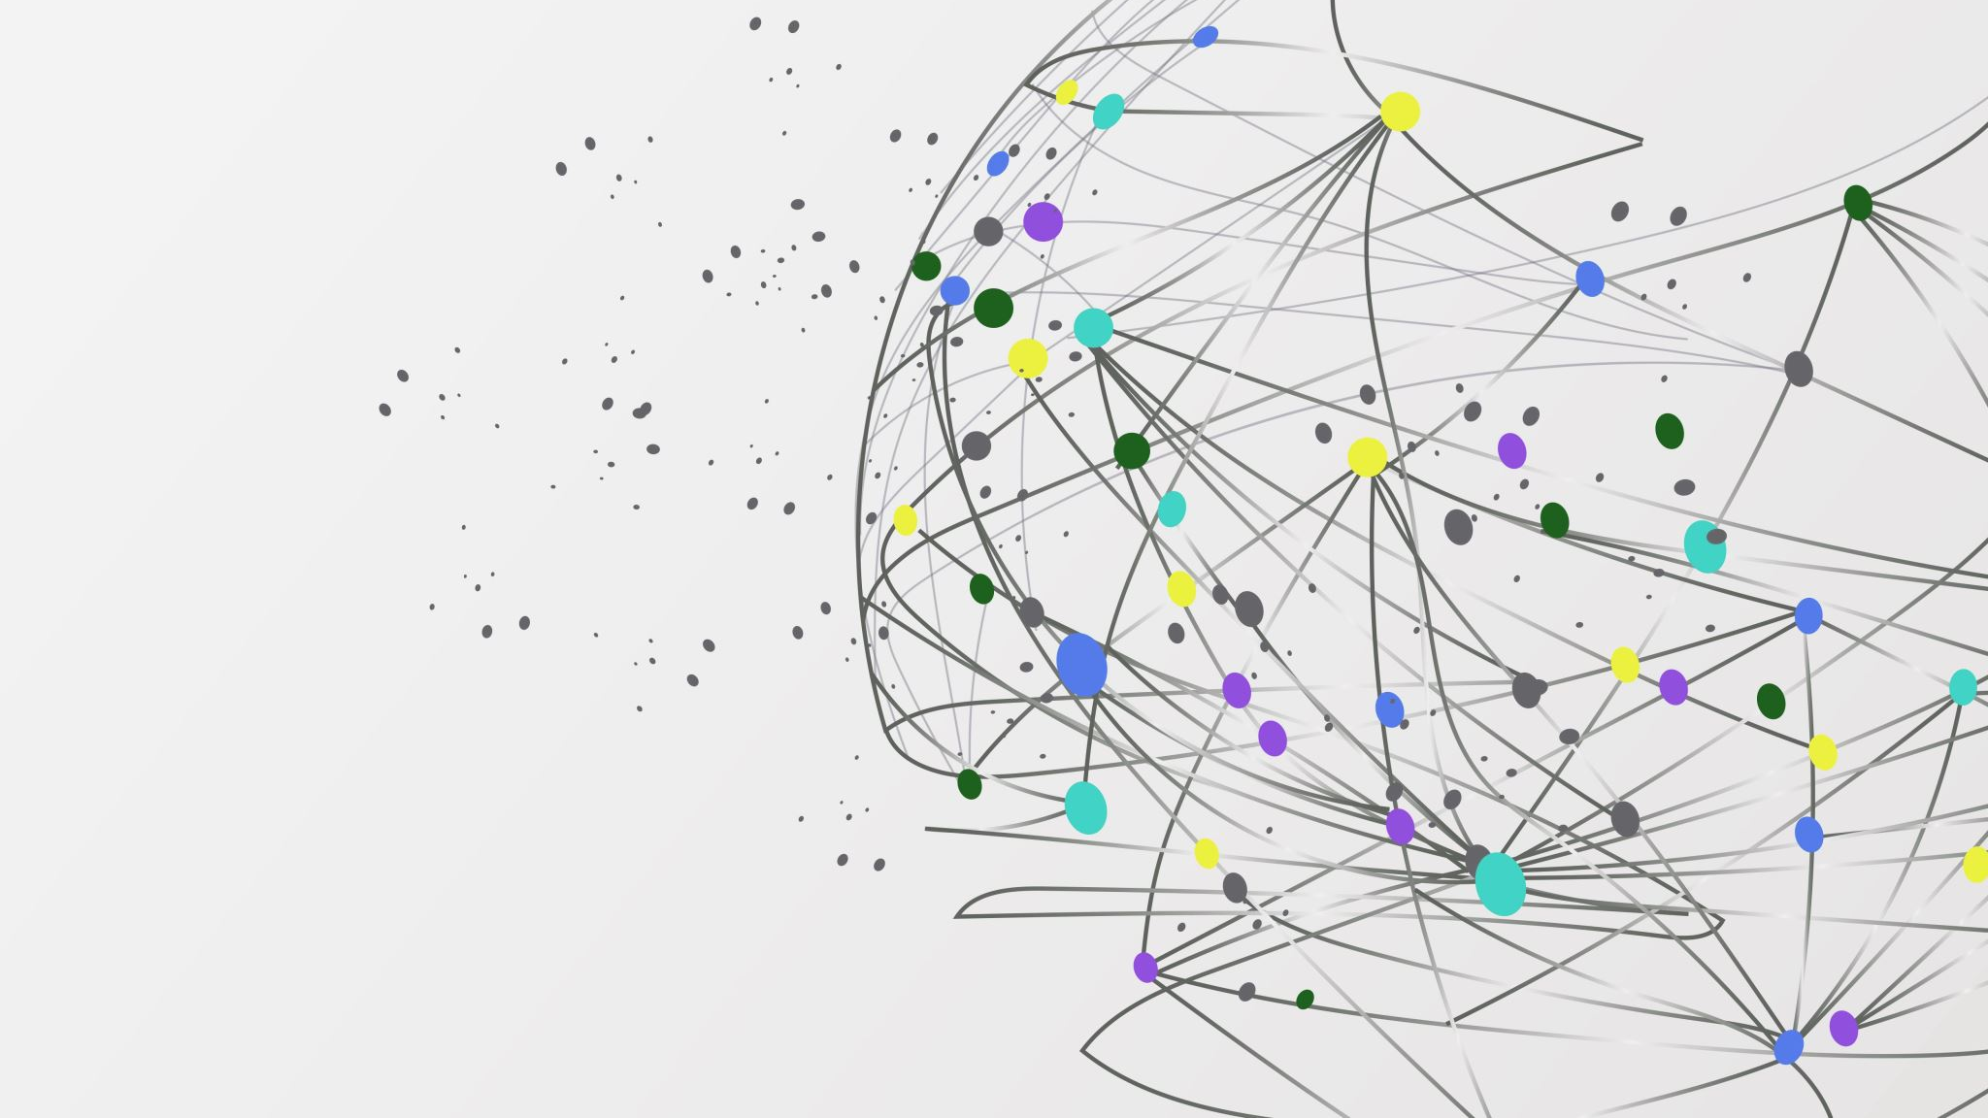
IMAGE CAPTION GENERATOR- exploring Worlds through Words and Pictures
Team members:
Shreya Das Gupta: E22BCAU0148
Steena Susan Abraham: E22BCAU0133

Slide 2
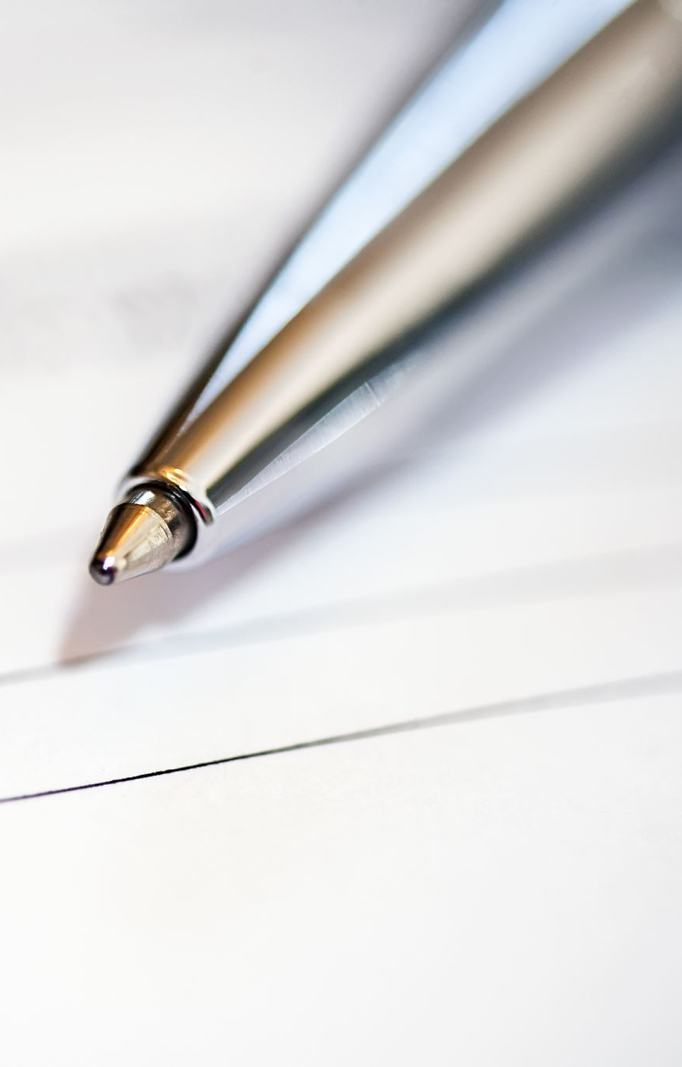
CONTENTS
INTRODUCTION
PROBLEM STATEMENT
METHODS USED
DATASET
METHODS TO OD THIS
CONCLUSION

Slide 3
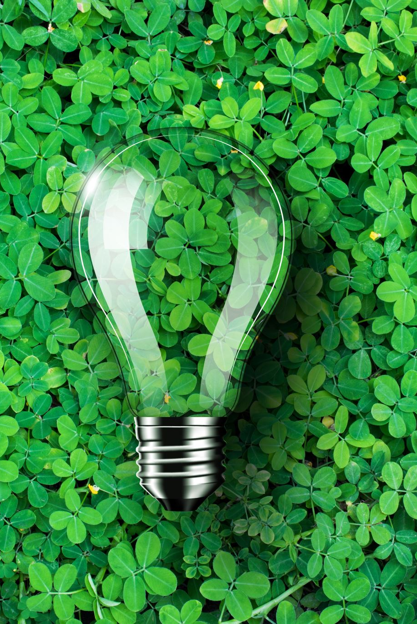
INTRODUCTION
Image Caption Generator is used to recognize the context of an image and to generate natural sentence description for given image.
It involves the Visual Context understanding in Computer Vision and the sentence generation in Natural Language Processing.
In this the input to model is an image and the output of the model is caption generated in natural language processing

Slide 4
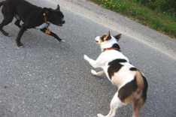
For example
When an image is passed as an input to the model, it should be able to generate captions in natural language such as “ Two dogs are playing”.

Slide 5

PROBLEM STATEMENT
Generating a Machine Learning model to predict the caption for a given image
You saw an image and your brain can easily tell what the image is about, but can a computer tell what the image is representing?
With the advancement in technology, availability of huge datasets and computer power, we can build models that can generate captions for an image.
This can be done using Convolutional Neural Networks (CNN) and Long short-term memory (LSTM) together.

Slide 6

METHODS USED
Convolutional Neural Networks (CNN) –
A convolutional neural network (CNN or convnet) is one of the various artificial neural networks used for different applications and data types. A CNN is specifically used for image recognition and tasks involving pixel data processing.
The image features will be extracted using CNN
Long short-term memory (LSTM) –
Long short-term memory deals with algorithms that try to mimic the human brain.
We will feed the image features extracted from CNN into the LSTM model which will be responsible for generating the image captions

Slide 7
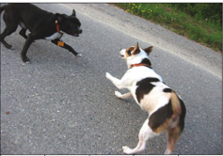
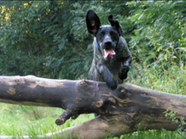
DATASET
Downloading the dataset from Kaggle:
Flickr8k Dataset:
8000 images
5 captions for each image
Caption1: A black dog and a spotted dog are fighting
Caption 2: A black dog and a tri-colored dog playing with each other on the road.
Caption 3: A black dog and a white dog with brown spots are staring at each other in the street.
Caption 4: Two dogs of different breeds looking at each other on the road.
Caption 5: Two dogs on the pavement moving toward each other.
Caption 1: black dog leaps over a log.
Caption 2: A grey dog is leaping over a fallen tree.
Caption 3: A large black dog leaps on a fallen log.
Caption 4: A mottled black and grey dog in a blue-collar jumping over a fallen tree.
Caption 5: The black dog jumped the tree stump.

Slide 8
METHODS TO DO THIS
● Import Libraries
Tensorflow, Os, Pickle, Keras
● Upload Flickr Dataset from Kaggle. (Data Preprocessing)
● Apply CNN to identify the objects in the image.
● Preprocess and tokenize the captions.
● Use LSTM to predict the next word of the sentence.
● Make a Data Generator .
● View Images with caption.

Slide 9
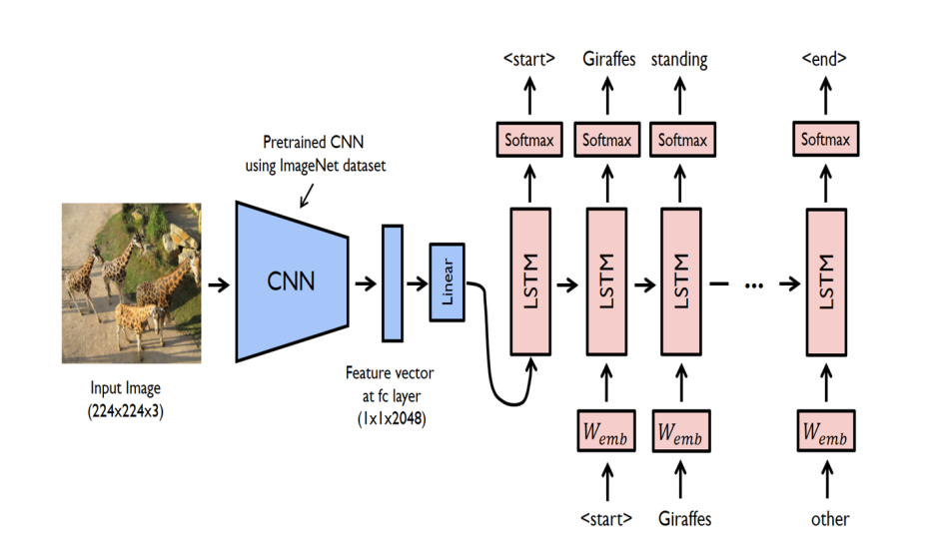
ARCHITECTURE

Slide 10
CONCLUSION
In conclusion, our project, 'IMAGE CAPTION GENERATOR: Exploring Worlds through Words and Pictures,' showcases the power of technology to bridge the gap between visual content and descriptive language. With its applications in various domains, from social media to accessibility, image caption generation opens up new avenues for exploration and understanding. We invite you to delve deeper into this fascinating field and discover its limitless possibilities. Thank you for joining us on this journey."

Slide 11

Thank you

