Slide 1
Features
Players can create stores to sell and acquire goods
Store owners can give stores purchasable popularity
Stores have views
Players can favorite stores, stores will increase the number of favorites
Stores can be reviewed
Store owner can set store description

Slide 2
Features
Store owners can set the coordinates of the physical location of the store
Merchandise can be limited to transaction time
Product can limit the transaction amount
The page has a search function
Transactions support taxes
Transactions support points, gold, and items as currency

Slide 3
Features
Administrator can sell store icons
Administrator can set unlimited number of items
Store icon can be displayed with player head
Support Mysql, Sqlite storage
Each transaction record can be seen by related players
Player pure page operation

Slide 4
Features
Fix invalid data in the database
Manual fixing of redundant and missing configuration items in Yaml configuration files
Administrators can open the page as a specified player to perform operations
Coordinates for accessing items and currency can be set
More features are not listed

Slide 5
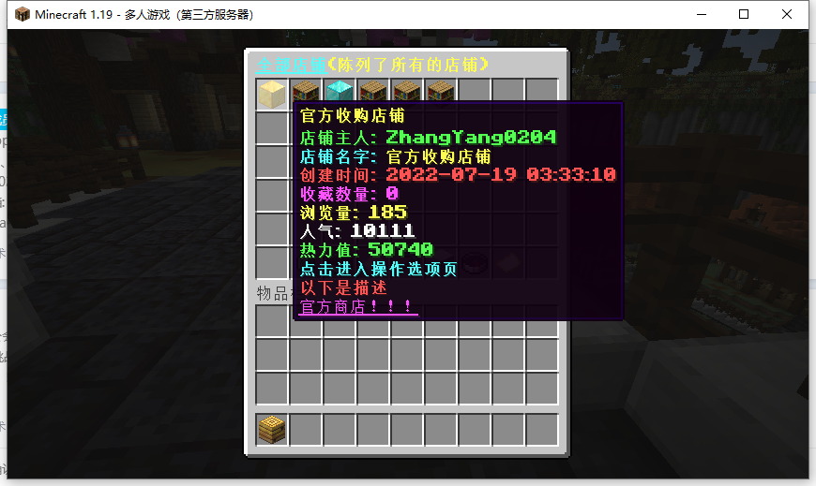
Image Gallery

Slide 6
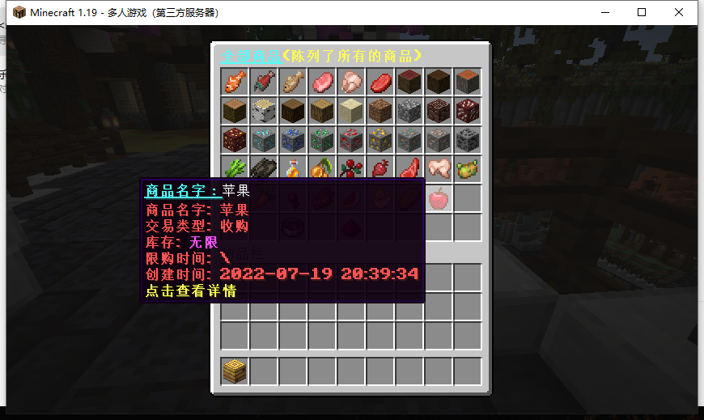
Image Gallery

Slide 7
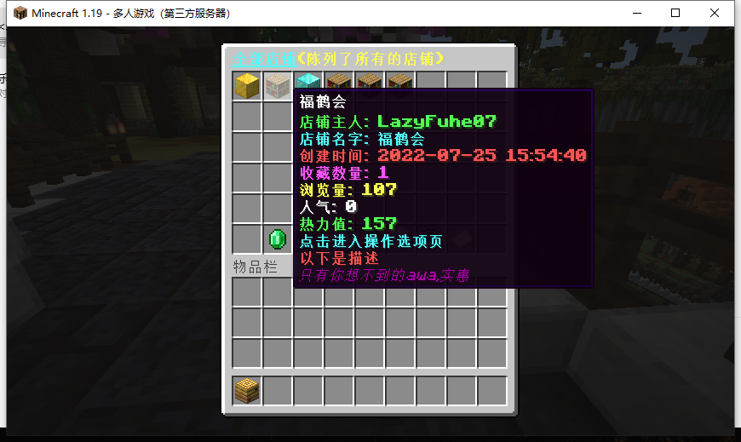
Image Gallery

Slide 8
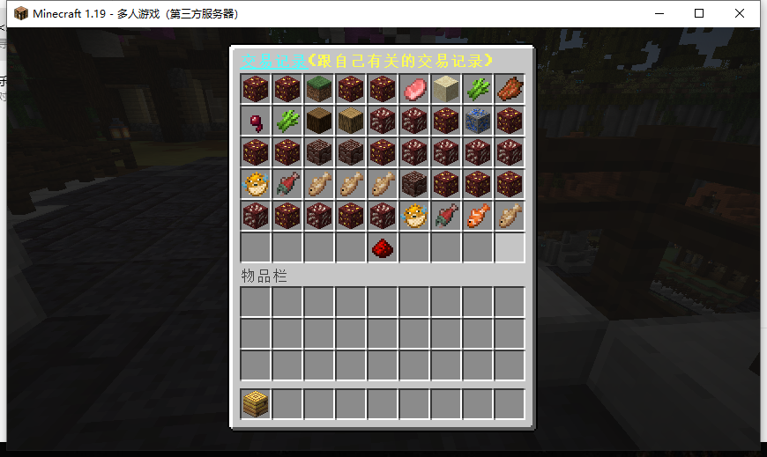
Image Gallery

Slide 9
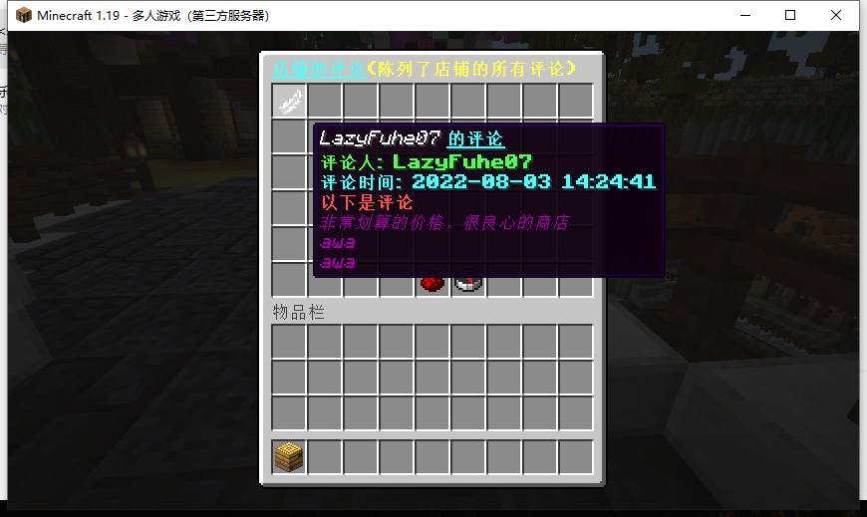
Image Gallery

