Slide 1
Chapter 13.
Red-Black Trees
A variation of binary search trees.
Balanced: height is O(lg n), where n is the number of nodes.
Operations will take O(lg n) time in the worst case.

Slide 2
Red - Black Trees
A red-black tree is a binary search tree + 1 bit per node:
an attribute color, which is either red or black.
All leaves are empty (nil) and colored black.
  We use a single sentinel, nil[T ], for all the leaves of red-black tree T.
  color[nil[T ]] is black.
  The root’s parent is also nil[T ].
All other attributes of binary search trees are inherited by red-black trees (key, left, right, and p).
We don’t care about the key in nil[T ].

Slide 3
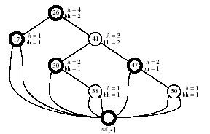
Properties of red-black trees
Every node is either red or black.
The root is black.
Every leaf (nil[T ]) is black.
If a node is red, then both its children are black. (Hence no two reds in a row on a simple path from the root to a leaf.)
For each node, all paths from the node to descendant leaves contain the same number of black nodes.
Example:

Slide 4
Height of red-black trees
Height of a node is the number of edges in a longest path to a leaf.
Black-height of a node x:
bh(x) is the number of black nodes (including nil[T ]) on the path from x to leaf, not counting x. By property 5, black-height is well defined.
Claim
Any node with height h has black-height b≥ h/2.
Proof
By property 4, ≤ h/2 nodes on the path from the node to a leaf are red.
Hence ≥ h/2 are black.
Claim
The subtree rooted at any node x contains ≥ 2^{bh(x)}-1 internal nodes.
Proof
By induction on height of x.

Slide 5
.. continued
Claim
The subtree rooted at any node x contains ≥ 2^{bh(x)}-1 internal nodes.
Proof : By induction on height of x.
Basis:
Height of x = 0 ⇒ x is a leaf ⇒ bh(x) = 0.
The subtree rooted at x has 0 internal nodes. 2⁰-1=0.
Inductive step:
Inductive Hypothesis: Let the height of x be h and bh(x) = b.
Any child of x has height h-1 and
black-height either b (if the child is red)
or b-1 (if the child is black).
By the inductive hypothesis, each child has ≥ 2^{bh(x)-1}-1 internal nodes.
Thus, the subtree rooted at x contains ≥ 2(2^{bh(x)-1}-1)+1=2^{bh(x)}-1
internal nodes. (The +1 is for x itself.)

Slide 6

.. continued
Lemma
A red-black tree with n internal nodes has height ≤ 2 lg(n+1)
Proof :
Let h and b be the height and black-height of the root, respectively. By the above two claims,
  Adding 1 to both sides and then taking logs gives lg(n + 1) ≥ h/2,
  which implies that h ≤ 2 lg(n + 1).

Slide 7
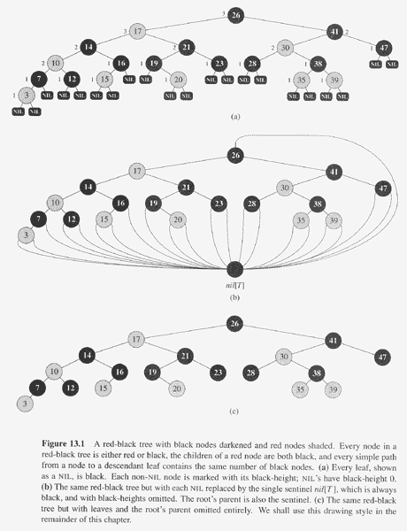

Slide 8
Operations on red-black trees
MINIMUM, MAXIMUM, SUCCESSOR, PREDECESSOR, and SEARCH operations in BST: O( height ) time.
Thus, on red-black trees: O(lg n) time.
Insertion and deletion are not so easy.
If we insert, what color to make the new node?
  Red? Might violate property 4.
  Black? Might violate property 5.
If we delete, what color was the node that was removed?
  Red? OK, since we won’t have changed any black-heights,
  nor will we have created two red nodes in a row.
  Also, cannot cause a violation of property 2, since if the removed node was red, it could not have been the root.
  Black? Could cause there to be two reds in a row (violating property 4), and can also cause a violation of property 5.
  Could also cause a violation of property 2, if the removed node
  was the root and its child - which becomes the new root - was red.

Slide 9
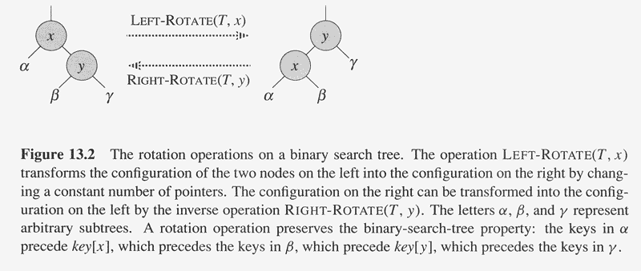
Rotations
The basic tree-restructuring operation.
Needed to maintain red-black trees as balanced binary search trees.
Changes the local pointer structure. (Only pointers are changed.): O(1)
Won’t upset the binary-search-tree property.
Have both left rotation and right rotation. They are inverses of each other.
A rotation takes a red-black-tree and a node within the tree.

Slide 10
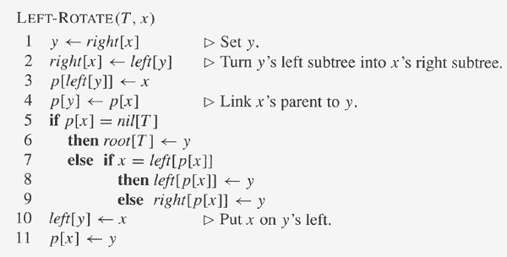
The pseudocode for LEFT-ROTATE assumes that
  right[x] (=y) ≠ nil[T ], and
  root’s parent is nil[T ].
Pseudocode for RIGHT-ROTATE is symmetric: exchange left and right everywhere.

Slide 11
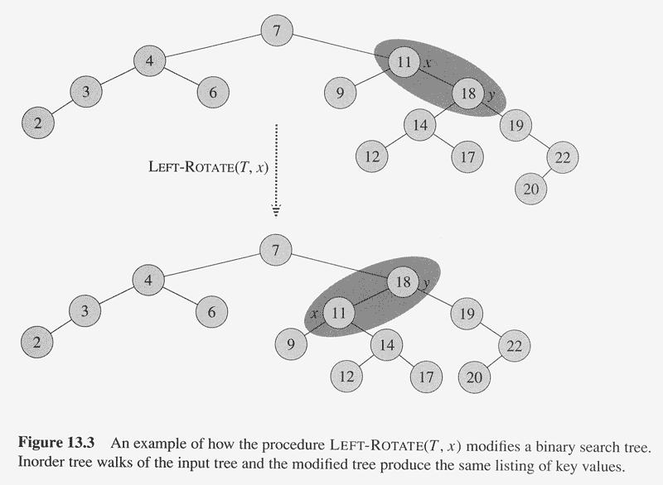

Slide 12
Example
Before rotation:
keys of x’s left subtree ≤ 11(=x’s key)
≤ keys of y’s left subtree ≤ 18 (=y’s key)
≤ keys of y’s right subtree.
Rotation makes y’s left subtree
into x’s right subtree.
After rotation:
keys of x’s left subtree ≤ 11(=x)
≤ keys of x’s right subtree ≤ 18 (=y)
≤ keys of y’s right subtree.
Time:
O(1) for both LEFT-ROTATE and RIGHT-ROTATE, since a constant number of pointers are modified.
Notes:
  Rotation is a very basic operation, also used in AVL trees and splay trees.
  Some books talk of rotating on an edge rather than on a node.

Slide 13
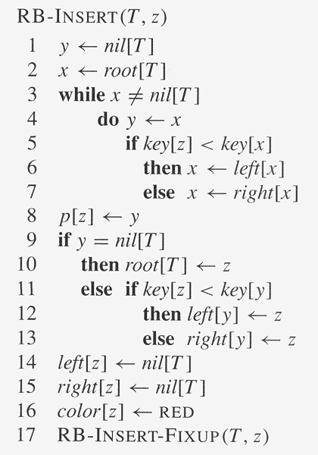

Slide 14
Insertion
Start by doing regular binary-search-tree insertion:
RB-INSERT ends by coloring the new
node z red.
Then it calls RB-INSERT-FIXUP
because we could have violated
a red-black property.
Which property might be violated?
1. OK.
2. If z is the root,
then there’s a violation. Otherwise, OK.
3. OK.
4. If p[z] is red, there’s a violation:
both z and p[z] are red.
5. OK.
Remove the violation
by calling RB-INSERT-FIXUP:

Slide 15
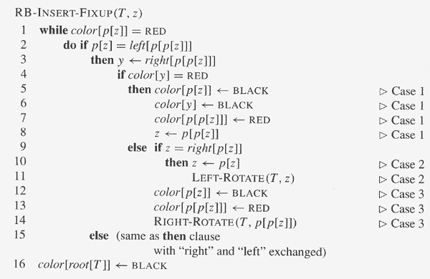
.. continued
Loop Invariant :
At the start of each iteration of the while loop,
a. z is red.
b. There is at most one red-black violation:
  Property 2: z is a red root, or
  Property 4: z and p[z] are both red.
Initialization:
We’ve already seen why the loop invariant holds initially.
Termination:
The loop terminates because p[z] is black.
Hence, property 4 is OK.
Only property 2 might be violated, and the last line fixes it.
Maintenance:
We drop out when z is the root (since then p[z] is the sentinel nil[T ], which is black). When we start the loop body, the only violation is of property 4.
There are 6 cases
- 3 of which are symmetric to the other 3.
The cases are not mutually exclusive.
Consider cases in which p[z] is a left child.
Let y be z’s uncle (p[z]’s sibling).

Slide 16
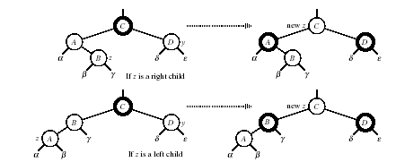
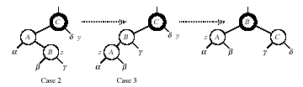
.. continued
Case 1: y is red
p[p[z]] (z’s grandparent) must be black, since z and p[z] are both red and there are no other violations of property 4.
Make p[z] and y black ⇒ now z and p[z] are not both red. But property 5 might now be violated.
Make p[p[z]] red ⇒ restores property 5.
The next iteration has p[p[z]] as the new z (i.e., z moves up 2 levels).
Case 2: y is black, z is a right child
Left rotate around p[z] ⇒ now z is a left child, and both z and p[z] are red.
Takes us immediately to case 3.
Case 3: y is black, z is a left child
Make p[z] black and p[p[z]] red.
Then right rotate on p[p[z]].
No longer have 2 reds in a row.
p[z] is now black ⇒ no more iterations.

Slide 17
.. continued
Analysis
O(lg n) time to get through RB-INSERT up to the call of RB-INSERT-FIXUP.
Within RB-INSERT-FIXUP:
  Each iteration takes O(1) time.
  Each iteration is either the last one or it moves z up 2 levels.
  O(lg n) levels ⇒ O(lg n) time.
  Also note that there are at most 2 rotations overall.
Thus, insertion into a red-black tree takes O(lg n) time.

Slide 19
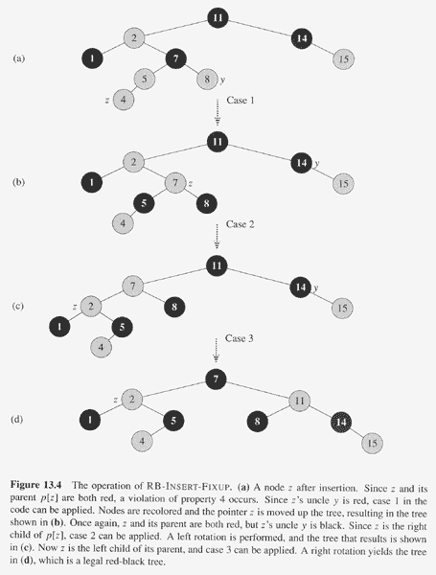

Slide 20
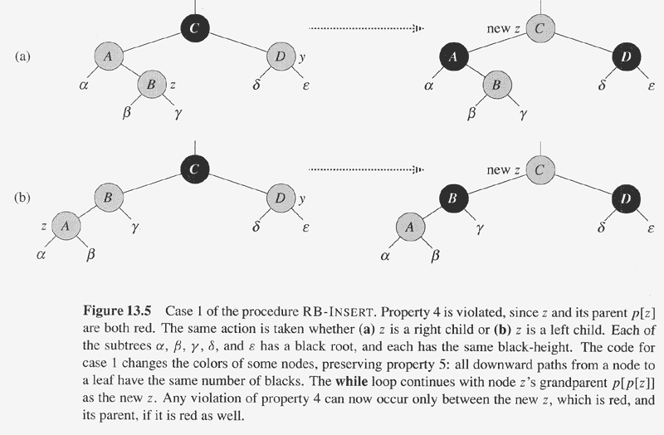

Slide 21
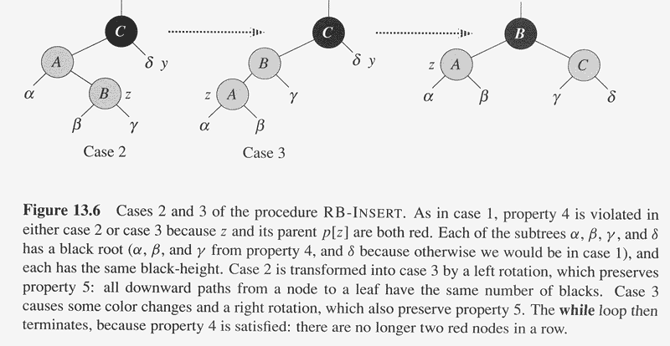

Slide 22
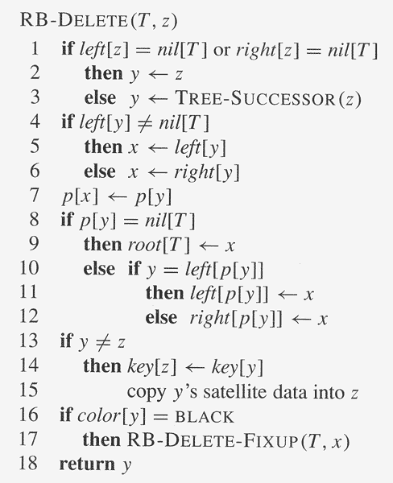
Deletion
Start by doing regular binary-search-tree deletion:
y is the node that was actually spliced out.
x is either
y’s sole non-sentinel child before was spliced out,
or the sentinel, if y had no children.
In both cases, p[x] is now the node that was previously
y’s parent.
If y is black, we could have violations of RB property.
1. OK.
2. If y is the root and x is red, then the root has become red.
3. OK.
4. Violation if p[y] and x are both red.
5. Any path containing y now has 1 fewer black node.
  Correct by giving x an “extra black.”
  Add 1 to count of black nodes on paths containing x.
  Now property 5 is OK, but property 1 is not.
  x is either doubly black (if color[x] = BLACK)
  or red & black (if color[x] = RED).
  The attribute color[x] is still either RED or BLACK.
  No new values for color attribute.
  In other words, the extra blackness on a node is
  by virtue of x pointing to the node.
Remove the violations by calling RB-DELETE-FIXUP:

Slide 23
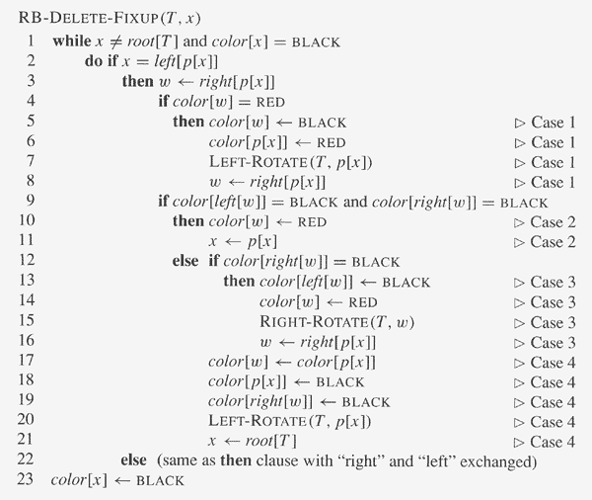
.. continued
Idea :
Move the extra black up the tree until
x points to a red & black node
⇒ turn it into a black node,
x points to the root
⇒ just remove the extra black, or
we can do certain rotations and re-colorings
and finish.
Within the while loop:
x always points to a non-root doubly black node.
w is x’s sibling.
w cannot be nil[T], since that would violate
property 5 at p[x].
There are 8 cases
- 4 of which are symmetric to the other 4.
The cases are not mutually exclusive.
Consider the cases in which x is a left child.

Slide 24


.. continued
Case 1: w is red
w must have black children.
Make w black and p[x] red.
Then left rotate on p[x].
New sibling of x was a child of w before rotation ⇒ must be black.
Go immediately to case 2, 3, or 4.
Case 2: w is black
and both of w’s children are black.
[Node with gray outline is of unknown color, denoted by c.]
Take 1 black off x (⇒ singly black)
and off w (⇒ red).
Move that black to p[x].
Do the next iteration with p[x] as the new x.
If entered this case from case 1,
then p[x] was red
⇒ new x is red & black
⇒ color attribute of new x is RED
⇒ loop terminates.
Then new x is made black in the last line.

Slide 25
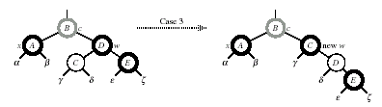

.. continued
Case 3: w is black,
w’s left child is red,
and w’s right child is black.
Make w red and w’s left child black.
Then right rotate on w.
New sibling w of x is black with a red right child ⇒case 4.
Case 4: w is black,
w’s left child is black,
and w’s right child is red.
[Now there are two nodes of unknown colors, denoted by c and c’ .]
Make w be p[x]’s color (c).
Make p[x] black and w’s right child black.
Then left rotate on p[x].
Remove the extra black on x (⇒ x is now singly black) without violating any red-black properties.
All done.
Setting x to root causes the loop to terminate.

Slide 26
.. continued
Analysis
O(lg n) time to get through RB-DELETE up to the call of RB-DELETE-FIXUP.
Within RB-DELETE-FIXUP:
  Case 2 is the only case in which more iterations occur.
    X moves up 1 level.
    Hence, O(lg n) iterations.
  Each of cases 1, 3, and 4 has 1 rotation ⇒ ≤ 3 rotations in all.
  Hence, O(lg n) time.
  [In Chap. 14, we’ll see a theorem that relies on red-black tree operations
  causing at most a constant number of rotations.
  This is where red-black trees has an advantage over AVL trees: in the worst
  case, an operation on an n -node AVL tree causes Ω(lg n) rotations.]

Slide 27
