Slide 1
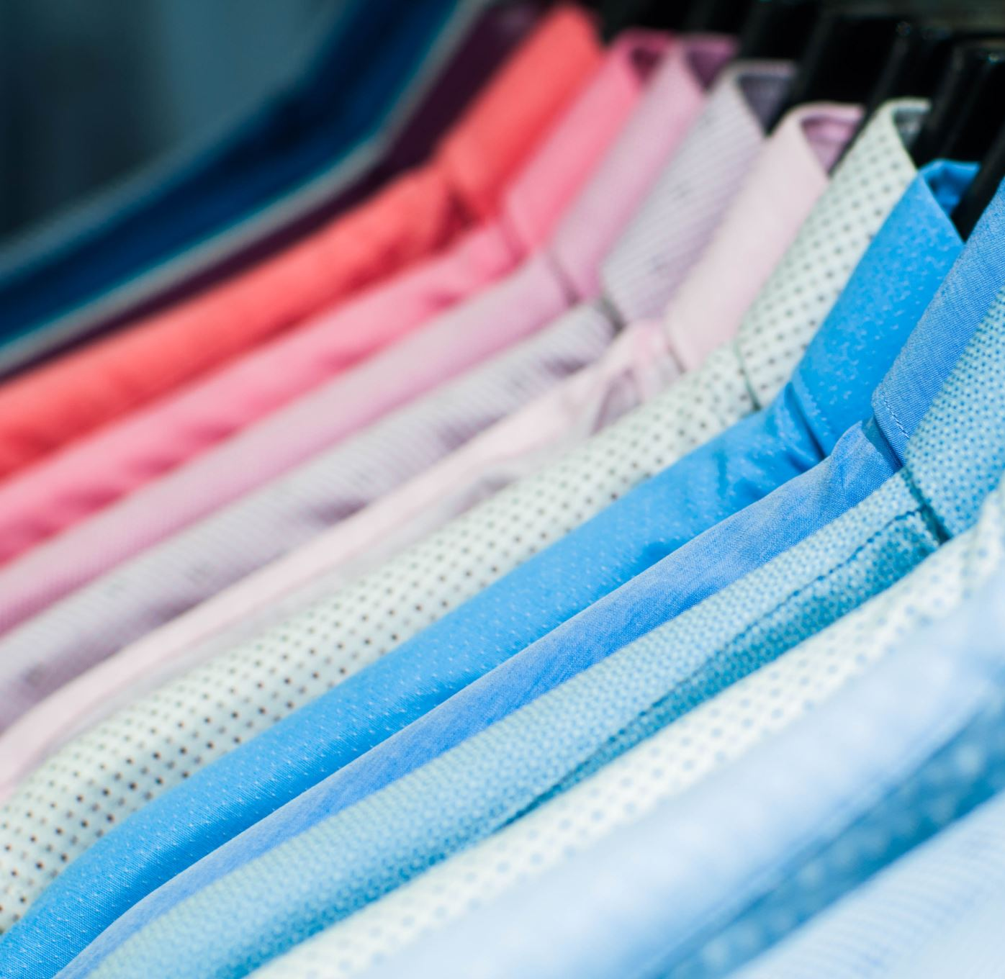
FUNKY FASHION STORE
Brites Marto Andrea
Le Thuong
Rodolfo Masera Tommaso
Taillefert Stefano

Slide 2

The problem

Slide 3
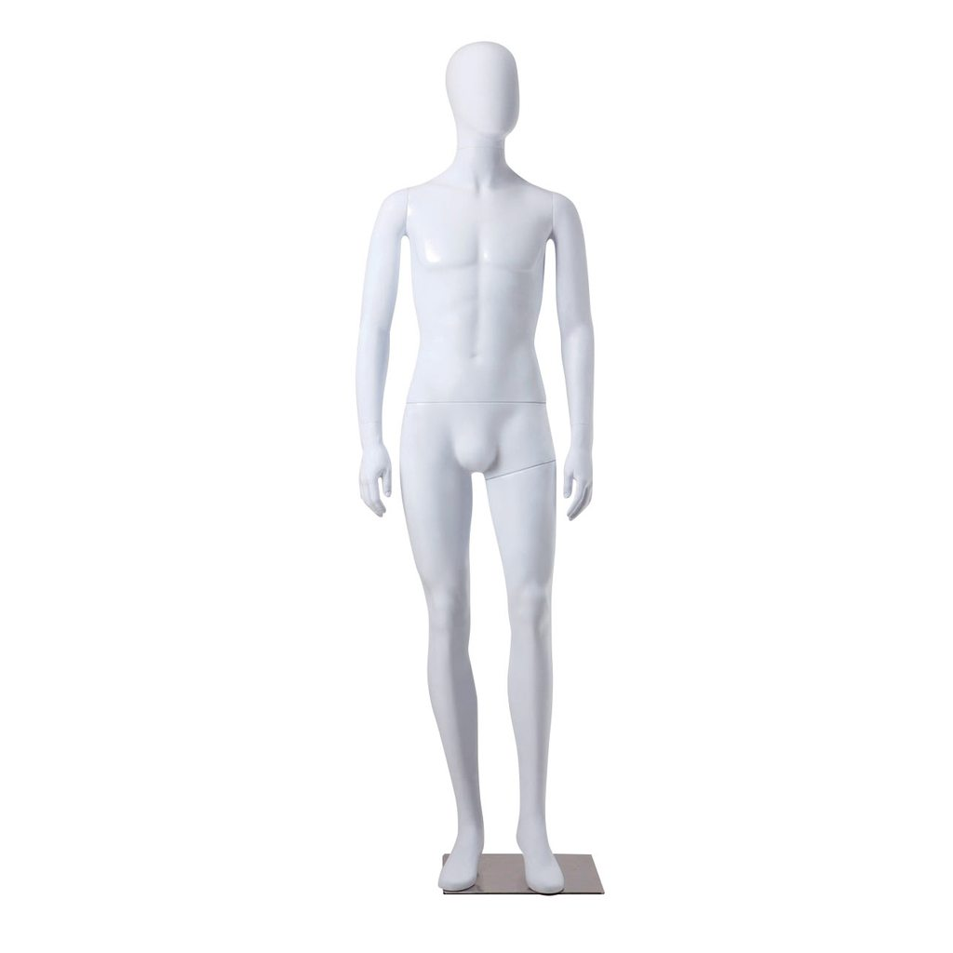
The problem
How can we dress this manequin?
With some style
Meaning
OPTIMIZING SOME CONSTRAINTS
CENSORED

Slide 4
Fashion Store Problem
Given a set of colored garments find a combination to dress your mannequin.
Constraints: some colors or garments don’t go together, too many colors might be extravagant, too little colors is dull, ...

Slide 5
Our inventory
Garments:
Pants
Shorts
Jackets
Scarfs
Ties
Gloves
Shirts
Hat
Sweater
Shoes
Colors:
Red
Yellow
Orange
Green
Blue
Purple
Brown
Pink
White
Black

Slide 6
Colors constraints
Yellow cannot go with white
Blue cannot go with purple
Blue cannot go with black
Red cannot go with green
Red cannot go with orange
Green cannot go with pink
Green cannot go with orange

Slide 7
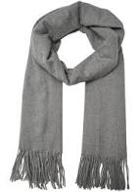
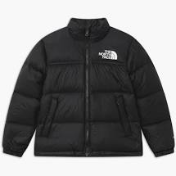
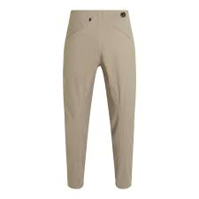
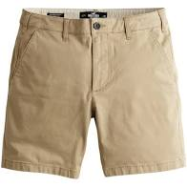
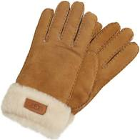
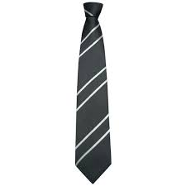
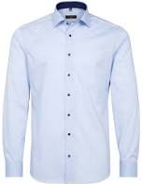
Garments constraints

Slide 8
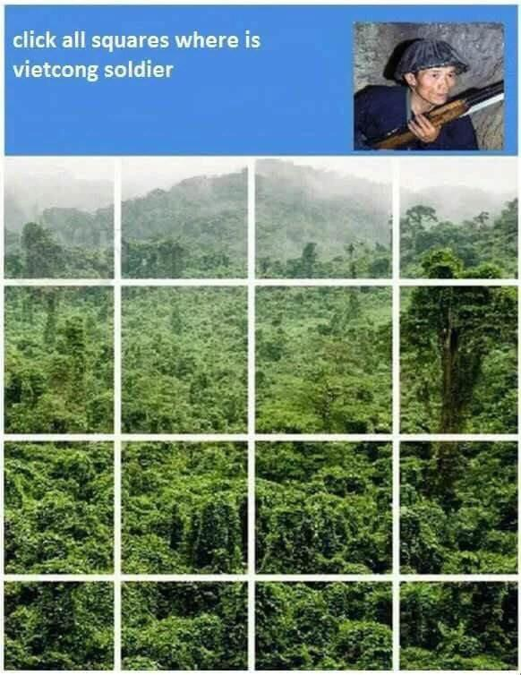
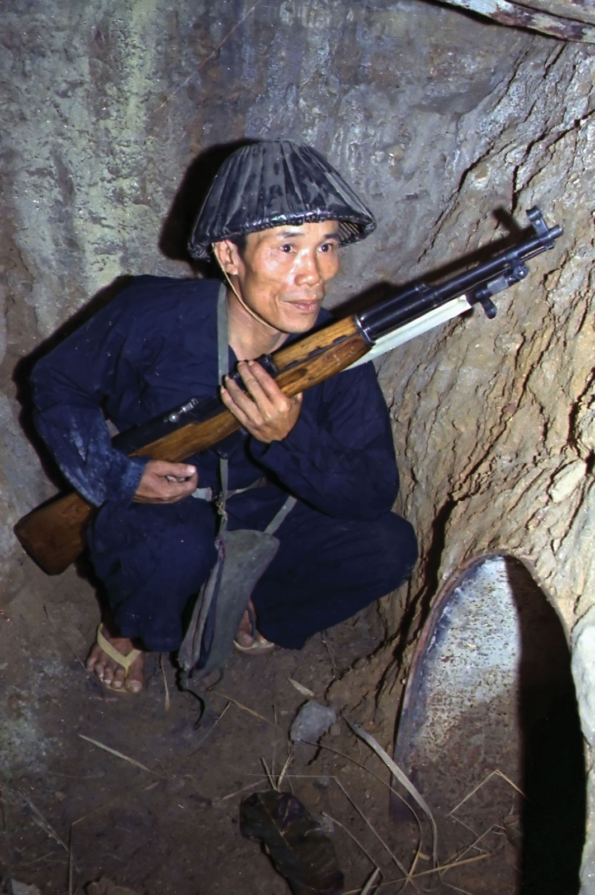
Example
Let’s dress a Vietnamese
Black/blue hat
Blue shirt
Blue pants
Mosin Nagant (optional)

Slide 9


App architecture

Slide 10
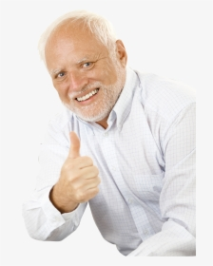
Conclusion

Slide 11
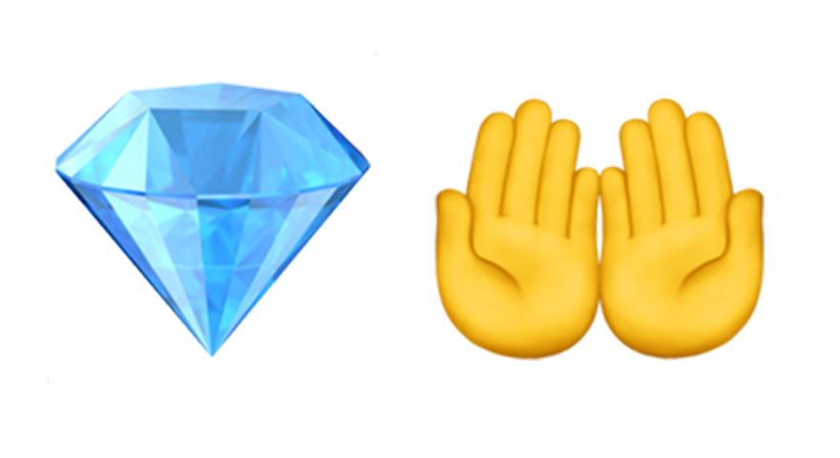
The real solution

Slide 12

Questions?

