Slide 1
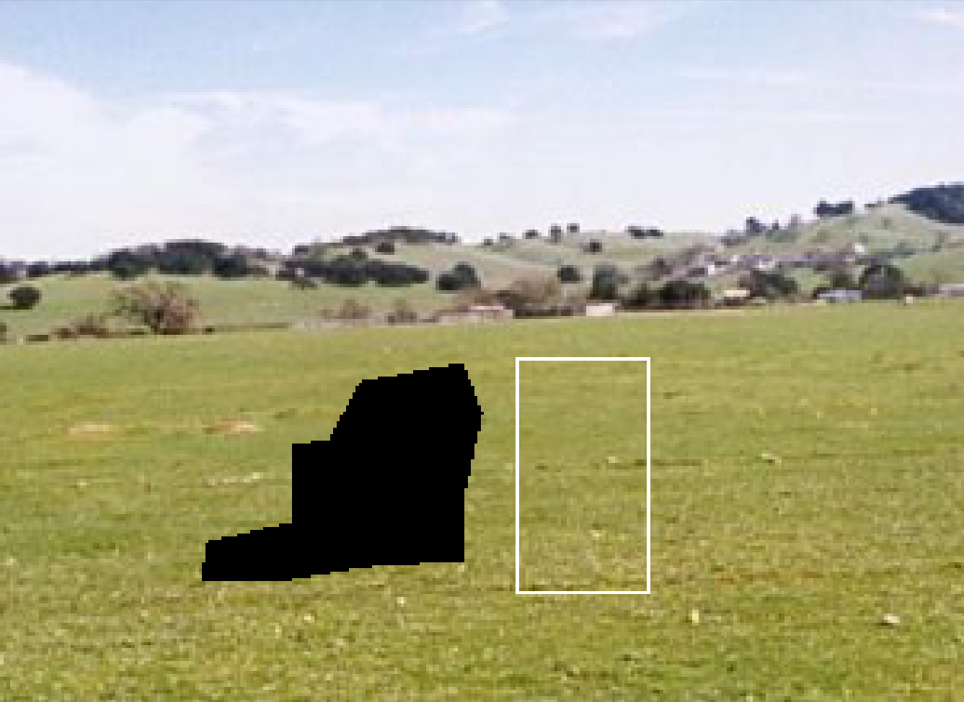
W
Texture region
P_{r}
W
r
Q_{r’}
r’
Window to find dissimilarity
Fill region

Slide 2
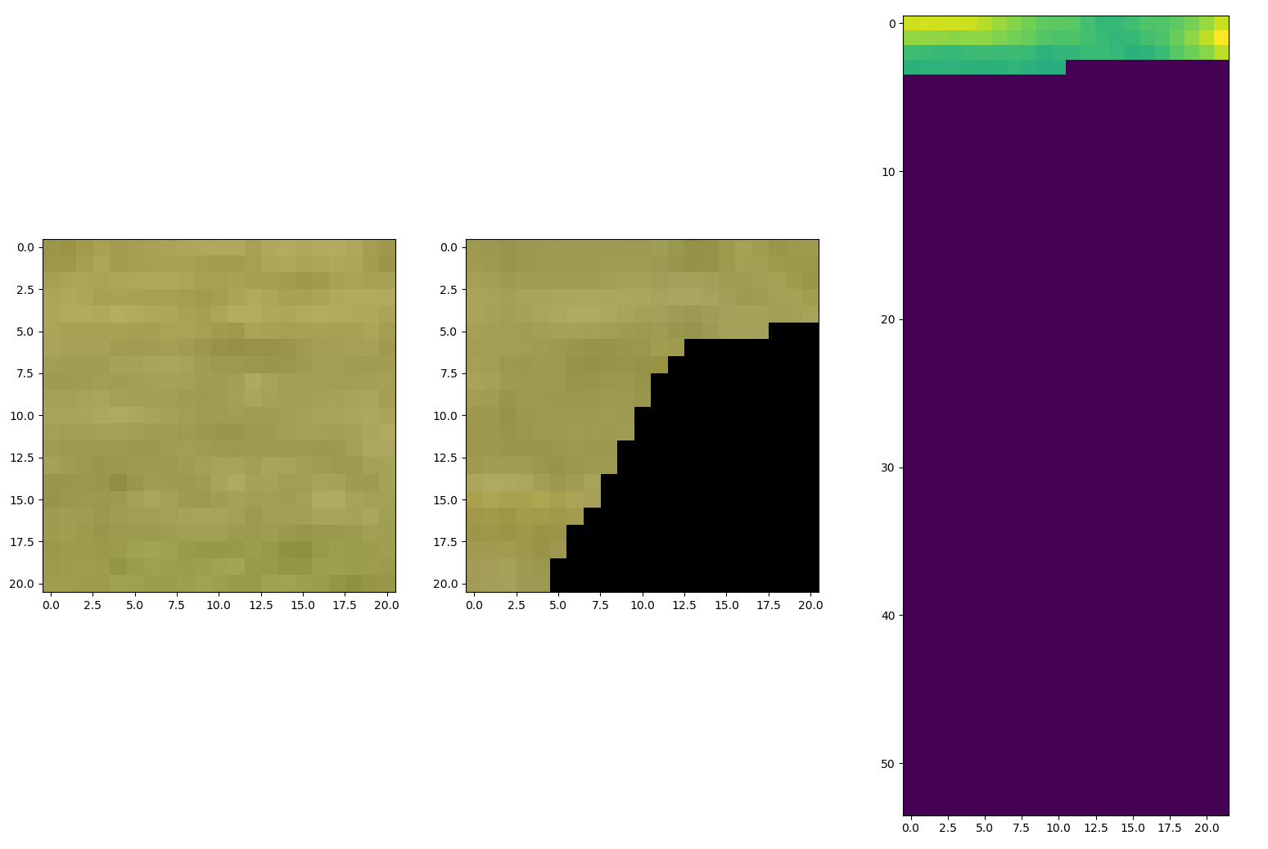
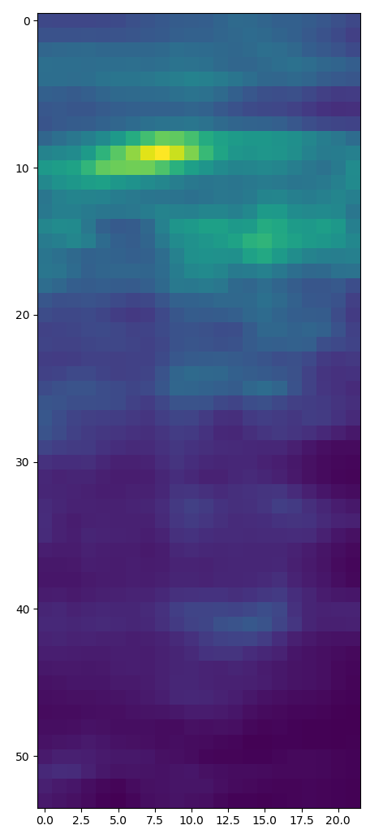
Unfinished SSD
1/SSD
Possible Q_{r’}
P_{r}
Best match

Slide 3
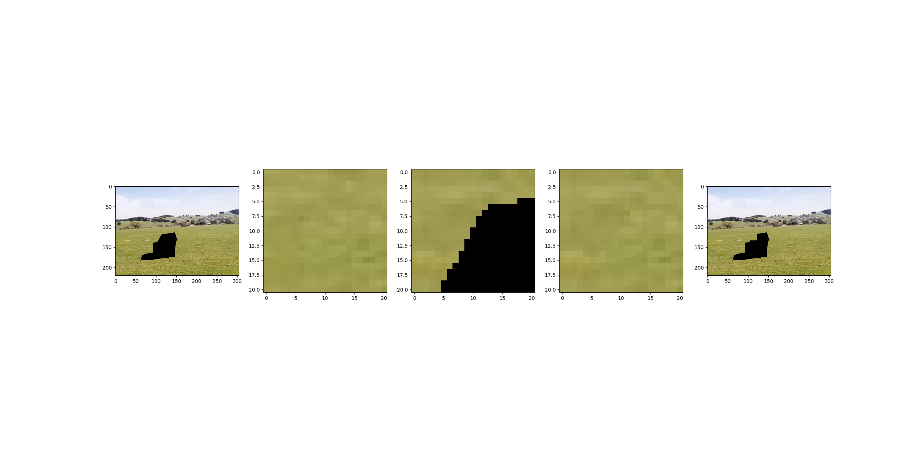
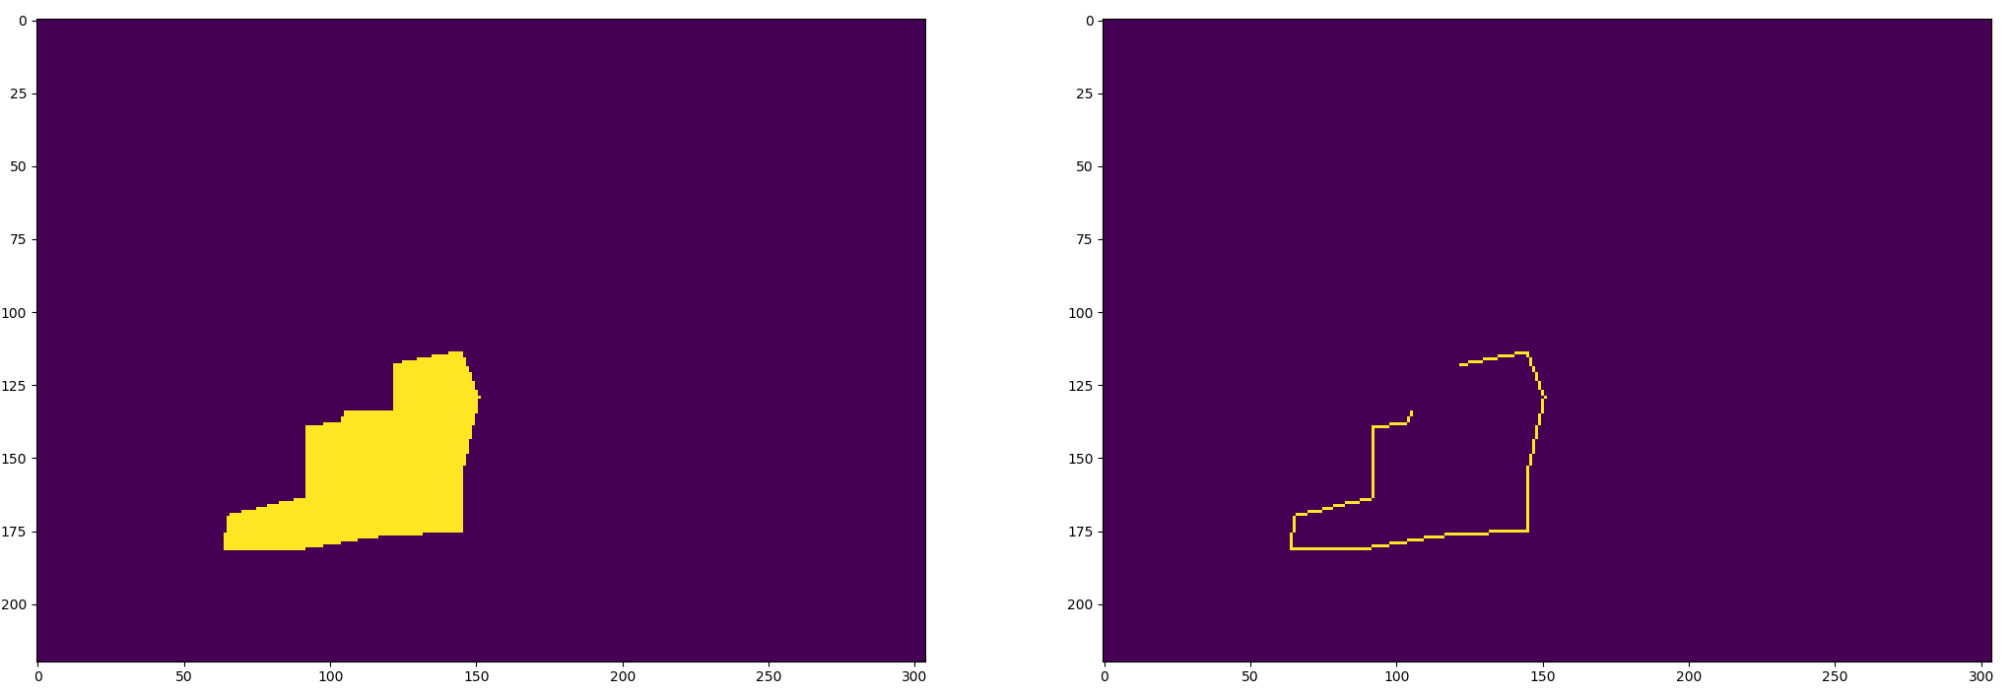
Q_{r’}
Filled img after first loop
Initial img
P_{r}
With P_{r} filled Q_{r’}
Fill region
Fill region edge

Slide 4
Iteration 1
Iteration 2
b
b
P_{2,1}
b
b
P_{1,1}
P_{1,2}
P_{2,2}
Two randomly picked points
Inliers
Outliers
Function
Band boundary

