Slide 1
eMAG
Stefan Stefanov
SOTIR DONKOV
A final assignment in ItTalents Season_14 tutored by Krasimir Stoev

Slide 2
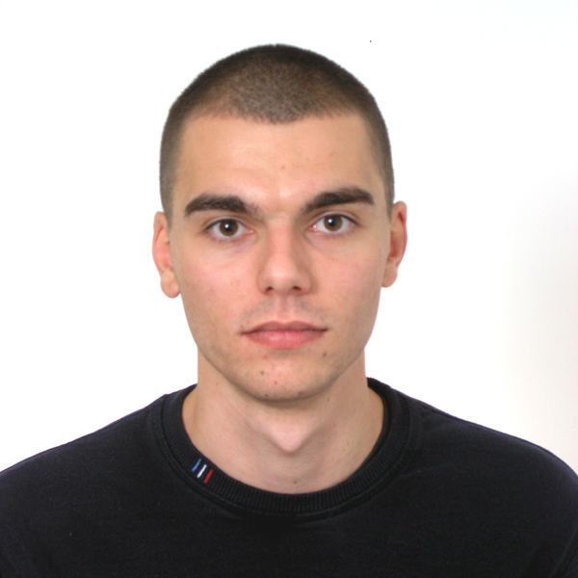
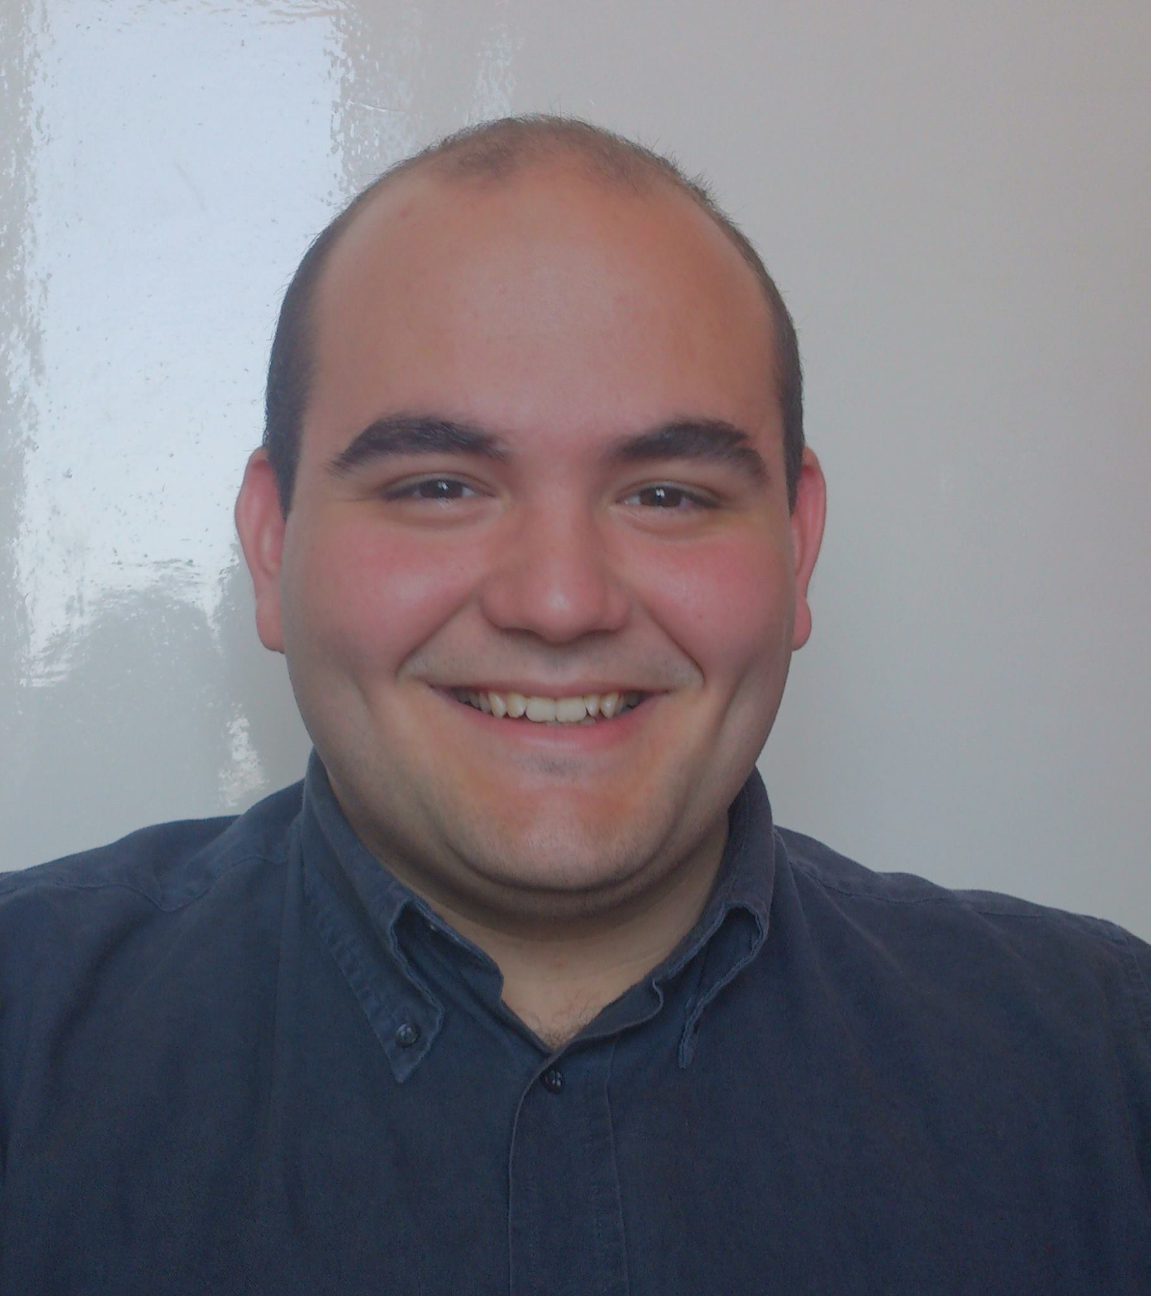
Who’s who?
Sotir Donkov
Background:
Dentistry
Stefan Stefanov
Background:
Political science

Slide 3
What was the assignment?
Must have:
Result:
Categories and subcategories
Checkout product. Add product to cart. Make order.
Search for product by name. Order products by pricing.
Admin functionality. CRUD products.
Set product discount.
Subscribe for mail notifications.
BONUS - Search by min and max price. Review product functionality.
Category self-relation
Done and added product Features
Done and added search by Feature
Done
Product and Category wide discount
Done
Done

Slide 4














Tech Stack

Slide 5
Main functionalities
User
Admin
CRUD
Favorite products
Buy products
Subscribe for notifications
Search for products
Search for categories
Make reviews
CRUD products
Make admin
Manage Categories, Features and everything else.

Slide 6
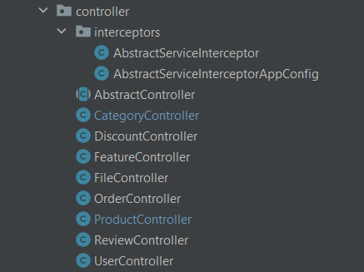
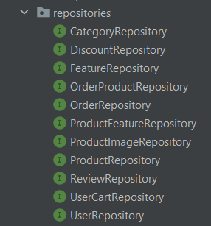
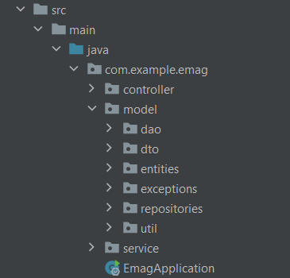
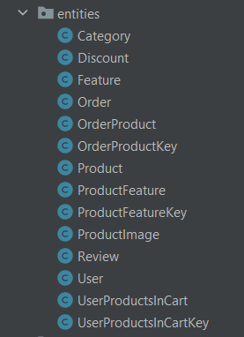
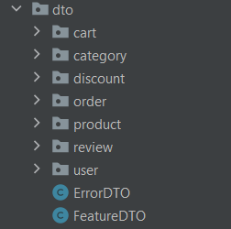
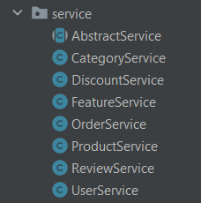

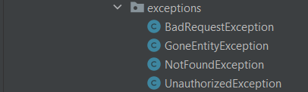
Class structure

Slide 7
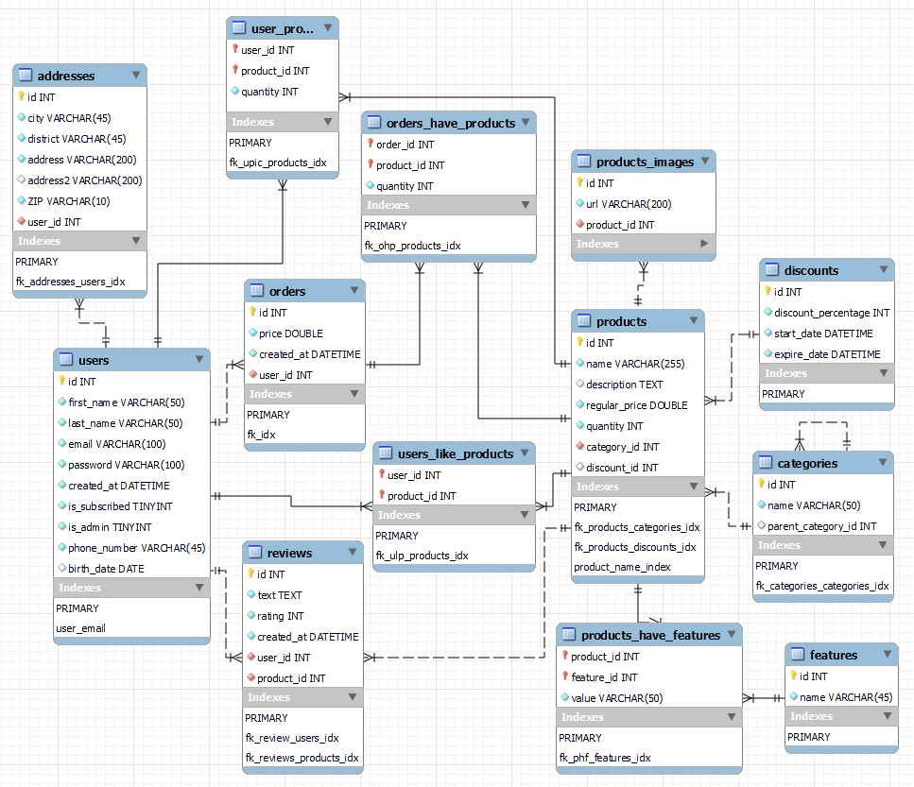
ER diagram

Slide 8
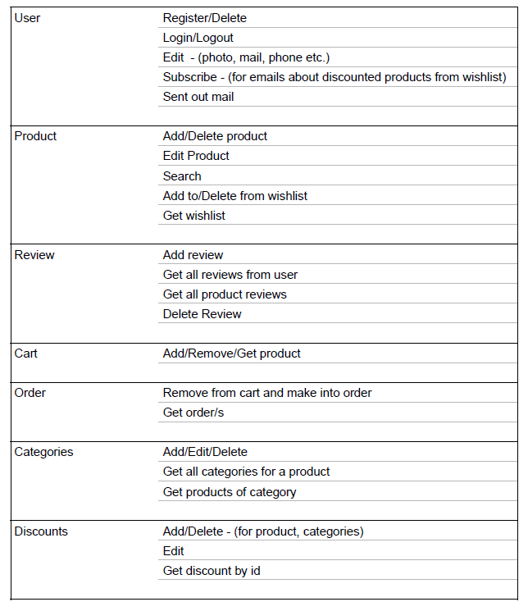
Action map

Slide 9
Demo

Slide 10
Q&A

Slide 11
Thanks for the attention!

