Slide 1
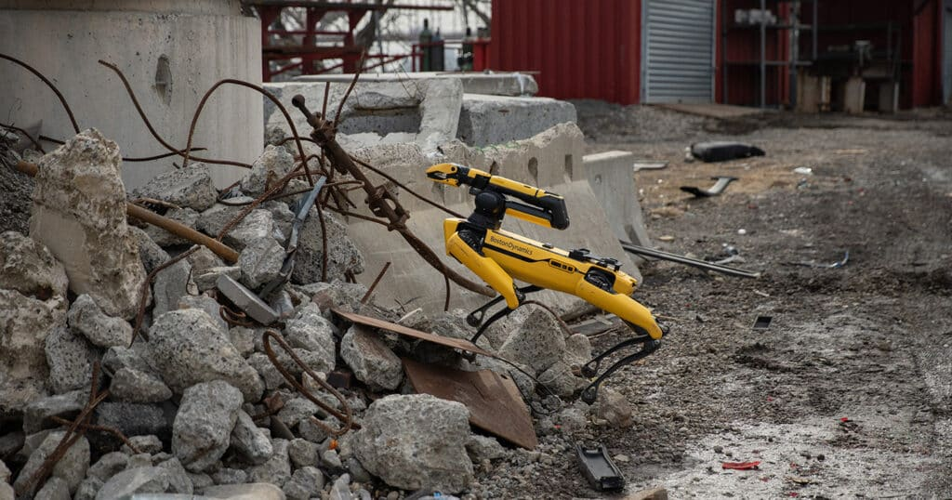
Search and Rescue– Unknown Victim Location Scenario:
By Stefania Germena

Slide 2
Objectives:
Robot: single mobile robot
Environment: known topology, unknown victim location
Tasks: exploration, detection, rescue
Constraints: information acquisition
Q1– Basic PDDL Model:
Approximate exploration using explicit predicates.
Provide:– one instance with known location– one requiring exploration
Q2– PDDL+ Model:
Introduce a process modelling victim health degradation.
Introduce an event representing discovery or failure conditions.
Show how exploration delays affect rescue success.

Slide 3
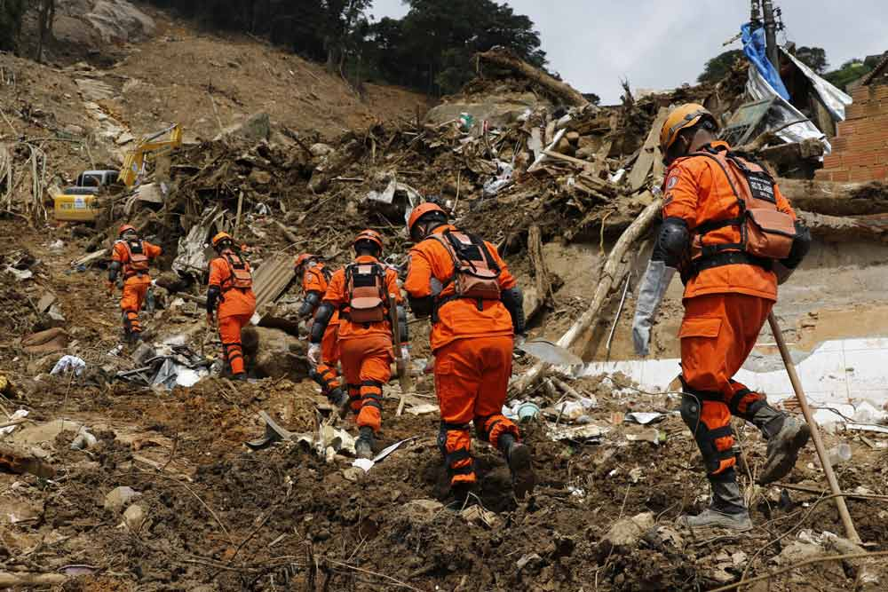
Design Logic:

Slide 4
Chemical sensing technology:
Chemical sensing technology enables robots to differentiate between living and deceased victims using a “fuzzy logic algorithm”.
The technology was implemented in a robot called SMURF.
Humans release VOCs through feces, urine, breath, skin, milk, blood, and saliva.
For deceased individuals, specific VOCs such as cadaverine, putrescine, skatole, and indole are released.
The highest detection accuracy for living or deceased victims occurs when the robot is positioned 2-3 meters away from them.

Slide 5
Thermal Cameras:
Thermal imaging aids in detecting living instances.
Thermal cameras are used to analyze scenes and verify victims' vital signs – fervers, heart rate, and respiratory rate.
Assists Search and Rescue (SAR) teams in their approach to situations.

Slide 6
Video Camera :
Application for unmanned aircraft systems (UASs).
Computer vision and machine learning techniques are utilized to assist search-and-rescue (SAR) teams in analyzing photographs for locating victims.
The algorithm is trained on diverse individuals across various ages and clothing types, including camouflage and casual wear.
It helps SAR teams by identifying high-probability target areas for victim location.
Ongoing technology advancements aim to enhance real-time regional identification for improved search efficiency.
Within the PDDL and SAR framework, this method enhances the identification of individuals under rubble and supports autonomous detection.

Slide 7
Two Microphones:
The sound-based controller uses two microphones to direct the robot towards sound sources.
This approach focuses on balancing noise levels between the microphones to determine sound direction, unlike traditional localization.
Synchronization of time differences in sound arrival at the microphones facilitates noise balance.
The method minimizes the impact of echo interference on the robot's heading direction.
In the context of PDDL and SAR teams dealing with debris, this technology improves the robot's autonomous orientation capabilities.

Slide 8
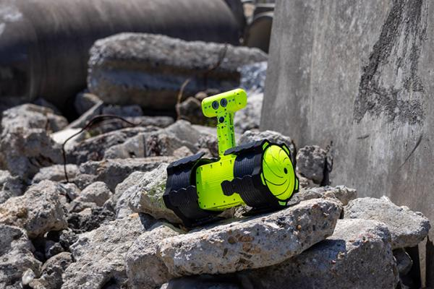
PDDL:

Slide 9
Instance 1: Know location
Move
Scan
Rescue
Moving between rooms
Detect victim
Oxygen Supply
Notes:
The scanning procedure ensures the presence of the victim. The victim is verified with a high decibel level, a red thermal reading, and a high visual probability.

Slide 10
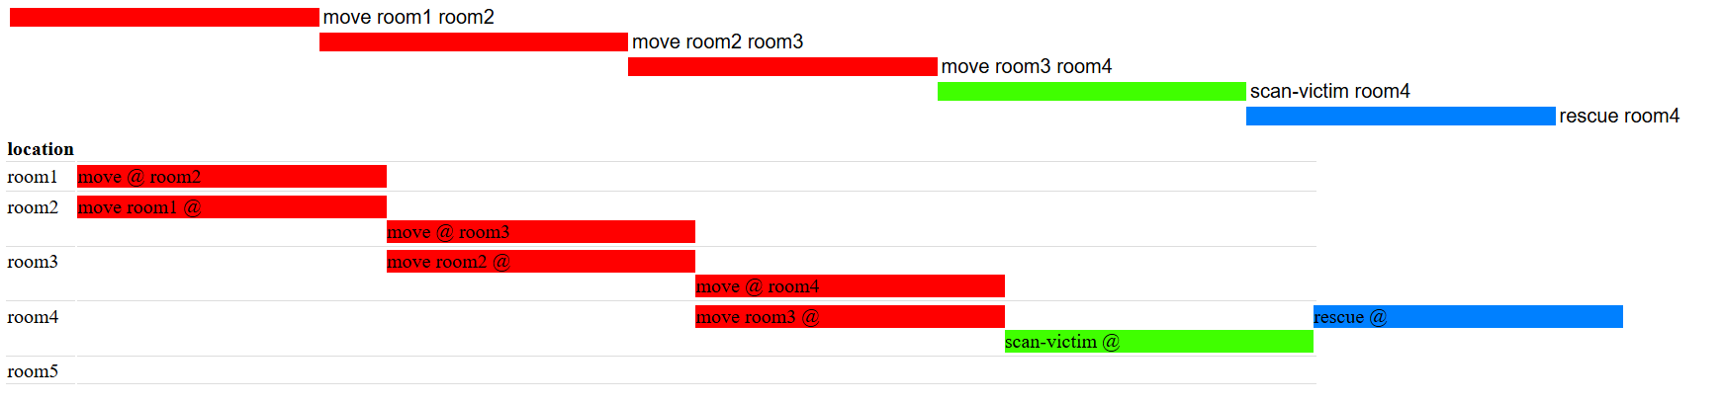
Instance 1: Results

Slide 11
Instance 2: Requires exploration
Verifies is alive or deceased victim
Scan
Locate
Check Vitals
Scanning every room before moving onto the next room
Certain checks are met which indicate a victim
Rescue
Move
Sends signal of path taken to SAR teams
Navigates between the rooms
Notes:
The scanning procedure ensures the presence of the victim. The victim is verified with a high decibel level, a red thermal reading, and a high visual probability.

Slide 12
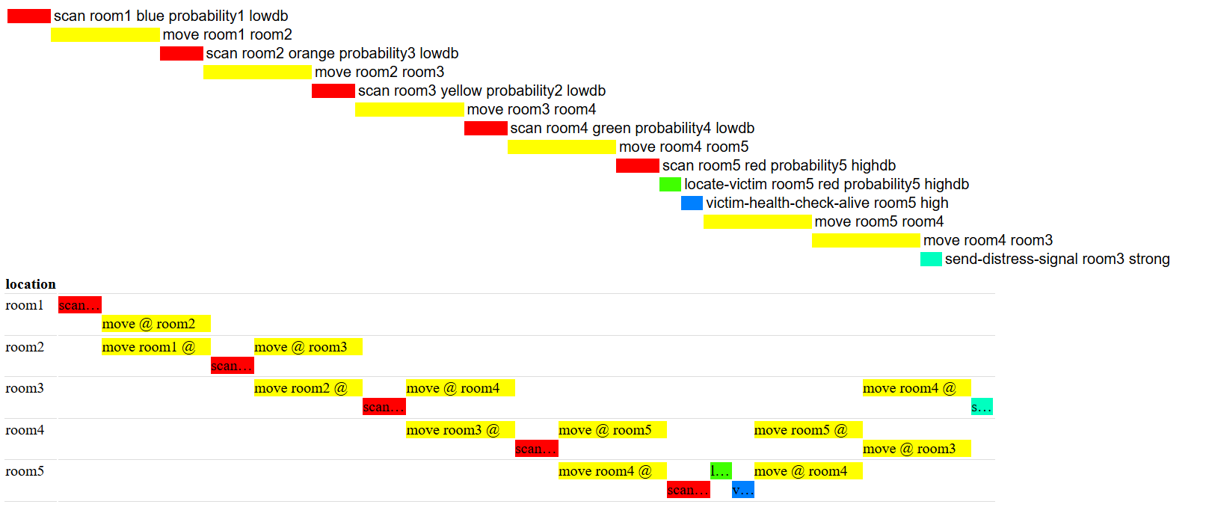
Instance 2: Results

Slide 13
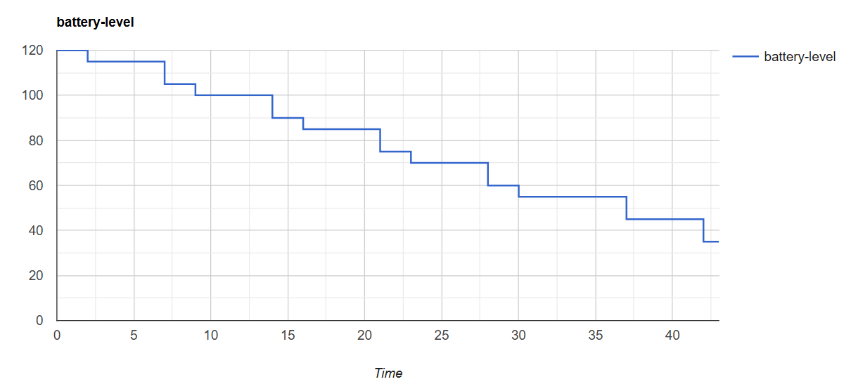
Instance 2: Results

Slide 14
PDDL +:

Slide 15
PDDL + Design
Verifies is alive or deceased victim
Scan
Locate
Check Vitals
Scanning every room before moving onto the next room
Certain checks are met which indicate a victim
Rescue
Move
Sends signal of path taken to SAR teams
Navigates between rooms

Slide 16
Processes
Victim’s Health prior to them being located
Victim’s Health after vitals were taken
Rescue Time
Depletion of victim’s health before their vitals are analyzed
Depletion of victim’s health but at a slower rate
Depletion of rescue time as a time limit may be set by SAR to ensure safety.
Scan
Move
To illustrate the time taken to complete the action and how it deplete the battery
Notes:
mimic the continuous physical dynamics of real-world operations. For example, when a robot commences a specific sensing action to acquire environmental information, the task inherently requires time to complete.
This allows the planner to evaluate the feasibility of a rescue operation at any exact millisecond."

Slide 17
Events:
Victims Health
Time
Battery Life
Obstacle

Slide 18
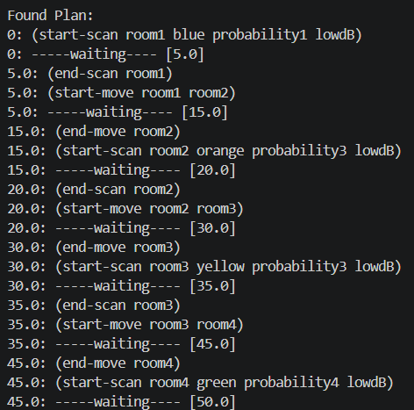
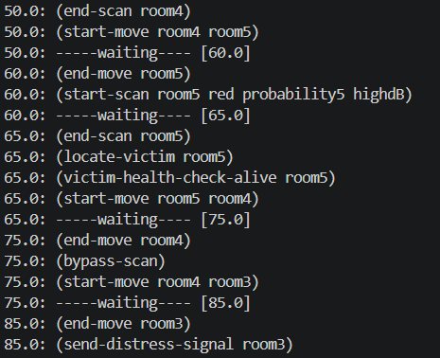
Results:

Slide 19
Scenarios:
Battery below 110
Victim’s Health below 110
Time below 80
Obstacle

Slide 20
Limitations:
Its reliance on topological representation, lacking continuous geometric representation of the environment.
The problem file defines world variables but does not consider geometric conditions, impacting the robot's ability to determine its exact location.
The scenario demonstrates this limitation, as the robot needs to adjust its position to assess a victim's vitals, ignoring the room's dimensions and movement requirements within the room.
The system assumes optimal conditions, leading to challenges in handling uncertainties
Rigidity in goal states poses issues- leads to decisions that disregard the appropriate sequence of actions in search and rescue (SAR) scenarios.
The heuristic planner tends to avoid challenging paths
Implementing an "abort-mission" effect prevents continuation of processes if certain conditions are met, aiming to align actions with logical SAR sequences.
Notes:
The system assumes optimal conditions, leading to challenges in handling uncertainties, like camera detection failures resulting in false negatives.

Slide 21
Limitations:
PDDL+ vs PDDL:
Converted into durative actions to prevent battery depletion issues caused by time conflicts in the planner.
Durative actions cannot be interrupted, a limitation of PDDL; PDDL+ addresses this by permitting the use of "events" to manage processes more effectively.
This is the difference between discrete intervals and continuous state evaluation.

Slide 22
Thank you for your attention!

