Slide 1
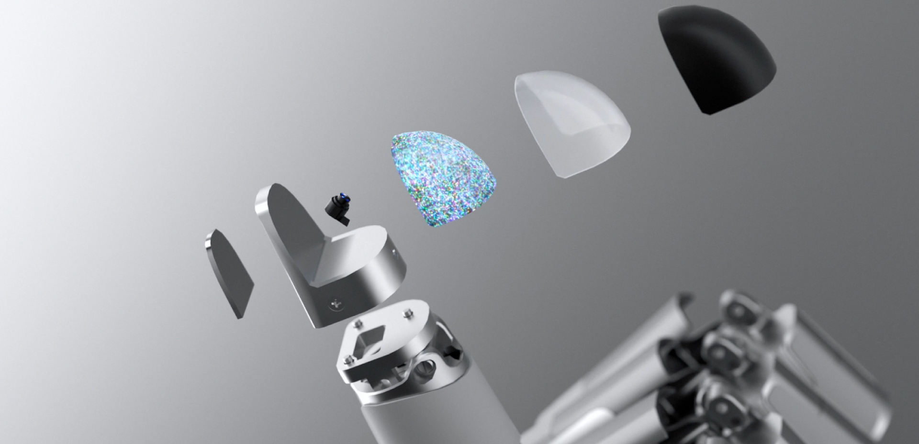
Multi-Modal Vision Based Tactile Sensor Dataset Creation
By Stefania Germena
NOx

Slide 2
State of the Art:
Research Problem:
Tactile perception is the subjective experience produced by mechanoreceptors in the skin upon contact with a surface.
To differentiate between materials, the primary distinctions must be analysed:
surface roughness and material hardness
sliding velocity and applied pressure
Utilise the Daimon sensor to conduct experiments on three distinct materials.
The collected data will then be fed into a neural network. This research aims to determine if sufficient information was collected to accurately classify materials for a live classification test.
Multi-Modal Vision Based Tactile Sensor Dataset Creation
This research aims to determine if sufficient information was collected to accurately classify materials for a live classification test.
By Stefania Germena

Slide 3
Research Problem:
State of the Art:
Tactile perception is explored through bio-inspired sensors linking human perception to robotics.
Correlating mechanoreceptors in human skin with material properties.
Materials classified based on physical qualities like surface roughness and hardness.
Study evaluated frictional and vibrational effects of an artificial finger.
Findings indicate that simple touch lacks precision; sliding motions with varied velocities and pressures improve classification accuracy of materials' attributes.
2. Using the GelSight sensor.
The GelSight sensor accurately captures fine details of materials, utilizing image processing techniques.
A substantial dataset has been collected using this sensor, covering a wide range of materials.
Employs image processing and neural networks (NN) for image analysis and training.
Deep learning approaches involve pre-trained models adjusted for different data types through transfer learning.
Data augmentation techniques used include scaling, cropping, and rotating images.

Slide 4
Research Problem:
State of the Art:
Advancement of tactile sensors
Compares different manufacturing techniques for tactile sensors.
Assesses hardware types, preparation procedures, and sensor cameras.
Evaluates material resilience under prolonged stress.
Discusses the impact of elastic deformation on sensitivity and information acquisition.
2. The operational mechanics of the Daimon sensor.
The sensor uses LEDs, a camera, markers, and a flexible elastomer pad for multimodality.
The study contrasts marker-based transduction with intensity-based transduction technologies.
Key factors discussed include compatibility with neural networks, ease of manufacture, and simplicity of structure.
A noted drawback is the sensor's insensitivity to spatial texture.

Slide 5
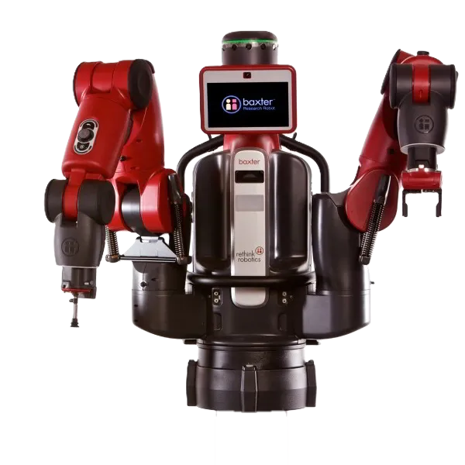
Research Formulation:
Research Problem:
State of the Art:
Using the Daimon sensor for assessing fruit ripeness in automated agriculture.
The aim was to evaluate the sensor's data reliability and integrate VBTS with conventional robotic picking techniques.
Employed to identify object hardness
Normal and shear force maps, and optical flow maps from the Daimon sensor.
Multiple experiments ranged from sensitive to firm fruits, showing clearer normal force distinctions with time.

Slide 6
Objectives:
Research Formulation:

Slide 7
Research Formulation:
Hypotheses :
Objectives:
If the Daimon sensor can formulate the materials' "fingerprint"
Understand the surface roughness and material hardness of the tested materials.
How the experiment should be conducted which stems from previously states research papers and how to incorporate tactile perception with VBTS technology.
Leads to defining constant variables such as the sensor sliding velocity and applied pressure during the motion across the material for material classification.
Feeding the collected data into a neural network
Identify if data collected was sufficient to accurately classify a tested material.

Slide 8
Objectives:
Methodology :
Hypotheses :
The data collected via the sliding motion will be sufficient for material classification when real-time classification is operated under the same conditions as when data were collected.
The dataset is naturally limited for training, as it bounds metal, plastic and rubber classification to these specific objects.
This limitation does not cover subtypes of these materials (i.e., the different hardness between ABS and PET), nor does it consider the diverse surface finishes due to manufacturing methods.
However, the features fed in the neural network will be sufficient enough to differentiate the chosen materials.

Slide 9
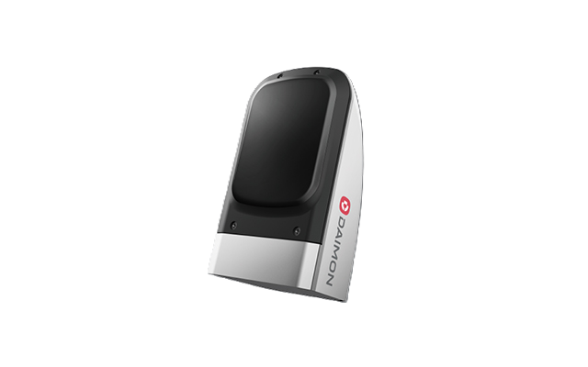
Hypotheses :
Methodology :
The experiments conducted will incorporate the information on tangential and normal deformation (from the Daimon sensor), the rate of tangential deformation, and the rate of depth deformation.
Three different materials were tested: plastic, rubber, metal
Sixty repetitive swiping actions, the object's orientation will be changed with respect to the sensor.
To ensure repeatability of every swipe, Baxter, manufactured by Rethink Robotics, has been used to conduct the experiments.
The results collected are fed into a time series transformer, where 16% of datasets were used for testing while 44% were used for training.
To verify the adequacy of the datasets for training, a "live classification" script was developed to evaluate the Daimon sensor's real-time capability to accurately identify the material.

Slide 10
Methodology :
Results:

Slide 11
Results:
The data obtained reflect the sensor's response to various materials. The effect is influenced by the direction of the applied motion, the magnitude of the pressure exerted, and the surface roughness and hardness of the material's.
Shear velocity is the slippage of the sensors.
Depth velocity indicates the point at which the material exhibits reduced influence on the sensor, resulting in the deformation of the object rather than the elastomer pad.
A stick-slip mechanism is also evaluated
To sustain continuous motion and applied pressure from Baxter, the object was rotated while maintaining Baxter's fixed location. This method produced varying contact surfaces, particularly for plastic due to its irregular shape.

Slide 12
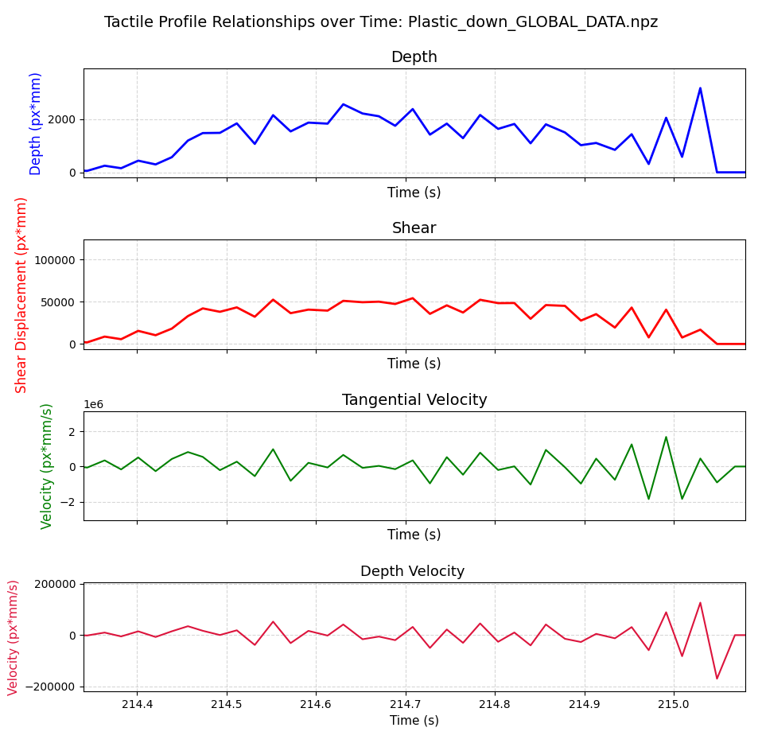
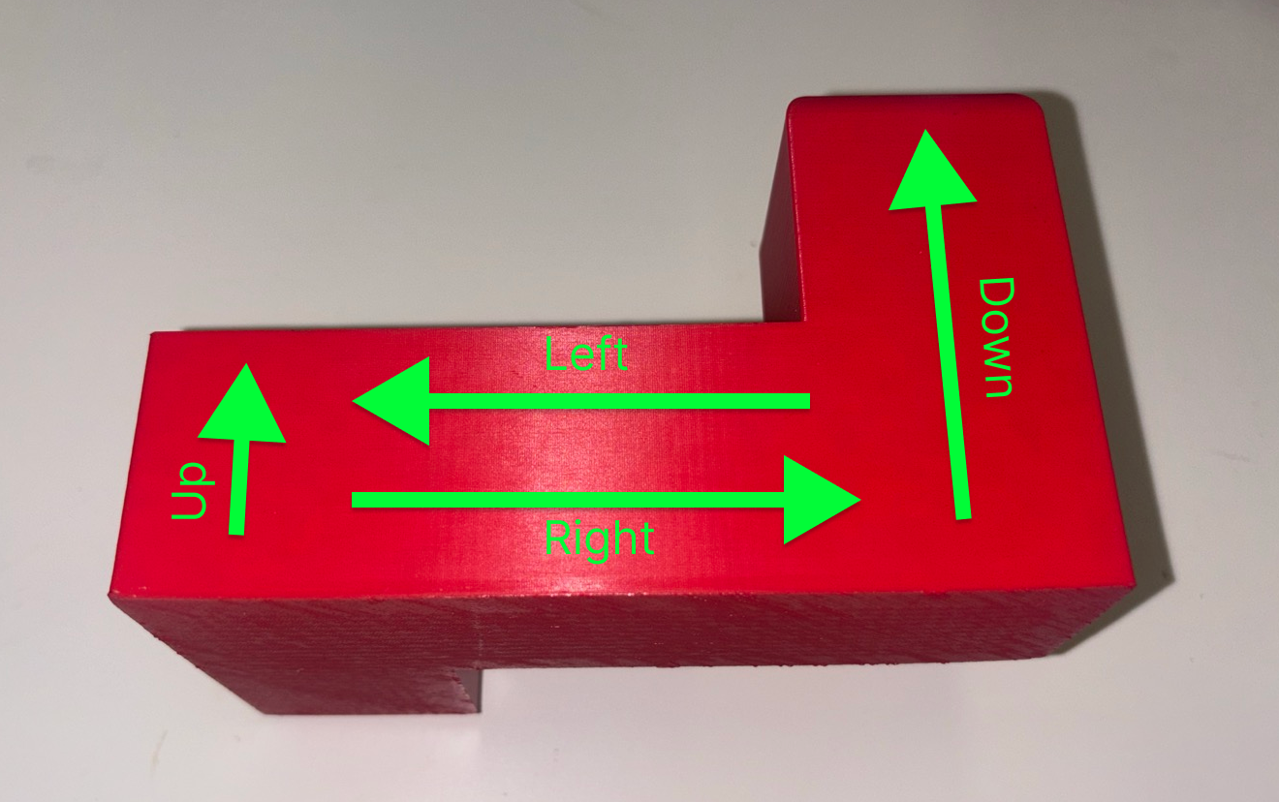
Results: Plastic

Slide 13
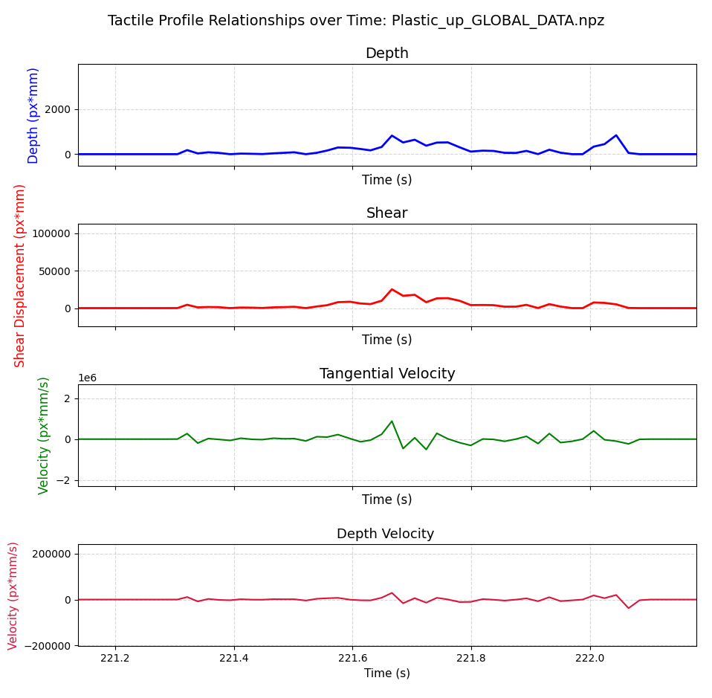
Results: Plastic

Slide 14
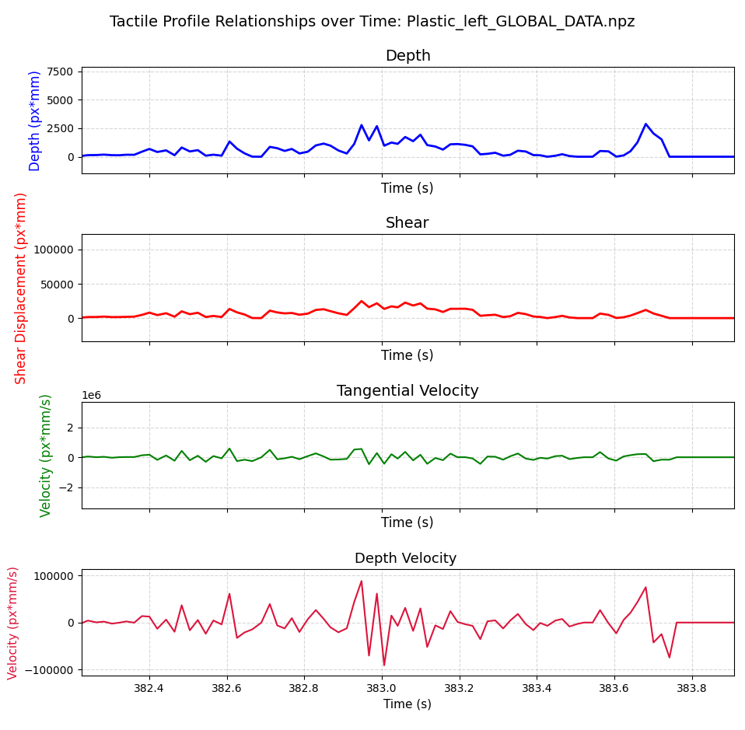
Results: Plastic

Slide 15
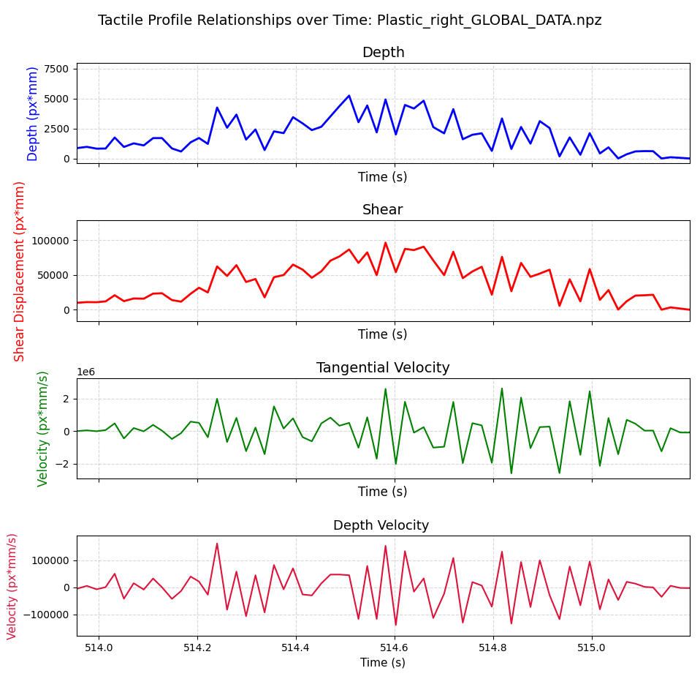
Results: Plastic

Slide 16
Results: Plastic
The irregular shape and contact surface area of the plastic object subjected it to different conditions.
As illustrated in the figure and the "Plastic up" graph, the contact area was less than in the "Plastic down" graph; the difference is indicated by the higher number of pixels per mm.
The "plastic left" graph and "plastic right" graphs show longer contact with the surface of the object. This data correlates with the illustration of the direction of motion.
The increased depth, caused by the sensor being pushed into the object, also affected the tangential deformation.
It is observed that sliding along the plastic material from the "right" direction resulted in a greater stick-slip effect.
The profiles of all the graphs are quite similar, but at varying scales.

Slide 17
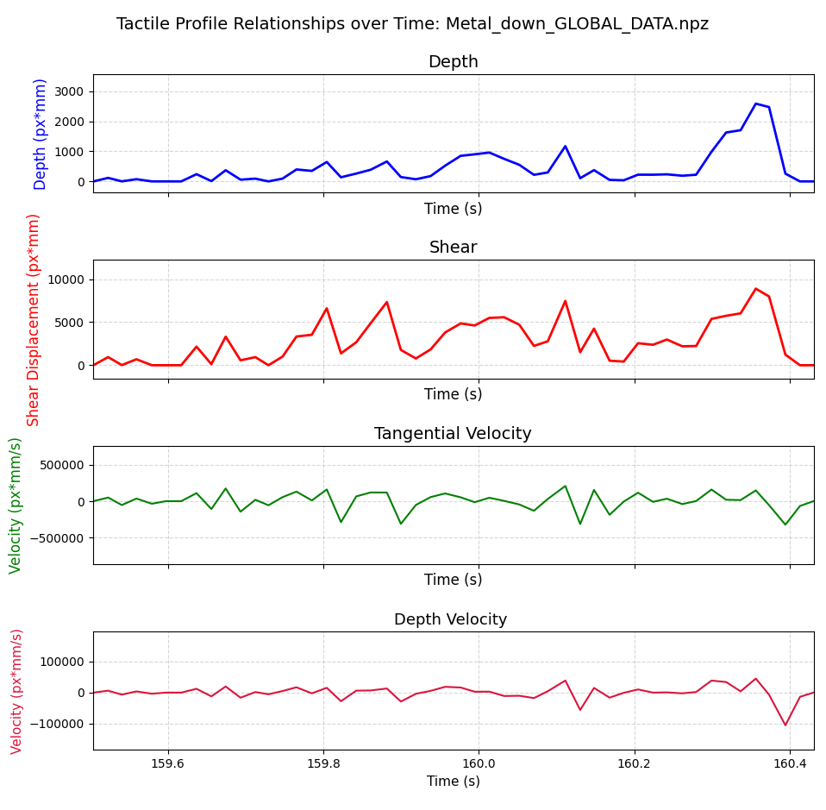
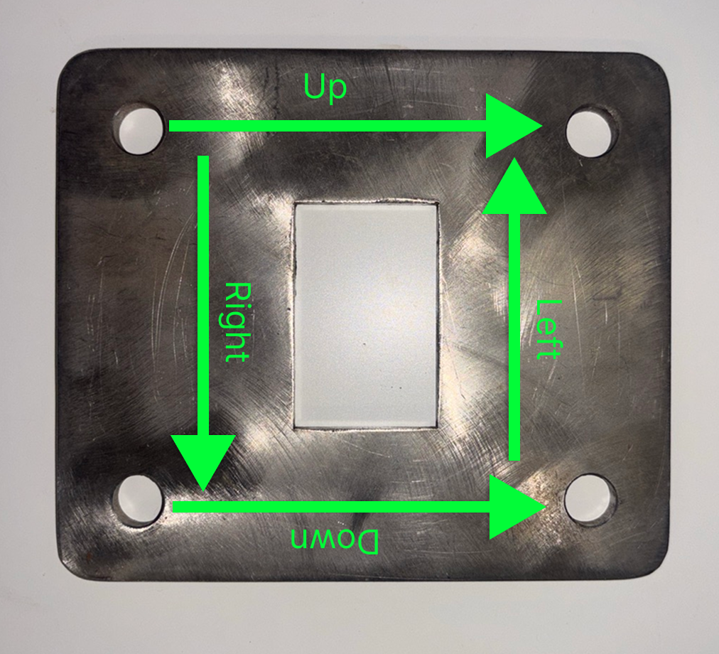
Results: Metal

Slide 18
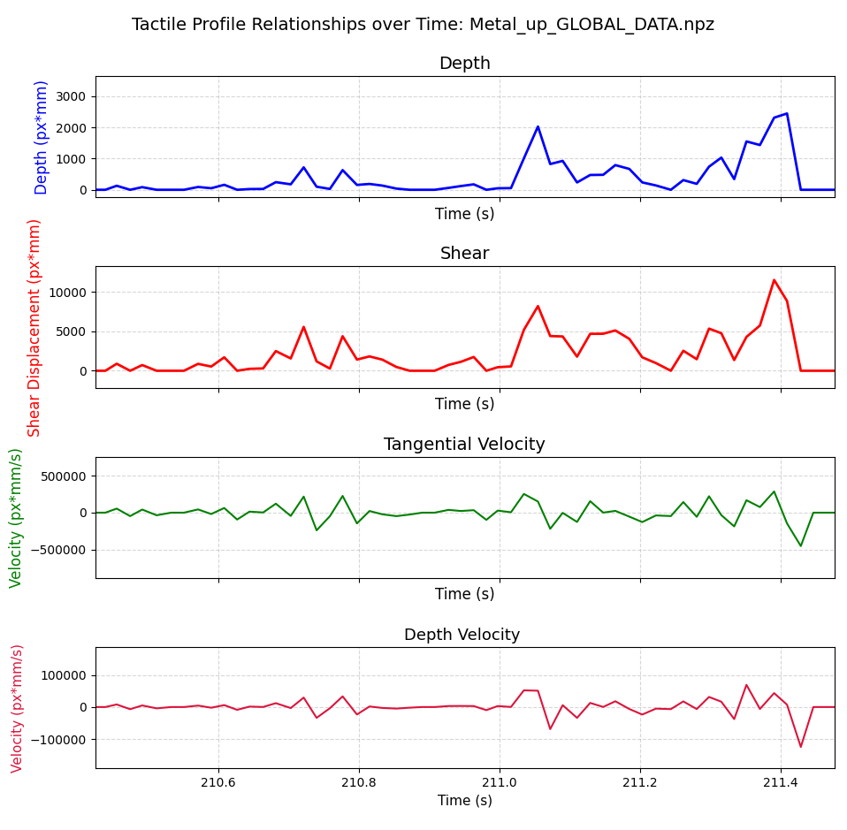
Results: Metal

Slide 19
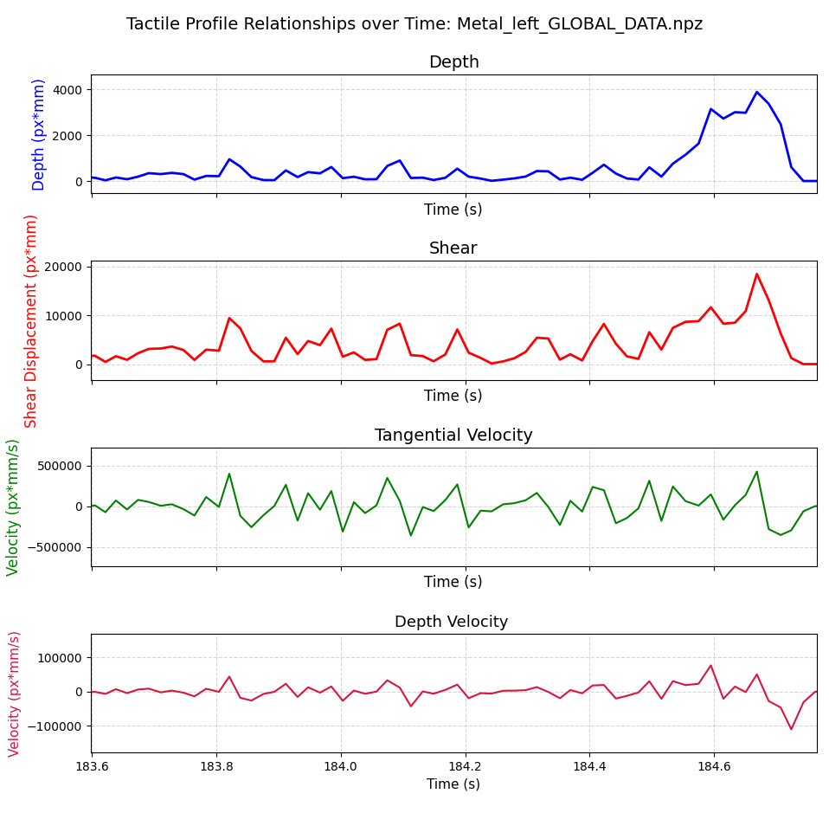
Results: Metal

Slide 20
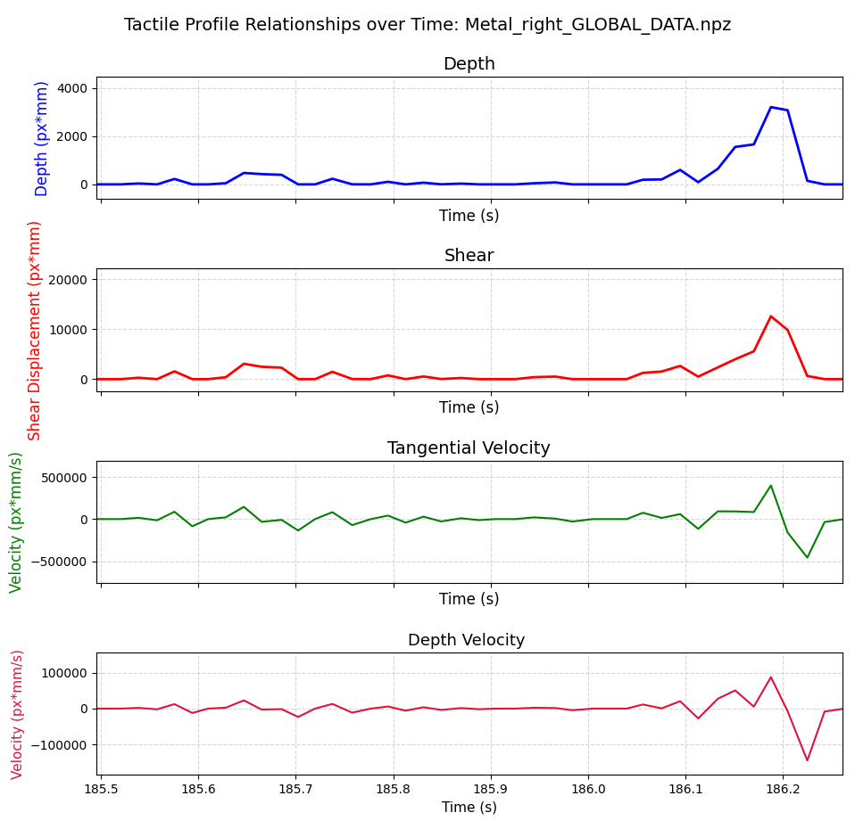
Results: Metal

Slide 21
Results: Metal
The "metal up" and "metal down" graphs exhibit similar results, indicating homogenous metal grains.
In contrast, the "metal left" and "metal right" graphs show differences, likely due to higher pressure during the "metal left" test, reflected in greater effects on depth, shear, and shear velocity.
The sensor's movement over holes affected the depth and depth velocity graphs
The spaced shear velocity suggests less slippage of the sensor, correlating with the metal's surface roughness.

Slide 22
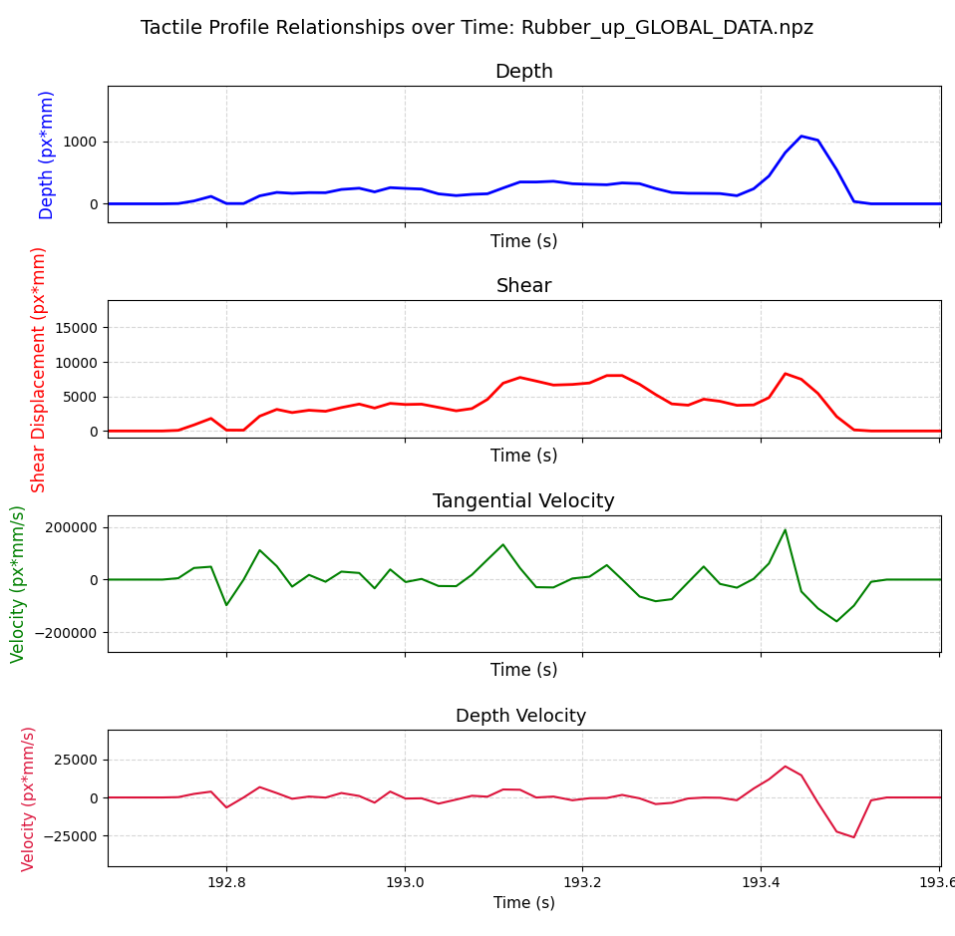
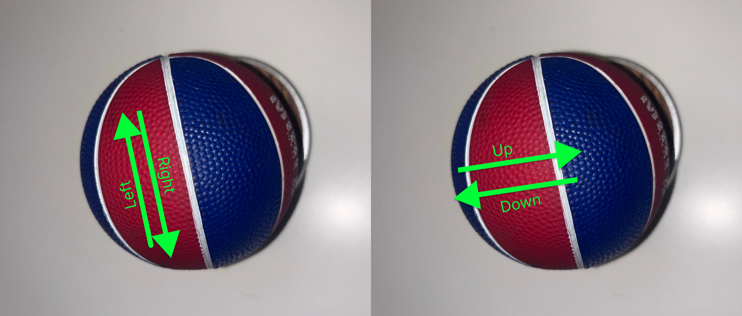
Results: Rubber

Slide 23
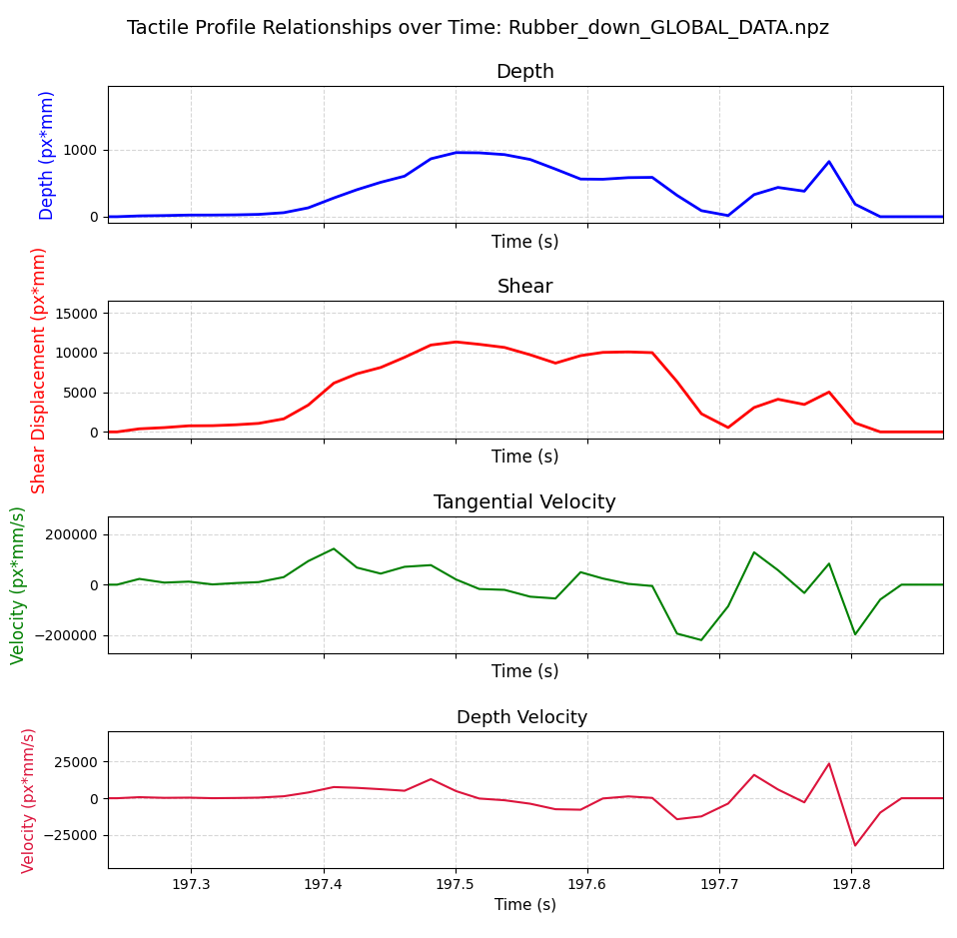
Results: Rubber

Slide 24
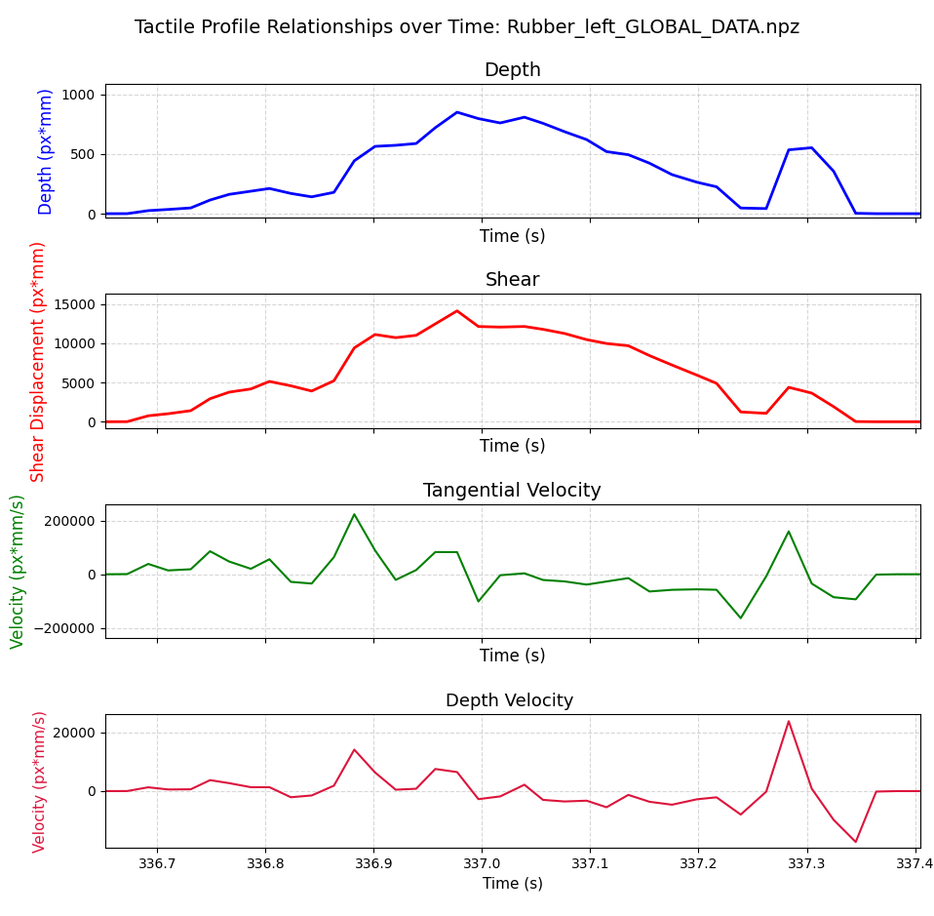
Results: Rubber

Slide 25
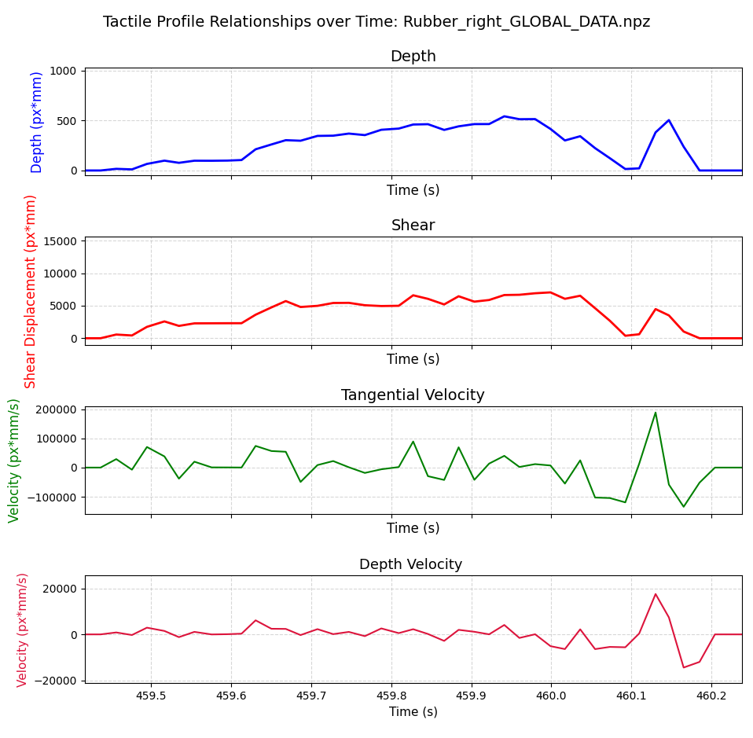
Results: Rubber

Slide 26
Results: Rubber
The analysis reveals that different graphs illustrate variations in texture across multiple axes.
The primary factor affecting material hardness is the depth of velocity graphs; this distinguishes metal from plastic, as the rubber ball's influence on the sensor diminishes during swiping.
Additionally, shear-graph contact pixels show a marked increase for plastic and metal under greater contact pressure, evident in the "spikes" on their graphs. In contrast, the shear graph for rubber is more curved, reflecting the ball's deformation.
Slippage, as indicated by tangential velocity graphs, behaves differently for elastomers compared to rigid materials, showing that the sensor's elastomer did not experience a "stick-slip" phenomenon as often as with metal and plastic.

Slide 27
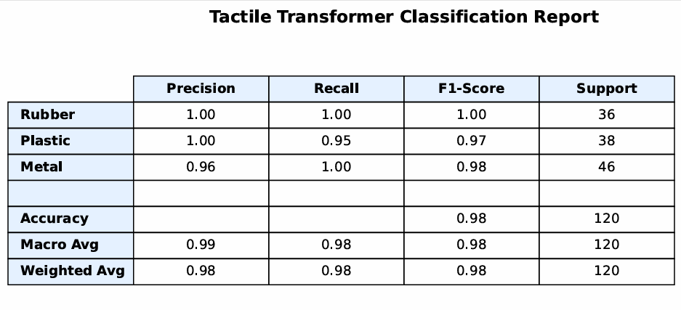
Neural Network

Slide 28
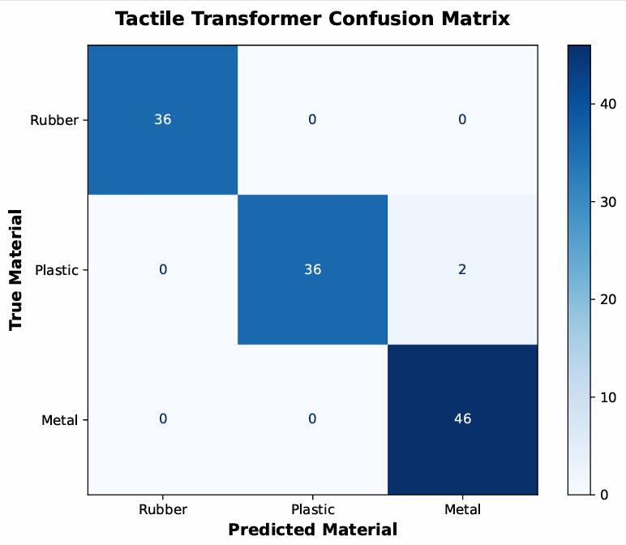
Neural Network

Slide 29
Neural Network
The data were processed using a time-series transformer.
Results from the classification report and confusion matrix showed high weighted and macro averages for precision, recall, and F1-score.
The classification is restricted to specific objects of metal, plastic, and rubber and does not include subtypes or variations in surface finishes from manufacturing.
Despite these constraints, the results suggest a clear relationship between the materials when analyzed using the Daimon sensor.

Slide 30
Live Testing:
Evaluated materials used in data-gathering experiments.
Neural Network results indicated discrepancies among materials; however, real-time testing led to inaccuracies.
Approximately 70% of misclassifications identified live-tested materials as "plastic".
Plastics testing conditions varied which led to a broader range of data.
Rubber and metal dataset was very restricted, hence with any deviations from set parameters leading to errors.

Slide 31
Conclusion:

Slide 32
Conclusion:
Applied pressure while maintaining constant velocity aids in distinguishing materials.
Live classification tests revealed challenges when pressure and velocity fluctuated, hindering accurate material identification.
The trained model inadequately accounts for elastomer pad behavior under different conditions.
Current model does not consider diverse material types and their manufacturing methods (e.g., moulded vs. 3D-printed plastics).
A more robust model is necessary – understanding the coefficient of friction changes with respect to contact materials, applied pressure, and sliding velocity, and to potentially establish a baseline comparison utilizing finite element analysis models.

Slide 33
Cognitive Approach:
Sensor Device/Interface:
Sensors gather depth and shear data, converting these measurements into shear and depth velocity for analysis.
Graphical Representation: The data, measured in pixels per mm, are visually represented to help users identify material differences.
Diagnostic Information: Raw images from the sensor provide insights into potential wear-and-tear issues.
Publish and Subscribe Mechanism:
The sensor operates as a subscriber within the system, initiating local recordings with the `"START"` command, which captures a 2-second swipe motion.
The `"STOP"` command ends recording, allowing for individual swipe data to be saved.
The command `"EXPERIMENT_COMPLETE"` finalizes recordings and compiles global data for graphing, ensuring synchronized data acquisition during swiping.
Hybrid Reactive-Deliberative Architecture:
This architecture involves analyzing sensory data from the VBTS (`sense`) to dictate actions based on material classification.
The planning phase determines the correct grasping force, leading into the execution of the grasping task.
It combines biological inspiration for material identification with a closed-world assumption framework.
Bio-Inspired Behaviors:
The deliberative layer employs conscious reasoning while the reactive layer follows reflexive logic.
Behavior is organized into perceptual and motor schemas triggered by specific sensory cues, leading to adjustments in grip strength based on material properties.

