Slide 1

Jetpack Compose Basics Thomas Künneth
https://unsplash.com/photos/bJhT_8nbUA0

Slide 2
Android‘s new declarative, native UI toolkit
Based on Kotlin functions
Favors composition over inheritance
Not part of traditional platform APIs

Slide 3

Continuous updates (like most Jetpack components)
Compose is added to module-level build.gradle file
Devs can pick or skip updates (based on what has changed)

Slide 4

First developer previews (0.1.0-devxy) summer 2020
Stable versions:
July 28, 2021: 1.0.0
February 9, 2022: 1.1.0
July 27, 2022: 1.2.0

Slide 5
Transform @Composable functions and enable optimizations with a Kotlin compiler plugin
Basic functionality like text and drawing primitives
Fundamental building blocks of Compose's programming model and state management; core runtime targeted by the Compose Compiler Plugin
compose.compiler
compose.foundation
compose.runtime

Slide 6
Build animations in your Compose apps to enrich the user experience
Fundamental components of the Compose UI needed to interact with the device, for example layout, drawing, and input
compose.animation
compose.ui
compose.compiler
compose.foundation
compose.runtime

Slide 7
Material Design Components. Higher-level entry point of Compose, designed to provide components that match those described at www.material.io.
compose.material / material3
compose.animation
compose.ui
compose.compiler
compose.foundation
compose.runtime

Slide 8
Each block is referenced as a separate implementation dependency in the module-level build.gradle file
Currently no “Gimme Compose 1.2” catch-all reference
Compose versions may influence other build settings like plugins, language levels

Slide 9
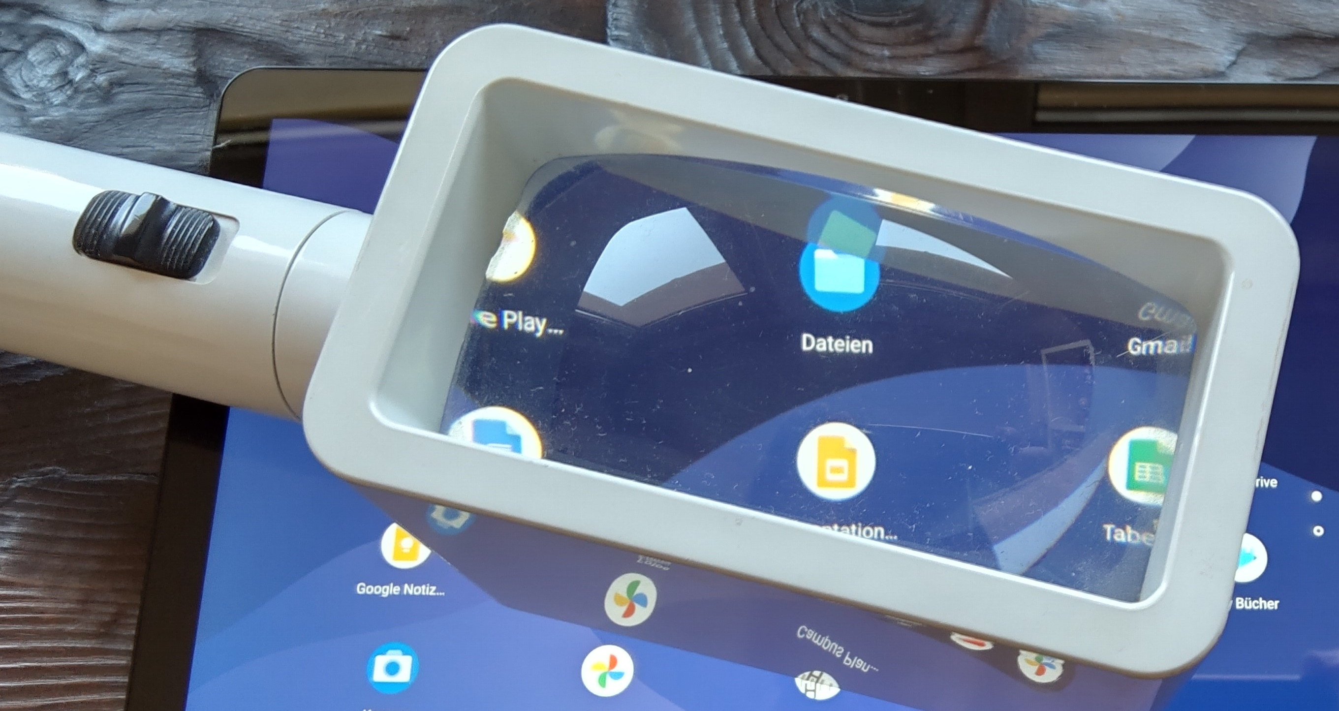
Despite version tags, no notion of API level
Hence, no API Difference Report like on the platform level

Slide 10
Google maintains separate release notes at https://developer.android.com/jetpack/androidx/versions
To find out what‘s new…
read them 😎
read official summary
https://android-developers.googleblog.com/2022/02/jetpack-compose-11-now-stable.html
https://android-developers.googleblog.com/2022/07/jetpack-compose-1-2-is-now-stable.html

Slide 11

Let‘s dive in
https://unsplash.com/photos/Q5ZjqF6Wd3k

Slide 12
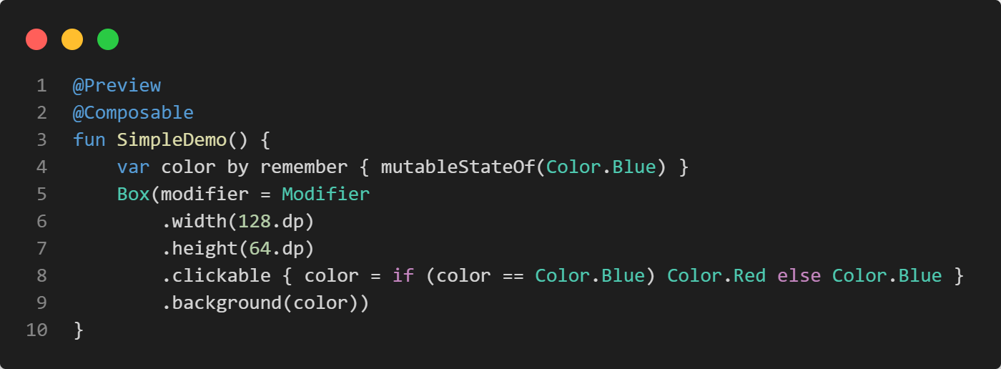
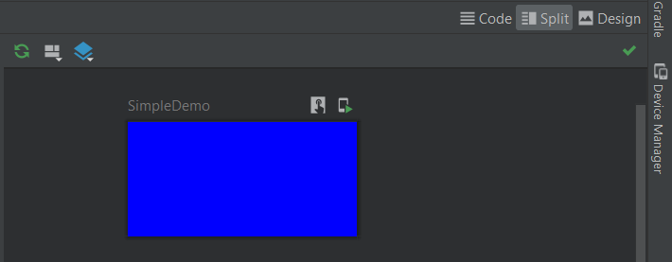
Composable functions can be previewed
Composable function
defines a state
and invokes another composable function
with one parameter
Interactive mode (inside IDE)
or on the device

Slide 13
Composable functions invoke other composable functions
Composables can receive parameters
They usually do not return a result
Note: usually their names are noun phrases

Slide 14
Invoking a composable adds it to internal data structures, which usually makes it visible at some point
We usually don’t need to look at these internal structures
But we should look at the source doe of predefined composables

Slide 15
Both visual appearance and behavior can be defined through
parameters
modifiers
Modifier are like component properties, but more flexible

Slide 16
The user interface is declared based on state
State can be passed to a composable function as a parameter
Or can be defined inside it

Slide 17
Two types of composables
stateful
stateless (preferred)
Jetpack Compose favors a unidirectional data flow and a concept called state hoisting

Slide 18
State is defined as early as possible
Data flows from top to bottom
If possible, behavior is passed to a composable via callbacks

Slide 19
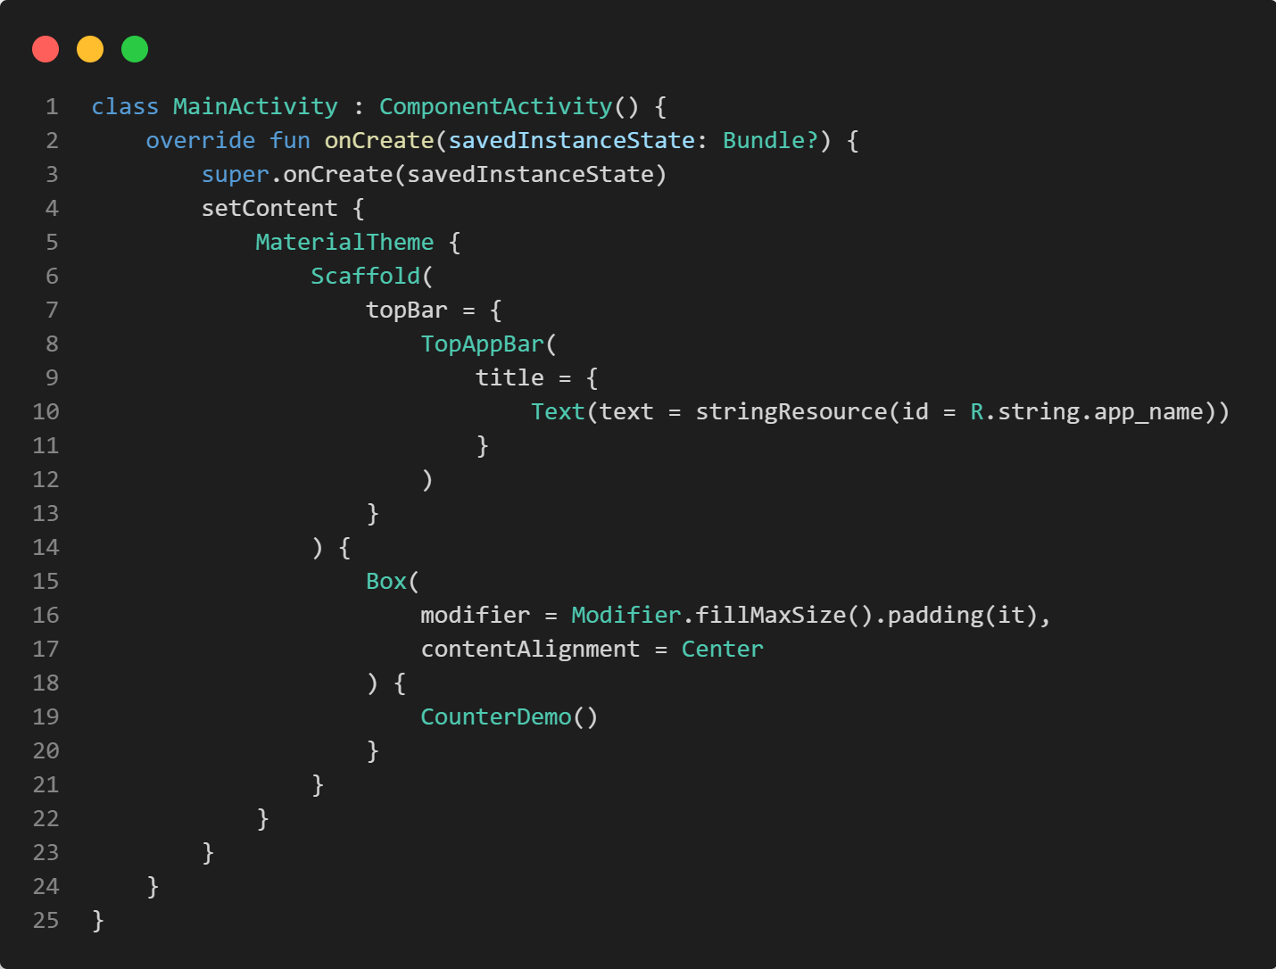
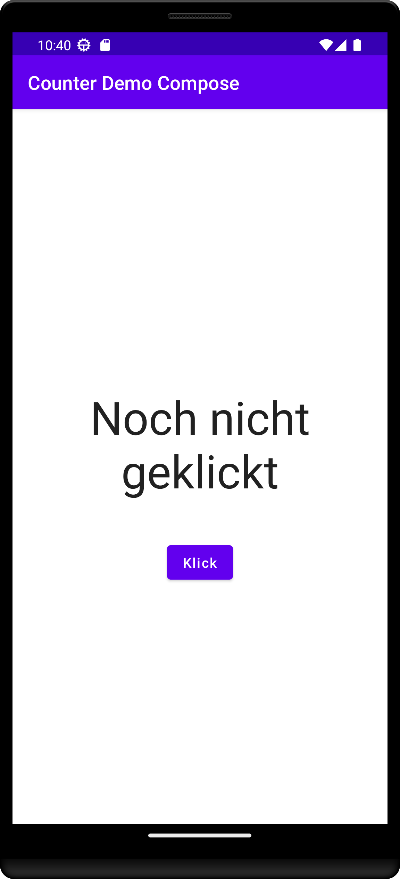
setContent { ... } shows a Compose hierarchy in an Activity
Sets colors, styles, and typography
Scaffold() and TopAppBar() provide an app frame
Provides the content

Slide 20
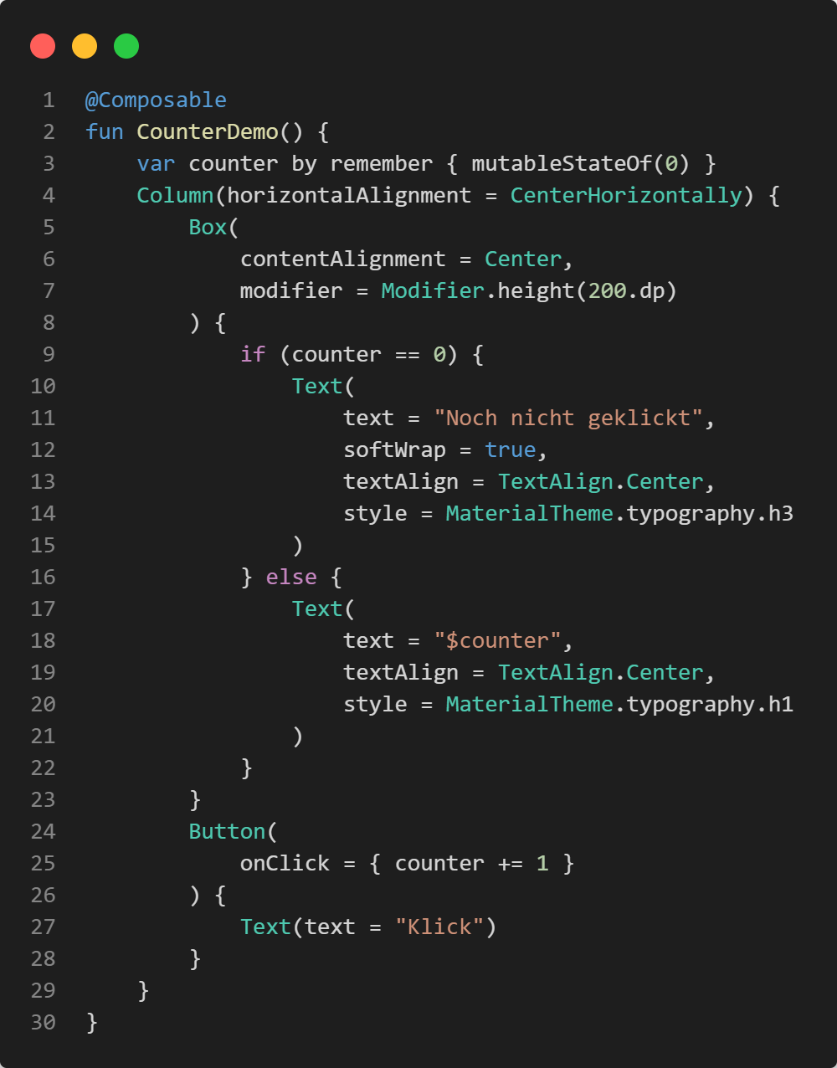
Define state
The column has two children: Box() and Button()
The UI is declared based on state
Button clicks change the state

Slide 21
Building the UI for the first time is called composition
Composable function that remember state are stateful
State changes trigger a recomposition of the UI
Jetpack Compose makes sure only affected UI elements are redrawn

Slide 22
Often, we create state with mutableStateOf()
We remember it
We assign it to a variable in order to read (and change) it

Slide 23

Exercise
https://unsplash.com/photos/IZOAOjvwhaM

Slide 24
CounterDemoCompose
Familiarize yourself with the first sample app CounterDemoCompose
In Compose apps, state is sometimes defined with the by keyword, sometimes with =
Modify the code to use =
Modify the code so that the state is passed to CounterDemo()

Slide 25

Questions…?
Short break… 😍

