Slide 1

Jetpack Compose Basics Thomas Künneth
https://unsplash.com/photos/bJhT_8nbUA0

Slide 2
Questions 🤔

Slide 3
Android‘s declarative, native UI toolkit
Based on Kotlin functions
Favors composition over inheritance
Not part of traditional platform APIs

Slide 4

Continuous updates (like most Jetpack components)
Compose is added to module-level build.gradle file
Devs can pick or skip updates (based on what has changed)

Slide 5
Transform @Composable functions and enable optimizations with a Kotlin compiler plugin
Basic functionality like text and drawing primitives
Fundamental building blocks of Compose's programming model and state management; core runtime targeted by the Compose Compiler Plugin
compose.compiler
compose.foundation
compose.runtime

Slide 6
Build animations in your Compose apps to enrich the user experience
Fundamental components of the Compose UI needed to interact with the device, for example layout, drawing, and input
compose.animation
compose.ui
compose.compiler
compose.foundation
compose.runtime

Slide 7
Material Design Components. Higher-level entry point of Compose, designed to provide components that match those described at www.material.io.
compose.material3
compose.animation
compose.ui
compose.compiler
compose.foundation
compose.runtime

Slide 8
The user interface is declared by nesting composable functions
Compose hierarchies can be shown inside activities and fragments
Composables and traditional views can be mixed

Slide 9
Jetpack Compose is only loosely coupled with the underlying platform
Compose Multiplatform by JetBrains makes Jetpack Compose available iOS, the desktop, and the web

Slide 10

Let‘s dive in
https://unsplash.com/photos/Q5ZjqF6Wd3k

Slide 11
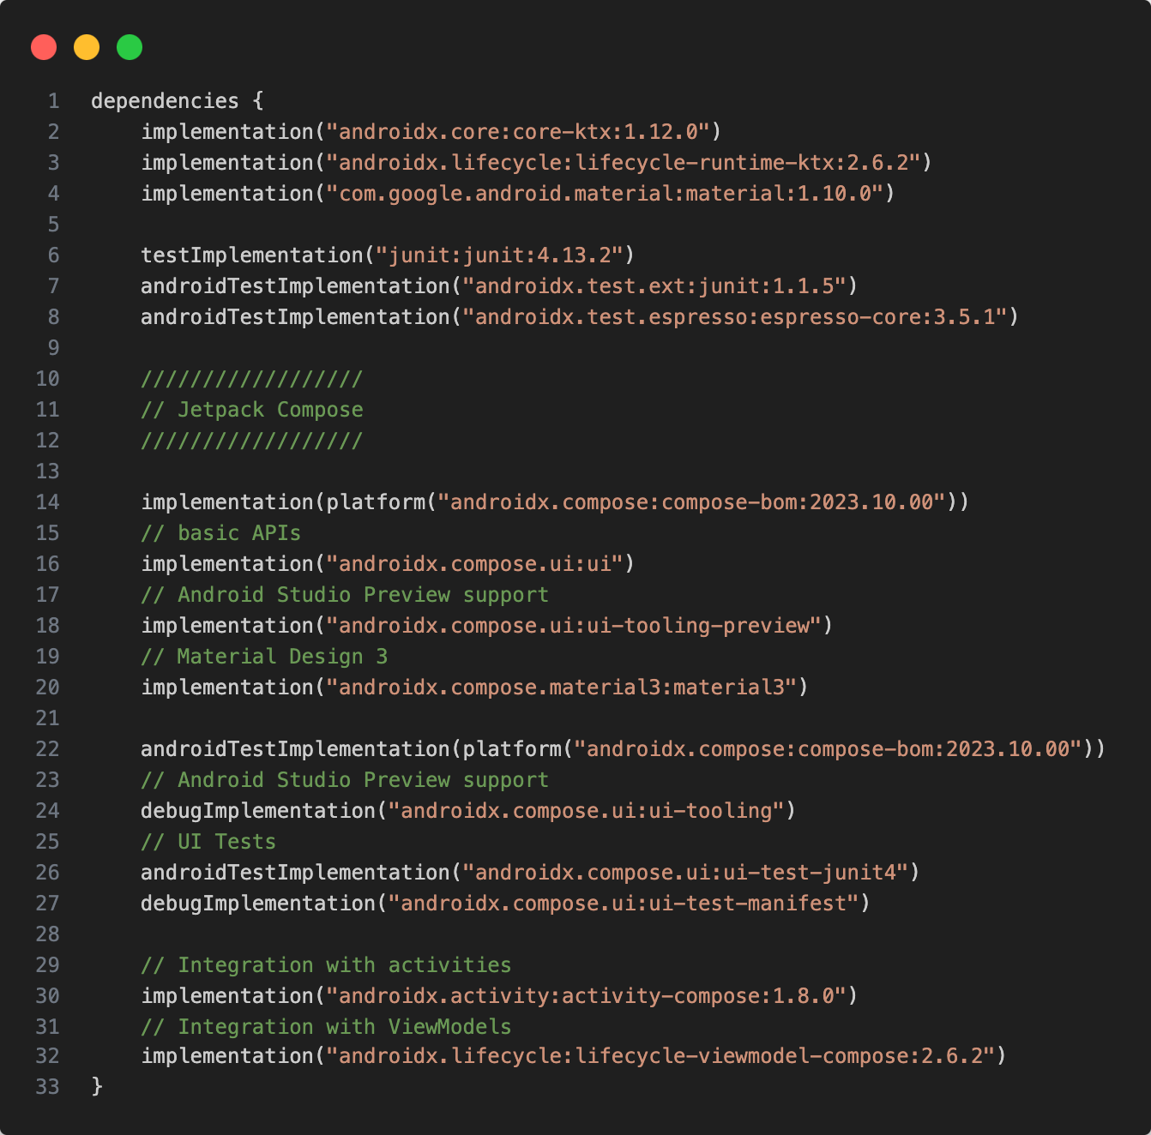
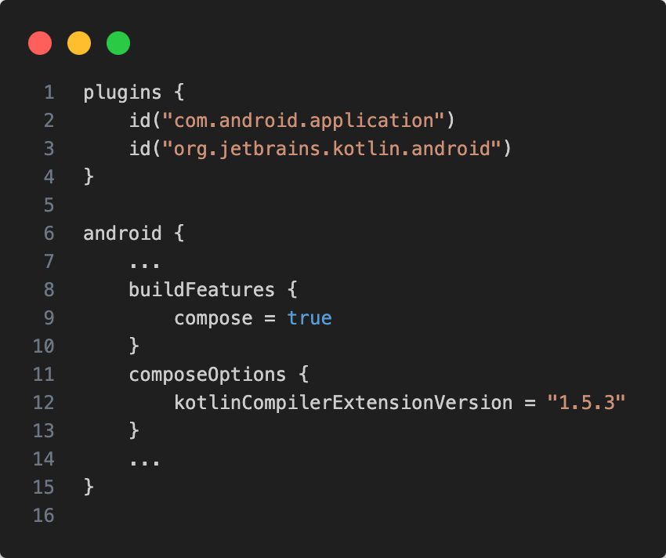
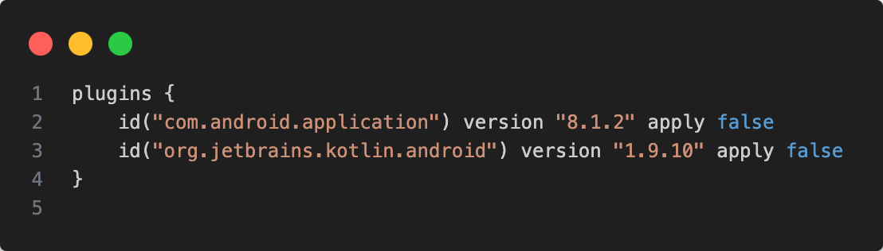

Slide 12
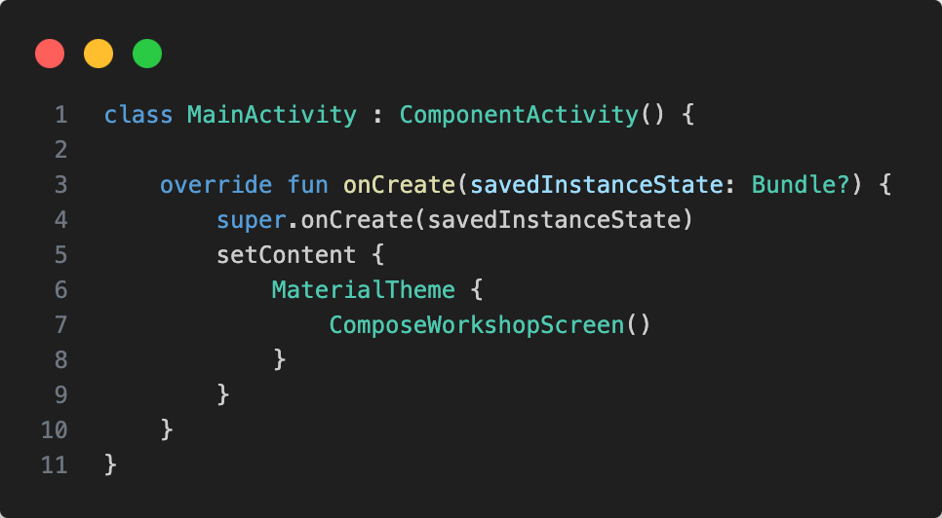

Slide 13
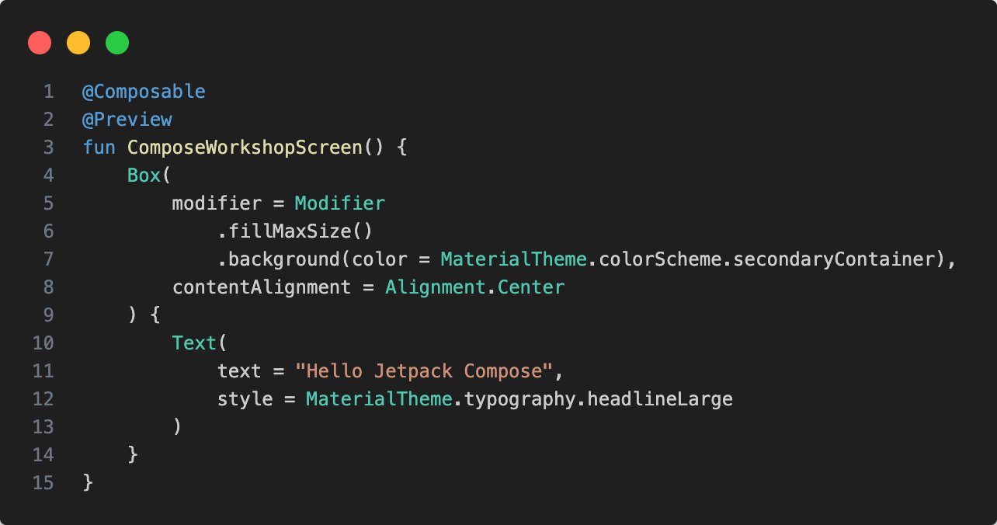
Composable function
Composable functions can be previewed
Composables invoke another composable functions

Slide 14
Composables can receive parameters
Usually, their names are noun phrases
They usually do not return a result
Invoking a composable adds it to internal data structures
This usually makes the composable visible at some point

Slide 15
Visual appearance and behavior can be defined through
parameters
modifiers
Modifiers are component properties on steroids

Slide 16
Properties in class-based frameworks are available only in the class that defines them, and its children
Modifier can be applied to any composable that can receive modifiers

Slide 17
Modifier amend composables with visual properties and behavior
They form chains, which start with Modifier
The order in the code defines when a modifier is applied

Slide 18
.fillMaxSize() maximizes a composable
.width() and .size() declare the preferred width or size
.padding() creates an inward-facing space
.background(color = ...) creates a colored background

Slide 19

Exercise
https://unsplash.com/photos/IZOAOjvwhaM

Slide 20
Switch to branch 00_initial_version of the compose_workshop repository (https://github.com/tkuenneth/compose_workshop)
Run the app to make sure everything works
Add Jetpack Compose to the project build files, write your first composable function and add it to the activity using setContent { } (try to show a Text() inside a Box())
A working version can be found on branch 01_add_compose

Slide 21
State is data that may change over time
A Compose user interface hierarchy is declared based on state
When the data changes, the UI needs to be updated
State can be passed to a composable function as a parameter, or it can be defined inside the composable

Slide 22
Two types of composables
stateful
stateless (preferred)
Jetpack Compose favors a unidirectional data flow and a concept called state hoisting

Slide 23
State is defined as late as possible (depending on which composables will be using it)
Data flows from top to bottom
If possible, behavior is passed to a composable via callbacks

Slide 24
Building the UI for the first time is called composition
State changes trigger a recomposition of the UI
Jetpack Compose makes sure only affected UI elements are redrawn

Slide 25
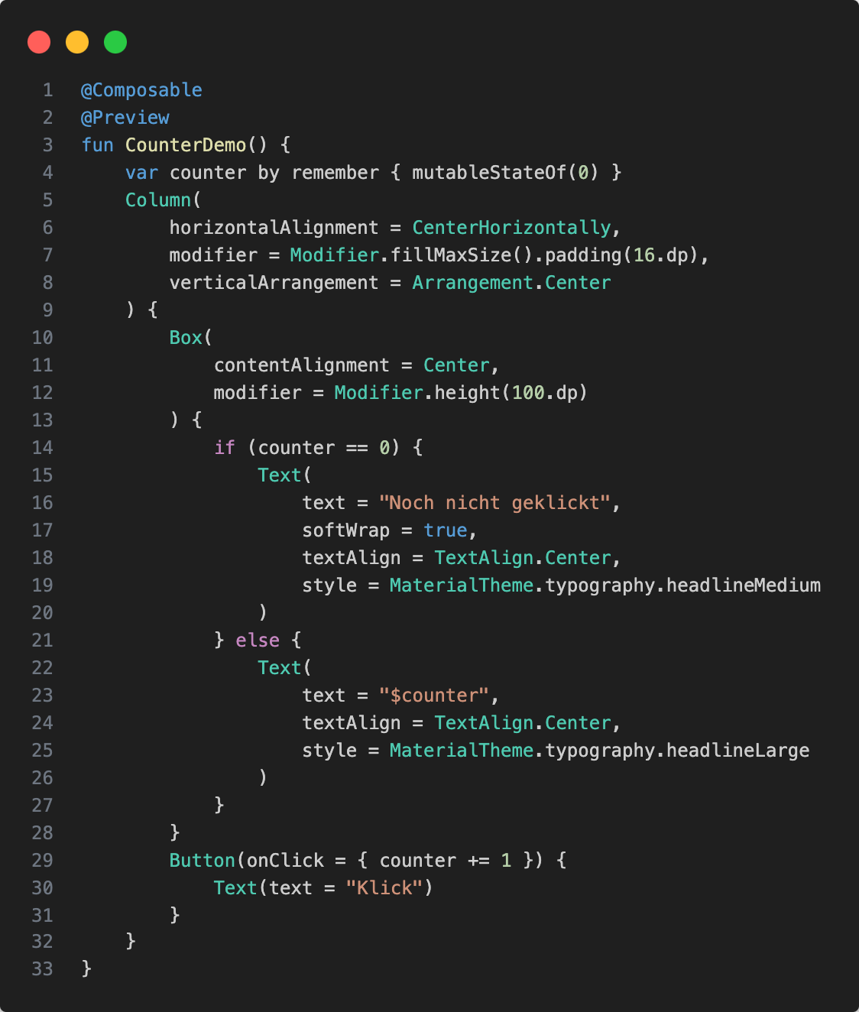
We create state with mutableStateOf()
We remember state
We assign state to a variable to read and change it
We pass behavior through callbacks
We use state to declare the UI

Slide 26
Exercise
https://unsplash.com/photos/IZOAOjvwhaM

Slide 27
Switch to branch 01_add_compose of the compose_workshop repository (https://github.com/tkuenneth/compose_workshop)
Run the app to make sure everything works
Implement a counter that is increased when a button is clicked, and show the current value
A working version can be found on branch 02_counter_demo

Slide 28

Short break… 😍

