Slide 1
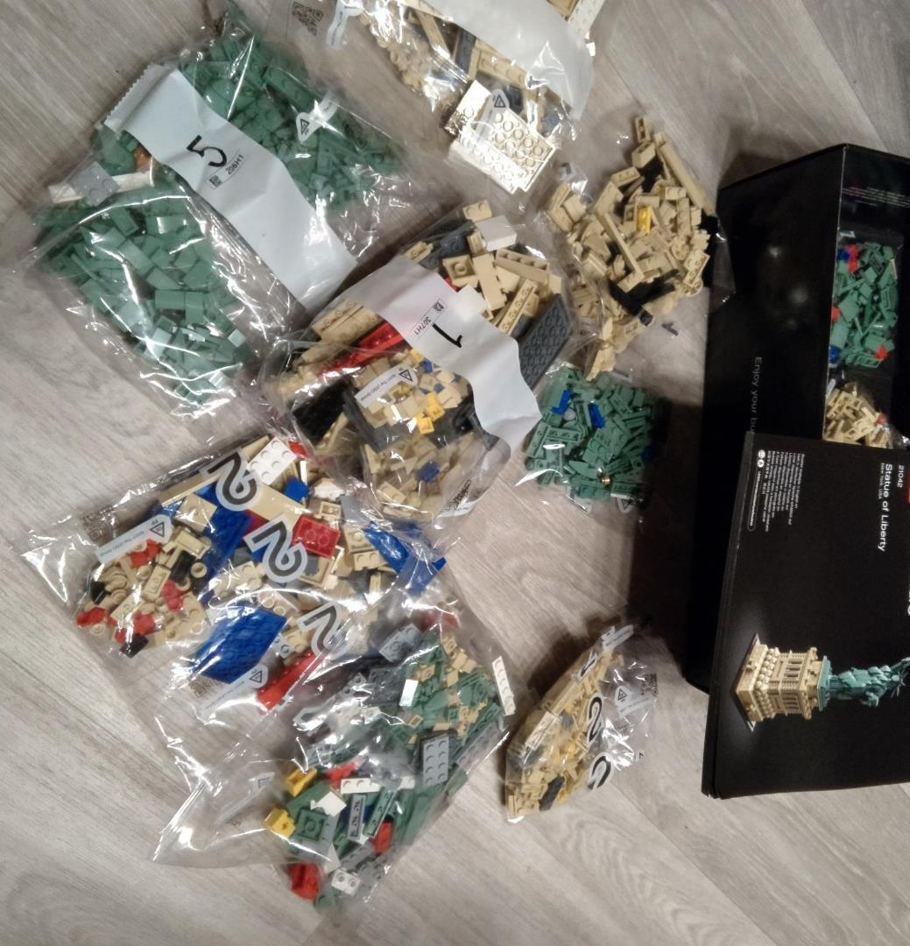
Jetpack Compose Workshop Thomas Künneth

Slide 2
Schedule
09:30 – 10:00 Introduction
10:00 – 10:50 Why declarative UI frameworks
11:00 – 11:50 Basics
12:10 – 13:00 Building UIs
13:00 – 14:00 🥗🍔🧃
14:00 – 14:50 Advanced topics
15:00 – 15:50 Interoperability
16:10 – 16:40 Beyond Android
16:40 – 17:00 Wrap up
20 minutes break
20 minutes break

Slide 3








https://thomaskuenneth.eu/
thomas@thomaskuenneth.eu
@tkuenneth
@tkuenneth
@tkuenneth

Slide 4
Prerequisites
A clone of the workshop repo at https://github.com/tkuenneth/compose_workshop
Installed Android Studio version (ideally Chipmunk or later, but at least Arctic Fox)
Configured Android Emulator or physical device connected via USB port

Slide 5
Tech check
Create a Jetpack Compose App using the New project wizard
Deploy the app to the virtual or physical device
Open the CounterDemoCompose example and run the app

Slide 6

Questions…?
Short break… 😍

