Slide 1
Project 7 Counterthief detection
Stefania Albarosa

Slide 2
Data Frames
Original columns
df
PCA columns
Margin low
Margin up Length
Is genuine
df_sc
PCA0
PCA1
PCA2
PCA3
PCA4
df_pca
df_log

Slide 3
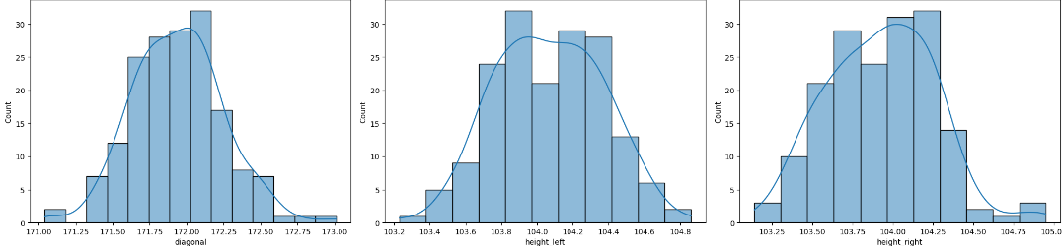
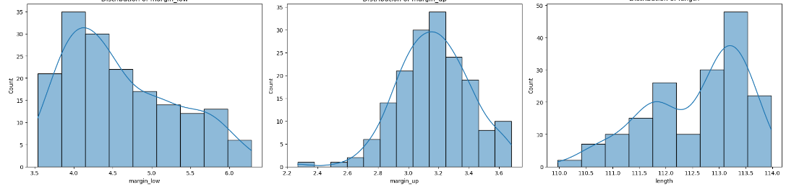
Diagonal
Left Height
Right Height
Lower Margin
Upper Margin
Length

Slide 4
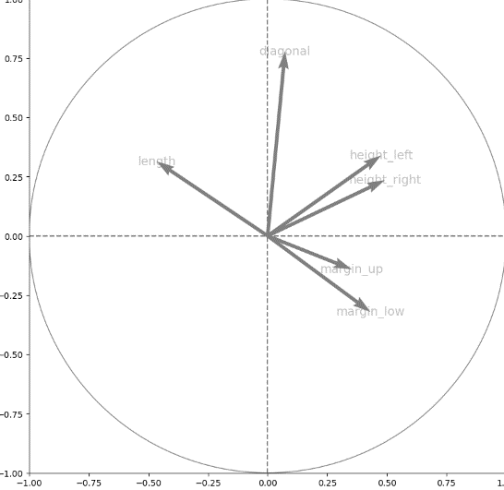
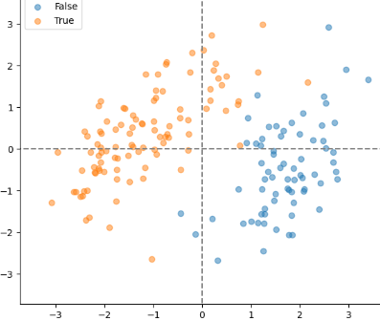
Correlation circle (PC0 and PC1)
Projection of points
(PC0 and PC1)
1.00
Diagonal
Length
Height_left
Height_right
PC1 (22%)
Margin_up
Margin_low
1.00
PC1 (47.4%)

Slide 5
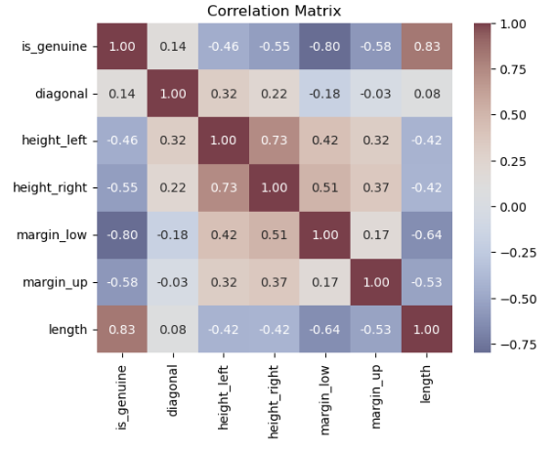
Correlation Matrix
Take aways
- Variables are normally distributed except for length which is right skewed
- Positively correlated variables
- genuine and length
- left height and right height
Negatively correlated variables
- genuine and lower margin
- length and lower margin

Slide 6
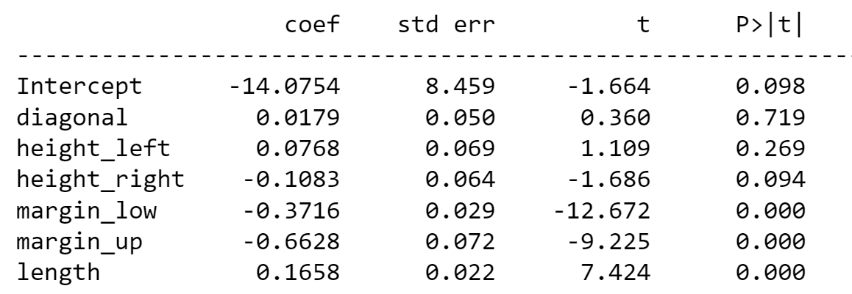
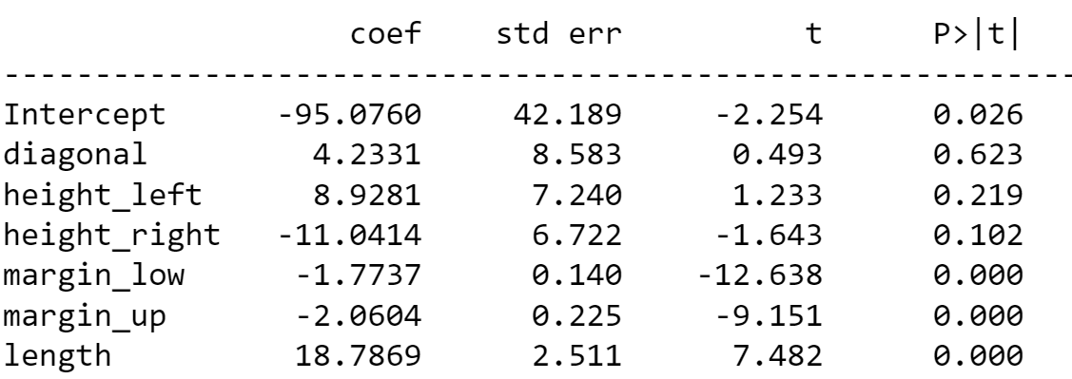
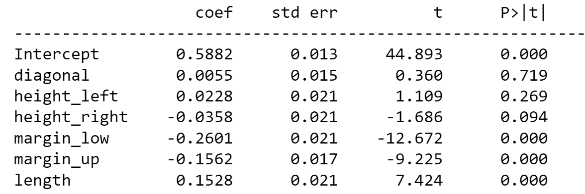
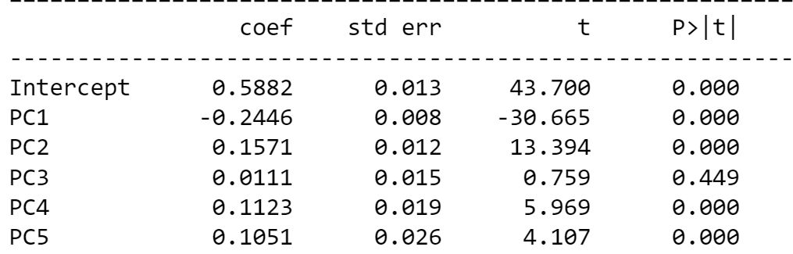
First OLS results
Dataframe: df
R – squared: 0.884
Dataframe: df_log
R – squared: 0.883
Dataframe: df_sc
R – squared: 0.884
Dataframe: df_pca
R – squared: 0.877
Conclusion: Variables with p-values >0.05 were eliminated

Slide 7
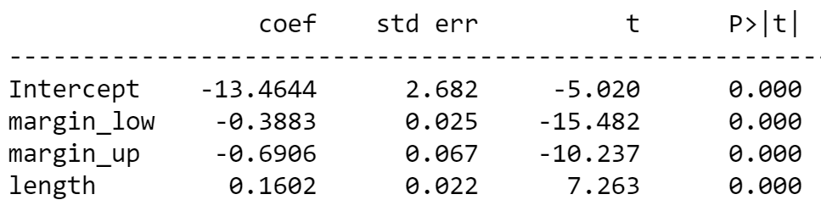
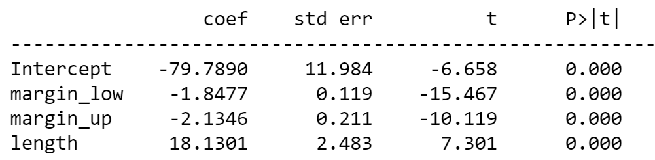
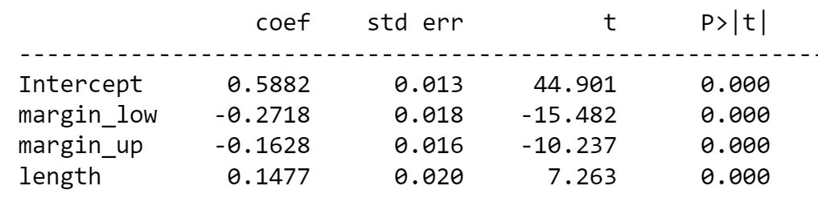
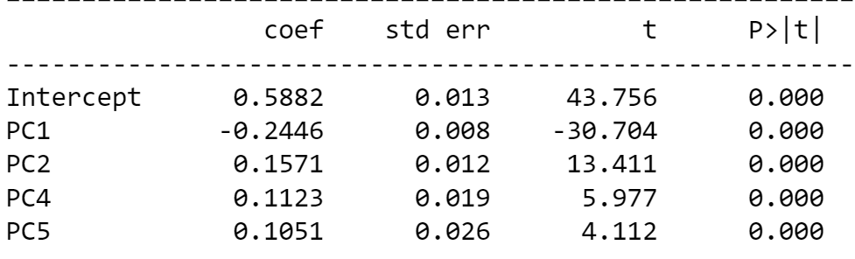
Second OLS results
Dataframe: df
R – squared: 0.882
Dataframe: df_log
R – squared: 0.881
Dataframe: df_sc
R – squared: 0.882
Dataframe: df_pca
R – squared: 0.877

Slide 8
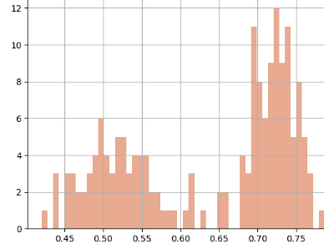
Train test results
Accuracy for df : 0.985
Accuracy for df_sc : 0.993 Accuracy for df_log : 0.956
Accuracy for df_pca : 0.963
Probability graph of df_sc
Highest Accuracy
Confusion Matrix for df_sc
Confusion Matrix for df_sc :
True Negatives (TN): 54
False Positives (FP): 0
False Negatives (FN): 1
True Positives (TP): 81

Slide 9
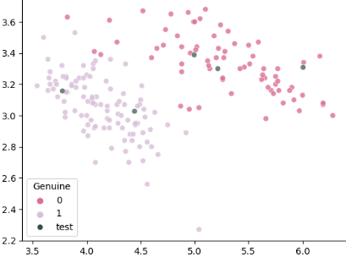
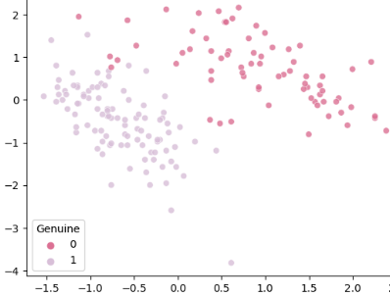
Plotting The Margins
‘is_genuine’ values in df
1 False negative
K-mean clusters in scaled df

Slide 10
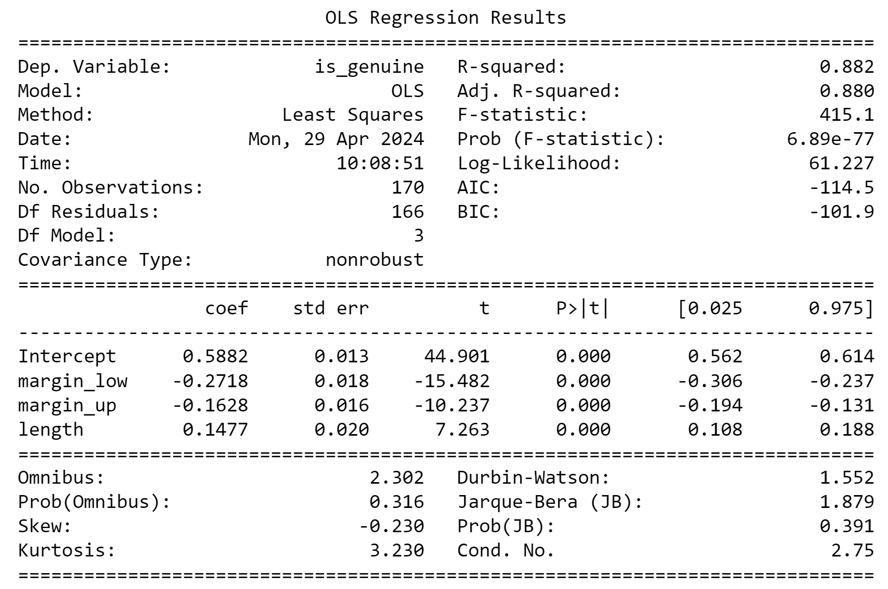
OLS Regression Prediction
Train model on df_sc
Scale test data: test_sc
Predict test results
 | margin_low | margin_up | length | is_genuine
0 | 5.21 | 3.30 | 111.42 | 0
1 | 6.00 | 3.31 | 112.09 | 0
2 | 4.99 | 3.39 | 111.57 | 0
3 | 4.44 | 3.03 | 113.20 | 1
4 | 3.77 | 3.16 | 113.33 | 1

