Slide 1
Income prediction
Stefania Albarosa

Slide 2
About this project
It is possible to predict someone’s income from only a few variables: country of residence and parent income.
How could we build such a model?
1st : Explore the country data
2nd : Generate dataset, parent's income class
3rd : make and test models

Slide 3
Task 1
Creating the dataframe

Slide 4
Data Cleaning
Columns
Country
Name and Code
Population
Of country
Income + Population + Gini
Income percentage, 100 for each country
Replacing missing values
Quantile
Changing data type
Income corresponding to percentage
Income
Correcting outliers
$ GDP per person - purchasing power parity
GDP_PPP
Gini Coefficient
Gini

Slide 5
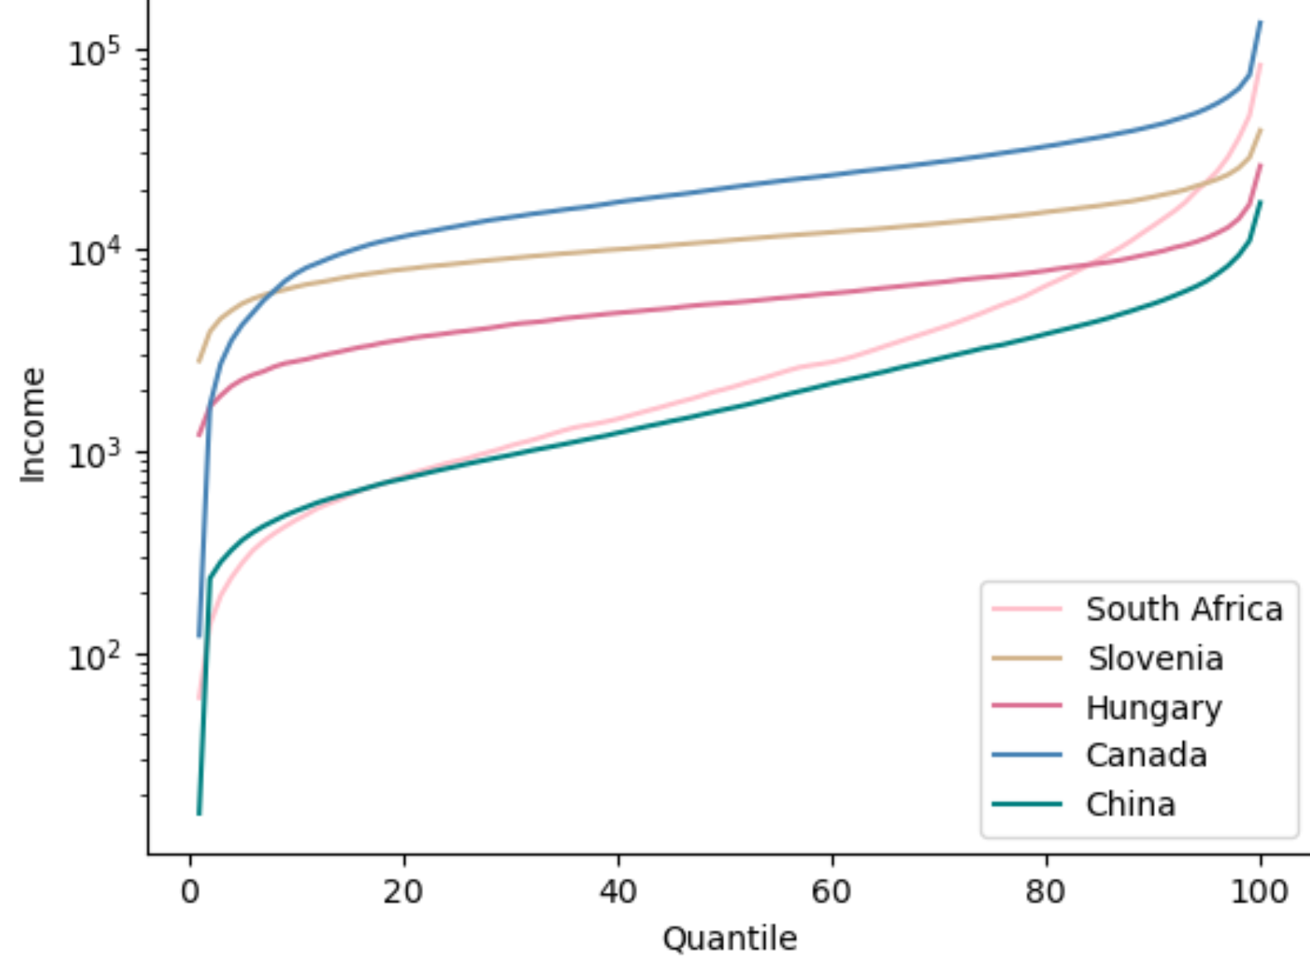
countries involved in study
Income Distribution by quantile
There are
114
91%
of the population
is covered by the dataset

Slide 6
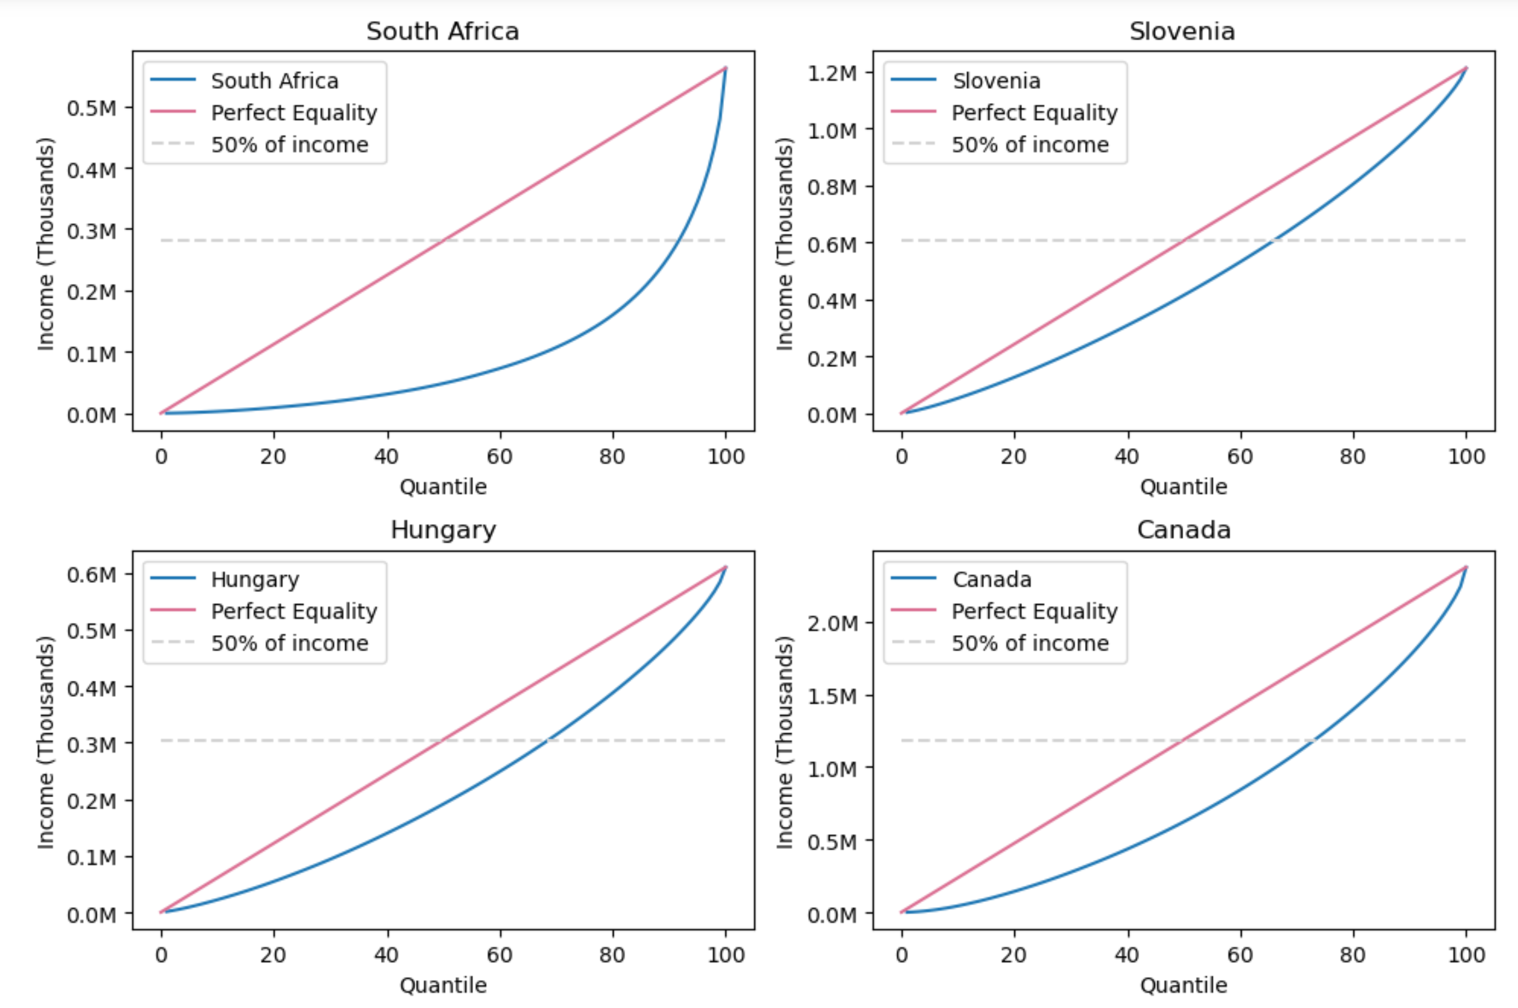
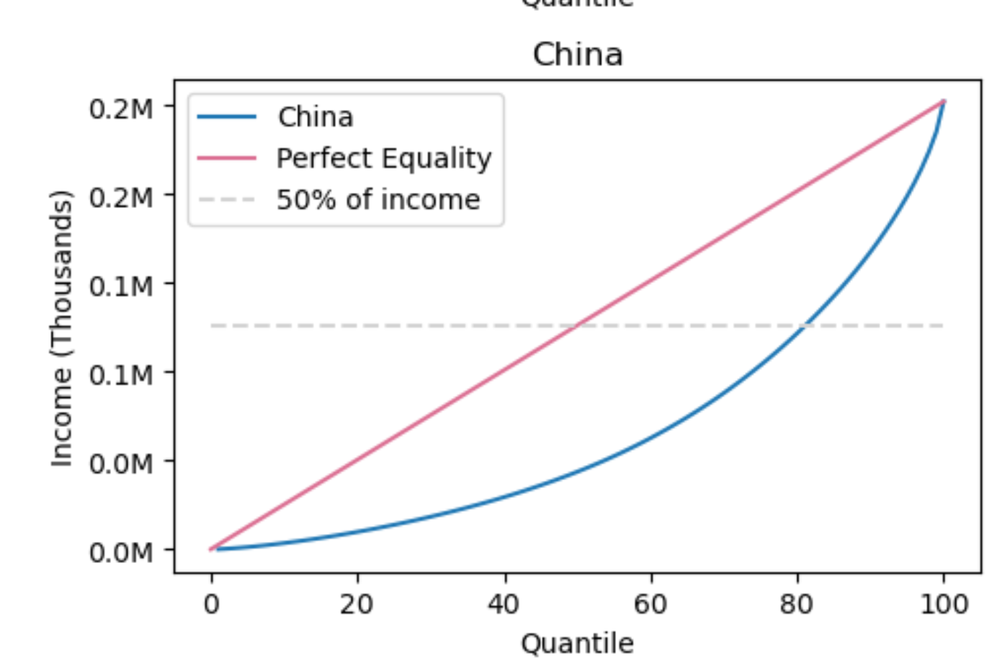
Lorenz curves
Based on the graphs, the incomes in Slovenia, Hungary and Canada are more equally distributed in comparison to China and South Africa.

Slide 7
Task 2
Generating parent income

Slide 8
Data Prep
Columns
Code
Country
Income percentage, 100 for each country
+ Given Elasticity
Quantile
Income
Income corresponding to percentage
+ Estimated Elasticity
GDP_PPP
$ GDP/p- purchasing power parity adjusted
+ Correcting values
Gini
Gini Coefficient
+ Mean Income
Elasticity
Income mobility
+ Generated clones
Mean Inc.
Of the country

Slide 9
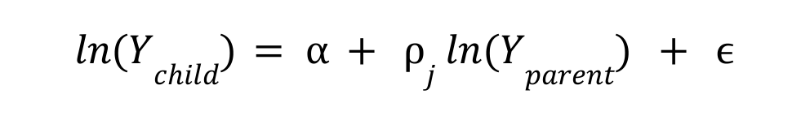
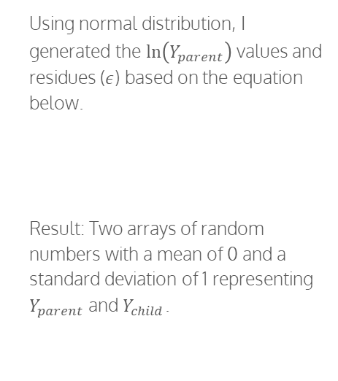
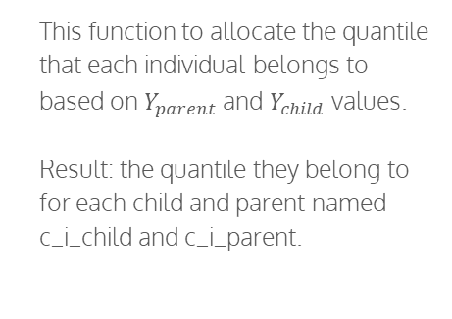
Generate Income
Compute Quantile
Transition Matrix
Using normal distribution, I generated the $\ln\left(Y_{parent}\right)$ values and residues ($ε$) based on the equation below.
Result: Two arrays of random numbers with a mean of 0 and a standard deviation of 1 representing $Y_{parent}$ and $Y_{child}$.
This function to allocate the quantile that each individual belongs to based on $Y_{parent}$ and $Y_{child}$ values.
Result: the quantile they belong to for each child and parent named c_i_child and c_i_parent.
Computes the probability of each child and parent couple. For example, it computes probability of parent being in the 50th quantile and child being in the 60th based on the number of pairs there are in the previous table.
Result: For each country, depending on their elasticity value, a matrix that shows the likeliness of the child’s quantile given a parent’s quantile.

Slide 10
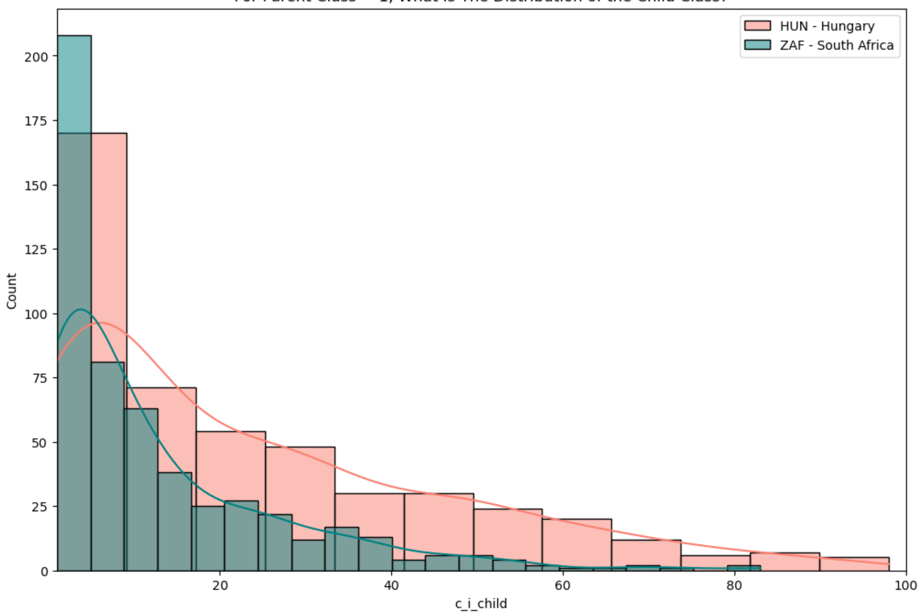
Parent Class = 1

Slide 11
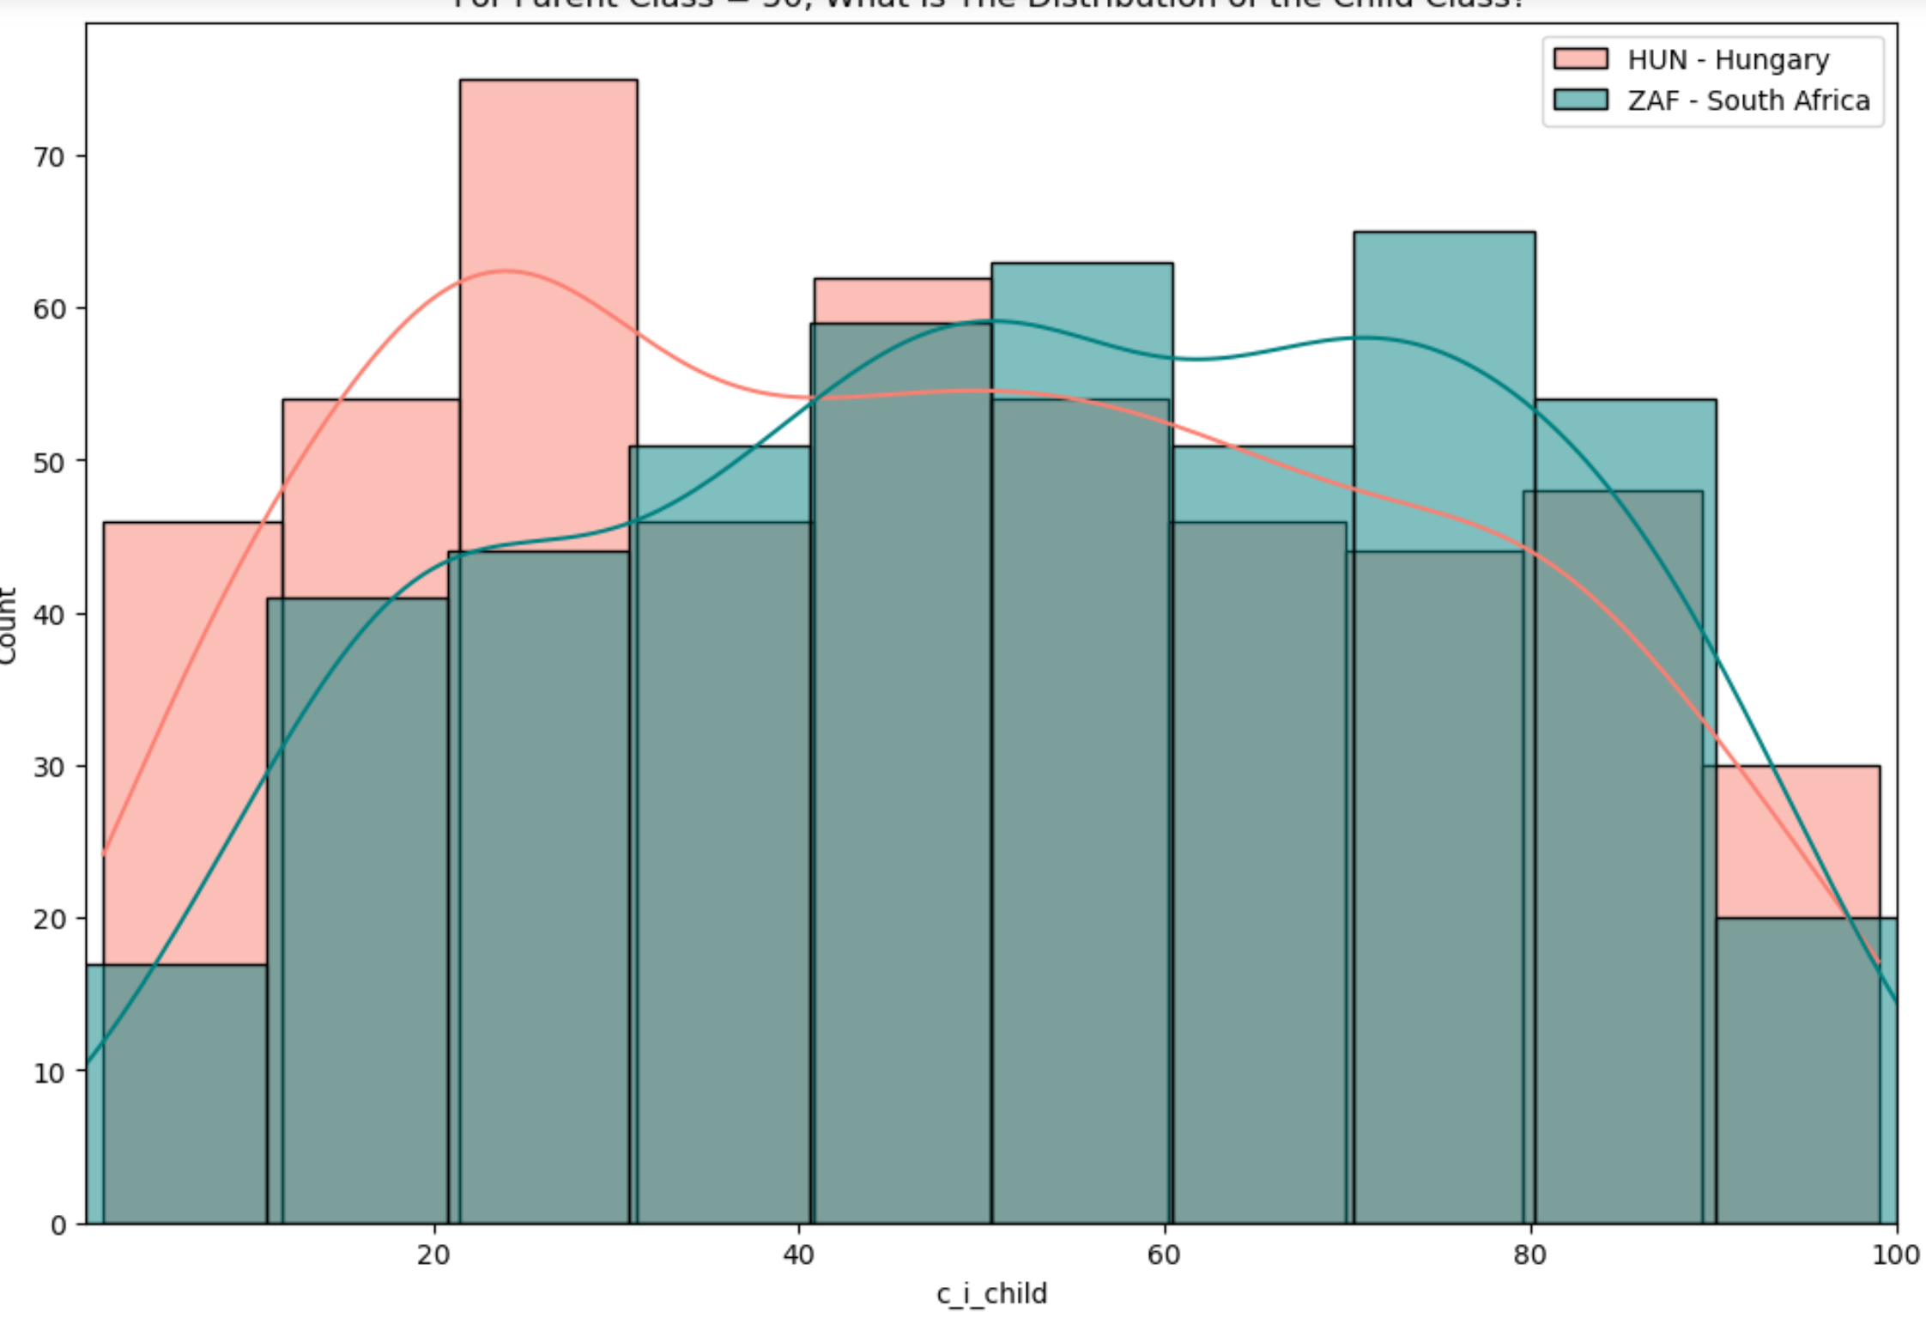
Parent Class = 50

Slide 12
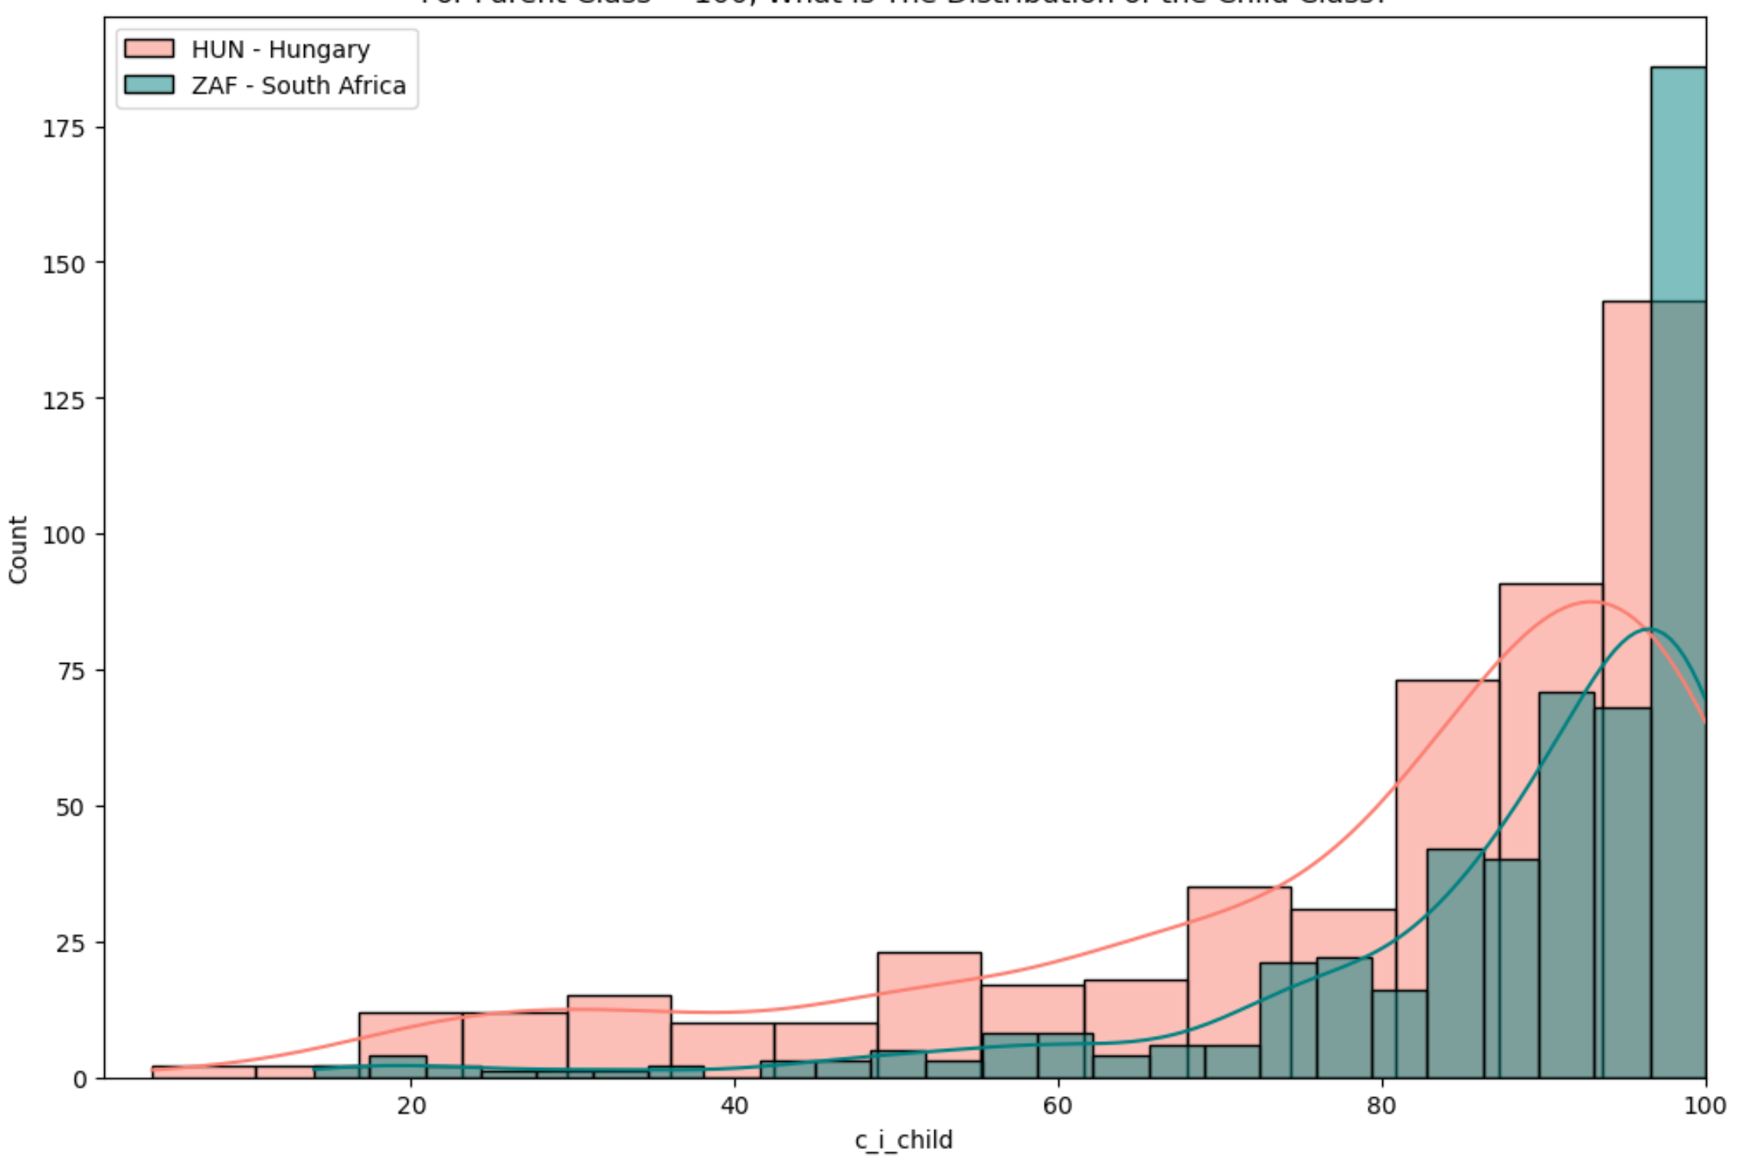
Parent Class = 100

Slide 13
Task 3
Correlations

Slide 14
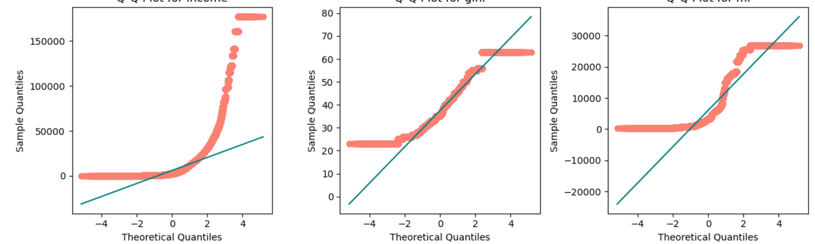
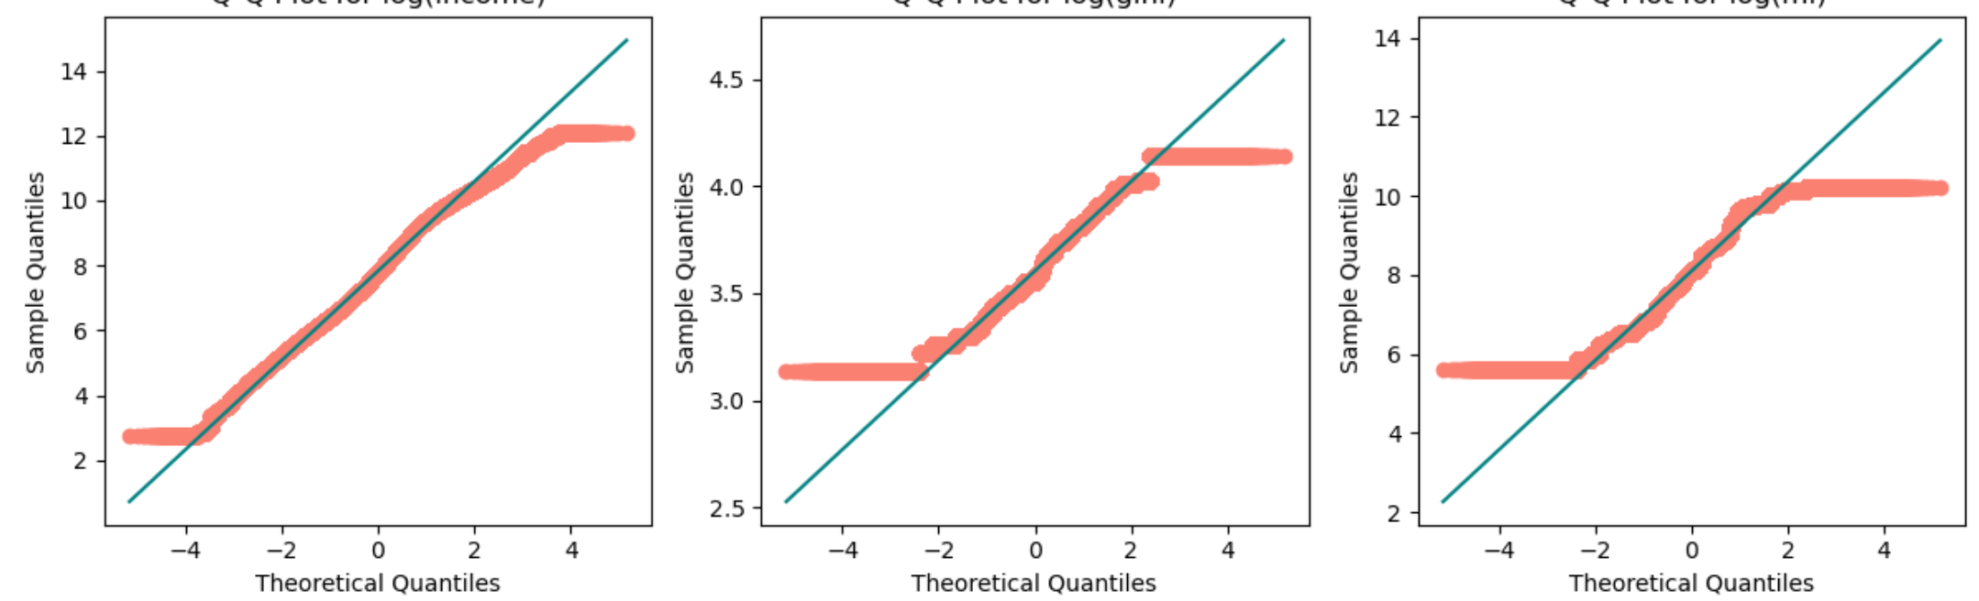
QQ plots
Income
Gini
Mean Inc.
Absolute
Logged

Slide 15
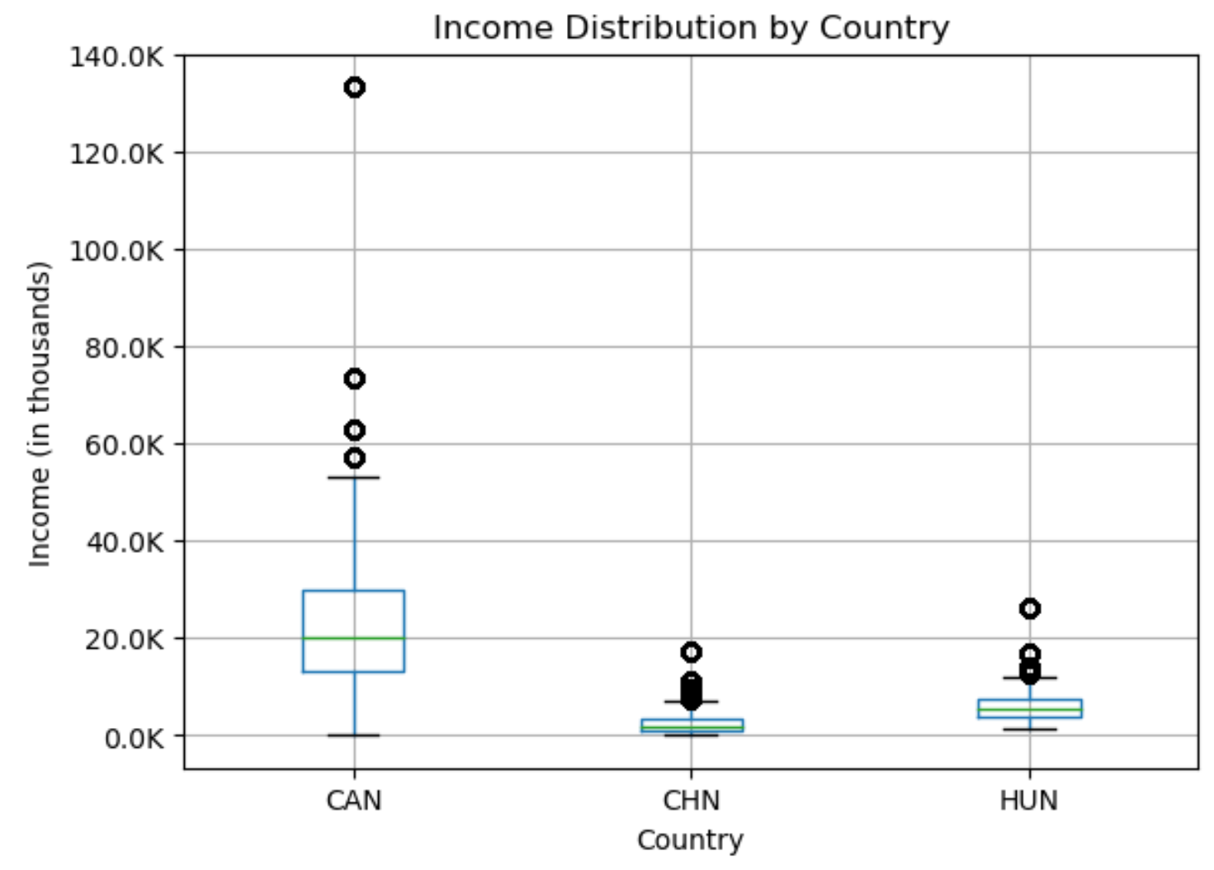
ANOVA on Income ~ Country
Null hypothesis: Incomes are not significantly different depending on countries.
 | F-Statistic | P-values
Absolute | 49,740 | <0.05
Logged | 134,615 | <0.05
Null hypothesis is rejected because of high F-statistic and low P-values

Slide 16
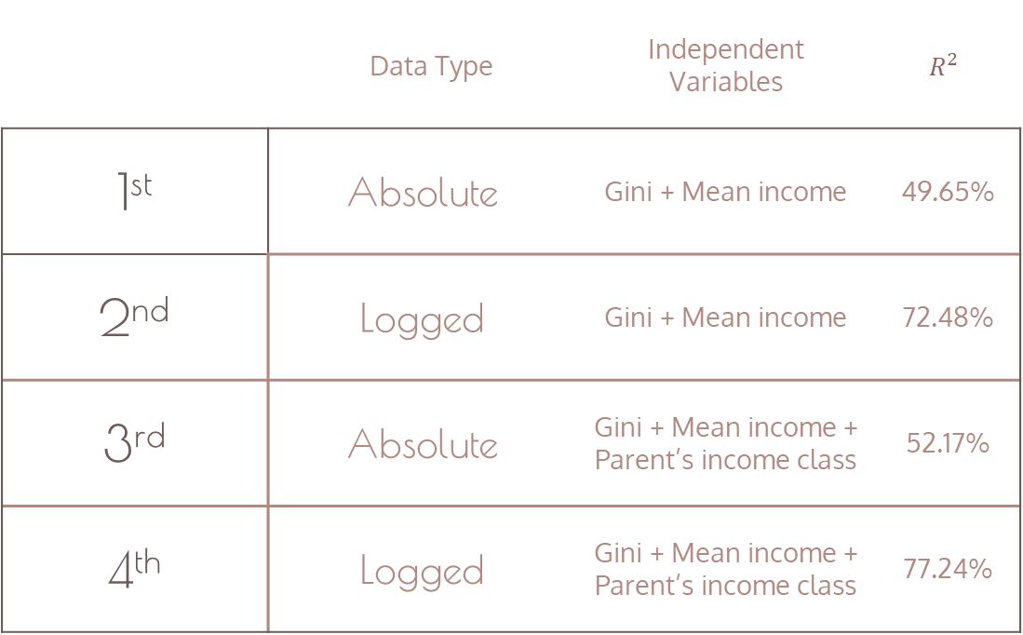
Linear Regression Models
Data Type |  | Independent Variables | $$R^{2}$$
1st | Absolute | Gini + Mean income | 49.65%
2nd | Logged | Gini + Mean income | 72.48%
3rd | Absolute | Gini + Mean income + Parent’s income class | 52.17%
4th | Logged | Gini + Mean income + Parent’s income class | 77.24%

Slide 17
Model 4
Gini_ln | 11%
Mi_ln | 62%
c_i_parent_ln | 5%
77%

Slide 18
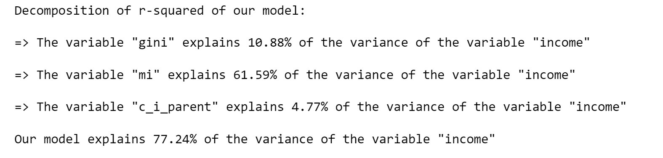

Slide 19
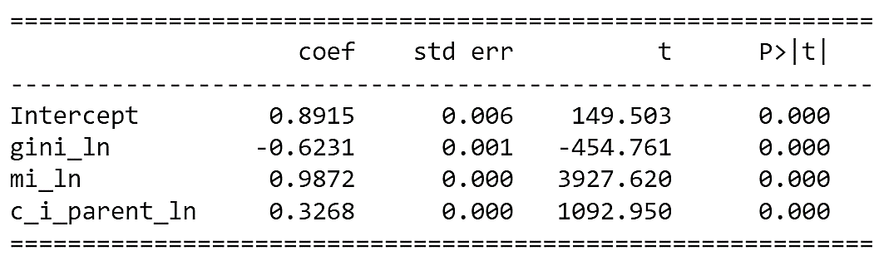
Question 1
How can we know that there are less people benefiting from a higher gini index?
The gini coefficient and the income of an individual is negatively correlated. This means that for a one-unit increase in gini_ln, income_ln is expected to decrease by approximately 0.6. This means the majority of people's income will decrease with the increase of a higher gini.
Model 4;

Slide 20
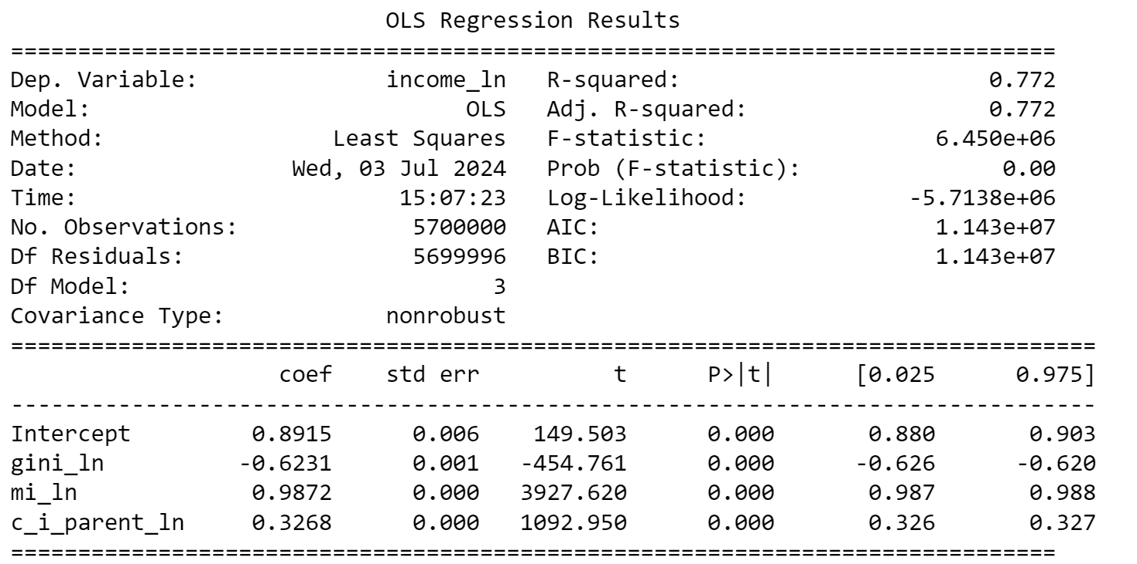
Question 2
Is this model worth using?
Approximately 77.2% of the variance in income_ln is explained by the model. The value suggests that the model fits the data well.
Model 4;
A highF-statistic and low p-values indicate that the model overall is statistically significant.

Slide 21
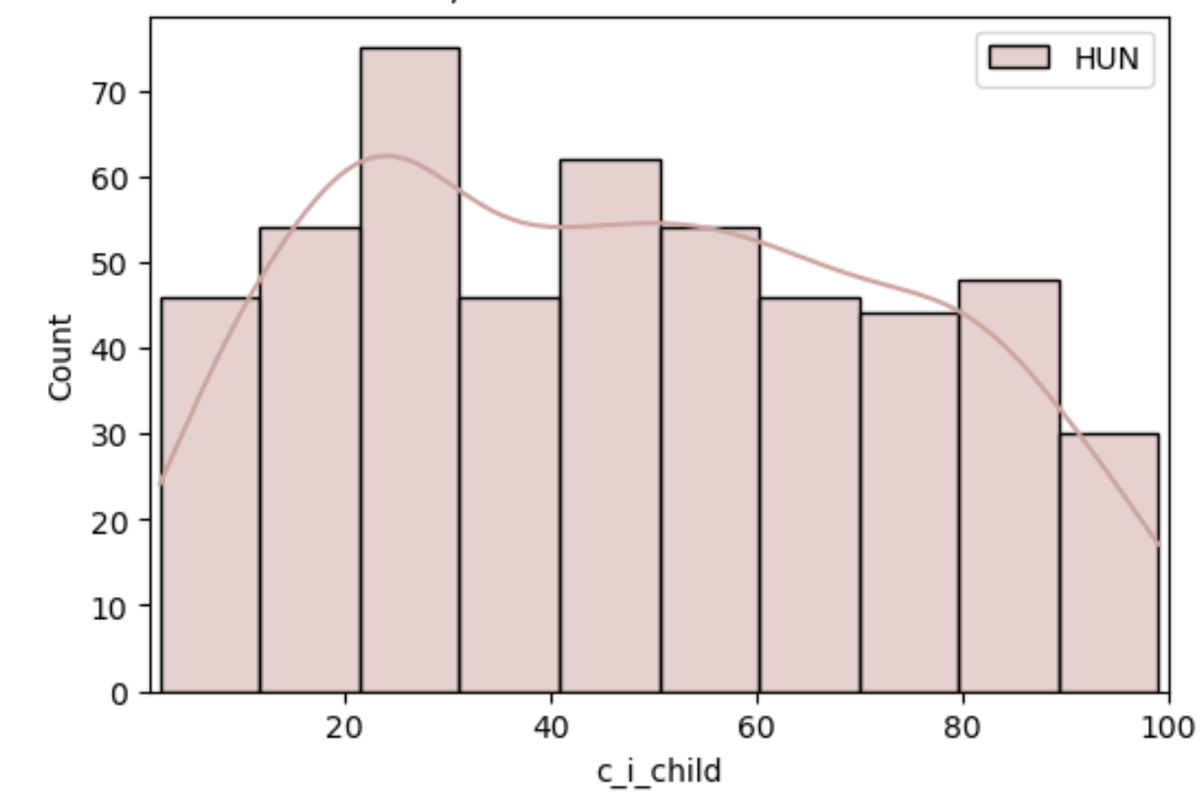
Question 3
Predict the income I’m supposed to have knowing that my parents earned approximately the mean income of the country.
Select 50 percentile for parent quantile column
Select the independent variables of model 4
Predict child income based on equation
Using this equation and the coefficients from model 4 we get this equation:
Ln(y) = intercept + (gini_ln_coef x gini_ln) + (mi_ln_coef x mi_ln) + (c_i_parent_ln_coef x c_i_parent_ln)

Slide 22
The end

