Slide 1
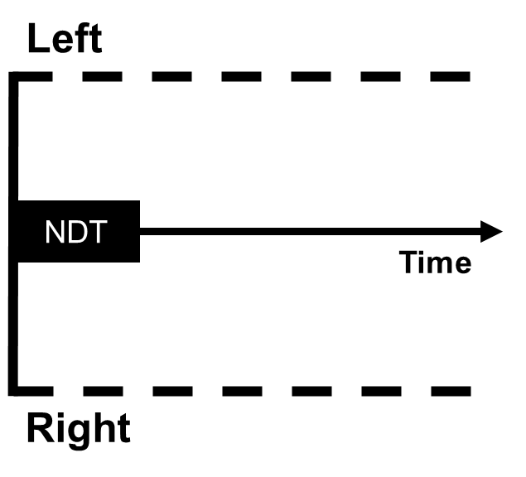
Incorporating Confidence in the Drift Diffusion Model
DDM workshop – March 2025

Slide 2
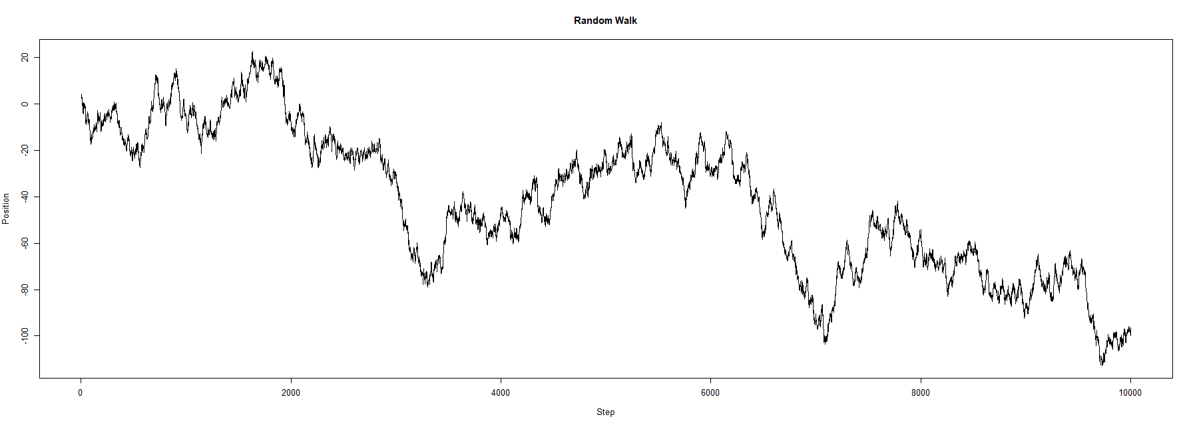
Confidence in the DDM
Left
NDT
Time
Right

Slide 3
Confidence in the DDM
Left
NDT
Time
Right

Slide 4
Confidence in the DDM
High confidence
Left
NDT
Time
Low confidence
Right

Slide 5
Confidence in the DDM
High confidence
Left
NDT
Time
Low confidence
Right

Slide 6
Confidence in the DDM
High confidence
Left
NDT
Time
Low confidence
Right

Slide 7
Time-based stopping criterium
High confidence
Left
NDT
Time
Low confidence
Right

Slide 8
Time-based stopping criterium
High confidence
Left
NDT
Time
Low confidence
Right

Slide 9
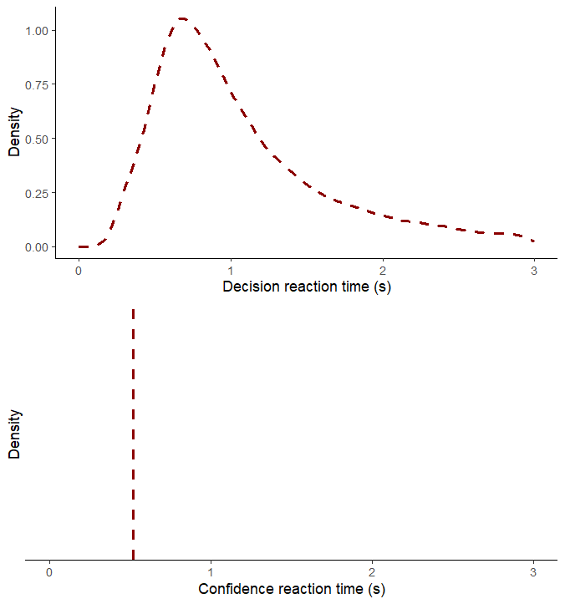
Time-based stopping criterium
Left
NDT
Time
Right

Slide 10
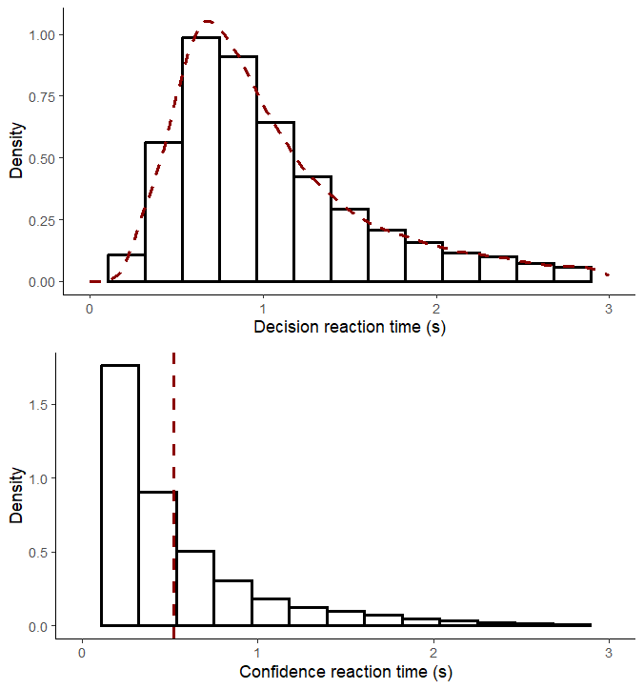
Time-based stopping criterium
Left
NDT
Time
Right

Slide 11
Evidence-based stopping criterium
High confidence
Left
NDT
Low confidence
Time
Right

Slide 12
Evidence-based stopping criterium
Left
NDT
Time
Low confidence
Right
High confidence

