Slide 1
Managing Firmware with FreeRTOS
S. Jaritz
Embedded Austria No. 3: Real Time OS

Slide 2

History of FreeRTOS
Developed ca. 2003 by Richard Barry
2007 SafeROTS
2013 start integrating libs
2016 Amazon becomes the steward of FreeRTOS, licence becomes MIT
2019 FreeRTOS + C-SDK
2021 AWS IoT Express Link

Slide 3
Overview
Available for almost all arch (arm, x86, risc V, pic, etc.)
Low overhead
Tick and tickless
Preemptive and cooperative
Hw tracer support (J-Link + Systemview etc.)

Slide 4
Why RTOS?
multiple “processes/tasks” run at the same time (management of tasks)
separation of peripheral + protocol & action (data streaming)
priority based event handling(detecting and handling of HW and SW events)
low power modes (= idle task/sleep/deep sleep)

Slide 5
Why FreeRTOS?
one of the most common RTOS(its old 2003 and it has always been there) – tons of solved issues on StackOverflow, etc.
lots of official and unofficial ports & HALs for platforms
you can do your own port easily
super light weight (you can tune it to run on HW with not much RAM, low cost MCUs)
sw timer, events, co-routines, ringbuffers, memory pools, easy MCU (deep) sleep

Slide 6
Trade-offs
FreeRTOS = kernel = scheduler
tick based → every 1ms isr → prob D/I cache flush → task switch check → overhead(pre-emptive) vs task yielding(cooperative)
each task has a task control block (extra memory)
each task has its own stack
→ RAM & MIPS for management

Slide 7
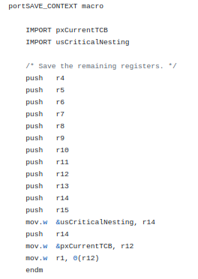
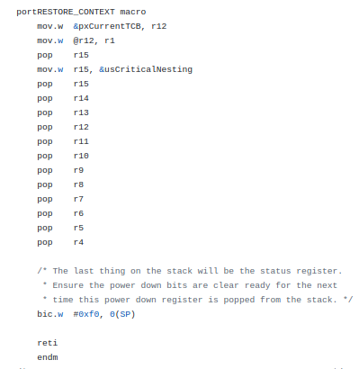
Yielding example(msp430)

Slide 8
A deeper dive into FreeRTOS

Slide 9
Key Components
Startup code (aka hw init)
Start scheduler
FreeRTOSconfig.h
preemptive or cooperative multitasking
memory pools
external stacks/libs like TCP/IP, mqtt, aws IoT, MCUboot

Slide 10
General issues
c-based kernel/scheduler does not really take care of MCU features
To make it run with well defined behaviour the tick ISR need to have highest prio (nested intr, Intr controler config)
Critical sections = en/disable tick ISR and the other ones
MCU features can cause problems (like stacked/shadow registers – aka loop ISAs etc.) → your compiler does not know that it compiles code for task 1 and the other for task 2

Slide 11
Special Issues
Atomic operations – single producer consumer FIFO as ringbuffer is much more performant than the generic ring buffer
Stack overflow detection
Gdb debugging is platform dependent
In general no APIs like gpio, serial, eth, bt etc – own driver development closely coupled to the HW

Slide 12
Tips

Slide 13
FreeRTOS repro and sources
Do your own:
  Cmake file with boiler template for your toolchain
  Remove all unused ports from the git
Separate:
  Startup code, peripheral init/deinit/sleep code into HAL
  Setup INTR controller and assign manually INTR prios in one place
  Use static code for TCBs, semaphores, etc. that works very well for debugging and in case of stack overflow you can check the memory map file generated by the linker

Slide 14
Imho best practises
Decouple HW and the FreeRTOS managed process!
Use a RTC or your TIMER0 as sys time
Create your own Ctest framework – the RTC/TIMER0 can be replaced by your own timer counter → you can write unit tests for your tasks
Manage all aspects of a task – creation, init, run, finished, failure(with/out exception)

Slide 15
Some tips – data passing
create your own ringbuffer for your platform (performance)
Use your ringbuffer as the interface between peripheral/driver and task
Use a counting semaphore to activate the task from ISR/other tasks (semaphores are ISR save and give you the best performance)
Next lvl:
  make your ringbuffer compatible with the DMA controler(claim - finish)
  Use the DMA INTR to set the semaphores

Slide 16
Some tips – state machines
Implement your state machine as semaphore + function pointer(state function)
A change of state triggers a set of the semaphore (use counting not binary so you can transition through several states without context switch)
Timing behaviour like timeouts – use a SW timer
magic formula = sem + sw timer + set of states as function pointer = best performance + no SM polling/event based SM processing

Slide 17
Some tips – timing and INTR
Do critical timing via own INTR (HW timer with higher prio than FreeRTOS tick timer) → for your own safety
Move non critical timing to FreeRTOS → relaxed fw development
INTR are your friends! Think more in that way – the silicon manufacturer gives you a HW OS(via INTR controler) and you embed a SW OS by using one INTR
HW always wins over SW but you can manage (debug from your periphals backwards into your firmware)

Slide 18
Some tips – arch data
Follow the data! Are they event based(random timing) or are the constant(streaming)?
Stream:
  data → DMA in → ISR → semaphore ← processing task wait for
  task → trigger DMA out
Events(non critical):
  ISR → ringbuffer & semaphore
  Task → read ringbuffer till semaphore blocks
Events(critical):
  ISR = handler

Slide 19
Some tips – arch processing
Less is more! Avoid tasks
You maybe need only one task that checks all ringbuffers of the UARTs – so UARTx ISR triggers the UART processing task via semaphore
You may want to process all state machines in one task – think of a list of state machines(function pointer vector)
You may want to design your data tasks as async worker queue – so you can put your system to deep sleep when there is nothing to do

Slide 20
Thanks – Let’s talk!

Slide 21
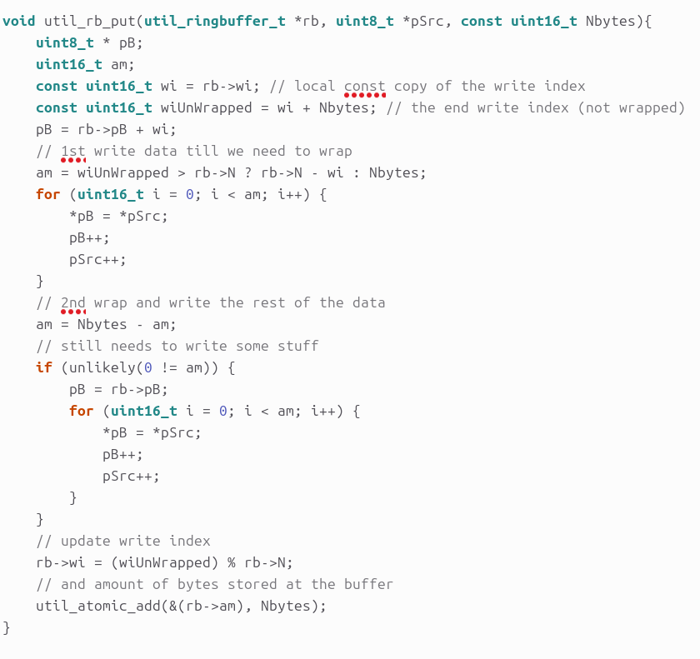
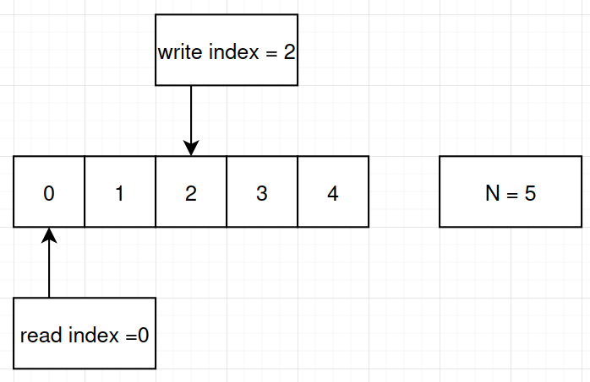
single producer – consumer ringbuffer – atomic ops 1/2

Slide 22
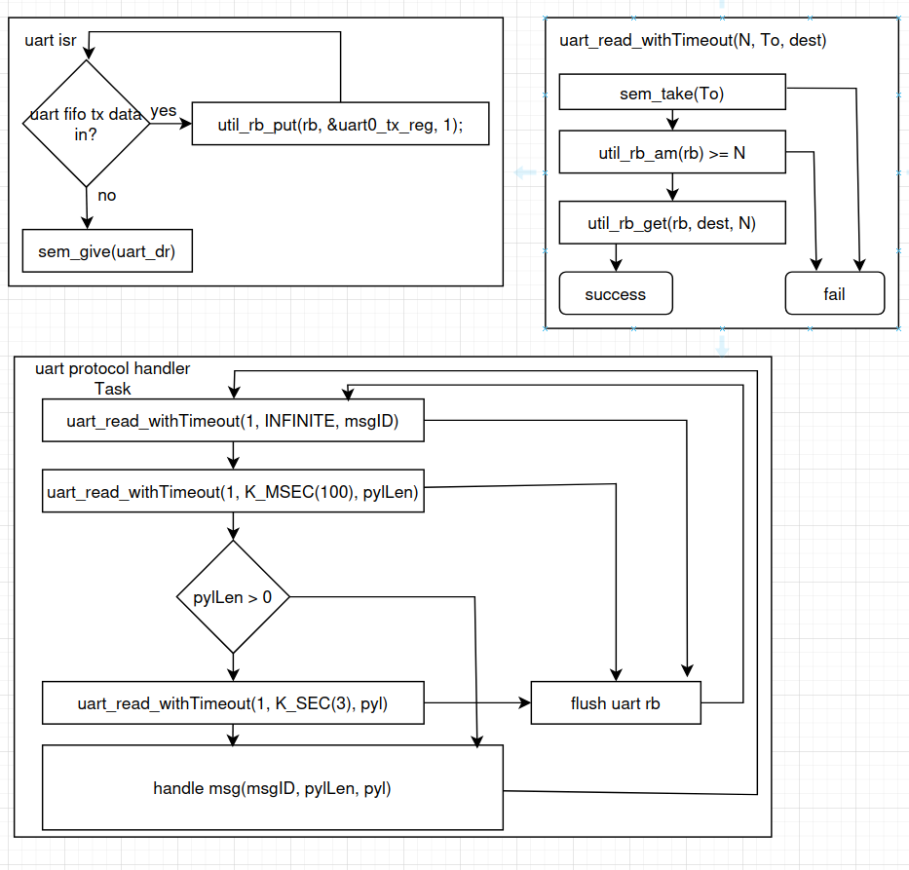
single producer – consumer ringbuffer – sync isr & task

